Slide 1
CENG-303
Database Systems
Chapter Five:
Data Modeling with the
Entity-Relationship Model
Part Three
5-<number>

Slide 2
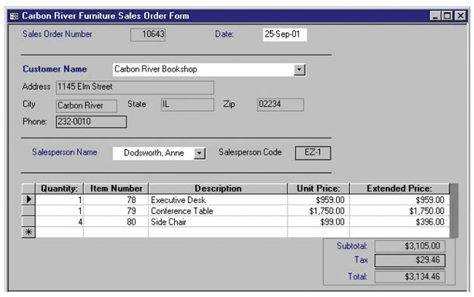
Mixed Patterns:
The Line-Item Pattern
5-<number>

Slide 3
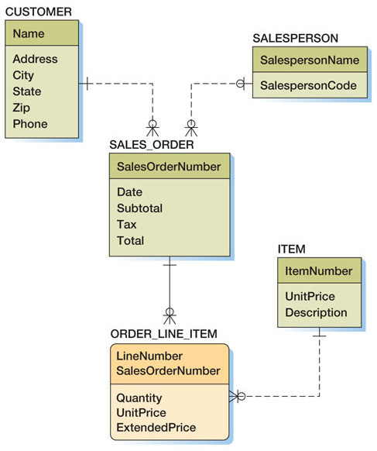
Mixed Patterns:
The Line-Item Pattern
5-<number>

Slide 4
Mixed Patterns:
Other Mixed Patterns
Look for a mixed pattern where:
  A strong entity has a multivalued composite group, and
  One of the elements of the composite group is an identifier of another strong entity
5-<number>

Slide 5
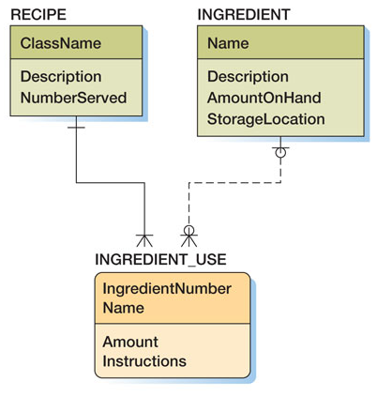
Mixed Patterns:
Other Mixed Patterns
5-<number>

Slide 6
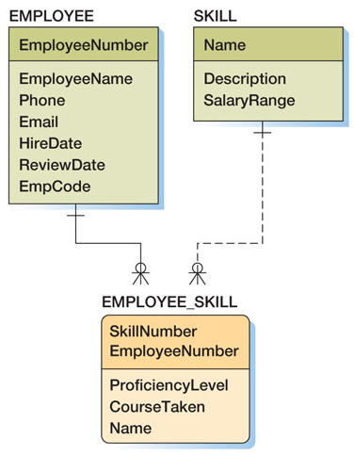
Mixed Patterns:
Other Mixed Patterns
5-<number>

Slide 7
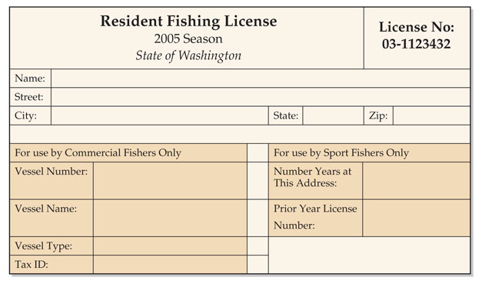
Mixed Patterns:
The For-Use-By Pattern
5-<number>

Slide 8
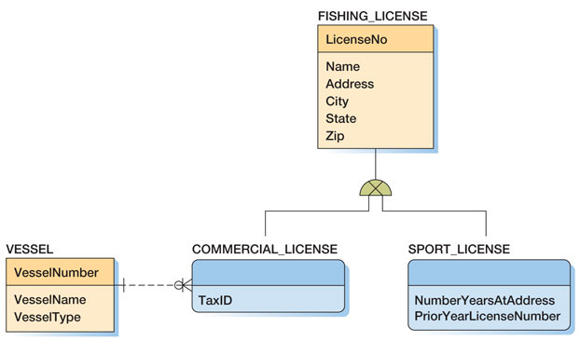
Mixed Patterns:
The For-Use-By Pattern
5-<number>

Slide 9
Recursive Relationships
A recursive relationship occurs when an entity has a relationship to itself
5-<number>

Slide 10
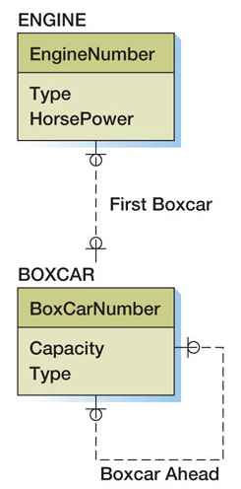
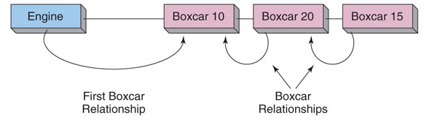
Recursive Patterns:
1:1 Recursive Relationship
5-<number>

Slide 11
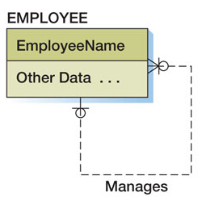
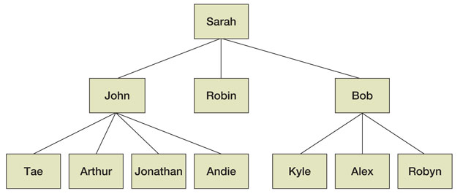
Recursive Patterns:
1:N Recursive Relationship
5-<number>

Slide 12
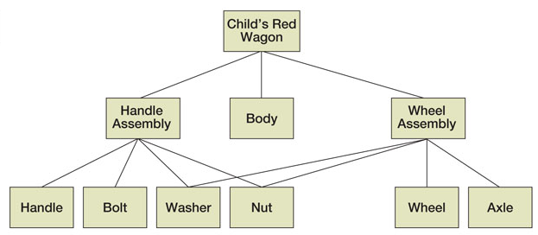
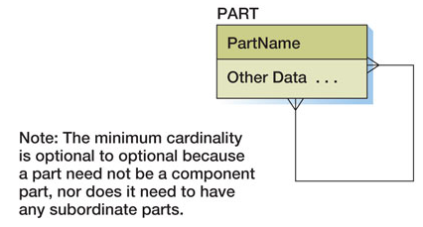
Recursive Patterns:
N:M Recursive Relationship
5-<number>

Slide 13
CENG-303
Database Systems
End of Presentation:
Chapter Five Part Three
5-<number>

