Slide 1
CENG-303
Database Processing
Chapter Five:
Data Modeling with the
Entity-Relationship Model
Part Four
5-<number>

Slide 2
Highline University
The Highline University [HU] database will track such entities as:
  Colleges
  Departments
  Faculty
  Students
We have gathered a set of HU reports that will be the source documents for a data model
5-<number>

Slide 3
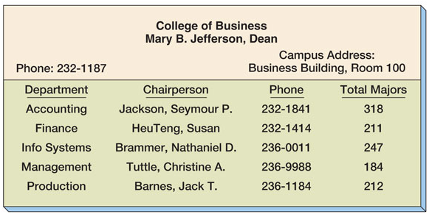
The College Report
5-<number>

Slide 4
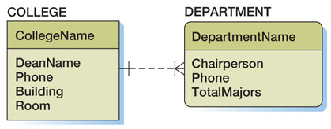
Data Model from the College Report
This is a weak, but not ID-dependent, 1:N relationship
5-<number>

Slide 5
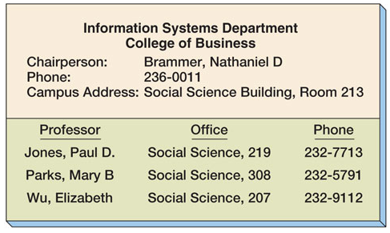
The Department Report
5-<number>

Slide 6
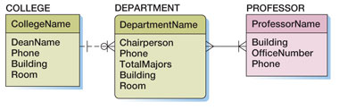
The DEPARTMENT / PROFESSOR Relatioship:
Alternate Model 1: Using an N:M Relationship
This is an N:M relationship
5-<number>

Slide 7
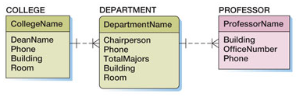
The DEPARTMENT / PROFESSOR Relatioship:
Alternate Model 2: Using a 1:N Relationship
This is a 1:N relationship
5-<number>

Slide 8
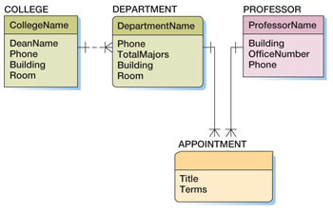
The DEPARTMENT / PROFESSOR Relatioship:
Alternate Model 3: Using an Association Pattern
This is an association pattern
5-<number>

Slide 9
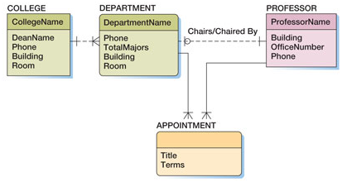
The DEPARTMENT / PROFESSOR Relatioship:
Alternate Model 4: Using a Association Pattern and a 1:N Relationship
This is a 1:1 relationship
This is an association pattern
5-<number>

Slide 10
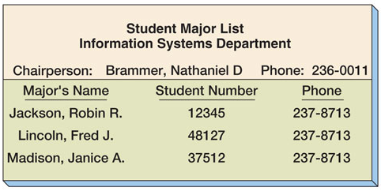
The Department Major Report
5-<number>

Slide 11
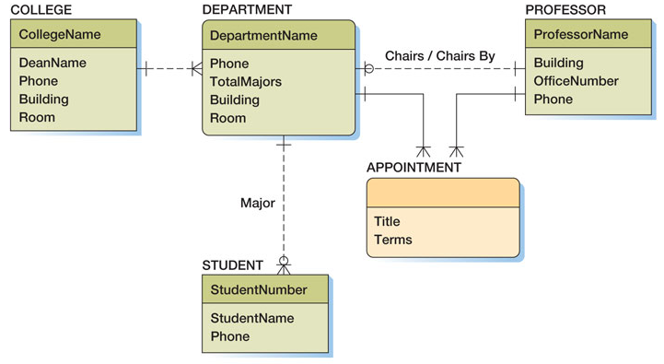
Data Model with STUDENT Entity
5-<number>

Slide 12
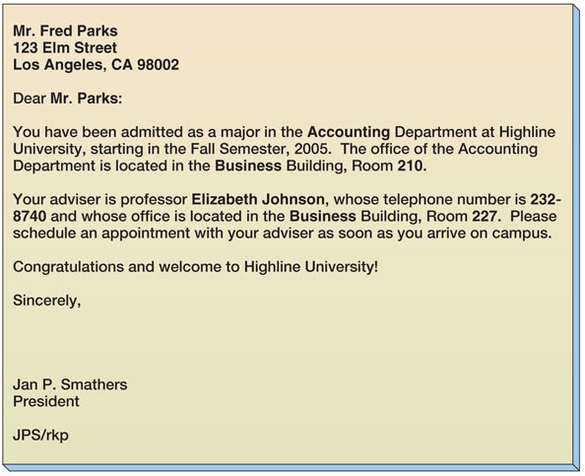
The Student Acceptance Letter
5-<number>

Slide 13
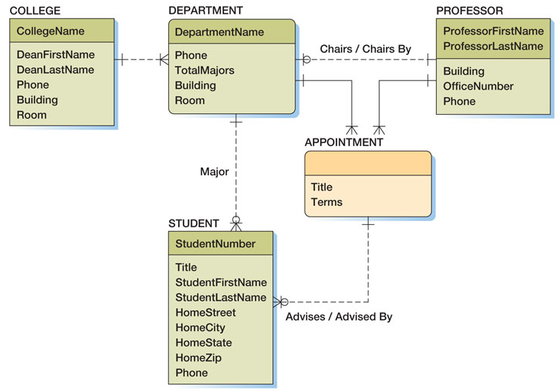
Data Model with Advises Relationship
5-<number>

Slide 14
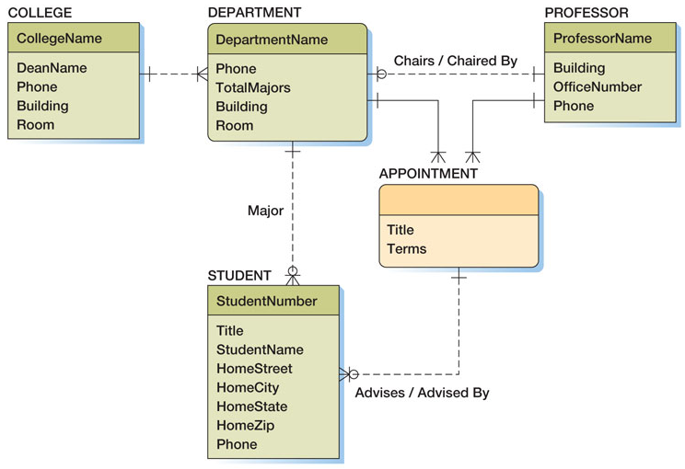
Final Highline University Data Model
5-<number>

Slide 15
CENG-303
Database Processing
End of Presentation:
Chapter Five Part Four
5-<number>

