Slide 1
Proximal Policy Optimization
John Schulman, Filip Wolski, Prafulla Dhariwal, Alec Radford, Oleg Klimov
Anilcan Polat, Rene Greff, Steffen Cintosun, Burak Tosun
19.06.2024

Slide 2
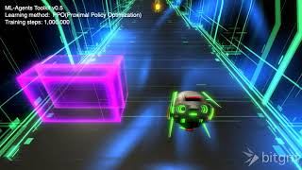
Spark interest

Slide 3
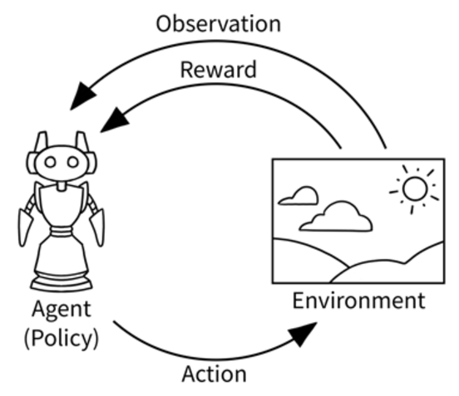
Agent-Environment Loop
Agent interacts with environment through action
Environment gives feedback (rewards and states
Agent takes another action and the
environment responds again
This cycle repeats
https://www.researchgate.net/profile/Adrian-Prados/publication/369550525/figure/fig1/AS:11431281130765673@1679925646365/Classical-agent-environment-loop-in-the-Reinforcement-Learning-paradigm-from-1.png

Slide 4
Markov Decision Process(MDP)
Formal description of an environment
Consists of :
A state space S, i.e., a set of all possible states
An action space A, i.e., a set of all possible actions
An initial state distribution 𝑷(𝑺_𝒕)
A state transition distribution 𝑷(𝑺_𝒕+𝟏|𝑺_𝒕, 𝑨_𝒕)
A reward function 𝑹(𝑺_𝒕, 𝑨_𝒕)

Slide 5
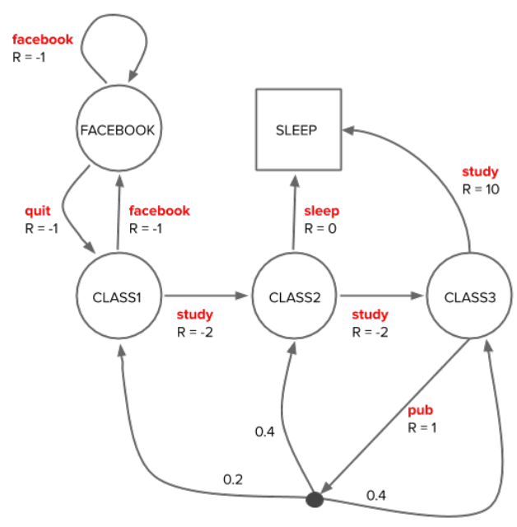
Markov Decision Process(MDP)

Slide 6


Return
Normal return function:
Discounted return function:

Slide 7

Policy
A policy π is a distribution over actions given a state
Stochastic policy : represents the probability of taking action a when in state s
Deterministic Policy: function that maps each state s to a specific action a
Goal : maximize the expected return (cumulative reward) from any given state

Slide 8

Value function
value function represents the expected return starting from state s and following policy π
:
where G is the return (cumulative future reward) from time step t
action-value function represents the expected return starting from state s, taking action a, and following policy π
The value function helps in evaluating the desirability of states (or state-action pairs) under a particular policy

Slide 9
Bellman expectation equation for value function
Basic idea behind Bellman expectation :
The value of your starting point is the immediate expected reward, plus the value of wherever you land next.
V^π(s) is the value of a state under policy π
R_t+1 is the reward received after transitioning from state s to the next state S_t+1
𝛾 is the discount factor (0 ≤ 𝛾 <1)
S_t+1 is the next state following policy π

Slide 10
Temporal difference learning
combination of Monte Carlo methods and Dynamic Programming (DP).
updates the value of a state based on the observed return and the estimated value of the next state
𝛼 learning rate
Similar to Bellman equation
Both update the Value function
TDL only considers the value function
Bellman also considers the Reward

Slide 11


Policy Gradient Methods
Define objective function that evaluates a policy
𝜃 are all parameters of the neural network
Goal: maximize the expected return
updating the policy parameters in the direction that increases the expected return using gradient ascent
Cannot compute the gradient of an expectation
→ Policy Gradient Theorem

Slide 12
Policy Gradient Theorem
log π_𝜃(A_t|S_t) is the logarithm of the probability of taking action A_t in state S_t​ according to the policy parameterized by 𝜃
In REINFORCE, this term scales the gradient by the return to give higher weight to actions with higher returns
It's the 'advantage' of taking action A_t​ in state S_t over the average return. It indicates how much better the action was compared to the average
By using G_t, the gradient is scaled by the advantage, guiding the optimization towards actions that lead to higher returns

Slide 13
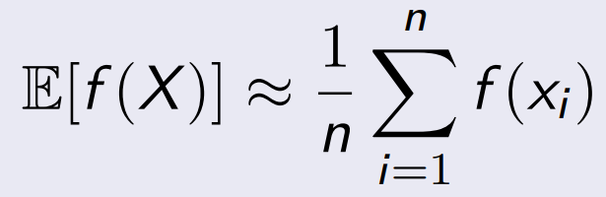
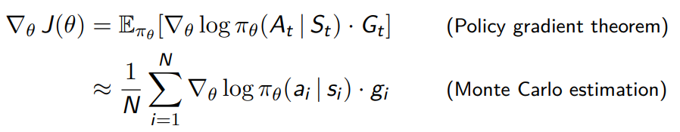
Monte Carlo Estimation
The expected value of any random variable X can be approximated by the empirical mean of independent samples x_1, … , x_n

Slide 14
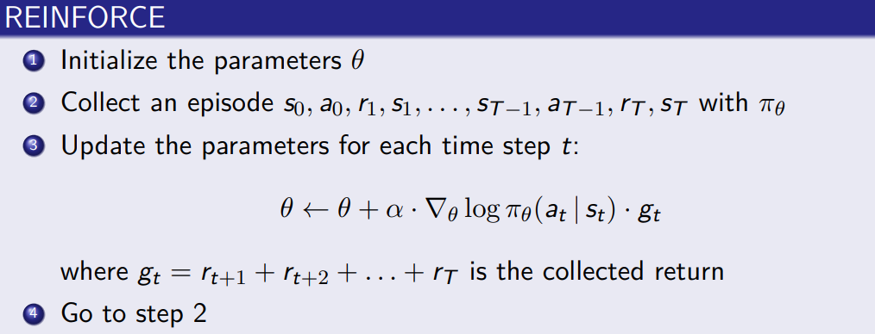
REINFORCE algorithm

Slide 15
Why computing gradients?
The gradient indicates how to adjust policy parameters 𝜃 to improve performance.
Using gradients, we update the policy to maximize expected returns
Direction of Improvement
Policy Improvement
Policy Stability
By computing the gradient for each sampled trajectory and then taking the average, we obtain an estimate of the true gradient of the expected return

Slide 16

Trust Region Methods (TRPO)
On-policy algorithm
Used for environments with discrete/continuous action spaces
Update by using largest step
Calculate distance between policies π_old and π
KL-Divergence
Large differences possible -> using a penalty

Slide 17
Advantage function
The estimate of the relative value of the selected action
Â_t = Return R_t - Value Function (Estimate Baseline)
Return
The actual rewards the agent received
Value Function V(s)
s -> Current state
Estimate of discounted reward from this state onwards
If positive the policy is updated, to which the behavior of the policy is reinforced
If negative the opposite will happen

Slide 18
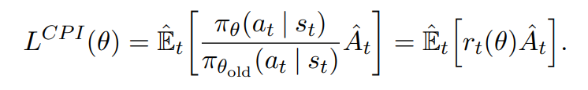

TRPO functionality
TRPO maximizes objective function

Slide 19

Objective of PPO
similar to TRPO
Penalizes changes away from 1
Using clipping with hyperparameter epsilon
Min of both objectives
Creating lower bound

Slide 20
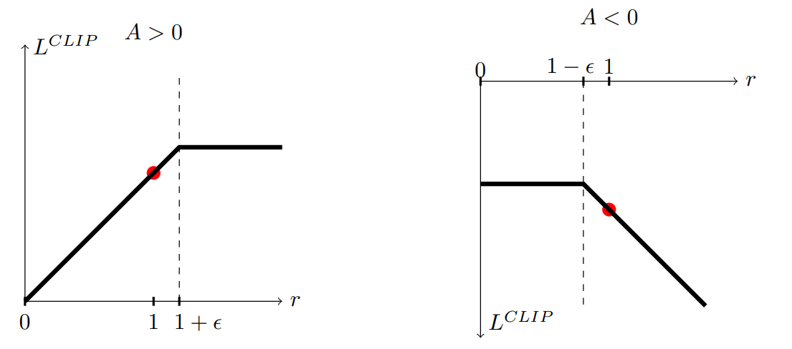
Schulman et al., Proximal Policy Optimization Algorithms (2017), https://arxiv.org/pdf/1707.06347.pdf, page 3.
Objective of PPO

Slide 21
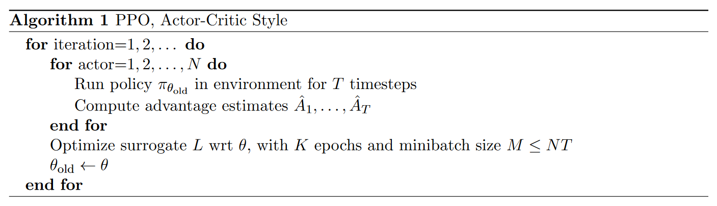
Schulman et al., Proximal Policy Optimization Algorithms (2017), https://arxiv.org/pdf/1707.06347.pdf, page 5.
PPO pseudo code

Slide 22
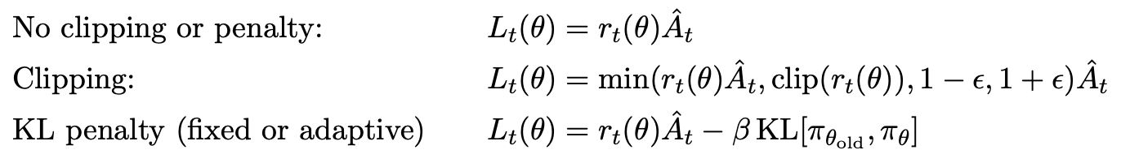
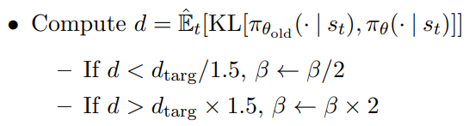
Performance metrics
Test using 7 robotics tasks (OpenAI Gym)
1 Million timesteps
3 Algorithms
No clipping
Clipping with parameters
Adaptive/Fixed KL
Normalize results
0 -> random policy , 1 -> best score

Slide 23
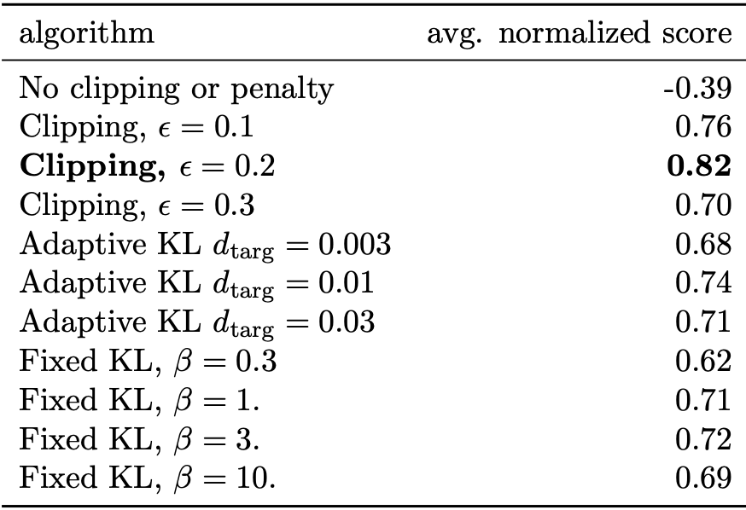
Schulman et al., Proximal Policy Optimization Algorithms (2017), https://arxiv.org/pdf/1707.06347.pdf, page 6.
Performance results
No clipping -> negative reward (half cheetah very negative)
Clipping with hyperparameter epsilon = 0.2 best

Slide 24
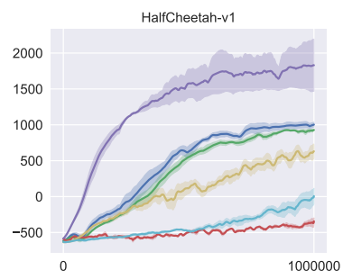
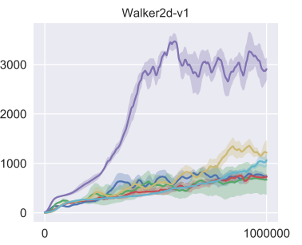
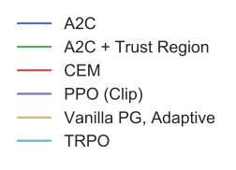
Schulman et al., Proximal Policy Optimization Algorithms (2017), https://arxiv.org/pdf/1707.06347.pdf, page 7.
Results from paper

Slide 25
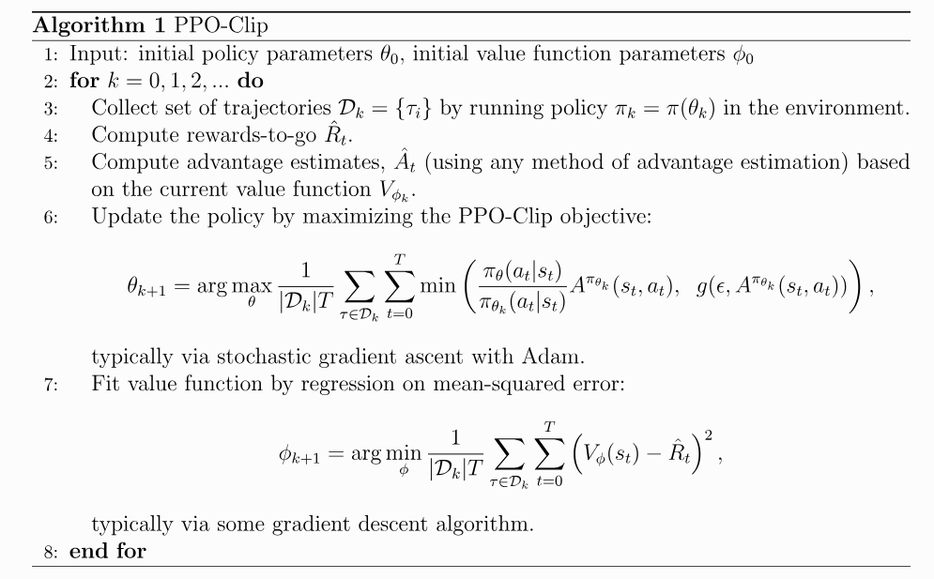
How to implement PPO
Class Network
Defines neural network
Class PPO
Init() - Step 1
Step 1
learn() - Steps 2-7
rollout() - Step 3
Called in learn()
computeRewToGo() - Step 4
Called in rollout()
Along with some help functions

Slide 26
Thank you for listening

