Slide 1
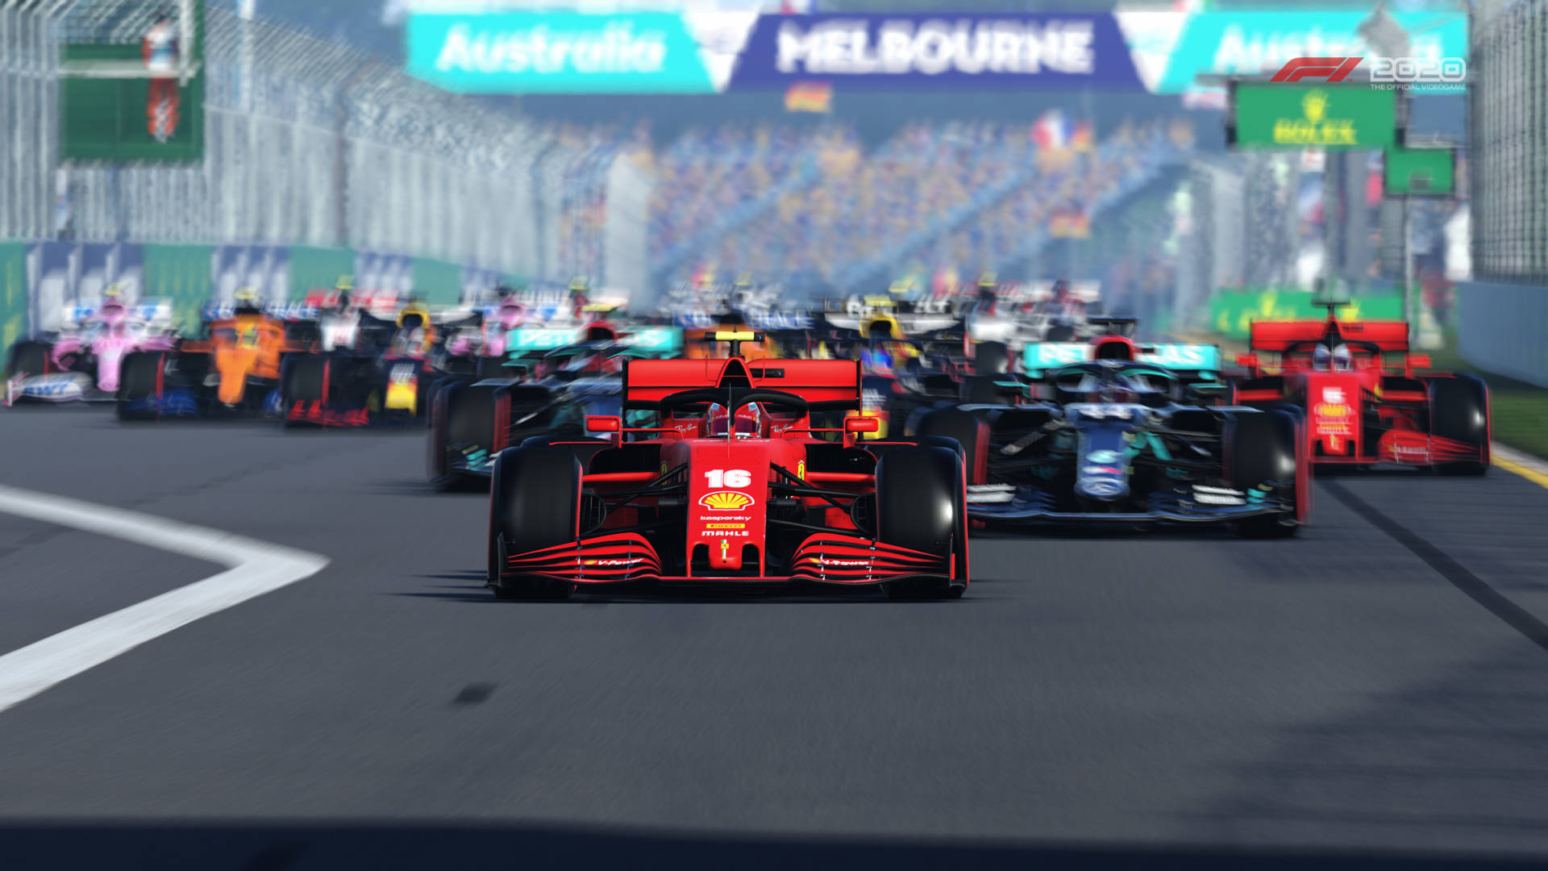
Pole Position
2d car racing game
↑: Accelerate
↓: Decelerate
←: Steer Left
→: Steer Right
No action

Slide 2
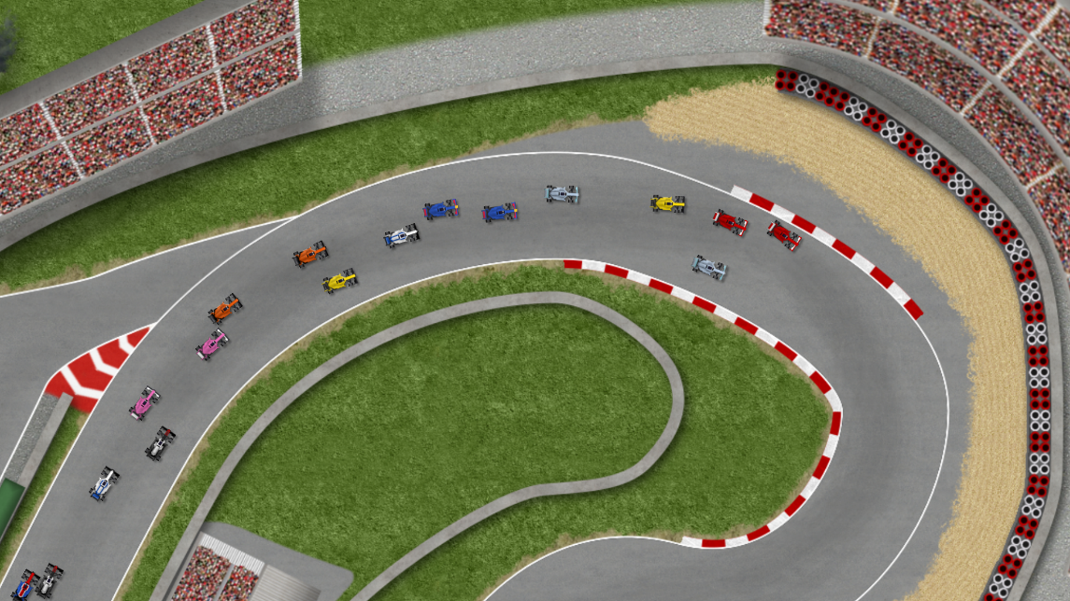
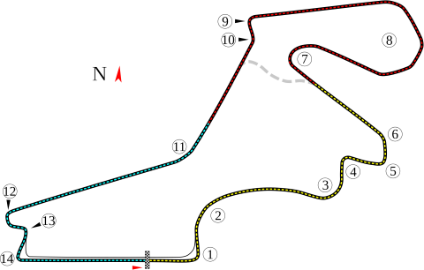
Istanbul Park Grand Prix
How does it look
Ultimate Racing 2d on Steam

Slide 3
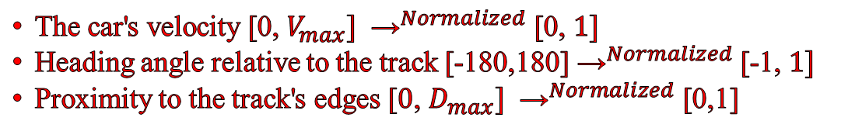
Feature Spaces
The car's velocity [0, $V_{max}] {\text{→}}^{Normalized}$ [0, $1]$
Heading angle relative to the track [-180,180] ${\text{→}}^{Normalized}$ [-1, $1]$
Proximity to the track's edges [$0$, $D_{max}] {\text{→}}^{Normalized}$ [0,1]

Slide 4
*(Game Terminated)
Reward Function
Speed Reward: +0.01 iff progression is made.
Contact with the track boundary -1.0 penalty.*
Every second -0.01
Crossing the finish line +1.0 reward.*

