Slide 1
E-PostMan
PRESentation By: DevDevils
Members:
Anil Chaurishya
Deep Risal
Suraj Shrestha

Slide 2

DevDevils
What happens when Devils become Developer?

Slide 3
Introduction
E-PostMan Version: 0.0.1SNAPSHOT
Electronic version of MUM Mail Box System.
Based on Spring MVC Framework.
It's main purpose is to minimized paper work
Stored all the mail box related data in database
Manage Mail Box user
From SCI view:-Do Less And Accomplish More

Slide 4
Technology Covered
Spring MVC based on Annotation(CoC)
GIT (Distributed Code Repository)
Dependency Injection or IoC
Spring Security
JPA/Hibernate
Internationalization
Validation
REST/Ajax
JSTL/Spring Tag Lib/JSP
Exception Handling
File Upload
Java Mail

Slide 5
Features
User Registration
Mail Box Management
User Management
Mail Item Management
Email Notification
Status Tracking

Slide 6
Advantages
Simplify your life
Time saving
Instant Notification
Record and Transaction history

Slide 7
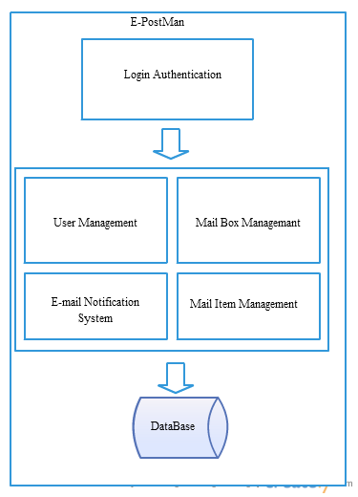
Block Diagram

Slide 8
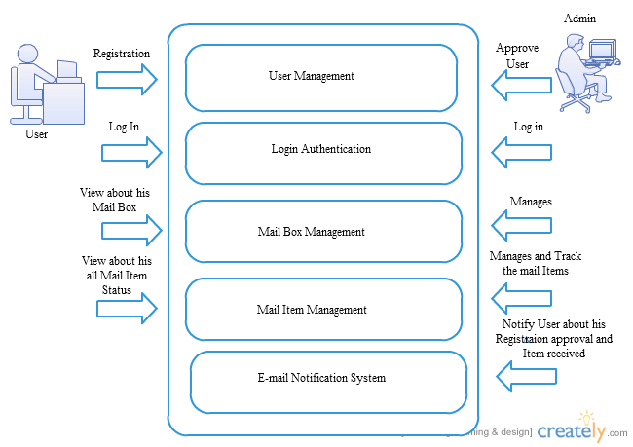
User Case Diagram

Slide 9
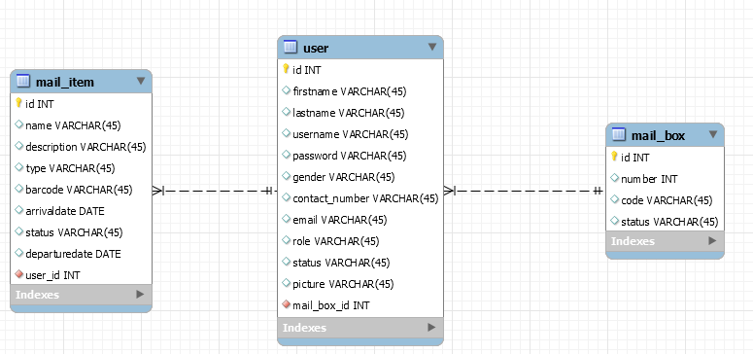
Schema Diagram

Slide 10
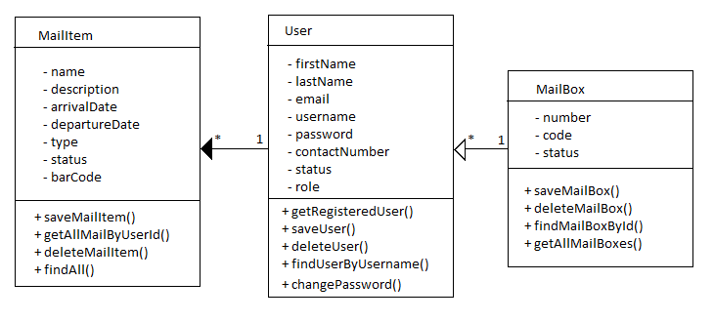
UML Class Diagram

Slide 11
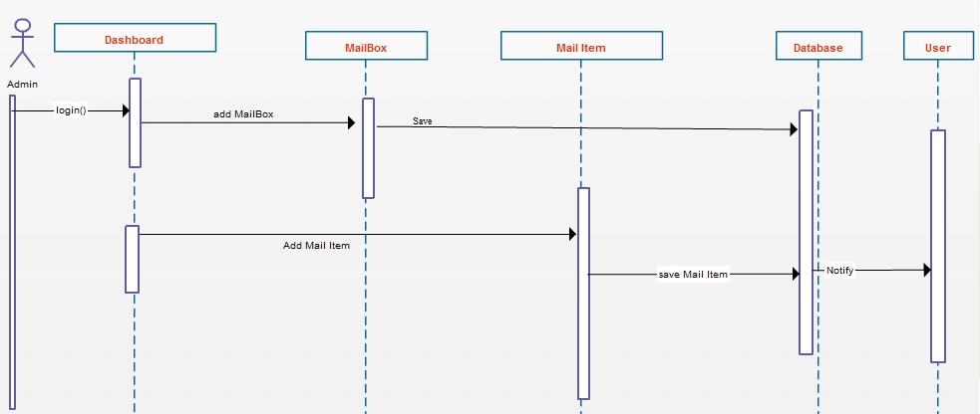
Sequence Diagram

Slide 12
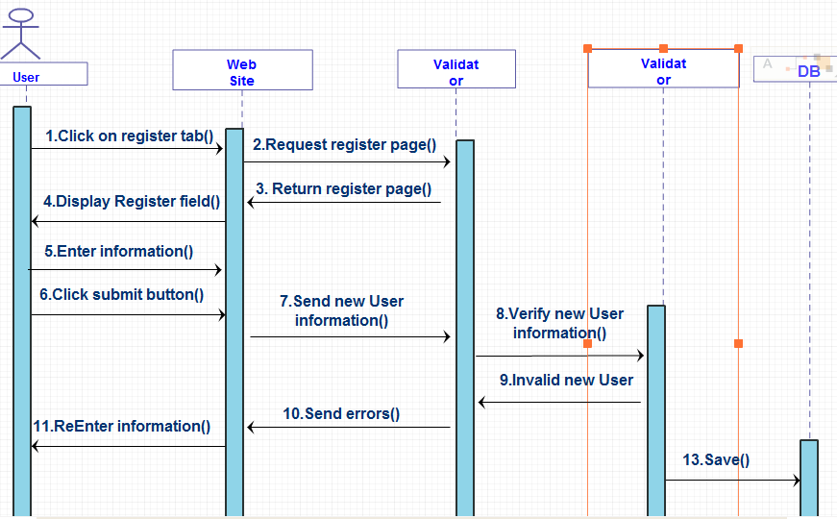
Sequence Diagram

Slide 13
Future Enhancement
Bar code scanning
Out going mail tracking
Multiple admin role
System Notification
Mobile Application

Slide 14
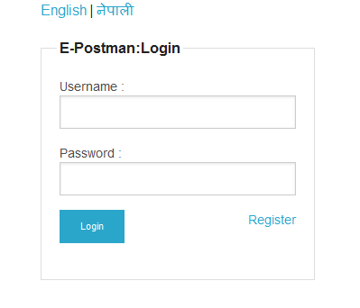
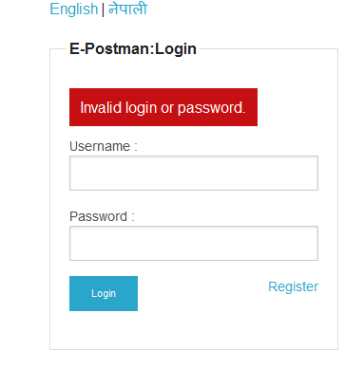
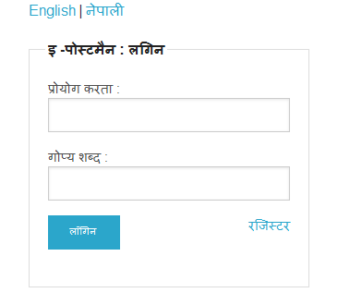
Login Page

Slide 15
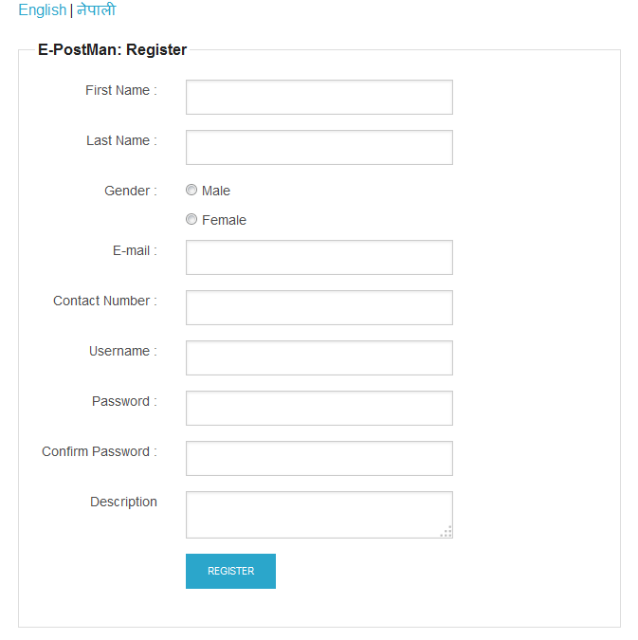
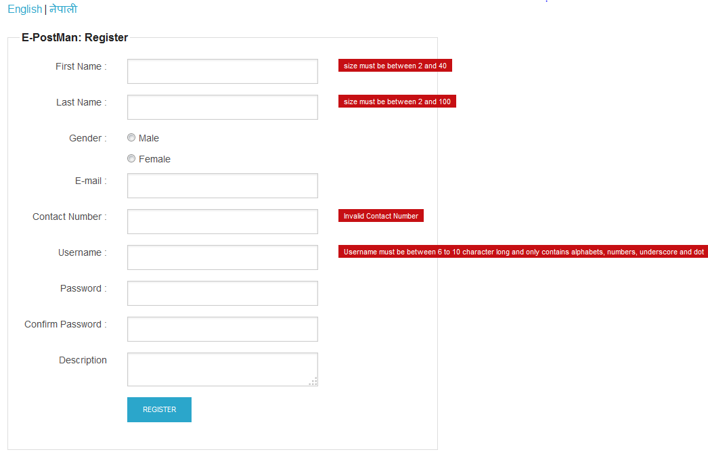
Registration Page

Slide 16
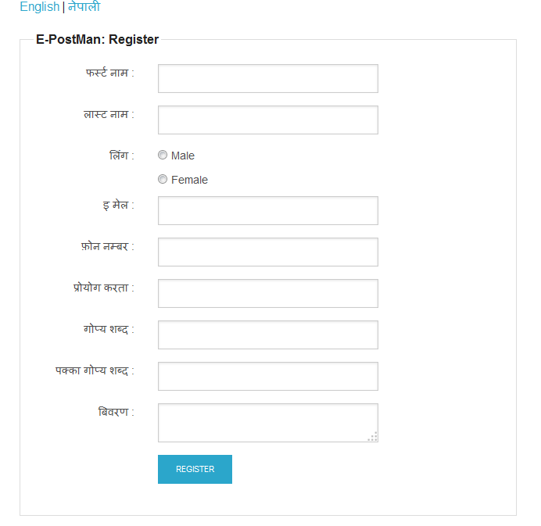
Registration Page (Internationalization)

Slide 17
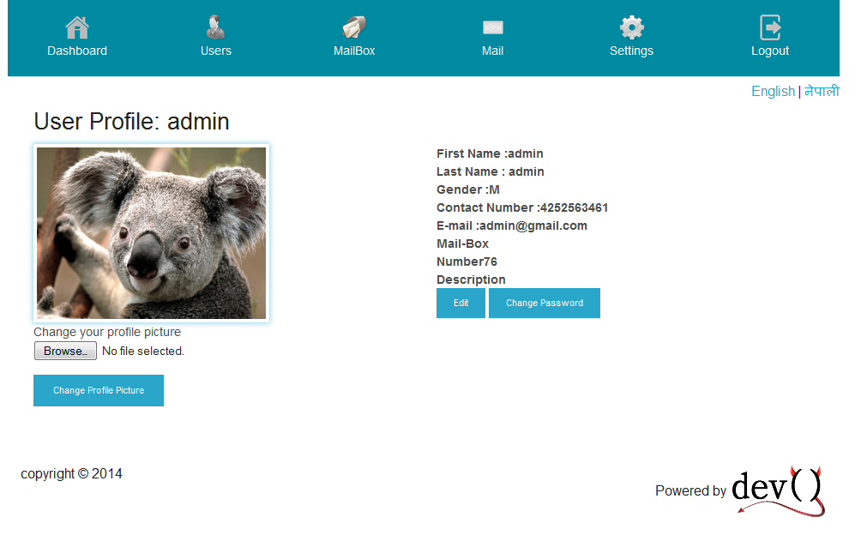
User Profile Page

Slide 18
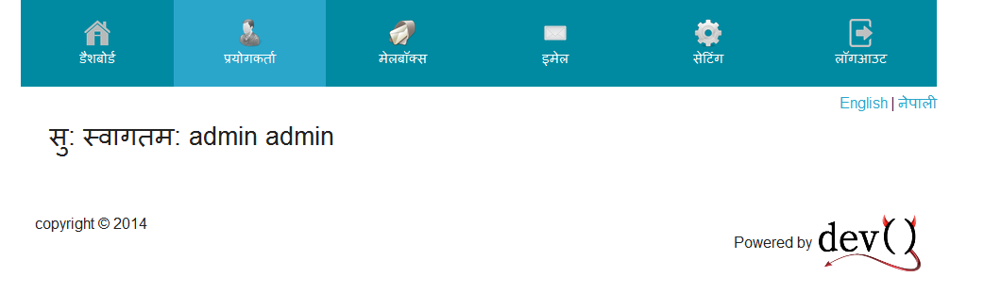
Menu Bar

Slide 19
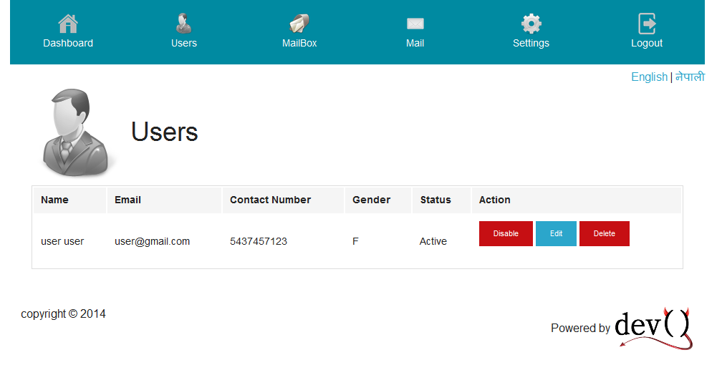
User List Page

Slide 20
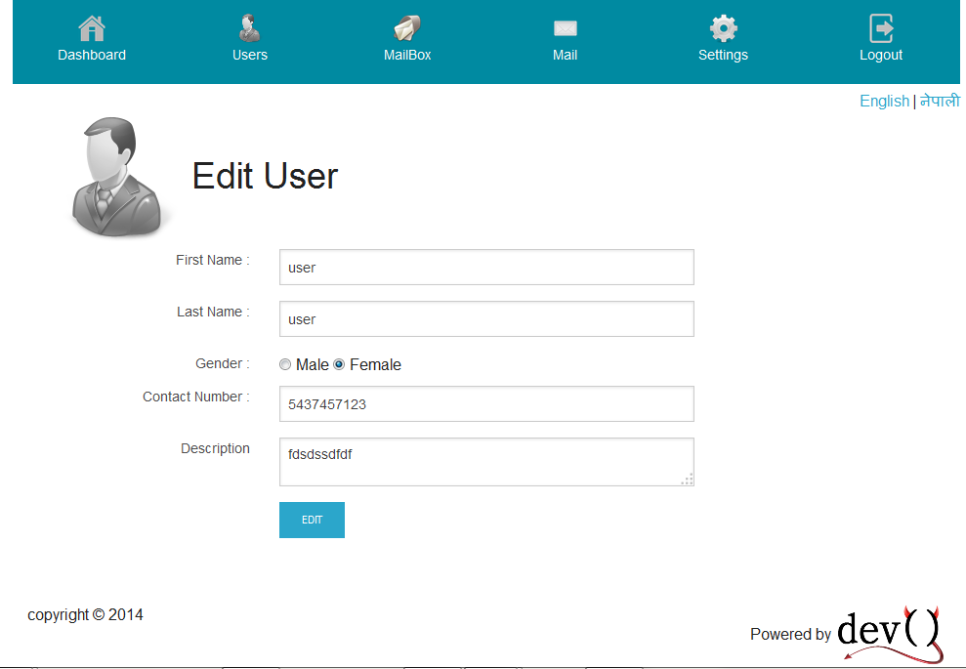
Edit User Page

Slide 21
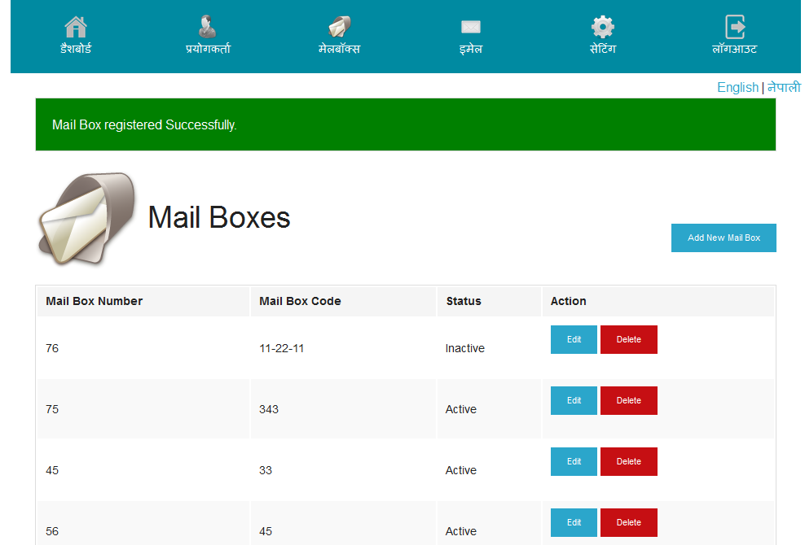
Mail BOX List Page

Slide 22
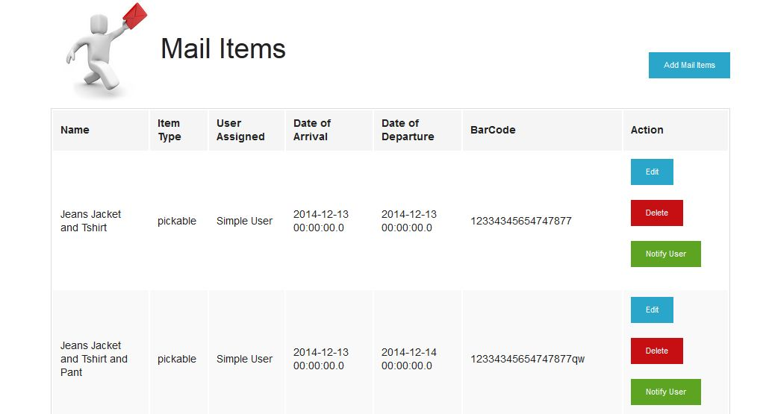
Mail Item List Page

Slide 23
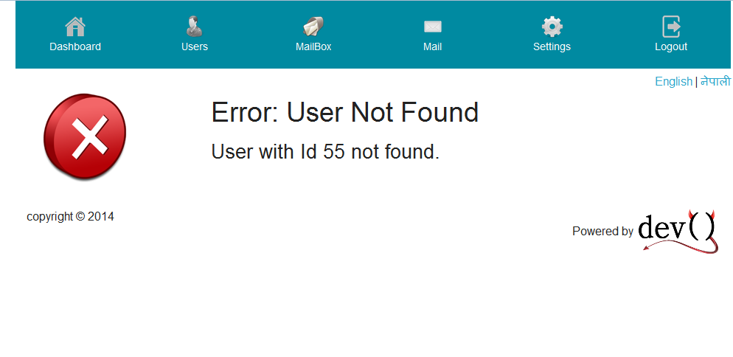
Exception Handled Page

Slide 24
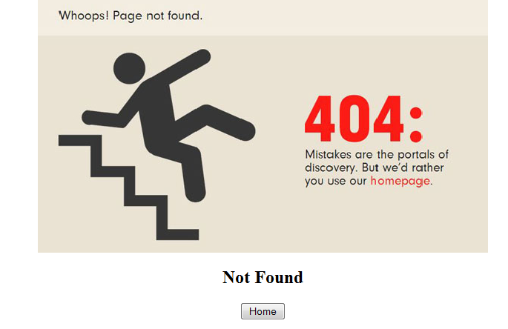
404 Page Error

Slide 25

Thank You

