Slide 1
PRCE-001
Medical Data History
Results and Outputs of SQL Problem Statements
Prepared by: Anil Kumar

Slide 2
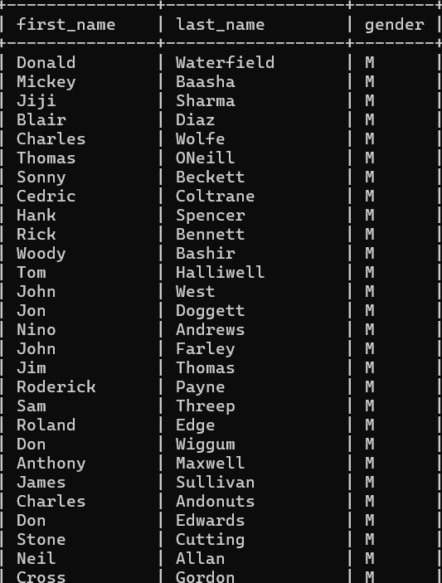
1. Show first name, last name, and gender of patients whose gender is 'M'

Slide 3
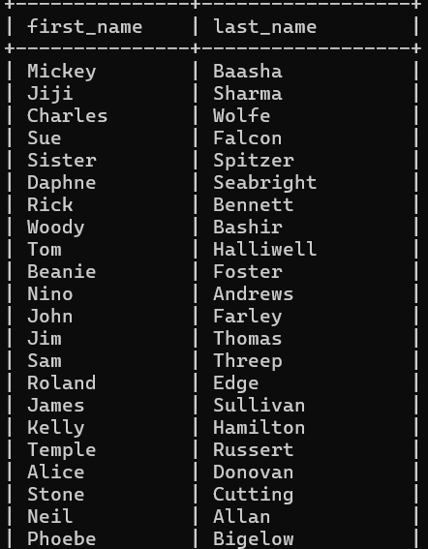
2. Show first name and last name of patients who do not have allergies.

Slide 4
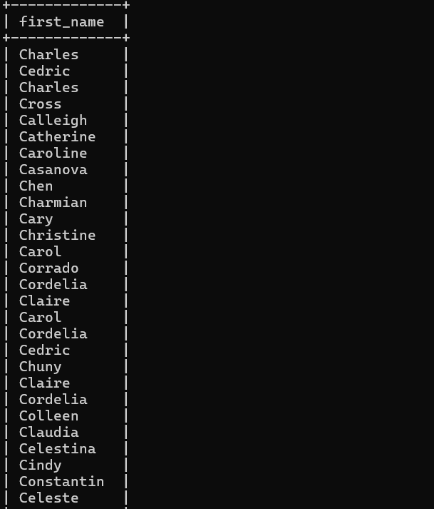
3. Show first name of patients that start with the letter 'C'

Slide 5
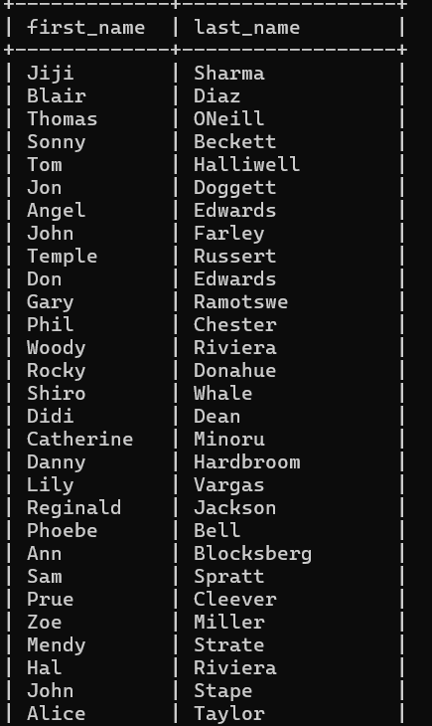
4. Show first name and last name of patients that weight within the range of 100 to 120 (inclusive)

Slide 6
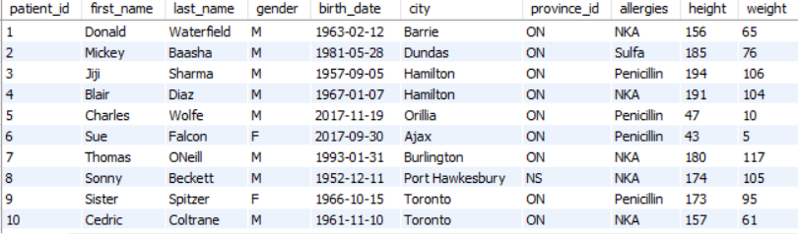
5. Update the patients table for the allergies column. If the patient's allergies is null then replace it with 'NKA'

Slide 7
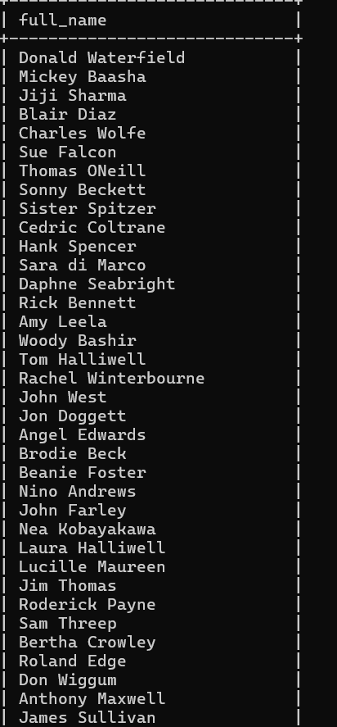
6. Show first name and last name concatenated into one column to show their full name.

Slide 8
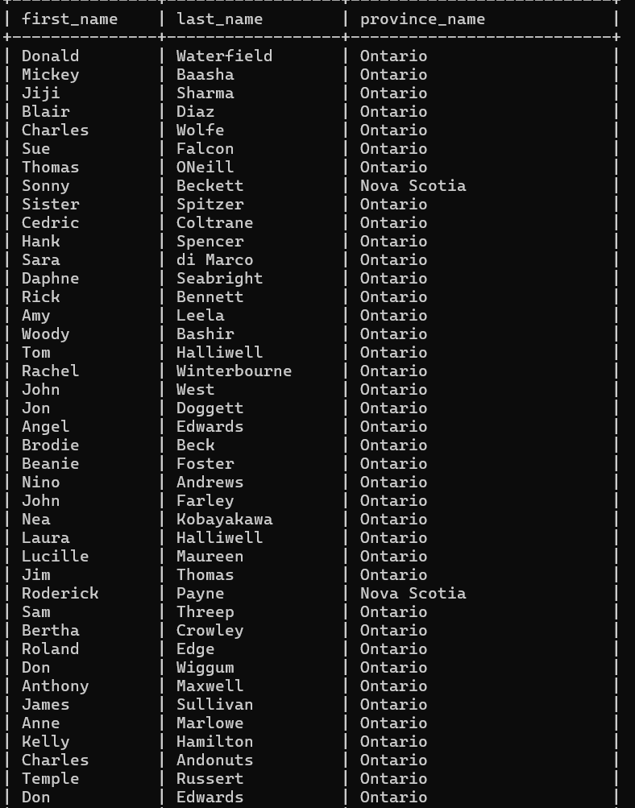
7. Show first name, last name, and the full province name of each patient.

Slide 9
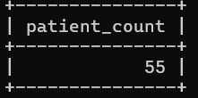
8. Show how many patients have a birth_date with 2010 as the birth year.

Slide 10
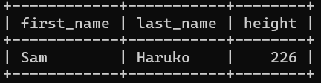
9. Show the first_name, last_name, and height of the patient with the greatest height.

Slide 11
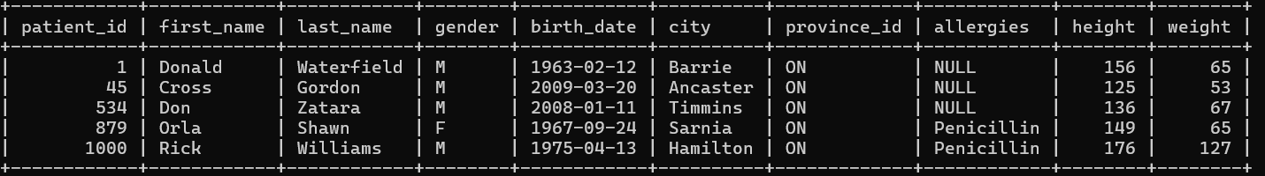
10. Show all columns for patients who have one of the following patient_ids: 1,45,534,879,1000

Slide 12
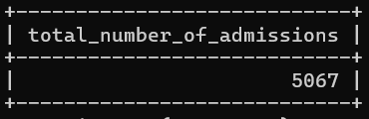
11. Show the total number of admissions.

Slide 13
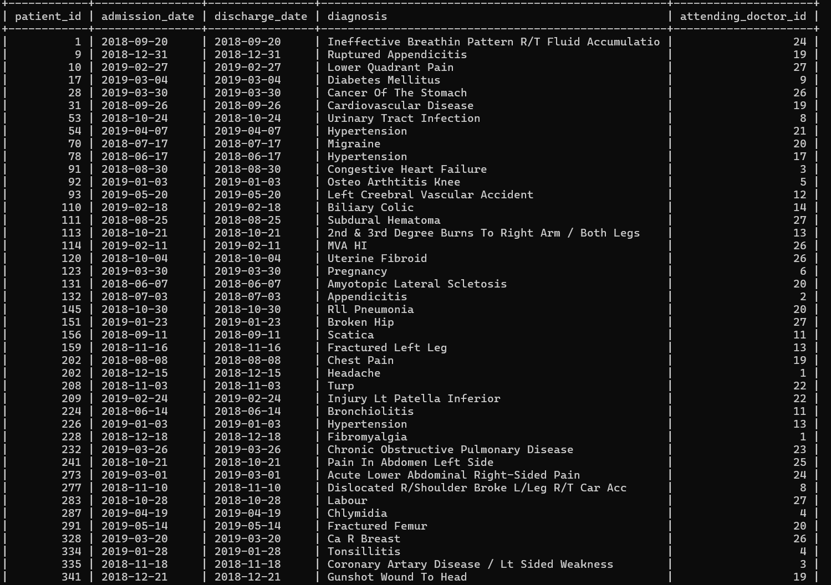
12. Show all the columns from admissions where the patient was admitted and discharged on the same day

Slide 14
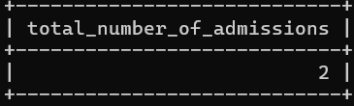
13. Show the total number of admissions for patient_id 579.

Slide 15
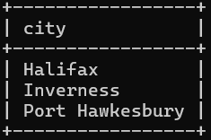
14. Based on the cities that our patients live in, show unique cities that are in province_id 'NS'?

Slide 16
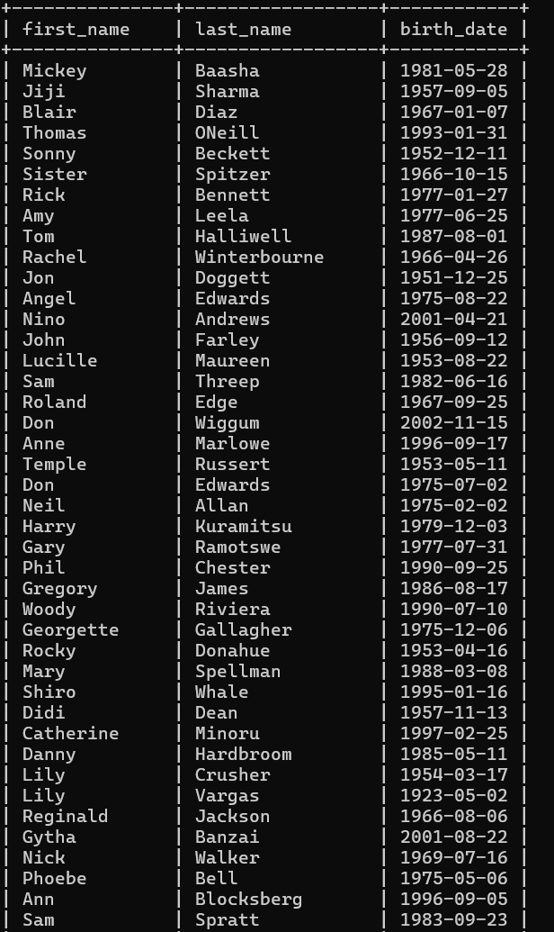
15. Write a query to find the first_name, last name and birth date of patients who have height more than 160 and weight more than 70.

Slide 17
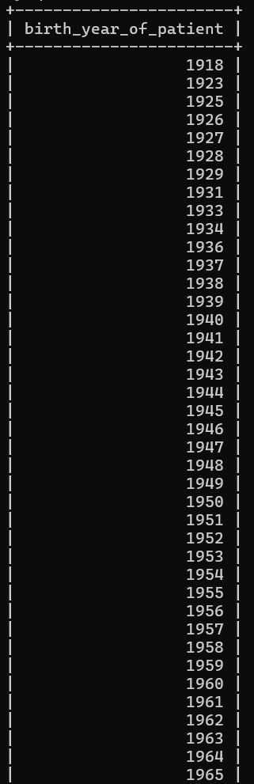
16. Show unique birth years from patients and order them by ascending

Slide 18
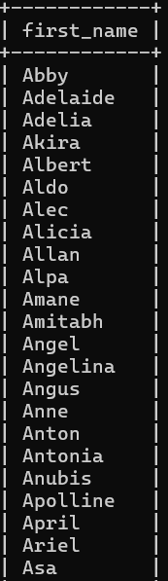
17. Show unique first names from the patients table which only occurs once in the list. For example, if two or more people are named 'John’ in the first_name column then don't include their name in the output list. If only 1 person is named 'Leo' then include them in the output.
Tip: HAVING clause was added to SQL because the WHERE keyword cannot be used with aggregate functions.

Slide 19
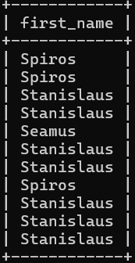
18. Show patient_id and first_name from patients where their first_name starts and ends with 's' and is at least 6 characters long.

Slide 20
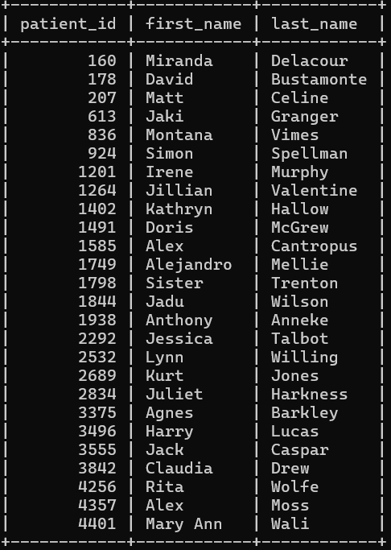
19. Show patient_id, first_name, last_name from patients whose diagnosis is 'Dementia'. Primary diagnosis is stored in the admissions table.

Slide 21
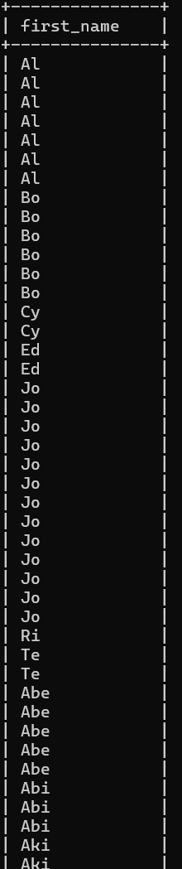
20. Display every patient's first_name. Order the list by the length of each name and then by alphabetically.

Slide 22
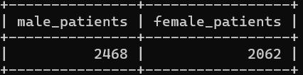
21. Show the total number of male patients and the total number of female patients in the patients table. Display the two results in the same row.

Slide 23
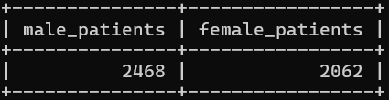
22. Show the total number of male patients and the total number of female patients in the patients table. Display the two results in the same row.

Slide 24
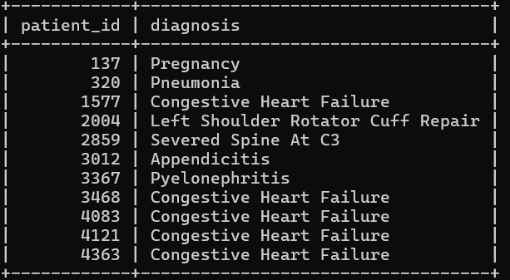
23. Show patient_id, diagnosis from admissions. Find patients admitted multiple times for the same diagnosis.

Slide 25
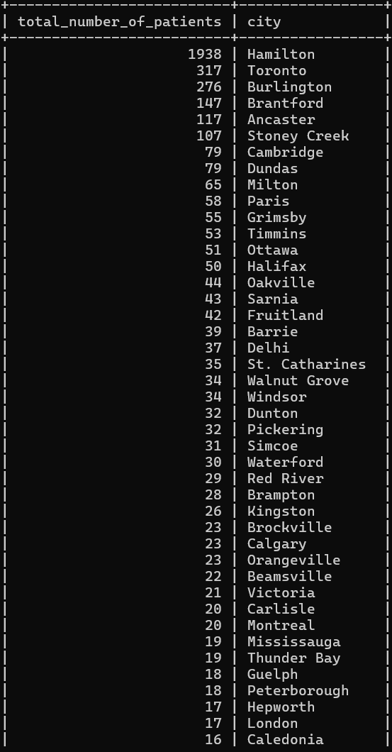
24. Show the city and the total number of patients in the city. Order from most to least patients and then by city name ascending.

Slide 26
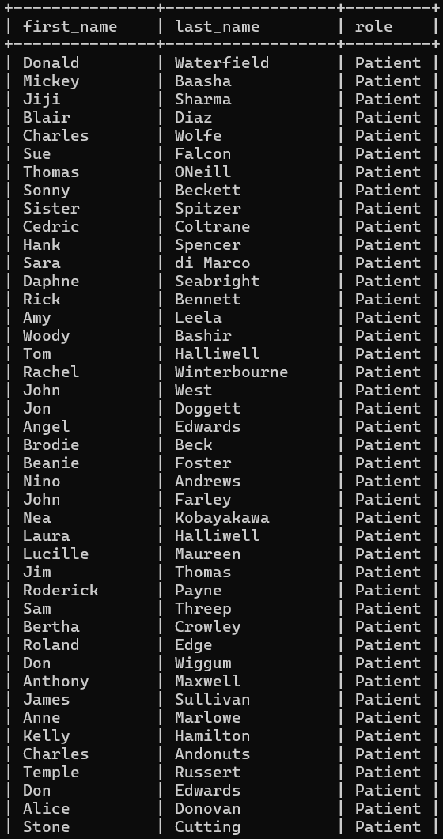
25. Show first name, last name and role of every person that is either patient or doctor. The roles are either "Patient" or "Doctor"

Slide 27
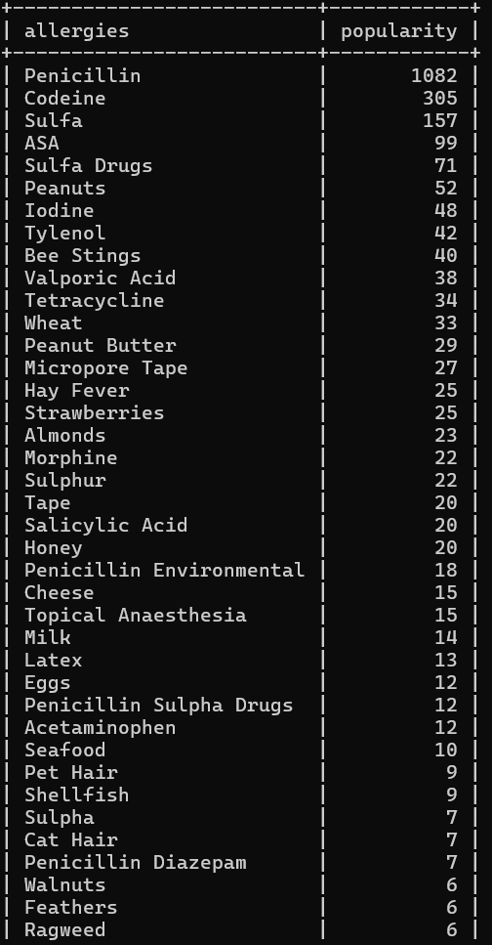
26. Show all allergies ordered by popularity. Remove NULL values from the query.

Slide 28
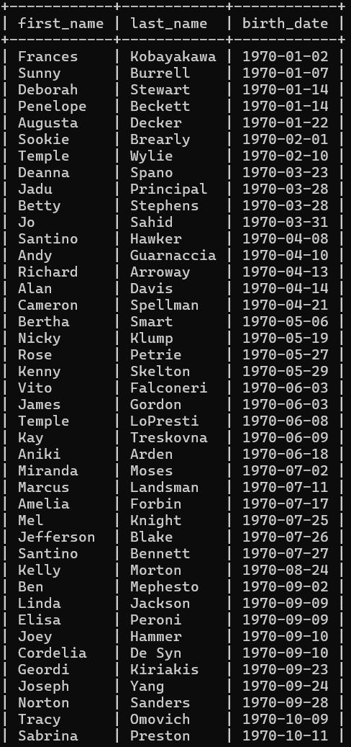
27. Show all patient's first_name, last_name, and birth_date who were born in the 1970s decade. Sort the list starting from the earliest birth_date.

Slide 29
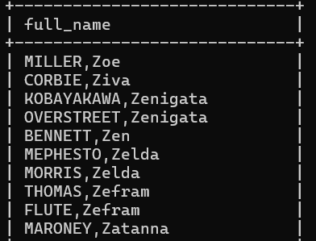
28. We want to display each patient's full name in a single column.
Their last_name in all upper letters must appear first, then first_name in all lower case letters. Separate the last_name and first_name with a comma. Order the list by the first_name in descending order EX: SMITH,jane

Slide 30
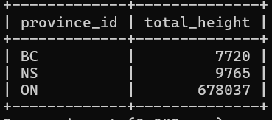
29. Show the province_id(s), sum of height; where the total sum of its patient's height is greater than or equal to 7,000.

Slide 31
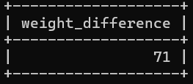
30. Show the difference between the largest weight and smallest weight for patients with the last name 'Maroni'

Slide 32
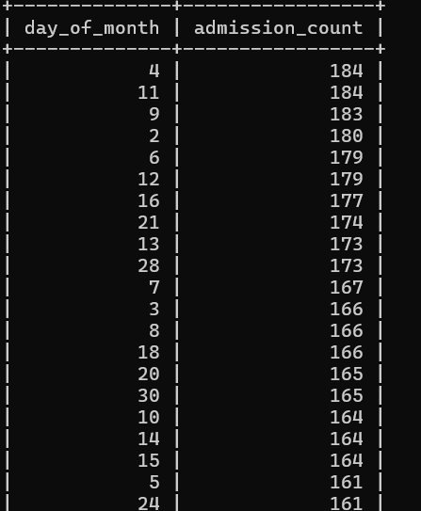
31. Show all of the days of the month (1-31) and how many admission_dates occurred on that day. Sort by the day with most admissions to least admissions.

Slide 33
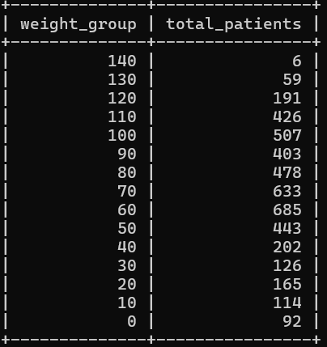
32. Show all of the patients grouped into weight groups. Show the total number of patients in each weight group. Order the list by the weight group descending. e.g. if they weigh 100 to 109 they are placed in the 100 weight group, 110-119 = 110 weight group, etc.

Slide 34
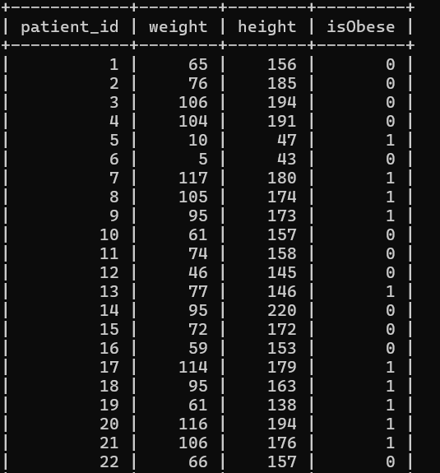
33. Show patient_id, weight, height, isObese from the patients table.
Display isObese as a boolean 0 or 1. Obese is defined as weight(kg)/(height(m). Weight is in units kg. Height is in units cm.

Slide 35
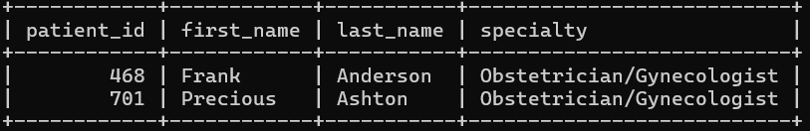
34. Show patient_id, first_name, last_name, and attending doctor’s specialty. Show only the patients who has a diagnosis as 'Epilepsy’ and the doctor's first name is 'Lisa'. Check patients, admissions, and doctors tables for required information.

Slide 36
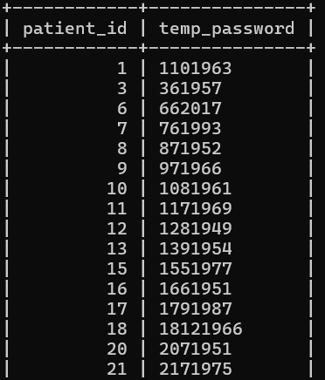
35. All patients who have gone through admissions, can see their medical documents on our site. Those patients are given a temporary password after their first admission. Show the patient_id and temp_password. The password must be the following, in order: - patient_id - the numerical length of patient's last_name - year of patient's birth_date

