Slide 1

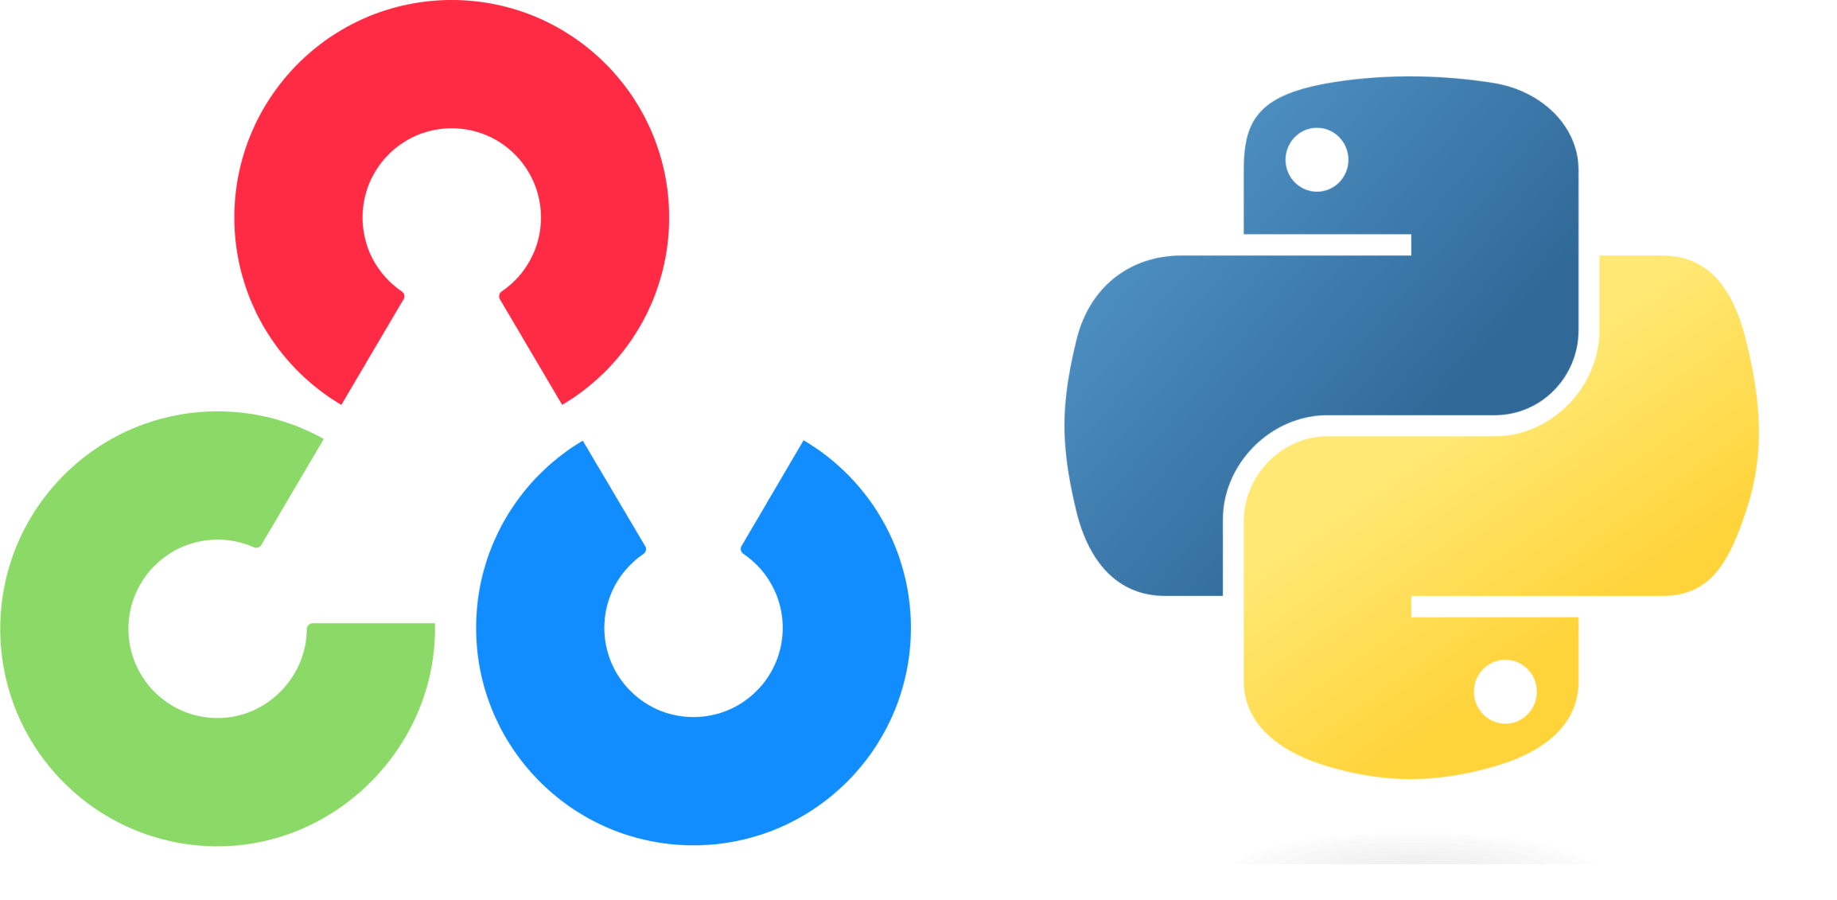

EEM463 – Introduction to Image Processing OpenCV Tutorial
Installation and Virtual Env. Settings
2022 –2023 Fall Semester

Slide 2


Apps
Download and install
Visual Studio Code
https://code.visualstudio.com
Anaconda
https://www.anaconda.com

Slide 3
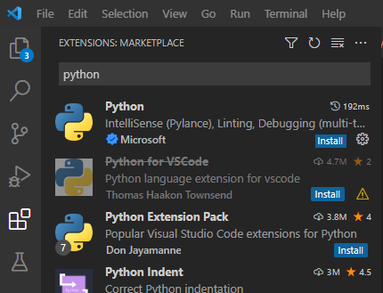
Virtual Environment Setup
Open Anaconda Prompt (Anaconda3) exe and insert :
>> conda create -n yourenvname python=3.9
>> conda activate yourenvname
Open Visual Studio Code App and install python

Slide 4
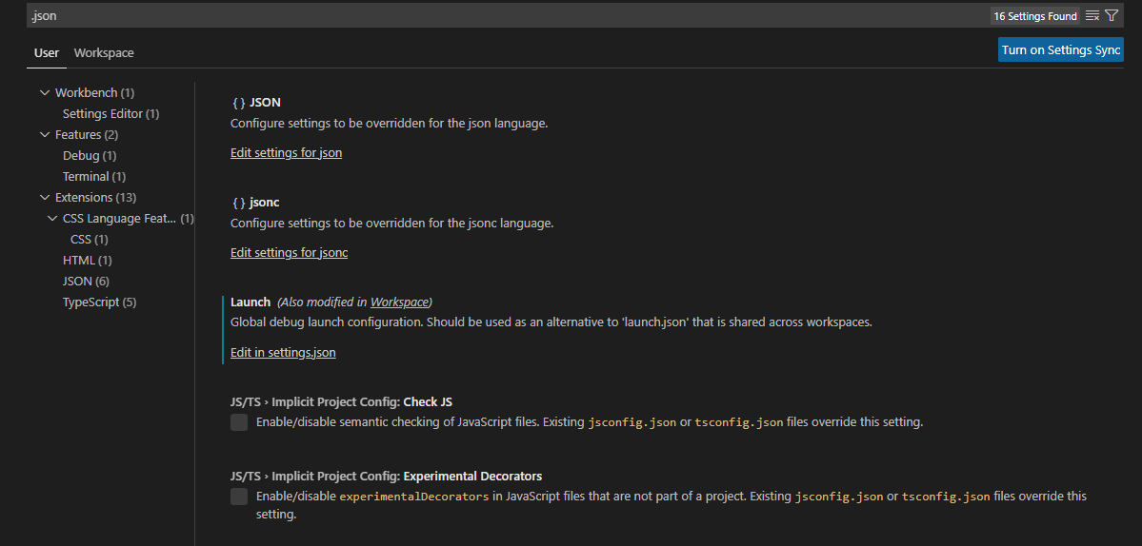
Virtual Environment Setup
Ctrl+Shift+P → Preference: Open User Settings
Search for .json and click Edit in settings.json

Slide 5
Virtual Environment Setup
Modify settings.json as :
{
"launch": {
"configurations": [],
"compounds": [],
"python.pythonPath":"C:\\Users\\Ali\\Anaconda3\\envs\\eem463_env\\python.exe",
"python.terminal.activateEnvironment": true,
"terminal.integrated.shell.windows": "C:\\Windows\\System32\\cmd.exe",
},
"terminal.integrated.shell.windows": "C:\\Windows\\System32\\cmd.exe",
"terminal.integrated.defaultProfile.windows": "Command Prompt",
"python.defaultInterpreterPath": "C:\\Users\\Ali\\.conda\\envs\\eem463_env\\python.exe",
"editor.minimap.enabled": false
}

Slide 6
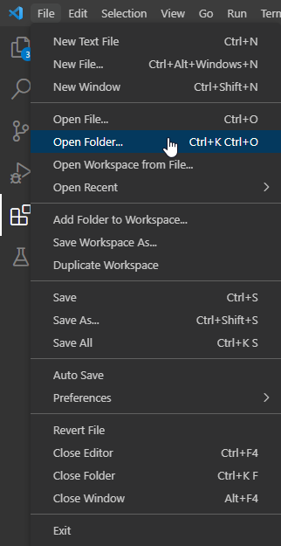
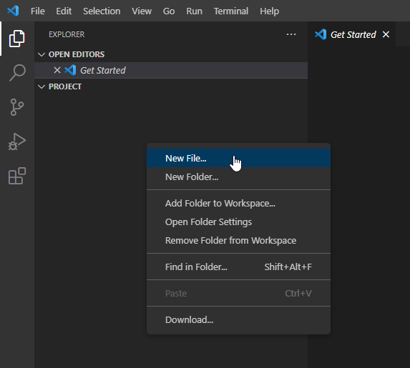
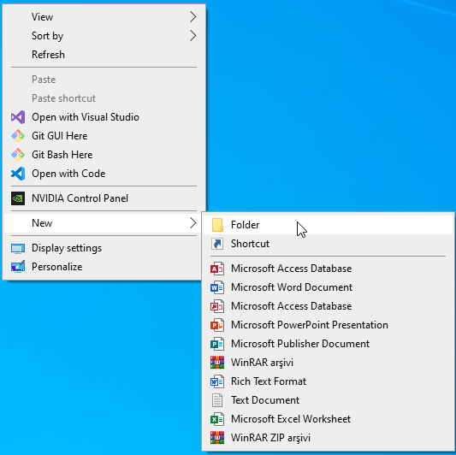
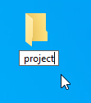
Virtual Environment Setup
Create a new folder in your computer and name it whatever you want.
Open Visual Studio Code app and from File->Open Folder
Then as shown above use right click and create new file
as opencv_tutorial.py

Slide 7
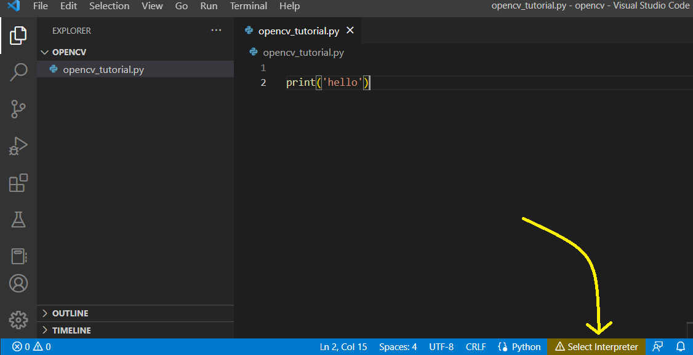
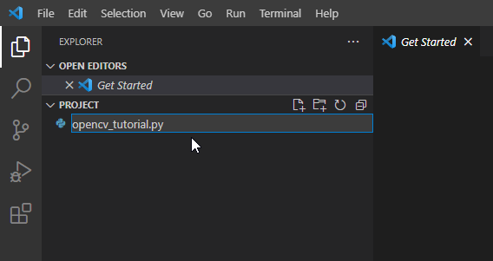
Virtual Environment Setup
Name new folder as opencv_tutorial.py
Before running your first command in that opencv_tutorial.py file, you must select interpreter as shown above with highlighted arrow.

Slide 8
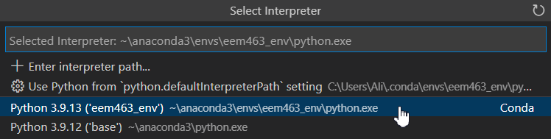
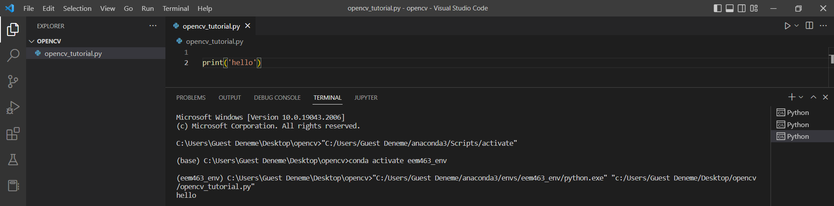
Virtual Environment Setup
Select your new virtual environment
(in here my virtual env “eem463_env”)
So run your first command and observe that your code is running on your new created virtual environment.

