Slide 1
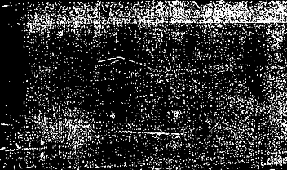


EEM463 – Introduction to Image Processing OpenCV Tutorial
2. Loading, Displaying, Saving and Dimensions
2022 –2023 Fall Semester

Slide 2
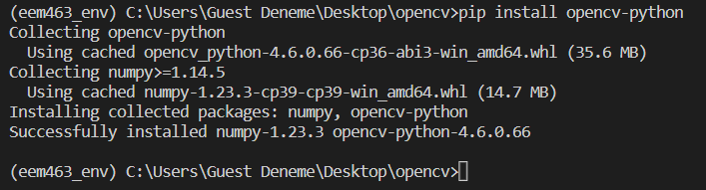
Getting Started
Installation
To import OpenCV, we first need to install it.
>> pip install opencv-python
Import OpenCV
# We can't use OpenCV's functions without first doing this
import cv2

Slide 3
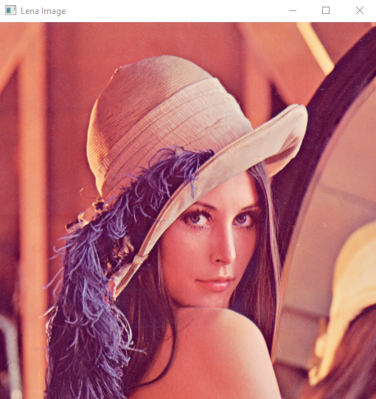
Loading Images
# Load an image using 'imread' specifying the path to image
image = cv2.imread('./lenna_image.png')
Displaying Images
cv2.imshow('Lena Image',image)
cv2.waitKey(0)

Slide 4
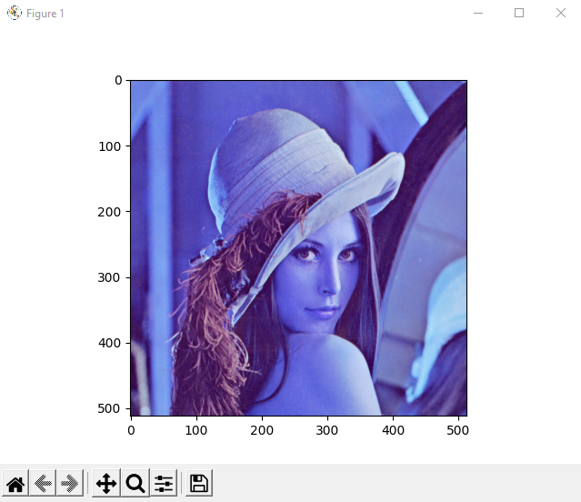
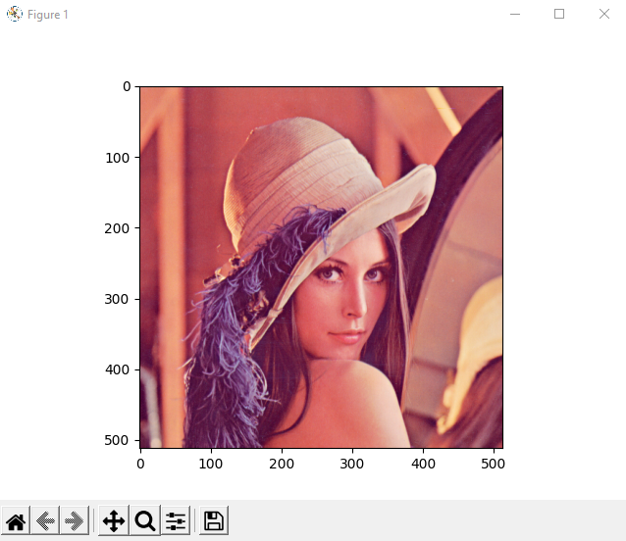
Displaying Images
from matplotlib import pyplot as plt
#Show the image with matplotlib
plt.imshow(image) # BGR Image
plt.show()
image_rgb = cv2.cvtColor(image,cv2.COLOR_BGR2RGB)
plt.imshow(image_rgb) # RGB Image
plt.show()

Slide 5
Saving Images
# Save it as a PNG
cv2.imwrite('output_rgb.png', image)
cv2.imwrite('output_bgr.png', image_rgb)

Slide 6
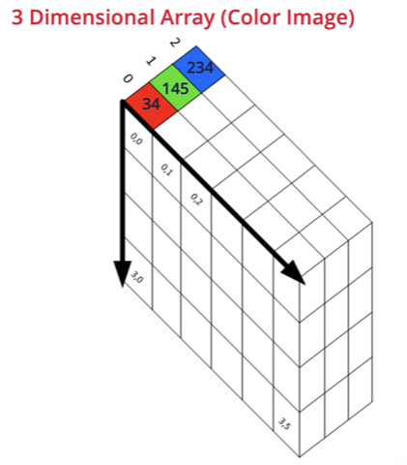
Displaying Image Dimensions
We need to use numpy to perform this operation.
import numpy as np
print(image.shape)
>> (512, 512, 3)
# To access a dimension, simply index it by using 0, 1 or 2.
print(image.shape[0]) >> 512 (Height)
print(image.shape[1]) >> 512 (Width)
print(image.shape[2]) >> 3 (Channel or Depth)

Slide 7
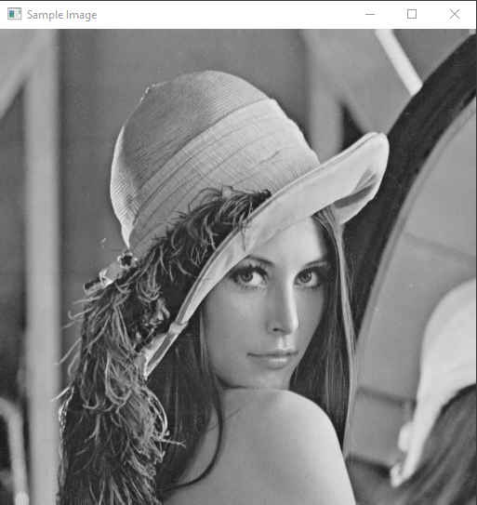
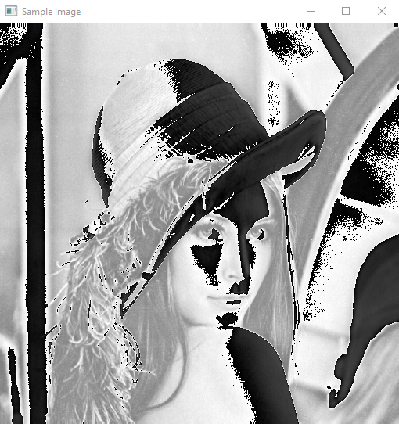
Loading Image
# Load an image using 'imread' specifying the path to image
image = cv2.imread('./bmpfiles/lena.bmp’)
Display it and print shape
cv2.imshow('Sample Image',image)
print(image.shape)
cv2.waitKey(0)
cv2.destroyAllWindows()
Add Constant Number to Image
c_image = image + 100
cv2.imshow('Sample Image',c_image)

Slide 8
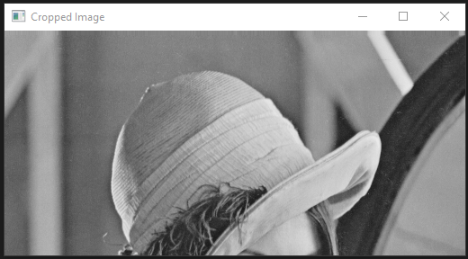
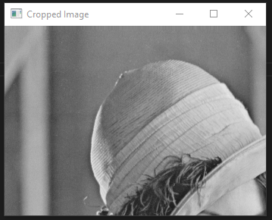
Crop Images
cropped_image = image[0:250,:,:]
cropped_image = image[0:250,5:350,:]

Slide 9
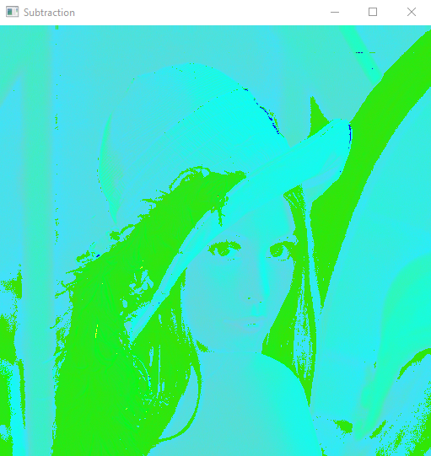
Subtracting Images
# image = cv2.imread("./bmpfiles/lena.bmp")
# color_image = cv2.imread("lenna_image.png")
sub_images = color_image – image

