Slide 1
Azure Agent for Azure Admins
Conversational AI that simplifies Azure operations — with near-zero friction
THE PROBLEM
THE SOLUTION
▸ Azure Admins spend hours daily on repetitive resource, cost & policy tasks
✓ Natural-language interface — ask questions, get answers & actions
▸ Multiple portal blades, CLI commands, and docs to achieve simple goals
✓ 6 specialised AI agents that route, reason & execute with high accuracy
▸ Quota requests & support tickets involve manual multi-step workflows
✓ Unified dashboard: resources, costs, health, compliance in one view
▸ No unified view across resources, costs, health, and compliance
✓ Extensible MCP architecture — admins add custom tools in minutes
Built on Microsoft Agent Framework · MCP Protocol · Azure REST APIs · Entra ID

Slide 2
What Azure Agent Does for You
40+ MCP tools across 9 domains — all accessible through natural language
🔍 Resource Discovery
💰 Cost Analysis
📈 Monitoring & Health
List, search & inspect resources using KQL Resource Graph queries
Cost summaries by RG, service, resource — up to 90-day windows
Metrics, resource health, activity logs & idle detection
📋 Policy Governance
📊 Quota Management
🎫 Support Tickets
List assignments, check compliance, author & assign custom policies
View limits, request increases, track approval across providers
Create, update & track tickets; manage communications lifecycle
📄 Interactive Reports
🏷️ Resource Management
📧 Email Notifications
Auto-generate HTML dashboards with charts, tables & filters
VM power ops, tag updates, orphan & idle resource detection
Send resource findings to owners & stakeholders
➕ Extensible by Design
Azure Admins can add custom MCP tools for their specific needs — proprietary APIs, internal databases, compliance checks, or automation workflows. Simply define a Python function, register it as an MCP tool, and the agent picks it up automatically.

Slide 3
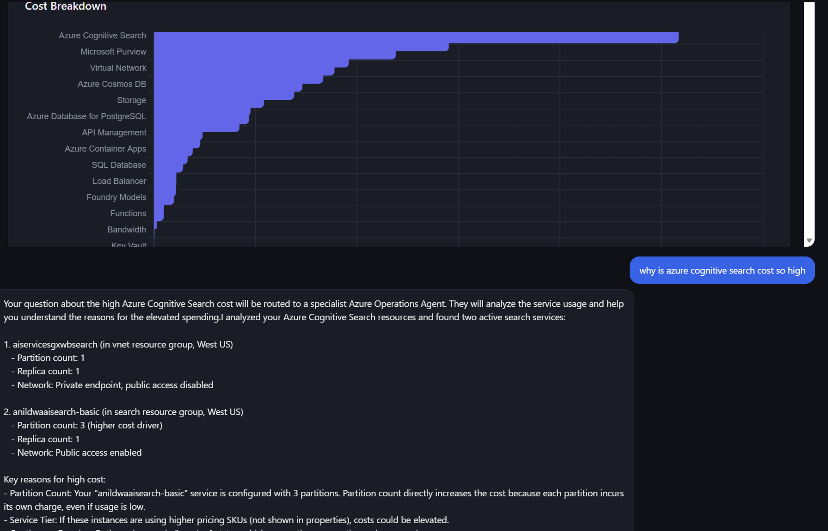
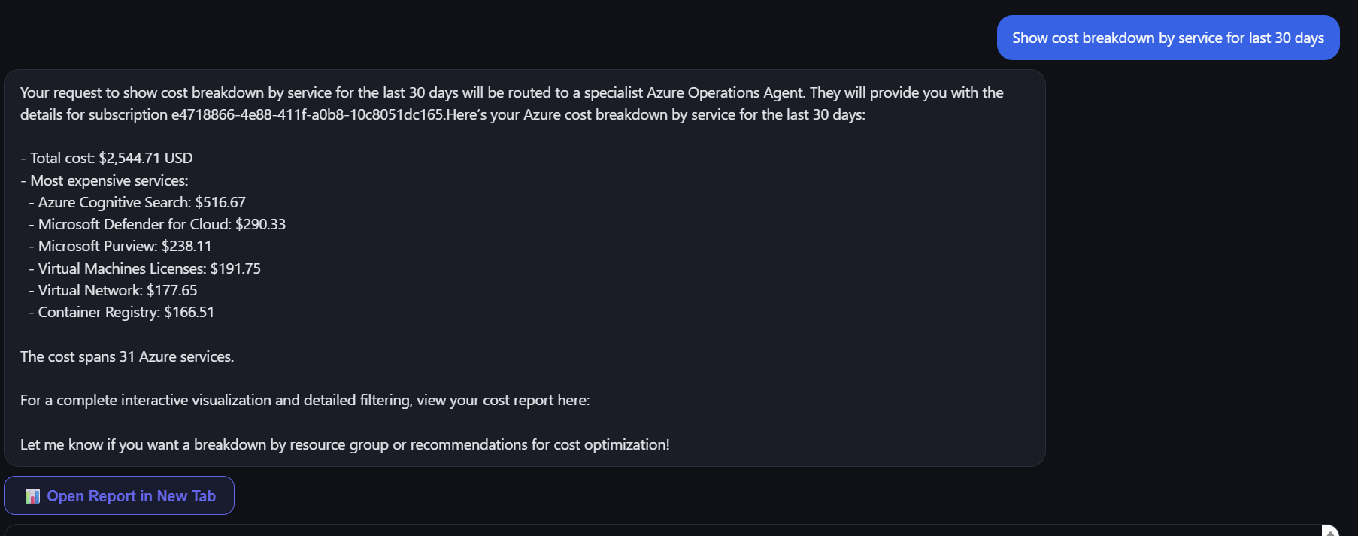

Slide 4
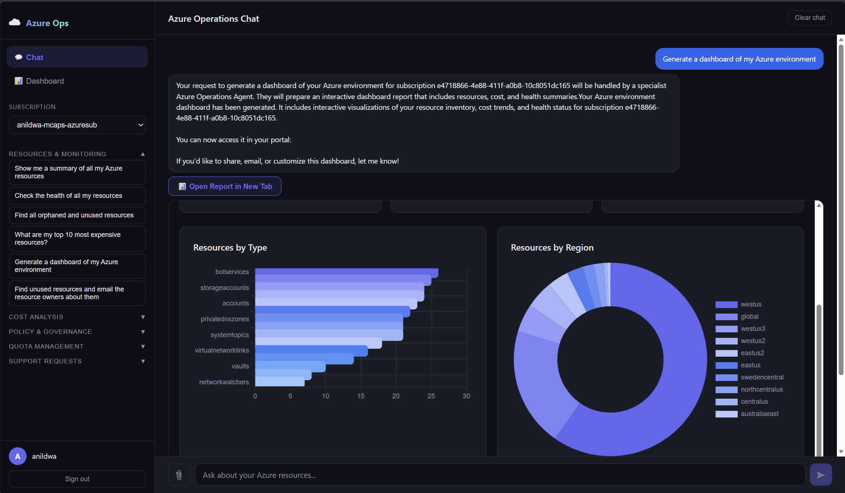

Slide 5
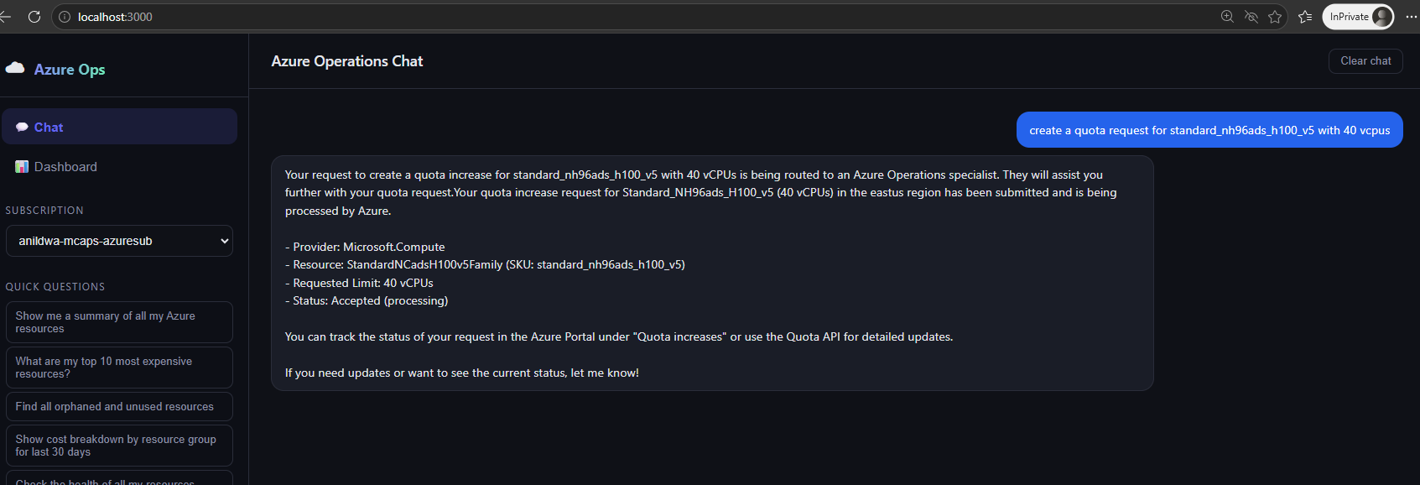

Slide 6
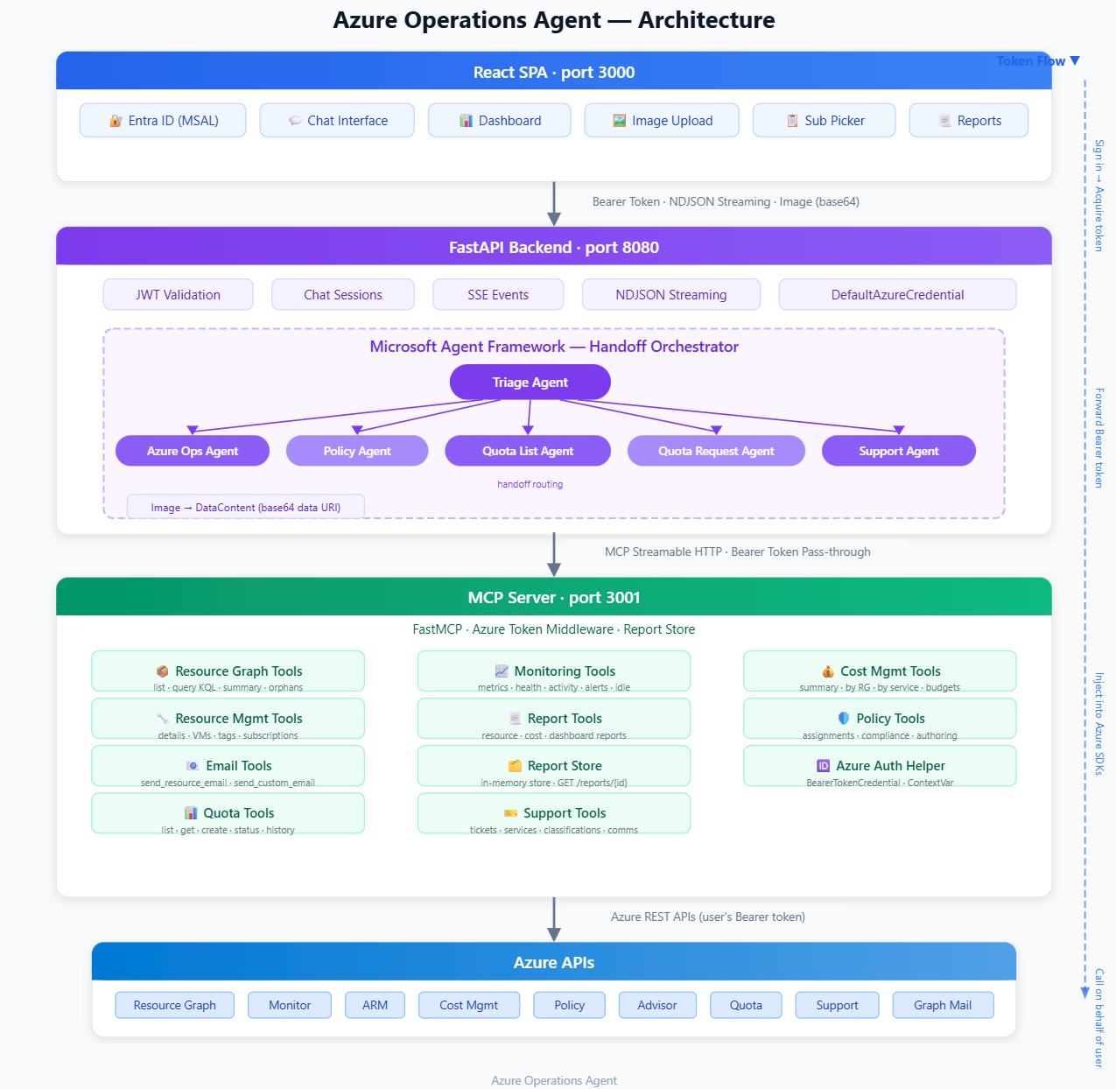
Azure Agent — Architecture Overview

