Slide 1
DATA SCIENCE Class Project Submitted by anilg

Slide 2
I. Project Description iI. DATASET III. EXPLOTARY DATA ANALYSIS IV. MODELING PROCESS V. Next Steps
agenda

Slide 3

Bike Rental Prediction
Project Description
kaggle competition (https://www.kaggle.com/c/bike-sharing-demand)
Forecast use of a city bikeshare system. Bike sharing systems are a means of renting bicycles where the process of obtaining membership, rental, and bike return is automated via a network of kiosk locations throughout a city
Combine historical usage patterns with weather data in order to forecast bike rental demand in the Capital Bikeshare program in Washington, D.C
.

Slide 4
Data exploration
Training Set
Two years of data - Jan 2011 till Dec 2012
Hourly predictor values for first 19 days
Hourly output for the first 19 days
10866 rows of observations
No missing values
Test Set
Two years of data from Jan 2011 till Dec 2012
Hourly predictor values for last days of the month (from 20th till 28, 29, 30 or 31)
Predict hourly bike demand
Output is not provided
.

Slide 5
Data exploration (Continued) – predictors & Output
Predictor | Description
datetime | Date and hour of the day
season | 1 = spring, 2 = summer, 3 = fall, 4 = winter
holiday | whether the day is considered a holiday –(1 – holiday, 0 – not a holiday)
workingday | whether the day is neither a weekend nor holiday ( 1- working day, 0 – not a working day)
weather | 1: Clear, Few clouds, Partly cloudy, Partly cloudy (Nice to bike on) 2: Mist + Cloudy, Mist + Broken clouds, Mist + Few clouds 3: Light Snow, Light Rain + Thunderstorm + Scattered clouds, Light Rain + Scattered clouds 4: Heavy Rain + Ice Pallets + Thunderstorm + Mist, Snow + Fog
temp | temperature in Celsius
atemp | "feels like" temperature in Celsius
humidity | relative humidity
windspeed | wind speed
Output | Description
casual | number of non-registered user rentals initiated
registered | number of registered user rentals initiated
count | number of total rentals (casual + registered)
.

Slide 6
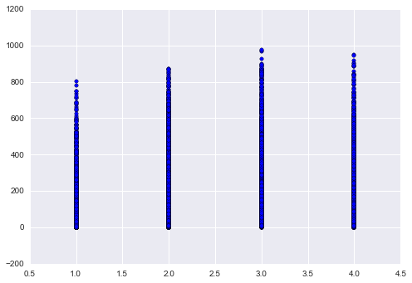
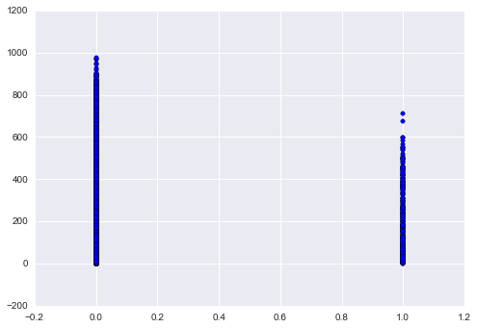
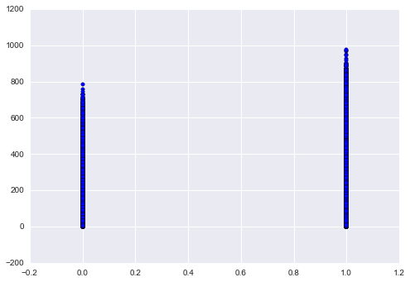
Data exploration (Continued) – DATA Plots
.
Season versus Count
1-Spring, 2-Summer, 3-Fall, 4-Winter
(Fall & Winter have more rentals than Summer & Spring)
Holiday versus Count
(More rental during non-holidays)
Workingday versus Count
(More rentals during Working days)

Slide 7
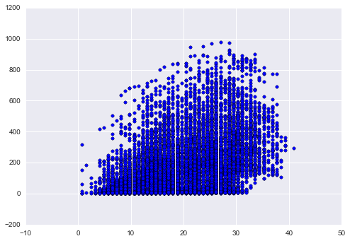
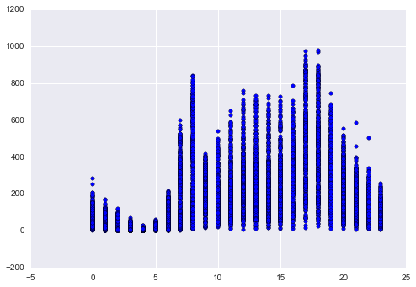
Data exploration (Continued) – DATA Plots
.
Temp (in Celusis) versus Count
(Expected – more rentals when
Temp is pleasant)
Hour of the day (00-23 hrs) versus Count
(Rental taper down in late nights and early morning)

Slide 8
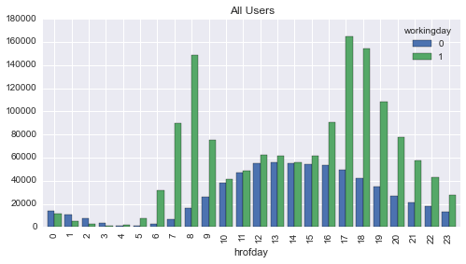
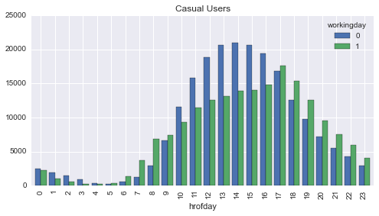
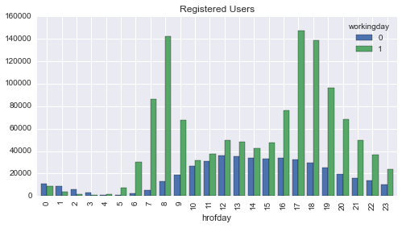
Data exploration (Continued) – DATA Plots
.
Hour of the day versus Total Rental on WorkingDay and non-WorkingDay
Hour of the day versus Casual Rental on WorkingDay and non-WorkingDay
Hour of the day versus Registered User Rental on WorkingDay and non-WorkingDay

Slide 9
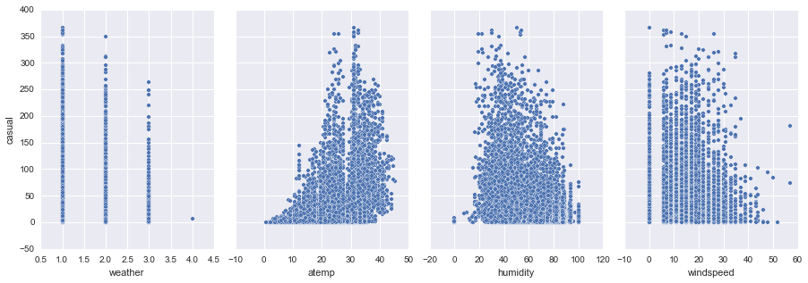
Data exploration (Continued) – DATA Plots
.
Plots of Casual renters against different parameters

Slide 10
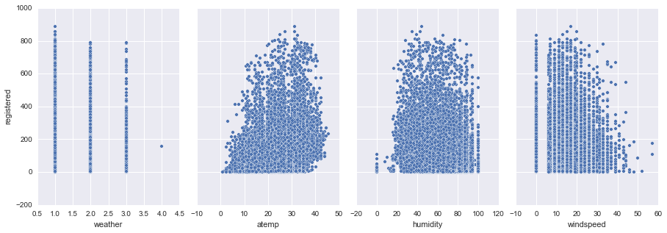
Data exploration (Continued) – DATA Plots
.
Plots of Registered renters against different parameters

Slide 11
Modeling - Problem Classification
continuous categorical
supervised regression classification
unsupervised dimension clustering
reduction

Slide 12
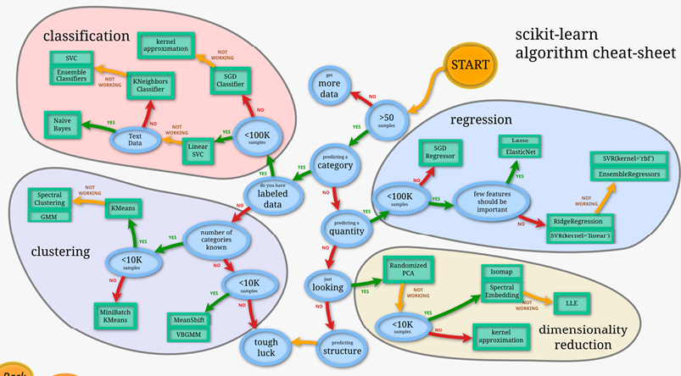
Modeling - how to proceed?
Source: http://scikit-learn.org/stable/tutorial/machine_learning_map/

Slide 13
MODELING
Need to define models for two different set of outputs
Casual Users
Registered Users
The models for these two users need to be different as the usage patterns are different based on the plots
Need for defining derived features based on the pattern observed

Slide 14
MODELING – Derived FEATURES
Derived Feature (Predictor) | Description
weekend | 1 – means weekend; 0 – not a weekend. (The input data provided called out working days and holidays but not weekends)
hrofday | 0-23 hrs of the day as the rental demand depends on the time of the day.
dayofmth | 1-end of the month
mth | 1-12 (jan to dec)
peak | Peak hours – they vary by the renter type Registers users seem to use for work commute (8-9am and 4-6pm) Casual users peak hours are 9am to 6pm
rollingmth | 1-24 for the rolling month. The users may be increasing per month as program gets popular
dayofweek | 1-7 for day of the week 1 – Monday 7-Sunday

Slide 15
MODELING – Algorithms used
Model | Description
Linear Regression | Standard Linear Regression model using Ordinary Least Squares method
Ridge Regression | A variation of Linear Regression which penalizes large coefficients
SVR (Linear) | A Support Vector Machine based algorithm that uses linear kernel. A kernel is a similarity function that takes two inputs and spits out how similar they are.
SVR (RBF) | A Support Vector Machine based algorithm that uses Radial Basis Function (RBF) kernel. A kernel is a similarity function that takes two inputs and spits out how similar they are.
RandomForest | A variation of decision tree algorithm that at each node uses some randomness in selecting the attribute to split on.
ElasticNet | A variation of Linear Regression mostly for sparse feature set
Used default 75/25 ratio for the train_test_split model training
Used 10 fold Cross Validation for Model Validation
Used scikit implementation for all the models

Slide 16
MODELING Results
Model | Features Used | RMSE Casual Renter | RMSE Regular Renter
Linear Regression | 'weather', 'temp', 'atemp', 'windspeed', 'workingday', 'season', 'holiday', 'hrofday', 'peak', 'rollingmth', 'dayofweek', 'weekend' | 34.47 | 91.28
Ridge Regression | 'weather', 'temp', 'atemp', 'windspeed', 'workingday', 'season', 'holiday', 'hrofday', 'peak' | 34.97 | 106.23
SVR (Linear) | 'weather', 'temp', 'workingday', 'season','holiday', 'hrofday' | 39.68 | 133.37
SVR (RBF) | 'weather', 'temp', 'atemp', 'windspeed', 'workingday', 'season', 'holiday', 'hrofday', 'peak','rollingmth' | 46.63 | 146.97
RandomForest | 'weather', 'temp', 'atemp', 'windspeed','hrofday','workingday' | 24.70 | 81.02
ElasticNet | 'weather', 'atemp', 'windspeed', 'humidity' | 39.86 | 137.20
Used default 75/25 ratio for the train_test_split model training
Used 10 fold Cross Validation for Model Validation
Used scikit implementation for all the models

Slide 17
CONCLUSION and Next STEPS
None of the model seems to be very accurate
Need to identify more derived features that predict the bike rental demand
The features need to be able to incorporate the influence of additional registered renter signing up with the program over a period of time
Current model looks at entire training set for cross-validation
Since RandomForest seems to be more accurate than the other algorithm – use the parameters to tune the model and also run the model with different feature sets.
Try additional algorithms based on decision trees and polynomial regression

Slide 18
Questions/Comments

Slide 19
DATA SCIENCE

