Slide 1

Adaptive differential pulse code modulation (ADPCM compression technique)
Encoded code
Decoder
Mixer
Mixer
Si
+
d
Quantizer
Inverse quantization
dq
Sp
-
+
+
Sp
q
Sr
Adaptive predictor
Step size predictor
Sound wave source: [online]http://www.sampleswap.org downloaded:15/10/19

Slide 2
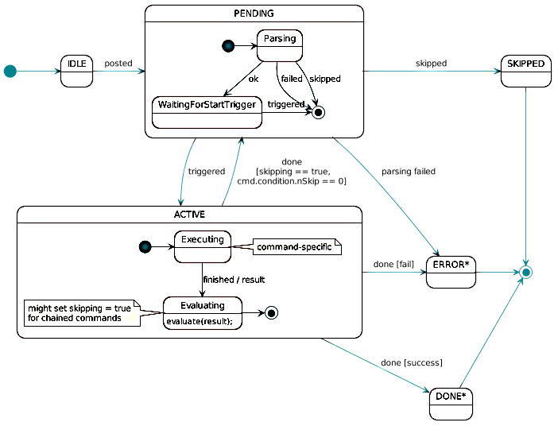
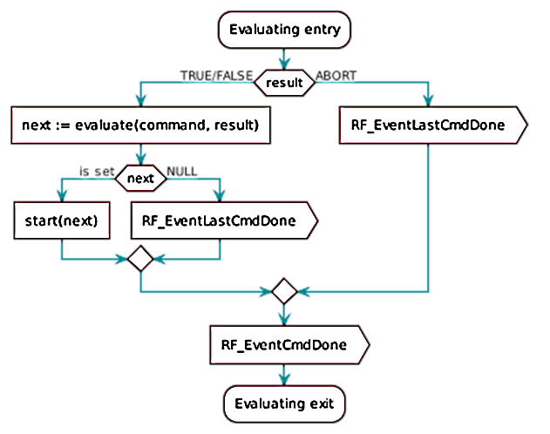
RF core command handling
RF operation state chart
SDL diagram of the evaluating phase
* Image Source: http://dev.ti.com/tirex/content/simplelink_cc13x0_sdk_1_30_00_06/docs/

Slide 3
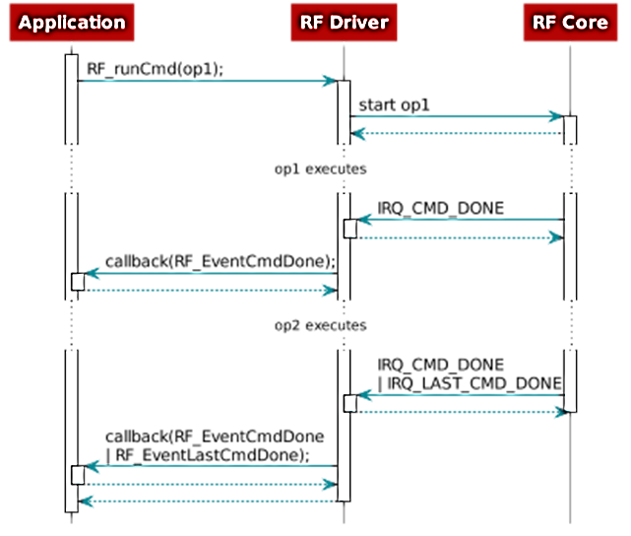
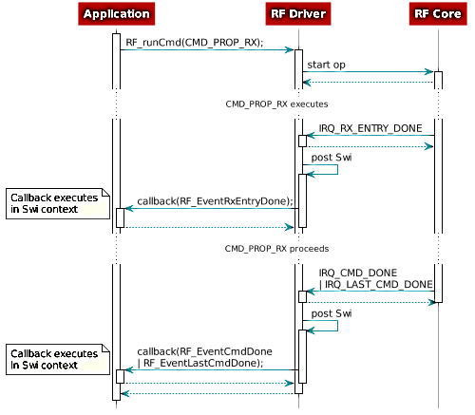
RF core command handling
Callback events for two chained RF operations op1 and op2
Callback events for CMD_PROP_RX
* Image Source: http://dev.ti.com/tirex/content/simplelink_cc13x0_sdk_1_30_00_06/docs/

Slide 4
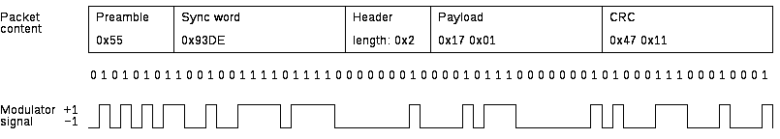
EasyLink API reference
Packet Format
Data Sending
EasyLink layer is initialized by calling EasyLink_init().
TX is enabled by calling EasyLink_transmitAsync()
Entering TX can be immediate or scheduled.
an Async operation can be cancelled with EasyLink_abort()
Data Receiving
EasyLink layer is initialized by calling EasyLink_init().
RX is enabled by calling EasyLink_receiveAsync().
Entering RX can be immediate or scheduled.
an Async operation can be cancelled with EasyLink_abort()
* Image Source: http://dev.ti.com/tirex/content/simplelink_cc13x0_sdk_1_30_00_06/docs/

Slide 5
Software architecture
Main CPU
Main CPU
ARM
Cortex-M3
RF core
ARM
Cortex-M0
RF core
Power consumption
Main MCU (Active@48Mhz) | 1.2mA + 25.5μA/Hz
Radio Rx | 5.5mA
RF core | 0.237mA
μDMA | 0.130mA
Timer | 0.113mA
I2C | 0.012mA
SPI | 0.093mA
UART | 0.164mA
ADC | 0.750mA
Radio Tx (VDDR=1.95V) , 14dbm o/p power GFSK | 23.5mA
Total | 32.9mA
Main Application
Non-RTOS
Drivers
IDE- Code composer studio
Extremely flexible ultra- low power radio
Built in autonomous packet engine
IDE: Smart RF studio
Peripherals
Sensor controller
Sensor controller
GPIO
DMA
Timer
SPI ( DAC Interface)
Ultra low power sensor interface
ADC Interface ( 4ksps)
Peripherals
Software
TI Simple Link PHY
1. 802.15.4g FSK
2. Proprietary
3. Long Range Communication
* Power consumption: CC1310 datasheet

Slide 6
Problems and solutions
Chip select is necessary to latch the DAC output during SPI communication
Carrier frequency configuration problem due to incorrect selection command
ADC counts calculation problem above 3.3V
Synchronization between Tx & RX

Slide 7
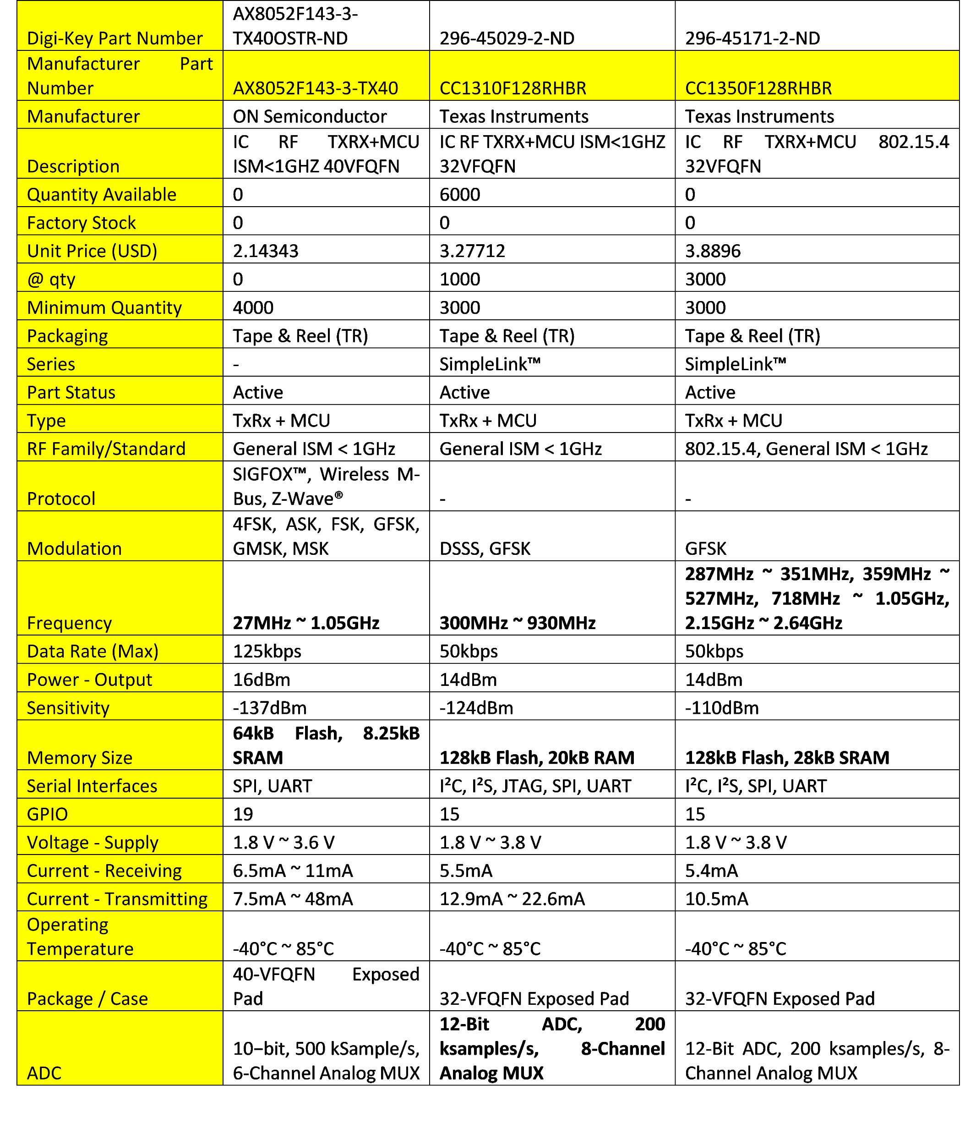
CC1310 Selection

