Slide 1
4CE Phase 1.2 and 2.2
April 25, 2021

Slide 2
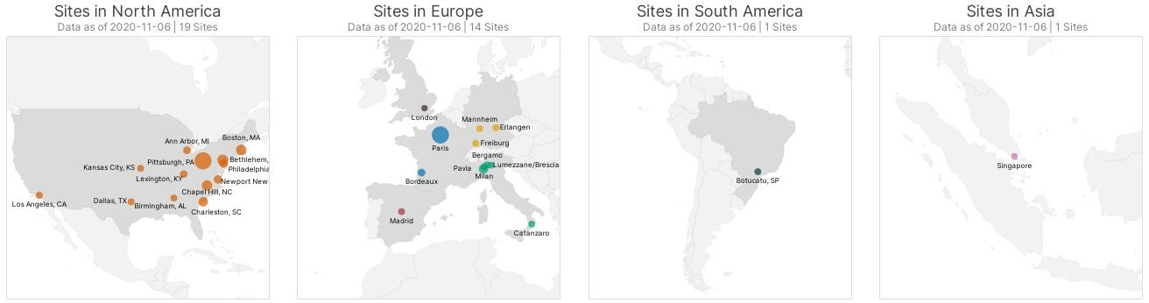
4CE ("foresee") Consortium
Problem: There are numerous national and international efforts to collect and analyze data on COVID-19 patients. This will only work if you can trust the data.
Approach: 4CE engages local experts (informatics, statisticians, clinicians) at hospitals around the world to iteratively improve sites' data quality, understand the limitations of EHR data, and conduct rapid analyses on COVID-19 through a federated model and patient chart review.
Goal: We believe that early intelligence is worth more than complete intelligence later. Our goal is to move quickly, publish results, and share lessons learned with others.
342 hospitals
8 countries
37,000 patients

Slide 3
Two Types of 4CE Analyses (Phases)
342 hospitals, 8 countries, 37,000 patients admitted for COVID-19
Different hospital perspectives, regional and country variation
SQL queries run on i2b2, OMOP, and others; leverages ACT ontology
Low regulatory barriers to participation
Project-specific subsets of sites (not all sites needed)
Deep dives into sites’ data with chart review to validate data and methods
ML models and complex analyses using R on patient-level data
Run on Docker image to create a standardized compute environment
Analyses run locally at sites, only share aggregate counts and statistics
Local data experts and clinicians refine questions, know coding practices, perform chart review
Data quality problems can be fixed in local databases
Iteratively fix data problems and improve methods to gain trust in the findings
A federated model based on locally-run analyses enables 4CE to "stay close to the data"
US Diversity, Global Perspectives
(Phase 1.x)
Federated Model
Deep Analysis, Chart Review
(Phase 2.x)

Slide 4
Example key data insights learned through 4CE
Hospital EHRs vary greatly in the availability, coding, and quality of key outcome measures (ICU, ventilation, death) → use standardized proxies
Algorithms developed in spring 2020 degrade in accuracy over time (hospital practices change, disease prevalence changes, etc.) → continually refine methods
Lab tests are hard (countries vary in what tests they use, a single hospital can be inconsistent with units and type of test, etc.) → local knowledge is essential for cleanup
Race and ethnicity coding varies greatly by hospital, has different meanings in other countries, and is not collected in some parts of the world → country based analyses

Slide 5
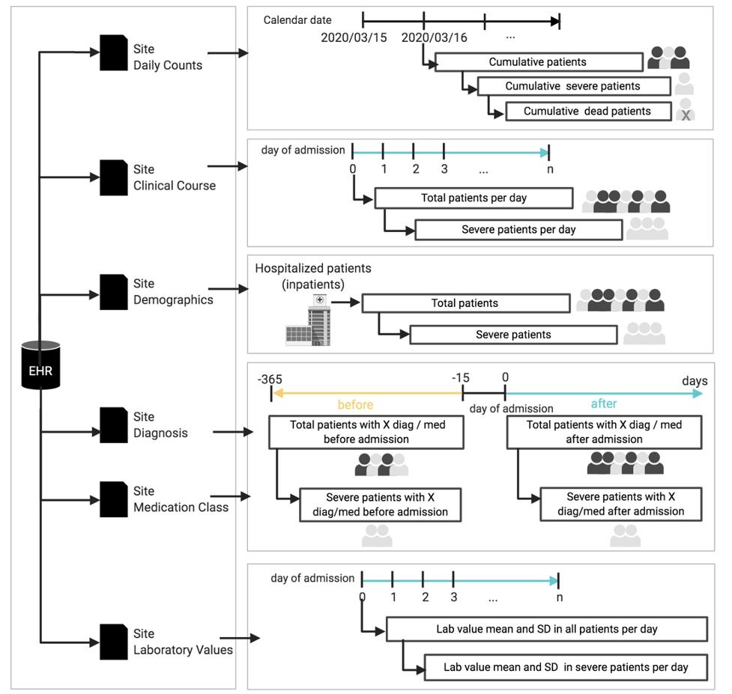
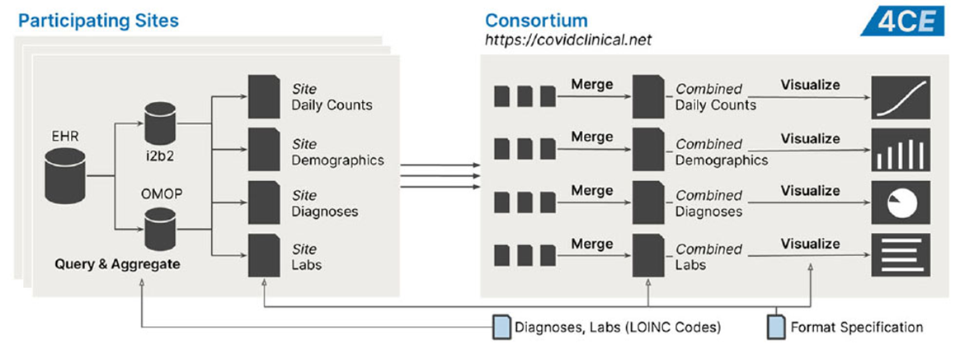
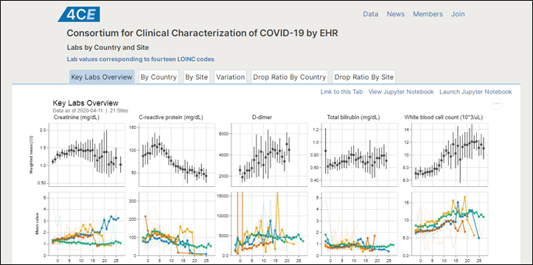
Phase 1 Methods
Step #1 - Sites generate aggregate CSV data files
Step #2 - Upload aggregate data, quality checks
Step #3 - Data and results on CovidClinical.net

Slide 6
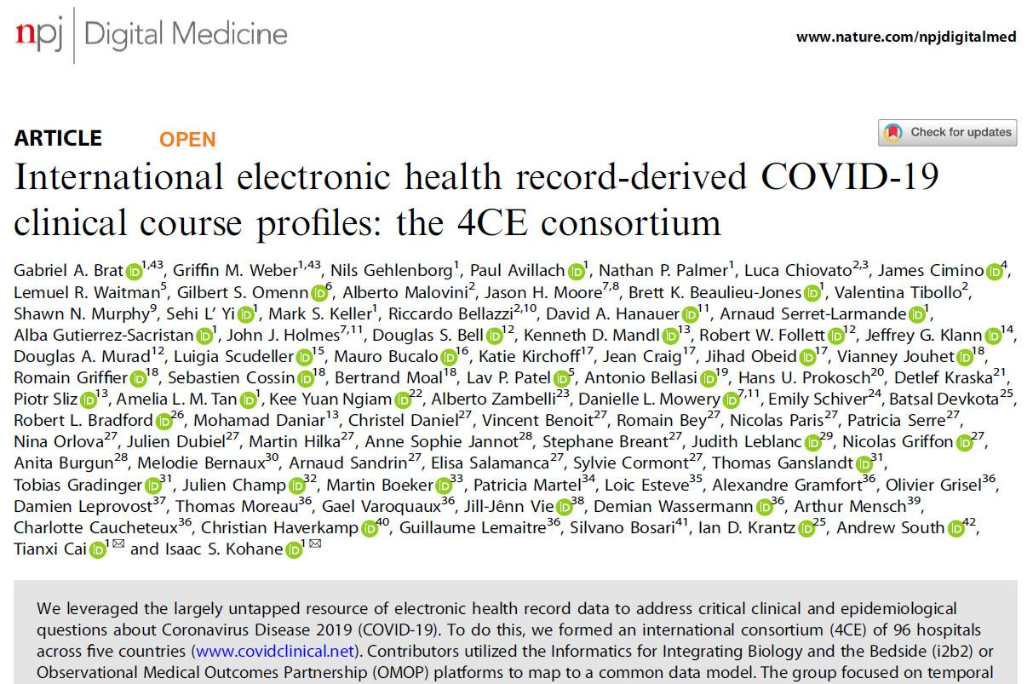
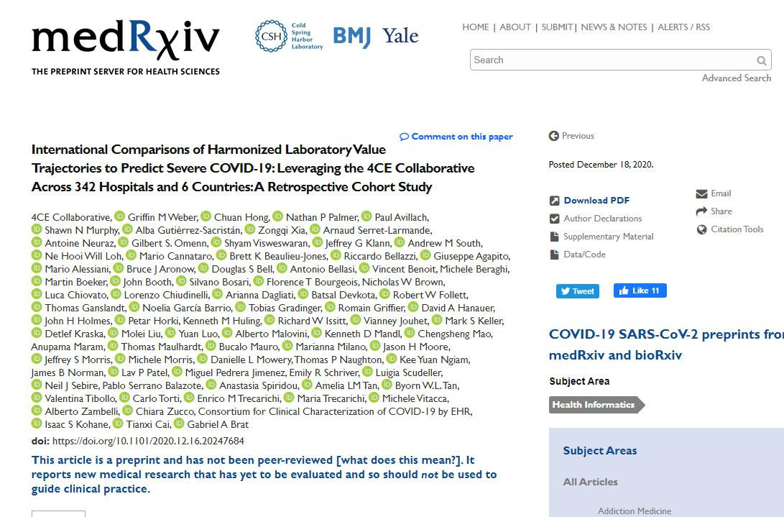
Phase 1 Results
Phase 1.0 – First preprint online in only 4 weeks, published in Nature Digital Medicine
Lab trajectories in 27,584 patients with COVID-19
Phase 1.1 – Predicting COVID-19 disease severity based on laboratory test trajectories
36,447 patients admitted for COVID-19 in 342 hospitals in 8 countries
https://doi.org/10.1038/s41746-020-00308-0
https://doi.org/10.1101/2020.12.16.20247684

Slide 7
Phase 2.1
Manual chart review and R scripts run on a Docker image at each hospital to provide a standardized local compute environment (still only share aggregate results externally)
Projects to refine and validate methods
COVID-19 disease severity algorithm
Longitudinal analyses: differences between pandemic waves
Projects looking at understudied or underrepresented populations
Pediatrics
Race and ethnicity
Projects on disease-specific diagnosis, risk factors, management and outcomes
Neurological diseases
Acute kidney injury
Thrombotic events
Others...

Slide 8
Post-Acute Sequelae
Phase 1.2
What post-acute sequelae are seen 30, 90, 180 days and longer after COVID-19?
Do post-acute sequelae vary by country or race?
What post-acute sequelae are seen in children (an understudied group, large representation in 4CE)?
Phase 2.2
Can chart review and information in clinical notes help distinguish post-acute sequelae from pre-existing comorbidities?
Are post-acute sequelae due to COVID-19 or the treatments (e.g., ventilation) given to patients?
Disease-specific post-acute sequelae through domain working groups.

Slide 9
Phase 1.0 Cohort (Spring 2020)
 | COVID PCR Test
 | Positive | U07.1 Diagnosis | Only Negative
Admitted | Phase 1.0 Cohort (All PCR Positive)
Not Admitted
In Phase 1.0, the 4CE cohort consisted of all patients with a positive PCR test result.
The test date was used as the index date.
Patients with U07.1 diagnosis (COVID-19 confirmed by test), but no PCR test result, were not included.

Slide 10
Phase 1.1 & 2.1 Cohort (Summer 2020)
 | COVID PCR Test
 | Positive | U07.1 Diagnosis | Only Negative
Admitted | Phase 1.1 Cohort (PCR Positive & Admitted)
Not Admitted
In Phase 1.1, the 4CE cohort was limited to patients with a positive PCR test result who were admitted between -7 and +14 days relative to the PCR test.
The index date was the admission date (day 0).

Slide 11
Phase 1.2 & 2.2 Cohorts (Spring 2021)
 | COVID PCR Test
 | Positive | U07.1 Diagnosis | Only Negative | Index Date
Admitted | All Sites (Required) | Separate Optional Cohort (Check IRB) | Separate Optional Cohort (Check IRB) | Admission Date
Not Admitted | Separate Optional Cohort (Check IRB) | Separate Optional Cohort (Check IRB) | Separate Optional Cohort (Check IRB) | PCR Test Specimen Date or U07.1 Diagnosis Date
In Phase 1.2, the primary 4CE cohort remains the same as Phase 1.1 (PCR positive and admitted).
If their IRB allows it, sites are encouraged to include additional cohorts for non-admitted PCR positive patients and all patients with a U07.1 diagnosis (but no PCR positive test) or a negative PCR test.

Slide 12
Phase 1.2 & 2.2 Cohorts
Phase X.2 partitions patients into cohorts based on admission date (3-month blocks: year+quarter)
Jan | Feb | Mar | Apr | May | Jun | Jul | Aug | Sep | Oct | Nov | Dec
Q1 |  |  | Q2 |  |  | Q3 |  |  | Q4
2019
Jan | Feb | Mar | Apr | May | Jun | Jul | Aug | Sep | Oct | Nov | Dec
Q1 |  |  | Q2 |  |  | Q3 |  |  | Q4
2020
Jan | Feb | Mar | Apr | May | Jun
Q1 |  |  | Q2
2021
Phase 1.1 & 2.1 Cohort
Before Admission Period
Admission Date
Phase 1.2 & 2.2 Cohorts
PosAdm2020Q1
Before Admission Period
Adm. Date
Followup Period
First Wave
PosAdm2020Q2
Before Admission Period
Adm. Date
Followup Period
PosAdm2020Q3
Before Admission Period
Adm. Date
Followup Period
PosAdm2020Q4
Before Admission Period
Adm. Date
Followup Period
Winter Wave
PosAdm2021Q1
Before Admission Period
Adm. Date
PosAdm2021Q2
Before Admission Period
Adm. Date

Slide 13
Phase 1.2 & 2.2 Cohorts
 | COVID PCR Test
 | Positive | U07.1 Diagnosis | Only Negative | Index Date
Admitted | (All Sites) | (Optional) | (Optional) | Admission Date
 | PosAdm2020Q1 | U071Adm2020Q1 | NegAdm2020Q1
 | PosAdm2020Q2 | U071Adm2020Q2 | NegAdm2020Q2
 | PosAdm2020Q3 | U071Adm2020Q3 | NegAdm2020Q3
 | PosAdm2020Q4 | U071Adm2020Q4 | NegAdm2020Q4
 | PosAdm2021Q1 | U071Adm2021Q1 | NegAdm2021Q1
 | PosAdm2021Q2 | U071Adm2021Q2 | NegAdm2021Q2
Not Admitted | (Optional) | (Optional) | (Optional) | PCR Test Specimen Date or U07.1 Diagnosis Date
 | PosNotAdm2020Q1 | U071NotAdm2020Q2 | NegNotAdm2020Q2
 | PosNotAdm2020Q2 | U071NotAdm2020Q1 | NegNotAdm2020Q1
 | PosNotAdm2020Q3 | U071NotAdm2020Q3 | NegNotAdm2020Q3
 | PosNotAdm2020Q4 | U071NotAdm2020Q4 | NegNotAdm2020Q4
 | PosNotAdm2021Q1 | U071NotAdm2021Q1 | NegNotAdm2021Q1
 | PosNotAdm2021Q2 | U071NotAdm2021Q2 | NegNotAdm2021Q2
When partitioned by COVID test result, admission, and time period, there can be up to 36 cohorts.
The cohort names (e.g., "PosAdm2021Q1" are indicated in this table.
Note that the index date (day 0) varies by cohort group.

Slide 14
Phase 1 (Aggregate Shared) Files
Phase 1.0 and Phase 1.1
Phase 1.2
DailyCounts.csv
ClinicalCourse.csv
AgeSex.csv
RaceByLocalCode.csv
RaceBy4CECode.csv
DiagMedProc.csv
Labs.csv
LabCodes.csv

Slide 15
Phase 1.2 & 2.2 Files
 | Phase 1.2 (All Sites) | Phase 2.2 (Some Sites)
Aggregate Counts | DailyCounts.csv | LocalDailyCounts.csv
 | ClinicalCourse.csv | LocalClinicalCourse.csv
 | AgeSex.csv | LocalAgeSex.csv
 | RaceByLocalCode.csv | LocalRaceByLocalCode.csv
 | RaceBy4CECode.csv | LocalRaceBy4CECode.csv
 | DiagProcMed.csv | LocalDiagProcMed.csv
 | Labs.csv | LocalLabs.csv
 | LabCodes.csv
Patient Level Data |  | LocalPatientSummary.csv
 |  | LocalPatientClinicalCourse.csv
 |  | LocalPatientObservations.csv
 |  | LocalPatientRace.csv
 |  | LocalPatientMapping.csv
 | Shared with 4CE, Obfuscated | Kept Locally, Not Shared, Not-Obfuscated
All sites are asked to generate and upload 8 aggregate count CSV files for Phase 1.2 analyses.
These shared files may contain obfuscation, such as masking small counts.
Sites may optionally participate in Phase 2.2 analyses, which are performed locally.
Phase 2.2 uses non-obfuscated aggregate files plus additional patient-level data files, which are not shared.

Slide 16
File changes from Phase 1.1 to 1.2
ClinicalCourse.csv is shown as an example here
Phase 1.1
siteid
days_since_admission
num_patients_all_still_in_hospital
num_patients_ever_severe_still_in_hospital
Phase 1.2
siteid
cohort
days_since_admission
pts_all_in_hosp
pts_all_in_icu
pts_all_dead
pts_severe_by_this_day
pts_ever_severe_in_hosp
pts_ever_severe_in_icu
pts_ever_severe_dead
siteid | days_since_admission
BIDMC | 0
BIDMC | 1
BIDMC | 2
New "cohort" column in every file as part of the primary key
Additional columns for extra counts
Column names are less than 30 characters
siteid | cohort | days_since_admission
BIDMC | PosAdm2020Q1 | 0
BIDMC | PosAdm2020Q1 | 1
BIDMC | PosAdm2020Q1 | 2
BIDMC | PosAdm2020Q2 | 0
BIDMC | PosAdm2020Q2 | 1
BIDMC | PosAdm2020Q2 | 2

Slide 17
Phase 1.1 Time Periods
admission
Patient 1
Patient 2
Patient 3
Inpatient Visit
Patient 4
CovPos Test
-365
-15
-14
Day 0
7
30
90
before (1)
since (4)
In Phase 1.1, diagnoses and medications were counted in two time periods: "before" and "since" admission.
The example above shows the timeline for the diagnosis of hypertension (I10) in Phase 1.1.
In Phase 1.2, diagnoses, medications, and procedures are combined into a single file with additional time periods illustrated on the next two slides.

Slide 18
DiagMedProc.csv (Phase 1.2 Time Periods)
admission
Patient 1
Patient 2
Patient 3
Inpatient Visit
Patient 4
CovPos Test
-365
-15
-14
Day 0
7
30
90
before (1)
since (4)
(?)
(acute)
(post-acute)
dayN14toN1 (2)
day0to29 (2)
day30plus (4)
(mid)
(late)
day30to89 (3)
day90plus (4)

Slide 19
DiagMedProc.csv (Phase 1.2 Time Periods)
admission
Patient 1
Patient 2
Patient 3
Inpatient Visit
Patient 4
CovPos Test
-365
-15
-14
Day 0
7
30
90
before (1)
since (4)
(?)
(acute)
(post-acute)
dayN14toN1 (2)
day0to29 (2)
1st_day0to29 (0)
day30plus (4)
1st_day30plus (2)
(mid)
(late)
All occurrences
First occurrences
day30to89 (3)
day90plus (4)
1st_day90plus (1)

Slide 20
Additional Notes
There are two race files, which contain the same data grouped differently:
RaceByLocalCode.csv – Aggregates by the codes you use internally for race and ethnicity
RaceBy4CECode.csv – Aggregates by 4CE race and ethnicity codes
The 4CE race codes vary by country. Make sure you are using the right codes.
Including race information is optional. Many sites do not collect this.
ICU and death data are optional since many sites do not have accurate data.
Dates in the files should be in the format YYYY-MM-DD.
Obfuscated small counts are represented by -99 in the Phase 1 files.
Missing data are represented as -999 (numbers) or 1900-01-01 (dates).
There should be no blanks, nulls, "n.a.", etc. in the files.
The LabCodes.csv file contains no patient data. It only has lab code mappings.

Slide 21
Phase 1.2 and 2.2 Summary
A single SQL script for both 1.2 and 2.2:
https://github.com/covidclinical/PhaseX.2SqlDataExtraction
By default, only looking at COVID positive patients who were admitted
Optionally include extra cohorts for all patients with COVID test or U07.1
Patients partitioned into quarterly cohorts based on admission (or index) date
As before, sites only share Phase 1.2 aggregate obfuscated files
The Phase 2.2 not-obfuscated aggregate files and patient-level files are never shared. They are analyzed locally using R through Docker.
For detailed file and column descriptions, see:
https://github.com/covidclinical/PhaseX.2SqlDataExtraction/blob/main/4CE_PhaseX.2_File_Descriptions.xlsx

