Slide 1
BioHackathon2020 Variant Pathogenicity Prediction
MetaHack
Anil Koundal
Bing Song
Gurpinder Singh

Slide 2
Flow Diagram
Data Cleaning & Exploration
Feature Extraction
Modeling
Comparison

Slide 3
Model Training
Data
Training Set
Validation Set
Model Training and Selection

Slide 4
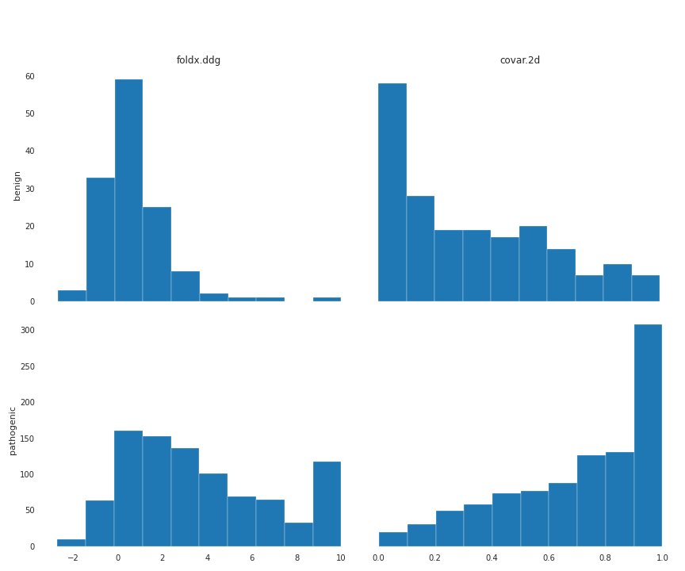
Histogram

Slide 5
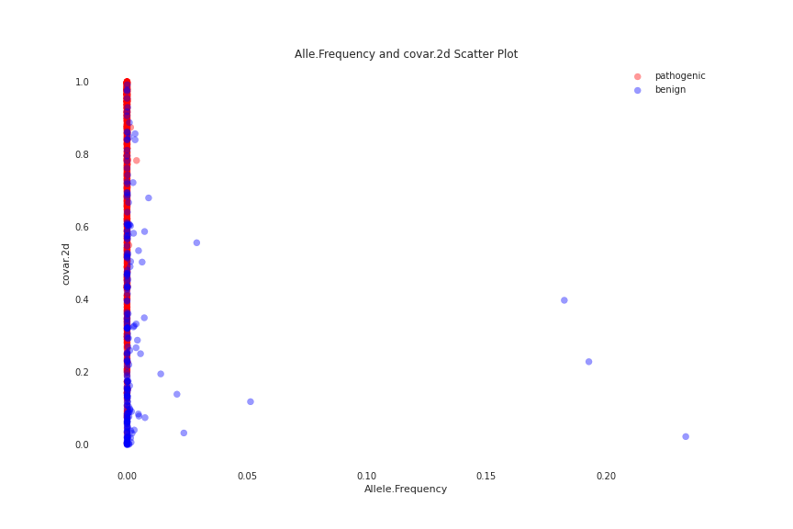

Slide 6
Feature Extraction
6 columns were used
One Hot Encoding for categorial variables
For amino acids NLF encoding was used
Novel encoding for foldx.ddg and covar.2d
Scaling before modeling

Slide 7
Modeling
Two algorithms: Support Vector Machine and Logistic Regression
Base Accuracy:
SVC: Training (0.8788), Validation (0.8468)
LR: Training (0.8896), Validation (0.8612)
Custom Accuracy:
SVC: Training (0.9442), Validation (0.9208)
LR: Training(0.9424), Validation (0.9208)

Slide 8
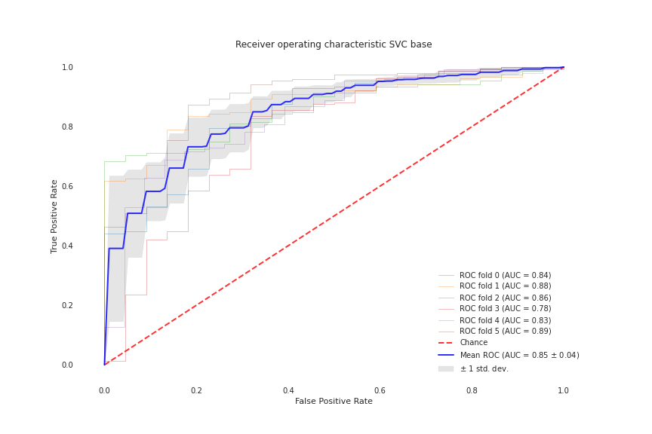
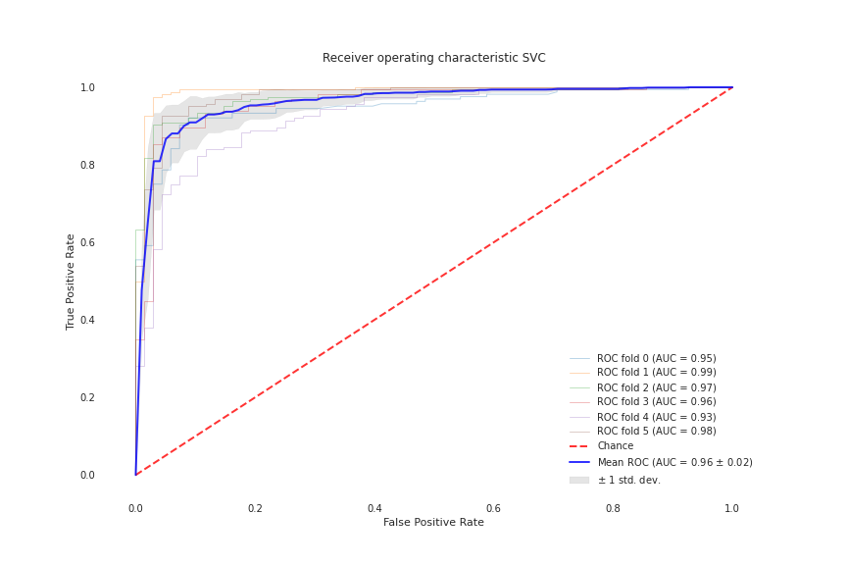

Slide 9
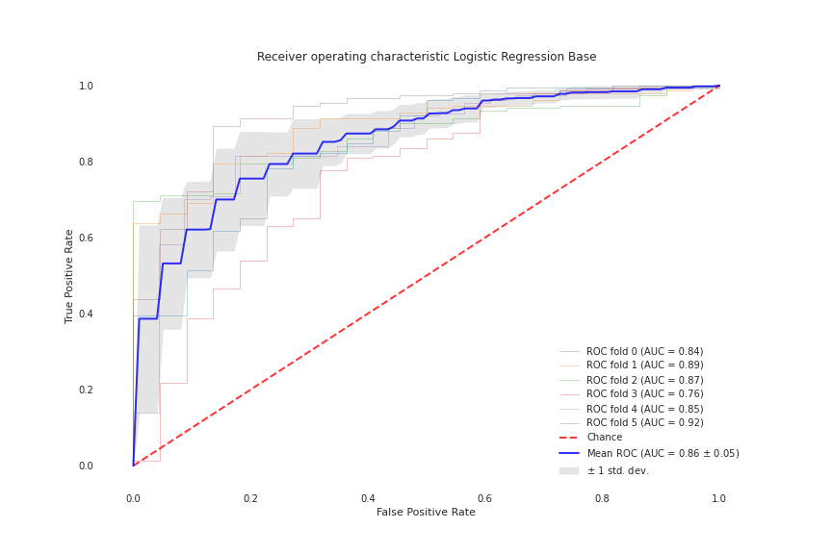
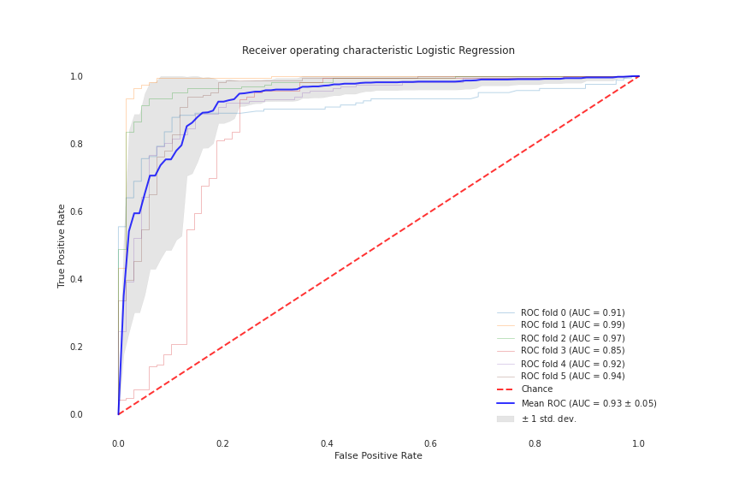

Slide 10
Conclusions
More data about benign variants would be beneficial
Requirement of a robust metric for assessment

