Slide 1
Performance models of TCP
can simulate (ns-2)
  + faithful to operation of TCP
  - expensive, time consuming
deterministic approximations
  + quick
  - ignore some TCP details, steady state
fluid models
  + transient behavior
  - ignore some TCP details

Slide 2

TCP behavior
TCP runs at end-hosts
congestion control:
  decrease sending rate when loss detected, increase when no loss
routers
  discard, mark packets when congestion occurs
interaction between end systems (TCP) and routers?
  want to understand (quantify) this interaction
congested router drops packets

Slide 3
Generic TCP behavior
window algorithm (window W )
  up to W packets in network
  return of ACK allows sender to send another packet
  cumulative ACKS
increase window by one per RTT W <− W +1/W per ACK
⇒ W <− W +1 per RTT
seeks available network bandwidth

Slide 4
receiver
W
sender

Slide 5
Generic TCP behavior
window algorithm (window W)
increase window by one per RTT W <− W +1/W per ACK
loss indication of congestion
decrease window by half on detection of loss, (triple duplicate ACKs), W <− W/2

Slide 6
receiver
TD
sender

Slide 7
Generic TCP Behavior
window algorithm (window W)
increase window by one per RTT W <− W +1/W per ACK
halve window on detection of loss, W <− W/2
timeouts due to lack of ACKs −> window reduced to one, W <− 1

Slide 8
receiver
sender
TO

Slide 9
Generic TCP Behavior
window algorithm (window W)
increase window by one per RTT (or one over window per ACK, W <− W +1/W)
halve window on detection of loss, W <− W/2
timeouts due to lack of ACKs, W <− 1
successive timeout intervals grow exponentially long up to six times

Slide 10
TCP throughput/loss relationship
loss occurs
Idealized model:
W is maximum supportable window size (then loss occurs)
TCP window starts at W/2 grows to W, then halves, then grows to W, then halves…
one window worth of packets each RTT
to find: throughput as function of loss, RTT
W
TCP
window
size
W/2
time (rtt)

Slide 11
TCP throughput/loss relationship
# packets sent per “period” =
W
TCP
window
size
W/2
period
time (rtt)

Slide 12
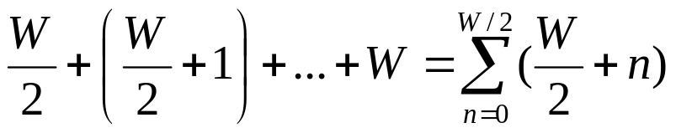
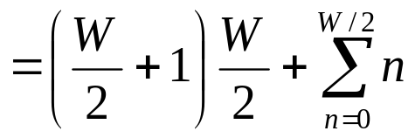
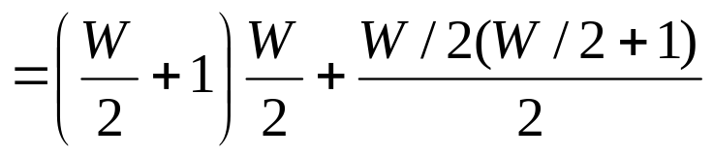
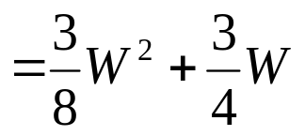
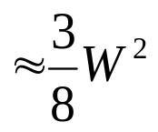
TCP throughput/loss relationship
# packets sent per “period” =
W
TCP
window
size
W/2
period
time (rtt)

Slide 13
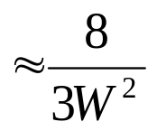
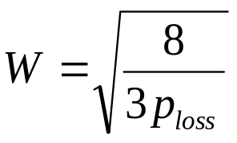
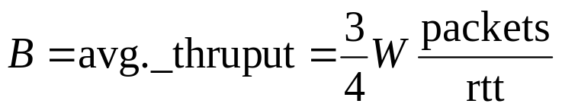
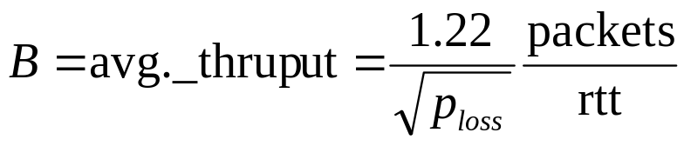
TCP throughput/loss relationship
# packets sent per “period”
W
1 packet lost per “period” implies:
TCP
window
size
p_{loss}
or:
W/2
period
time (rtt)
B throughput formula can be extended
to model timeouts and slow start (PFTK)

Slide 14
Recall RED queue management
dropping/marking packets depends on average queue length -> p = p(x)
More generally: active queue management (AQM)
1
Marking probability p
p_{max}
₀
t_{min}
t_{max}
2t_{max}
Average queue length x

Slide 15
Bottleneck behavior
bottleneck router:
capacity fully utilized
all interfering sessions see same loss prob.
do all sessions see same thruput?
Σ_{i} B_{i} (RTT_{i} ,p) = C
C - router bandwidth
B_{i} - throughput of flow i

Slide 16
Single bottleneck: infinite flows
N infinite TCP sessions
  two way propagation delay A_{i}, i = 1,…,N
  throughput B_{i}(p,RTT_{i})
one bottleneck router
  RED queue management
    avg. queue length x ; dropping probability p(x)
to discover
  B_{i}: TCP sessions’ throughput,
  router behavior, e.g., drop prob. avg. queue len.

Slide 17
Model and solution
model
solve a fixed point problem for x
unique solution provided B is monotonic and continuous on x
resulting x can be used to obtain RTT_{i} and p
p = p(x) (AQM)
RTT_{i} = A_{i} + x /C (round trip time)
Σ_{i} B (p , RTT _{i}) = C, for i =1 ,…,N
Σ_{i} B_{i} (x) = C, for i =1 ,…,N

Slide 18
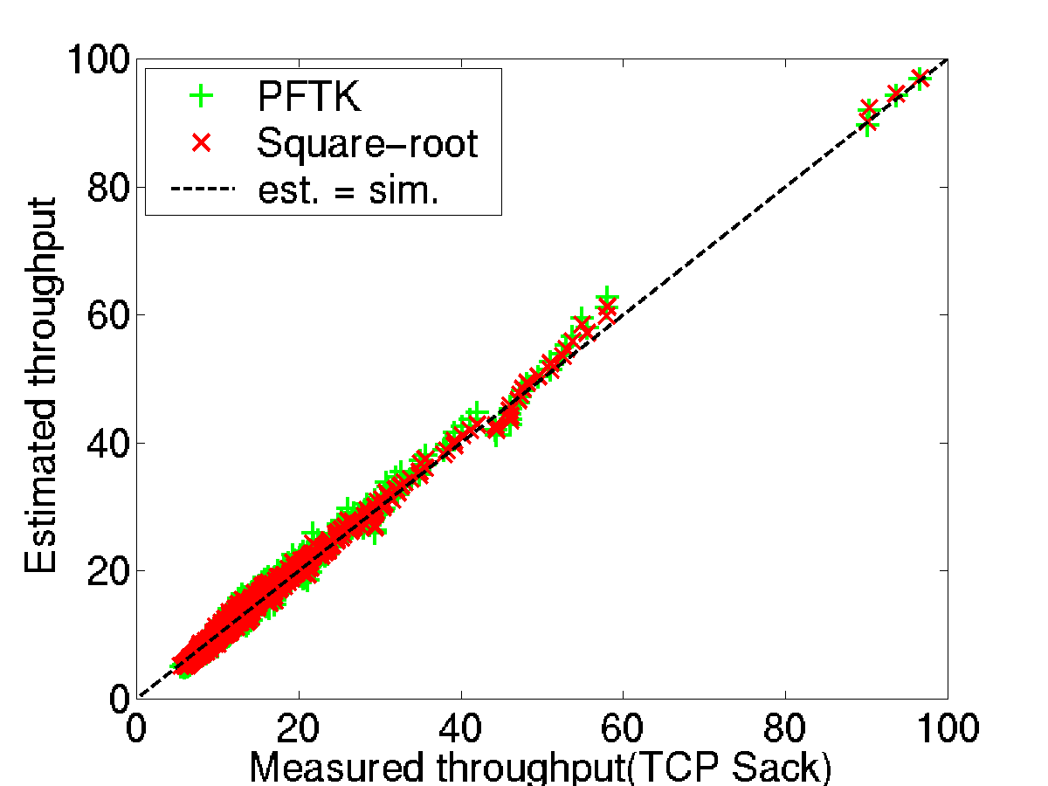
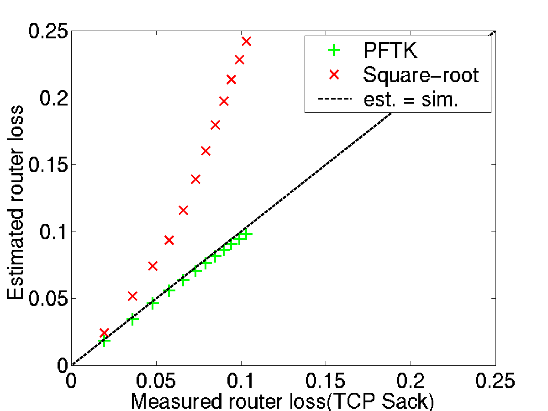
Model versus simulation: single bottleneck, infinite flows
fixed router capacity 4 Mbps and RED parameters
10-120 TCP flows
two-way prop. delay 20+2i ms, i = 1,…,N
throughput
router loss

Slide 19
Bottleneck principle: a qualitative result
B_{new}(p)
new/improved, B_{new}(p)
TCP, B_{TCP}(p)
thruput
B_{TCP}(p)
B_{new}(p) > B_{TCP}(p)
p

Slide 20
Sharing bottleneck with TCP
C
N_{new}
N_{TCP}
N_{new} B_{new}(p) + N_{TCP} B_{ni}(p) = C
⇒ B_{new}(p) > B_{TCP}(p)
a win!
friendly?
p

Slide 21
Replacing TCP with TCP-new
N B_{new}(p_{new}) = C
C
N
vs
N B_{TCP}(p_{TCP}) = C
⇒ p_{new} > p_{TCP}
a loss!
p_{TCP}
p_{new}

Slide 22
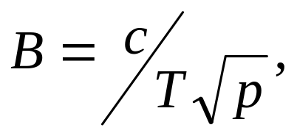

simple model for TCP c ≈ 1.2
bottleneck principle
multiple bottlenecks
fluid models

Slide 23
Multiple Bottleneck: infinite flows
N TCP flows
  throughputs B = <B_{i} (R_{i},p_{i})>
V congested AQM routers
  capacities C = <C_{v} >
  avg. queue lengths x = <x_{v} >
  discard prob. p = <p_{v} (x_{v} )>
bottleneck router model
Σ_{i} B_{i} (x ) = C_{v} , v =1,…,V
V equations, V unknowns

Slide 24
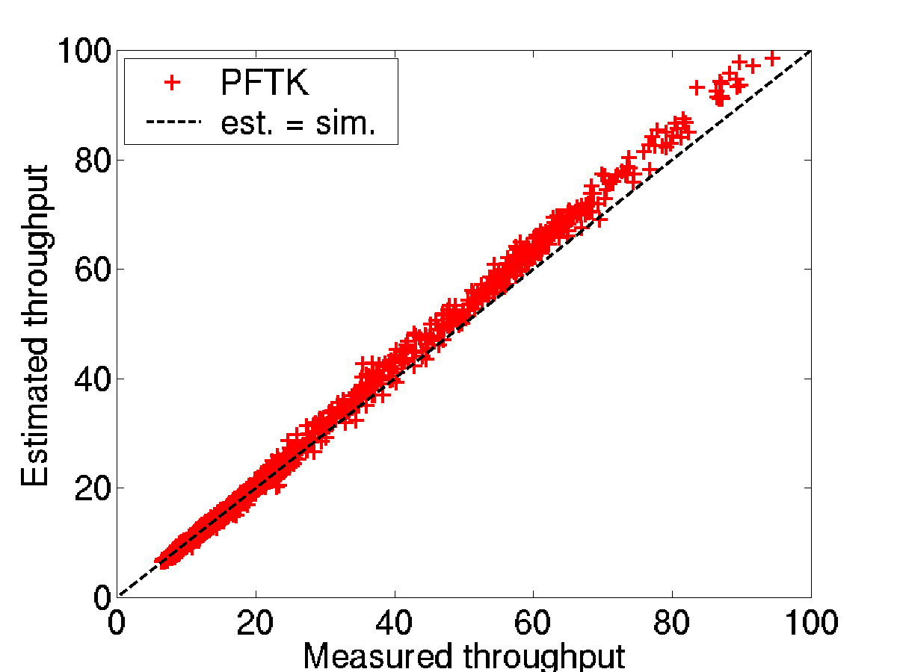
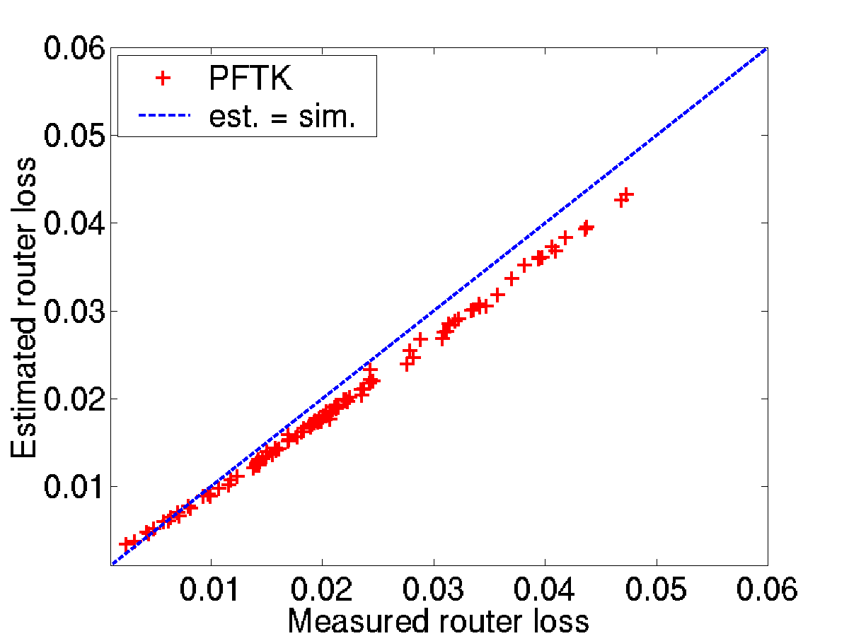
Results: multiple bottleneck, infinite flows
tandem network core, 5 -10 routers
2-way propagation delay 20-120 ms
bandwidth, 2-6 Mbps
PFTK model error
  throughput < 10%
  loss rate < 10%
  avg. queue length < 15%
similar results for cyclic networks
throughput
router loss

Slide 25
Comments
what about UDP / non-TCP flows?
  If there are “non-responsive” flows, just decrease bottleneck capacity by non-responsive flow rate
what about short lived flows?
  Hard (some work in sigcomm 2001 – massoulie)
note: throughout, assumption that time to send packets in window is less that RTT

Slide 26
Dynamic (transient) analysis of TCP fluids
model TCP traffic as fluid
describe behavior of flows and queues using Ordinary Differential Equations
solve resulting ODEs numerically

Slide 27
Loss Model
B(t)
AQM Router
Packet Drop/Mark
p(t)
Sender
Receiver
Round Trip Delay (τ)
Loss Rate as seen by Sender: λ(t) = B(t-τ)∗p(t-τ)

Slide 28

A Single Congested Router
focus on single bottlenecked router
  capacity {C (packets/sec) }
  queue length q(t)
  discard prob. p(t)
N TCP flows thru router
  window sizes W_{i}(t)
  round trip time
  R_{i}(t) = A_{i}+q(t)/C
  throughputs
  B_{i} (t) = W_{i}(t)/R_{i}(t)
TCP flow i
AQM
router
C, p

Slide 29
Adding RED to the model
RED: Marking/dropping based on average queue length x(t)
1
Marking probability p
p_{max}
t_{min}
t_{max}
2t_{max}
Average queue length x
- q(t)
- x(t)
x(t): smoothed, time averaged q(t)
t ->

Slide 30
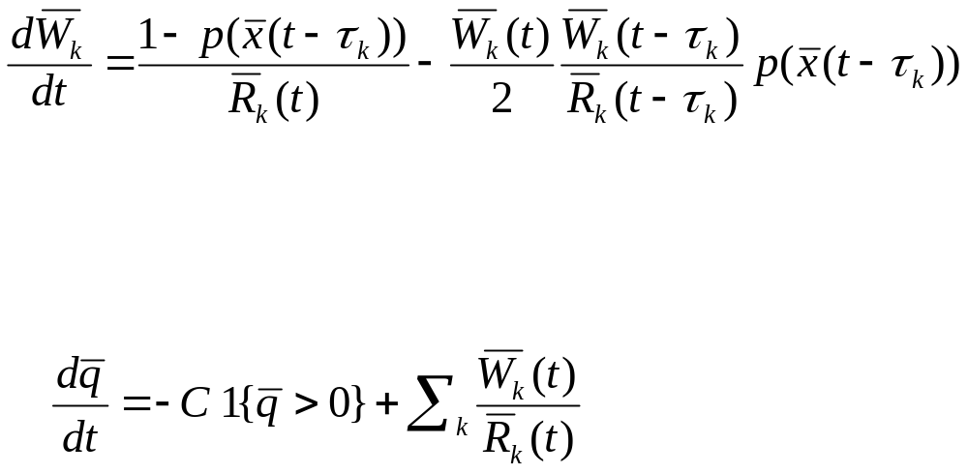
System of Differential Equations
Timeouts and slow start ignored
Window Size:
Additive
increase
Mult.
decrease
Loss arrival
rate
Queue length:
Outgoing
traffic
Incoming
traffic

Slide 31
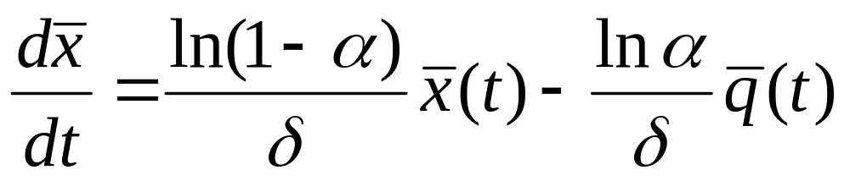
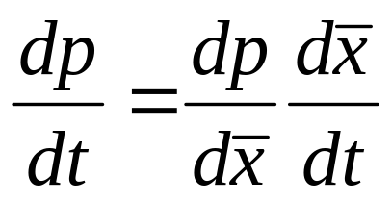
System of Differential Equations (cont.)
Average smoothed
queue length:
Where
α = averaging parameter of RED(w_{th})
δ = sampling interval ~ 1/C
Loss probability:
Where dp is obtained from the marking profile
dx

Slide 32
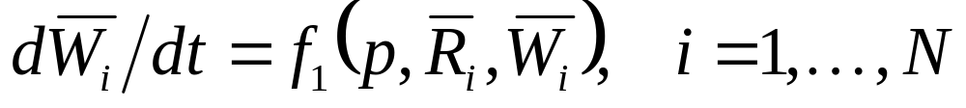
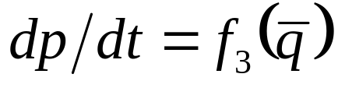
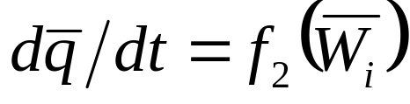
N+2 coupled equations
N flows
W_{i}(t) = Window size
of flow i
R_{i}(t) = RTT of flow i
p(t) = Drop probability
q(t) = queue length
Equations solved numerically using MATLAB

Slide 33
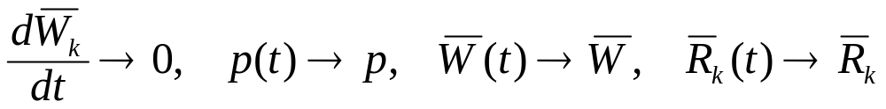
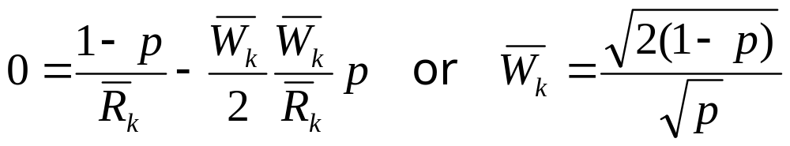
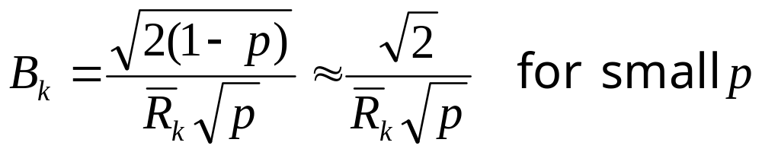
Steady slate behavior
let t → ∞
this yields
the throughput is

Slide 34
A Queue is not a Network
Network - set of AQM routers, V
sequence V_{i} for session i
Round trip time - aggregate delay
R_{i}(t) = A_{i} + Σ_{v∈Vi} q_{v}(t)
Loss/marking probability - cumulative prob
p_{i} (t) = 1-Π_{v ∈Vi} (1 - p_{v}(q_{v}(t)))
Link bandwidth constraints
Queue equations

Slide 35
How well does it work?
OC-12 – OC-48 links
RED with target delay 5msec
2600 TCP flows
OC-12
OC-48
decrease to 1300 at 30 sec.
increase to 2600 at 90 sec.
2600 × j
2600 × j
1300 × j
t=30
t=90

Slide 36
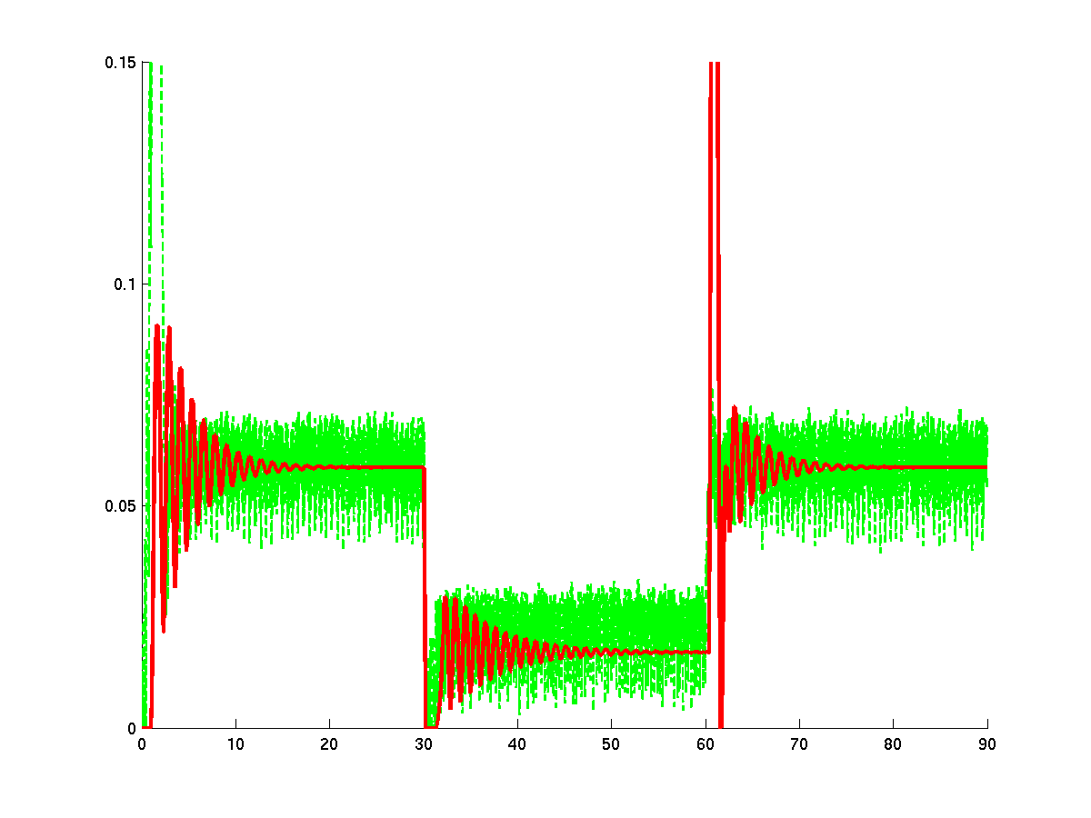
simulation
fluid model
instantaneous delay
time (sec)
Good queue length match

Slide 37
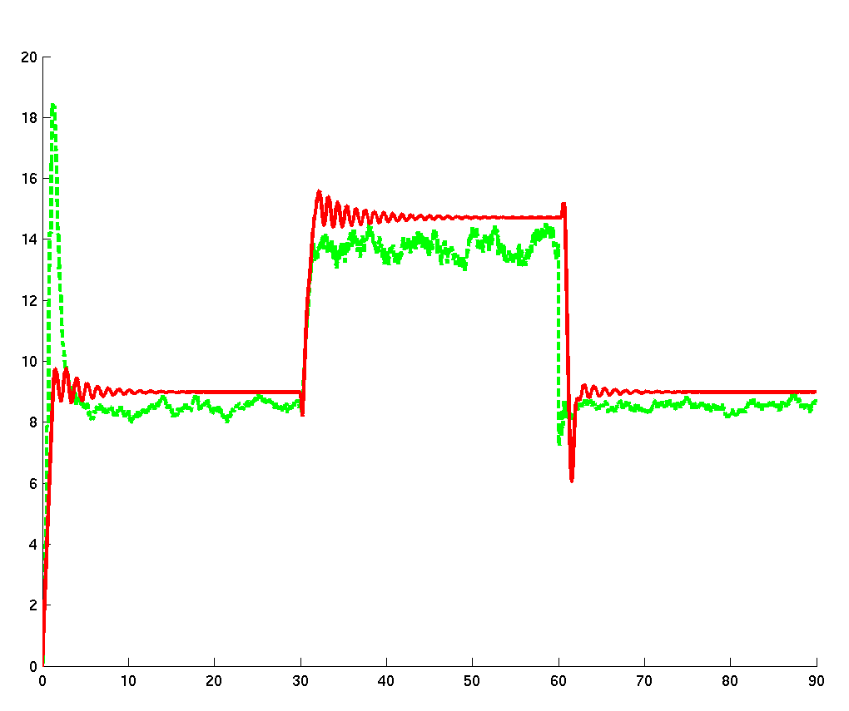
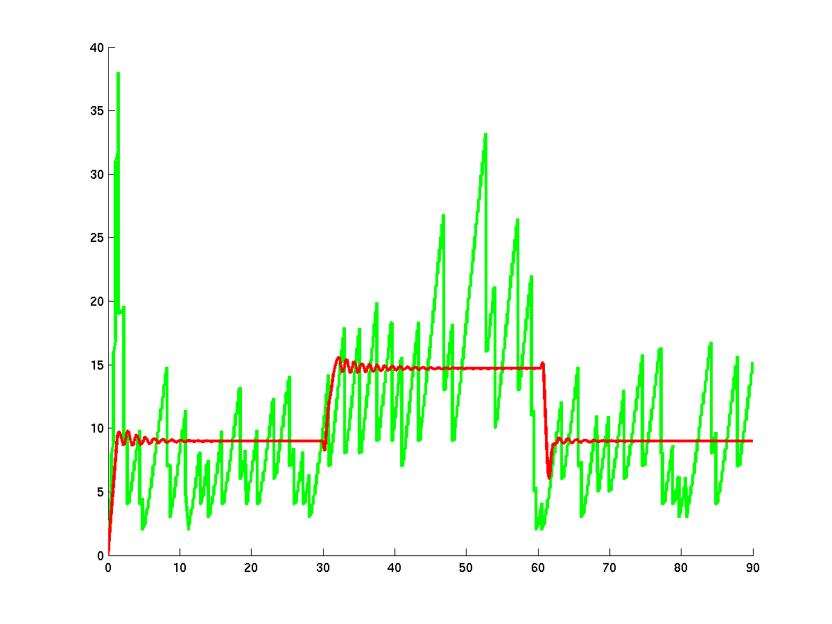
simulation
fluid model
average window size
window size
simulation
fluid model
time (sec)
time (sec)
matches average window size

Slide 38
Scaling Properties
OC-12
OC-12 × j
OC-48
OC-48 × j
2600
2600 × j
1300 × j
2600 × j
1300
2600
t=30
t=90
t=30
t=90
W_{k}(t) = W^{j} _{k}(t)
q_{v}(t) = q^{j}_{v}(t)/100

Slide 39
Summary: TCP flows as fluids
What have we seen?
model TCP as constant rate fluid flows
rate sensitive to congestion via:
  capacities C = <C_{v} >
  avg. queue lengths x = <x_{v} >
  discard prob. p = <p_{v} (x_{v} )>
dynamic (transient) behavior of TCP modeled as system of differential equations
ability to predict performance of
system of TCP flows using fluid models

