Slide 1


Slide 2
Pre-requisite
Window OS
Basic understanding of any programming language, Java Preferred.
Basic knowledge of Selenium Webdriver.
Learning attitude
Continued..

Slide 3
Continued..
Goal of the course
Cucumber BDD framework implementation
Setup – Java, Maven, Cucumber, Eclipse, Extend Report, Git, Jenkins
Java - Scripting language
Eclipse - IDE
Maven - Build Tool
Cucumber and BDD
Gherkin – BDD language
Test Scripts - Java, Gherkin, Cucumber and Selenium
Execution – Cucumber Options
GIT – Version control system
Extent Report – Advanced Reporting
Jenkins - Continuous Integration tool

Slide 4
TDD Vs BDD
TDD
Tests written by developer → Run tests by dev, test failed
Develop Application code → Run Tests, test should pass
Refactor tests if required
Mostly written to test each unit level code/method (Unit Tests)
Covers low level design scenarios
Test cases are written in programing language e.g. Java, Ruby
Focuses on to test implementation of code (methods and classes)
BDD
Design high level scenario to test expectations from application
Designed normally for acceptance testing
Stakeholders/Non-Technical resources defines behavior of application in simple English language
Focuses on to test/application behaviors
BDD enables all stakeholders on the same page
Continued..

Slide 5
Cucumber Basics
Overview
Cucumber implements BDD
Cucumber Written in Ruby language
Supports Ruby, Java, Java Scripts, Python, Perl
Can be used with Selenium, Watir and Capybara
All business stakeholders and processes can communicate with each other in common language
Focuses on user experience
To Automate Acceptance tests
Way to write tests that anybody can understand
Use Non Technical resources/stakeholders to contribute in automation
How to use Cucumber
Feature File
Step Definition file
Cucumber Options
Continued..

Slide 6
Environment Setup
Local Machine – Part I
Continuous Integration Machine – Part II
Continued..

Slide 7
Environment Setup (Local Machine) – Part I
Java
Scripting language
Eclipse
Integrated development Environment
Maven
Build tool
Selenium Webdriver
UI Automation tool
Cucumber-Junit
Junit testing framework integrated with Cucumber
Cucumber-java
Cucumber lib
Cucumber Eclipse Plugin
Gherkin syntax highlighter
Extent Report
Advanced Reporting
Continued..

Slide 8
Environment Setup Links
Java
http://www.oracle.com/technetwork/java/javase/downloads/jdk8-downloads-2133151.html
Eclipse
http://www.eclipse.org/downloads/packages/
Maven
Available with Eclipse
Selenium Webdriver
Maven Dependency : Selenium-java
Selenium Browser drivers
http://www.seleniumhq.org/download/
Cucumber-Junit
Maven Dependency : cucumber-junit
Cucumber-java
Maven Dependency : cucumber-java
Cucumber Eclipse Plugin
Eclipse → Help → Search of “Cucumber Eclipse Plugin” and install
Extent Report
Maven Dependency : cucumber-extentsreport, extentreports
Continued..

Slide 9
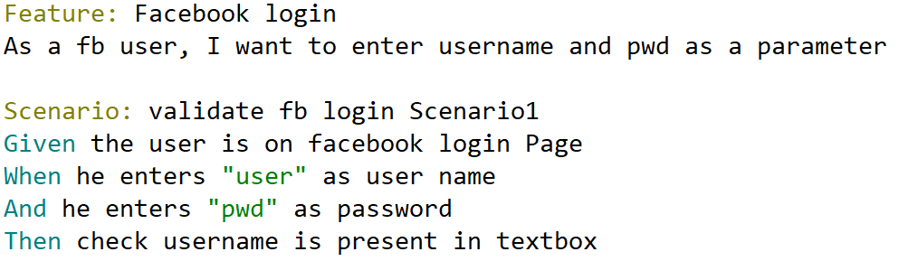
Gherkin Introduction
Business readable plain-text English language
Designed to be easy to learn by non-programmers
Cucumber understands the Gherkin language
Describes behavior of application without detailing implementation
Used for : Documentation and Automated tests
Gherkin is a line-oriented language uses indentation to define structure
Feature file with .feature extension
Continued..

Slide 10
Cucumber/Gherkin BDD Implementation
Keywords
Given
When
Then
And
But
Feature
Background
Scenario
Scenario Outline
Example
Functionality
Multiple scenario in feature
Parameterization tests
Maps in Data Table
Cucumbers Tags
Cucumber hooks
Tagged hooks
Multiple Feature and Step Def File
Data Sharing with picocontainer
Continued..

Slide 11
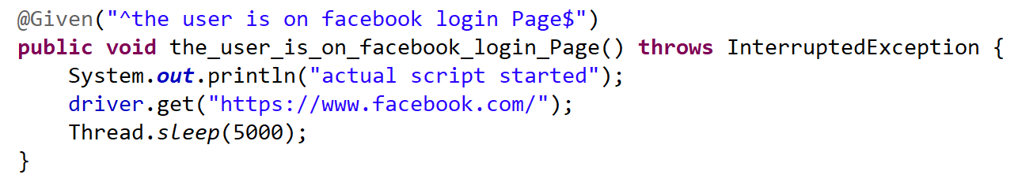
Step Def File
Feature files steps mapped with Step definition file code
Step Defs are implementation of Feature files
It’s Java code methods with annotation attached
Step Defs can be distributed in multiple java files
Selenium commands and Java Code
Continued..

Slide 12
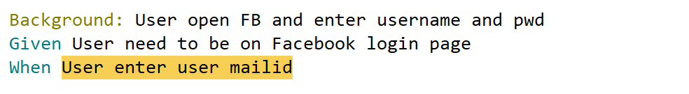
Background Keyword
Background Keyword
Run Before each and every scenario present in feature file
Common Step or Series of Steps
Continued..

Slide 13
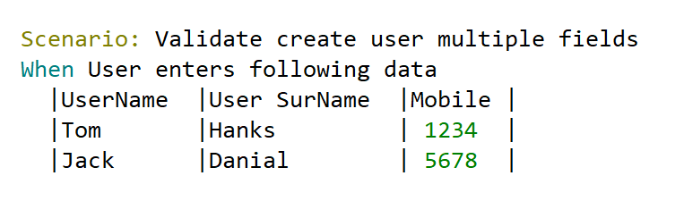
DataTable in Cucumber
DataTable
How you are managing data in Feature File
More readable and Easy to understand
Pipe Operator and indentation
Data Specific for single step
Continued..

Slide 14
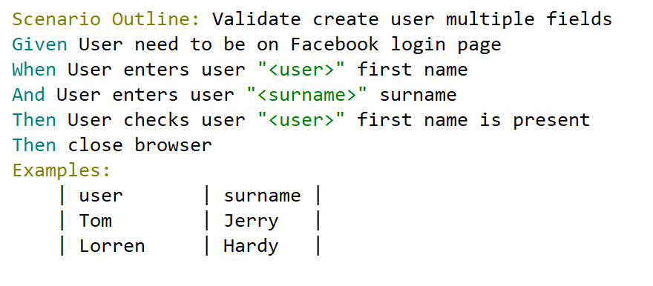
Scenario Outline and Examples Keyword : Data Driven Testing
Scenario Outline & Examples
Data Driven testing achieved with these keywords
Same Scenario can run multiple time with different data
Each row of Examples table will be a new test scenario
No need to change anything in Step Def file
Continued..

Slide 15
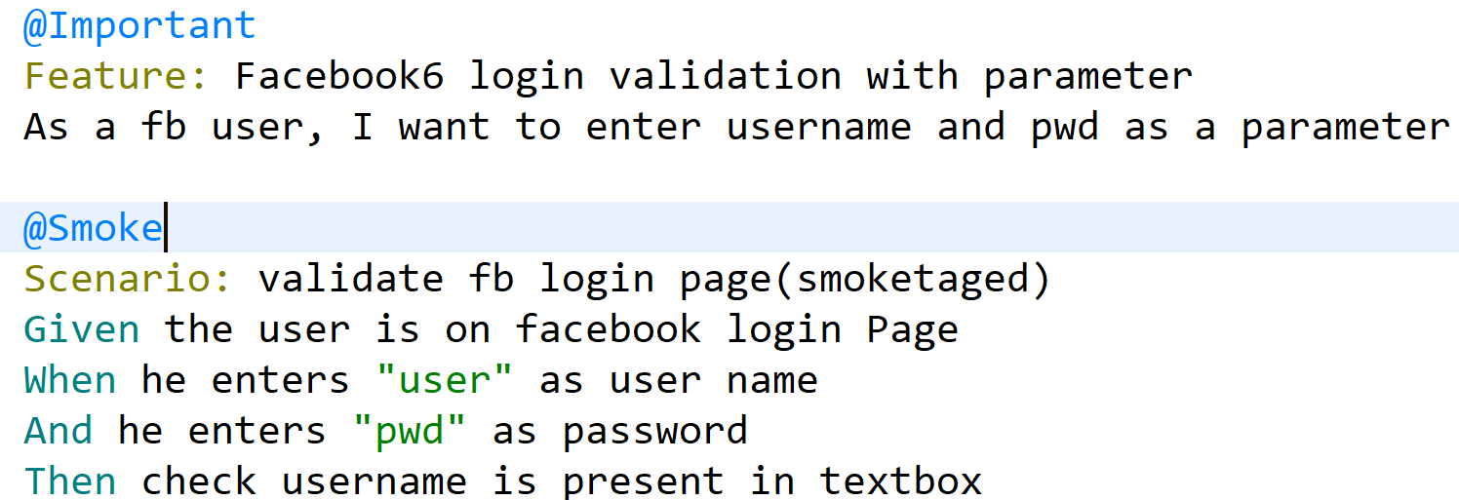
Tags of Cucumber
Tags
Manage and organize execution
Provides flexibility in the execution
Tags needs to be provided in runner class
Continued..

Slide 16
Cucumber Hooks
@Before
Before Every Scenario
E.g. Launching of the browser code, common config setting
@After
After Every Scenario
E.g. Tear down code
Continued..

Slide 17
Cucumber Hooks execution order
@Before
Incrementing order
@After
Decrementing order
Continued..

Slide 18
Environment Setup (Continuous Integration) – Part II
Jenkins
Continuous Integration tool
Plugins Installation on Jenkins
Cucumber Report, HTML Publisher, Github branch source, Maven Integration, Junit
GIT Installation
GIT installation on Jenkins Machine
Maven
Build tool for Jenkins
Continued..

Slide 19
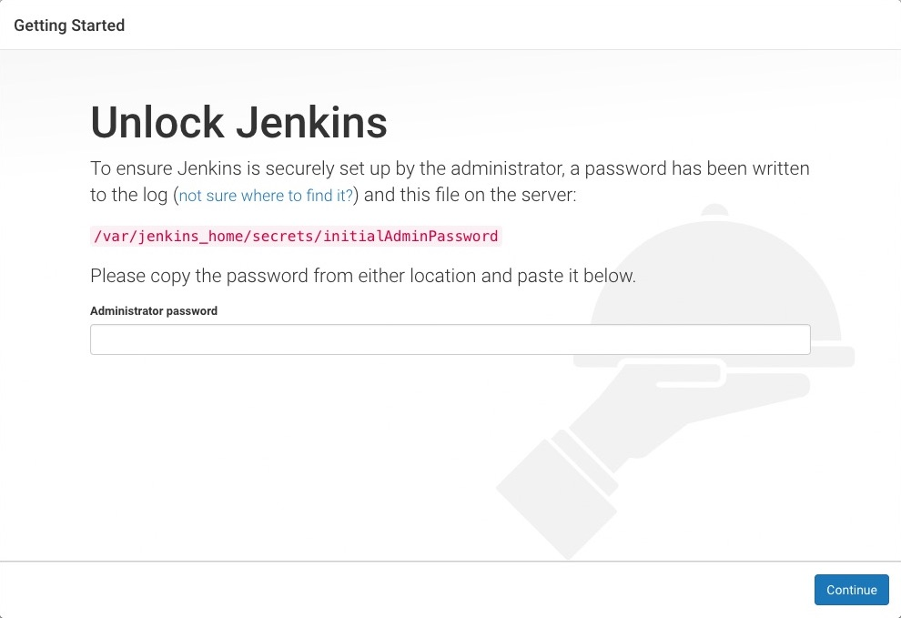
Continuous Integration : Jenkins Installation
Download Jenkins.war
https://jenkins.io/doc/book/installing/
Java –jar Jenkins.war
Default installation http ://localhost:8080
Continued..

Slide 20
GIT Installation
Version Control system
Check in code to GIT
Download GIT setup
https://git-scm.com/download/win
Install .exe
Continued..

Slide 21
Maven Installation
Download Maven
https://maven.apache.org/download.cgi
Set Environment variable
Continued..

Slide 22
Git Hub Account
Git
Free Version Control System
Available over the internet
Account Creation
https://github.com/
Continued..

Slide 23
GIT Integration With Eclipse Cucumber Project
Pre-requisite-
Cucumber Code ready for Execution
Created Git Account and Repository
Upload Code to GIT
Right click Eclipse Project → Team→ Share Project → Create New Directory
Right click Eclipse Project → Team →Commit, and commit the changes
Right click Eclipse Project → Team →Show in Repository View
Right click on Remote and Create Remote, Provide the GIT repository URL and username/pwd
Push the changes
Update any File → Right click on file → Team → Commit
Right click Eclipse Project → Team →Show in Repository View
Expand the branches → Local → Push branch
Continued..

Slide 24
Creating Jenkins Job
Create Maven Project
Provide GIT repository details
Provide Build Information
Provide Post Build Action for Cucumber Report
Continued..

Slide 25
Jenkins Job Execution
Build the Job
Check the Console Logs
Check the Cucumber Reports
Continued..

Slide 26
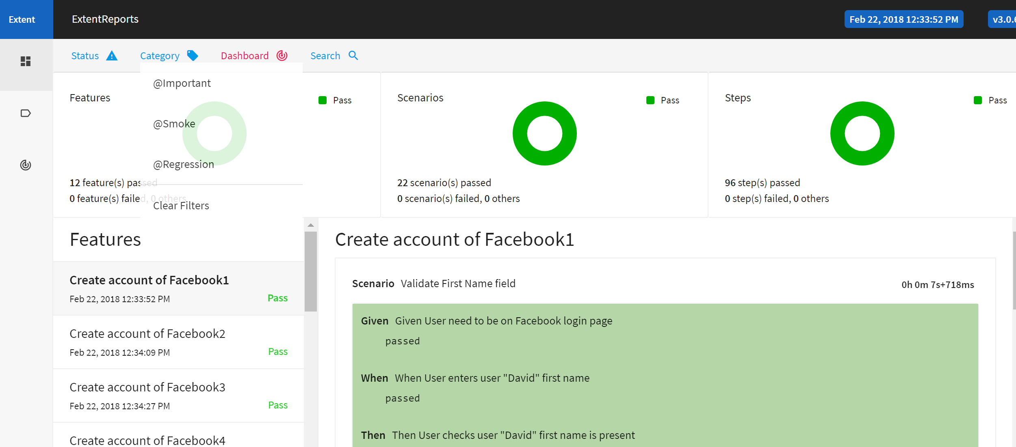
Jenkins With Extent Report
Configure Jenkins Post Build for Extent Report
Continued..

Slide 27
Thank You

