Slide 1
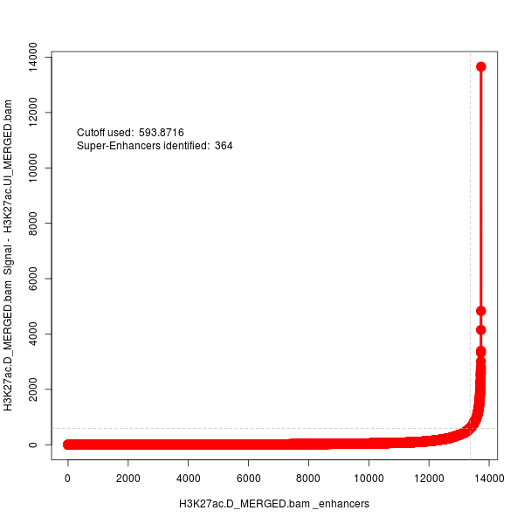
ChIP-Seq H3K27ac super-enhancer analysis
Total enhancers: 13739
Total super-enhancers: 364
OVERLAP_GENES | PROXIMAL_GENES | CLOSEST_GENE | enhancerRank | isSuper
Rn45s |  | Rn45s | 1 | 1
Sept9 |  | Sept9 | 2 | 1
Mreg |  | Mreg | 3 | 1
Tbc1d2 | Coro2a | Tbc1d2 | 4 | 1
 | Plekhg6,Cd9 | Plekhg6 | 5 | 1
Ndufa13,Pbx4,Cilp2 | Lpar2,Tssk6 | Cilp2 | 6 | 1
Hs6st1 |  | Hs6st1 | 7 | 1
Amn,Cdc42bpb |  | Amn | 8 | 1
 | Cux2,Myl2 | Cux2 | 9 | 1
Gng7 | Diras1,Timm13,Gadd45b,Lmnb2 | Gadd45b | 10 | 1
UI_vs_D
H3K27ac_D Enhancers

Slide 2
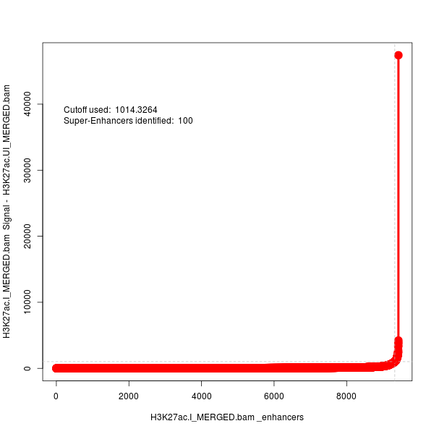
ChIP-Seq H3K27ac super-enhancer analysis
Total enhancers: 9433
Total super-enhancers: 100
OVERLAP_GENES | PROXIMAL_GENES | CLOSEST_GENE | enhancerRank | isSuper
Sfi1,Pisd-ps1 | Eif4enif1 | Sfi1 | 1 | 1
Pear1,Ntrk1 | Insrr,Lrrc71 | Pear1 | 2 | 1
 |  | Fam92b | 3 | 1
 |  | Zfpm1 | 4 | 1
 | Ube2v1,Snai1 | Snai1 | 5 | 1
Dnahc8 |  | Dnahc8 | 6 | 1
2610028E06Rik |  | 2610028E06Rik | 7 | 1
Tfeb | Pgc,Tfeb | Tfeb | 8 | 1
Doc2b | Ywhae | Doc2b | 9 | 1
 |  | Tpra1 | 10 | 1
UI_vs_I
 | Bowtie2 Peaks
UI | 44522
D | 44337
I | 21468
H3K27ac_I Enhancers

