Slide 4
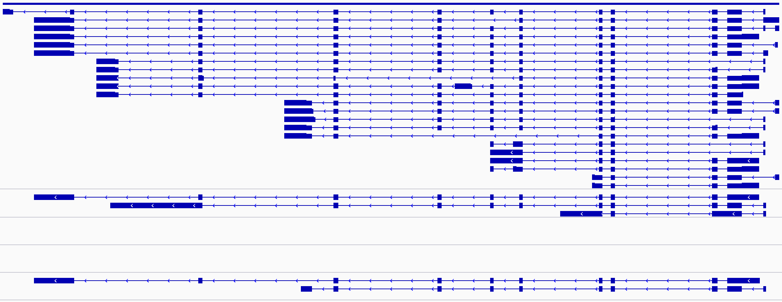
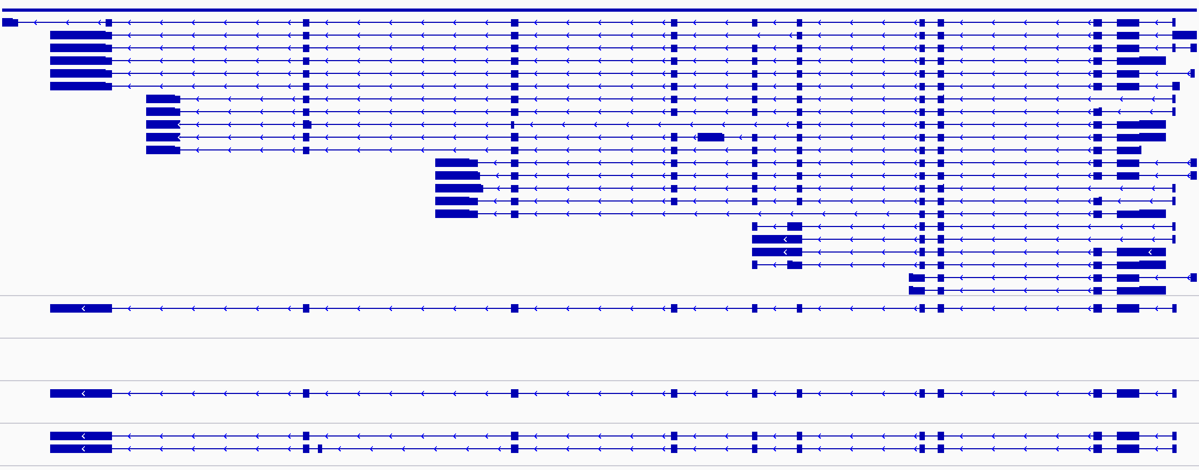
CTCFL gene: HQ and Singleton data
GENCODE v34 transcripts: CTCFL Gene
NNC
ParRep 10-230
Singleton
Hem-A
N/A
Skmel 239
FSM
FSM
NNC
hTESE
Singleton

Slide 5
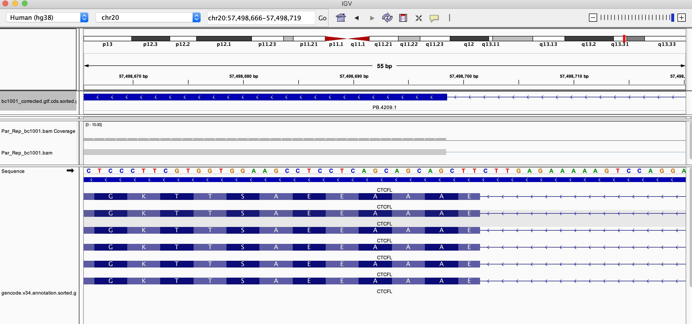
HQ Data: ParRep CTCFL 3-bp deletion

Slide 6
Iso-Seq HQ data:
Convert Ensembl ID’s to Gene symbols
Compare top 10 gene isoforms
CTCFL NNC isoforms sequence analysis

Slide 7
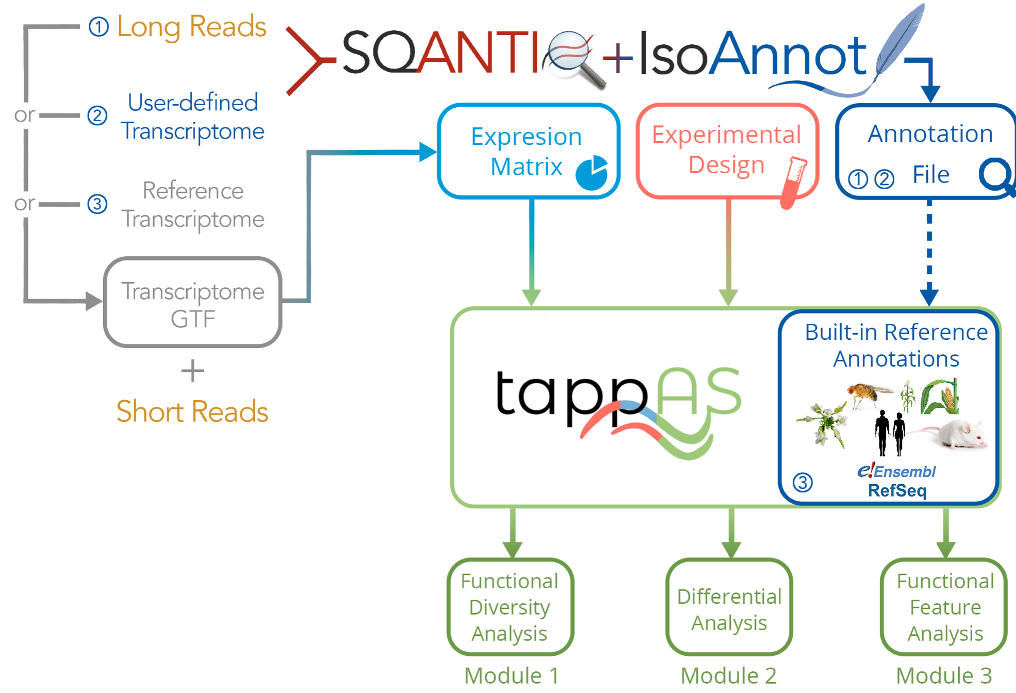
Iso-Seq Data Analysis Workflow
Clustered HQ FASTA
Alignment (minimap2)
SAM
Sort SAM (samtools)
Sorted SAM & BAM
Collapse Isoforms (cDNA_Cupcake)
Collapsed FASTA, GFF & GTF
SQANTI3
IsoAnnot
tappAS

