Slide 1
What is Docker? And Why?
Docker is a container technology: A tool for creating and managing containers
The same container always yields the exact same
application and execution behavior! No matter where or by whom it might be executed.
Container
A standardized unit of software
Support for Containers is built into modern operating systems!
A package of code and dependencies to run that code (e.g. NodeJS code + the NodeJS runtime)
Docker simplifies the creation and management of such containers

Slide 2
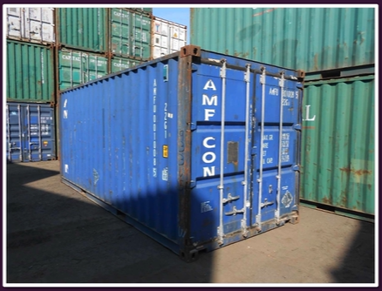
A Container?

Slide 3
Why Containers?
Why would we want independent, standardized “application packages”?
Different Development & Production Environments
Different Development Environments Within a Team / Company
Clashing Tools / Versions Between Different
Projects
We want to build and test in exactly (!) the same environment as we later run our app in
Every team member should have the exactly (!) same environment when working on the same project
When switching between projects, tools used in project A should not clash with tools used in project B

Slide 4
The Problems
Environment: The runtimes, languages, frameworks you need for development
Development Environment
Production Environment
often not the same
Development Environment for Employee A
Development Environment for Employee B
often not the same
Tools & Libraries required for Project A
Tools & Libraries required for Project B
often not the same

Slide 5



We Want Reliability & Reproducible Environments
We want to have the exact same environment for development and production ➔ This ensures that it works exactly as tested
It should be easy to share a common
development environment/ setup with (new)
employees and colleagues
We don’t want to uninstall and re-install local dependencies and runtimes all the time

Slide 6
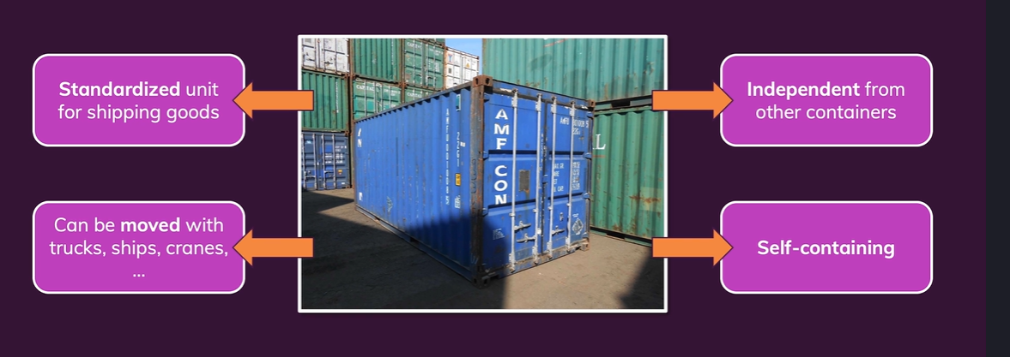
A Container?

Slide 7
Solution: Virtual Machines / Virtual Operating Systems
App A
App B
App C
Libraries, Dependencies, Tools
Libraries, Dependencies, Tools
Libraries, Dependencies, Tools
Virtual OS (e.g. Linux)
Virtual OS (e.g. Linux)
Virtual OS (e.g. Linux)
Your Operating System

Slide 8
Solution: Virtual Machines / Virtual Operating Systems
App A
App B
App C
Libraries, Dependencies, Tools
Libraries, Dependencies, Tools
Libraries, Dependencies, Tools
Virtual OS (e.g. Linux)
Virtual OS (e.g. Linux)
Virtual OS (e.g. Linux)
Wastes a lot of space on your hard drive and tends to be slow
Your Operating System

Slide 9
Virtual Machines / Virtual OS: Summary
Pro
Con
Separated environments
Environment-specific configurations are possible
Environment configurations can be shared and reproduced reliably
Redundant duplication, waste of space
Performance can be slow, boot times can be long
Reproducing on another computer/ server is possible but may still be tricky

Slide 10
Docker Helps You Build & Manage “Containers”
Container
Container
Container
App A
App B
App C
Libraries, Dependencies, Tools
Libraries, Dependencies, Tools
Libraries, Dependencies, Tools
Docker Engine
OS Built-in / Emulated Container Support
Your Operating System

Slide 11
Containers vs Virtual Machines
Docker Containers
Virtual Machines
Low impact on OS, very fast, minimal disk space usage
Sharing, re-building and distribution is easy
Encapsulate apps/ environments instead of “whole machines”
Bigger impact on OS, slower, higher disk space usage
Sharing, re-building and distribution can be challenging
Encapsulate “whole machines” instead of just apps/ environments

Slide 12
Docker Setup
macOS
Windows
Linux
Require- ments met
Require- ments not met
Require- ments not met
Require- ments met
Install Docker Engine on Linux
Install Docker Toolbox
Install Docker Desktop
https://docs.docker.com/desktop/setup/install/windows-install/

Slide 13




Docker Tools & Building Blocks
Docker Engine
Docker Desktop (incl.
Daemon & CLI)
Docker Hub
Docker Compose
Kubernetes

Slide 14
Course Outline
Getting Started & Overview
Foundation
”Real Life”
Kubernetes
Kubernetes Introduction & Basics
Images & Containers
Multi-Container Projects
Using Docker-Compose
Kubernetes: Data & Volumes
Data & Volumes
(in Containers)
“Utility Containers”
Kubernetes: Networking
Containers & Networking
Deploying Docker Containers
Deploying a Kubernetes Cluster

Slide 15
Thank You

