Slide 1
Java Annotations

Slide 2
Annotations
Annotations are metadata or data about data. An annotation indicates that the declared element should be processed in some special way by a compiler, development tool, deployment tool, or during runtime.
Annotation-based development is certainly one of the latest Java development trends
Annotations can be applied to several Java Elements like,
  package declarations,
  class,
  constructors,
  methods,
  fields,
  Variables and etc.

Slide 3
The Basics
Example to Define an Annotation (Annotation type)
  public @interface MyAnnotation {
    String doSomething();
    }
Example to Annotate Your Code (Annotation)
  MyAnnotation (doSomething="What to do")
  public void mymethod() {
  .......
  }

Slide 4


Structure of Java Compiler
Parser
Type
Checker
Class File
Writer
Source File
class C {
@NonNull
Object field;
C(@NonNull
Object p) {
field = p;
}
@NonNull
Object get() {
return field;
}
}
Class
File
Comments
Error

Slide 5
Structure of Java5 Compiler
Parser
Type
Checker
Annotation
Checker
Class File
Writer
Source File
class C {
@NonNull
Object field;
C(@NonNull
Object p) {
field = p;
}
@NonNull
Object get() {
return field;
}
}
Class
File
Program
with
annotations
Error
Error
Annotation
Checker
Plugins

Slide 6
Annotation Types
Marker
Single-Element
Full-value or multi-value

Slide 7
Marker
Marker annotations take no parameters. They are used to mark a Java element to be processed in a particular way.
Example:
public @interface MyAnnotation {
}
Usage:
  @MyAnnotation
  public void mymethod() {
  ....
  }

Slide 8
Single-Element
Single-element, or single-value type, annotations provide a single piece of data only. This can be represented with a data=value pair or, simply with the value (a shortcut syntax) only, within parenthesis.
Example:
    public @interface MyAnnotation {
    String doSomething();
    }
Usage:
    @MyAnnotation ("What to do")
    public void mymethod() {
    ....
    }

Slide 9
Full-value or multi-value
Full-value type annotations have multiple data members.
Example:
  public @interface MyAnnotation {
  String doSomething();
  int count;
  String date();
  }
Usage:
@MyAnnotation (doSomething=
"What to do",
count=1,
date="09-09-2005")
public void mymethod() {
....
}

Slide 10
The Built-In Annotations
Java defines seven built-in annotations.
Four are imported from java.lang.annotation
    @Retention,
    @Documented,
    @Target,
    and @Inherited.
Three are included in java.lang.
  @Override,
  @Deprecated,
  and @SuppressWarnings.

Slide 11
@Retention Meta-Annotation
Where is the annotation retained
➢Where can the annotation be accessed and used
➢Default is CLASS
public @interface Retention {
RetentionPolicy value();
}
public enum RetentionPolicy {
SOURCE, CLASS, RUNTIME };

Slide 12
@Retention Policies
SOURCE
➢Discarded by the compiler
▪ CLASS
➢Retained by compiler to class file, may be
discarded by VM
▪ RUNTIME
➢Retained in class file and by VM
➢Can be accessed with reflection

Slide 13
Simple Annotations (or) Standard Annotations
There are three types of simple annotations provided by JDK5. They are:
  Override
  Deprecated
  Suppresswarnings

Slide 14
Override
Override is a Marker Annotation type that can be applied to a method to indicate to the Compiler that the method overrides a method in a Superclass. This Annotation type guards the programmer against making a mistake when overriding a method. For eg The syntax ---@Override
Example Program:
class Parent {
public float calculate (float a, float b) {
return a * b;
}
}
Whenever you want to override a method, declare the Override annotation type before the method:
public class Child extends Parent {
@Override
public int calculate (int a, int b) {
return (a + 1) * b;
}
}

Slide 15
The Deprecated annotation
This annotation indicates that when a deprecated program element is used, the compiler should warn you about it. Example 2 shows you the deprecated annotation.
The syntax --- @Deprecated
Example :
public class DeprecatedTest {
@Deprecated
public void serve() {
}
}
If you use or override a deprecated method, you will get a warning at compile time.
public class DeprecatedTest2 {
public static void main(String[] args) {
DeprecatedTest test = new DeprecatedTest();
test.serve();
}
}

Slide 16
The Suppresswarnings annotation
SuppressWarnings is used to suppress compiler warnings. You can apply @SuppressWarnings to types, constructors, methods, fields, parameters, and local variables.
The syntax --- @SuppressWarnings
Eg:
  import java.util.Date;
  public class Main {
  @SuppressWarnings(value={"deprecation"})
  public static void main(String[] args) {
  Date date = new Date(2009, 9, 30);
  System.out.println("date = " + date);
  }
  }

Slide 17
Documentation
public class Generation3List extends {
  // Author: John Doe
  // Date: 3/17/2002
  // Current revision: 6
  // Last modified: 4/12/2004
  // By: Jane Doe
  // Reviewers: Alice, Bill, Cindy
  // class code goes here
}
Using Java Annotation
  @Documented
  @interface ClassPreamble {
    String author();
    String date();
    int currentRevision() default 1;
    String lastModified() default "N/A";
    String lastModifiedBy() default "N/A";
    String[] reviewers();
  }
  @ClassPreamble (
    author = "John Doe",
    date = "3/17/2002",
    currentRevision = 6,
    lastModified = "4/12/2004",
    lastModifiedBy = "Jane Doe",
    reviewers = {"Alice", "Bob", "Cindy"}
  )

Slide 18
The Target annotation
@Target(ElementType.TYPE)—can be applied to any element of a class
@Target(ElementType.FIELD)—can be applied to a field or property
@Target(ElementType.METHOD)—can be applied to a method level annotation
@Target(ElementType.PARAMETER)—can be applied to the parameters of a method
@Target(ElementType.CONSTRUCTOR)—can be applied to constructors
@Target(ElementType.LOCAL_VARIABLE)—can be applied to local variables
@Target(ElementType.ANNOTATION_TYPE)—indicates that the declared type itself is an

Slide 19
Java Annotation in Struts2
Two mechanisms for declaring your architecture
  XML
  Java annotations

Slide 20
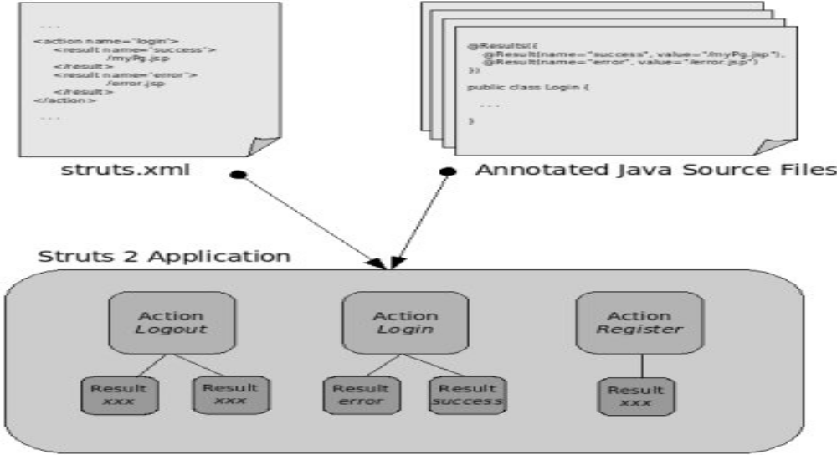
Design

Slide 21
Thank You

