Slide 1
STAT 515 –MID PROJECT BAD GRAPH OR TABLE REDESIGN PROJECT
BY
Anil Kumar Mureboina
Vishwa Sujit Reddy Challa
Group 12

Slide 2
INTRODUCTION
Misrepresenting data: Mislabelling, using the wrong chart, wrong correlations, etc.
Too much data: a lot of data, can miss the main point.
Distorting data: truncation of axes, rounding off too much.
Cherry picking: using part of the data to prove a point.

Slide 3
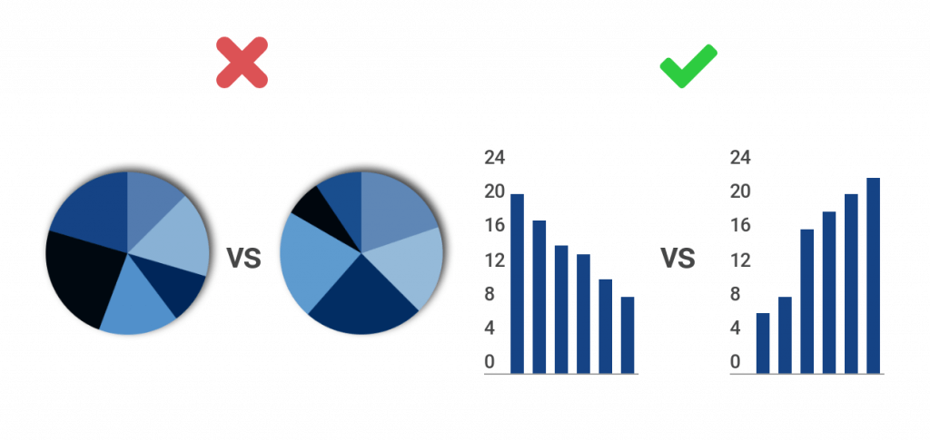
CREATING EFFECTIVE VISUALIZATIONS
The basic thumb rule of a graph is to maintain at most two variables.
Graph should be designed in such a way that it should not require extensive statistical knowledge to be understood
The right amount of information needs to be shown to keep the reader’s attention
The axis labels should be accurate and precise

Slide 4
REDESIGN – 1: GDP
1

Slide 5
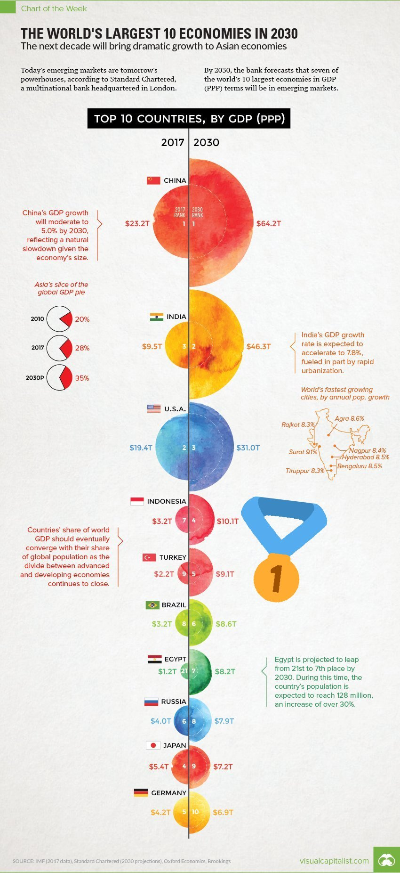
BAD GRAPH
Circles are used to exaggerate change.
The colors do not signify anything and add further to the confusion.
Data used is overly rounded off

Slide 6
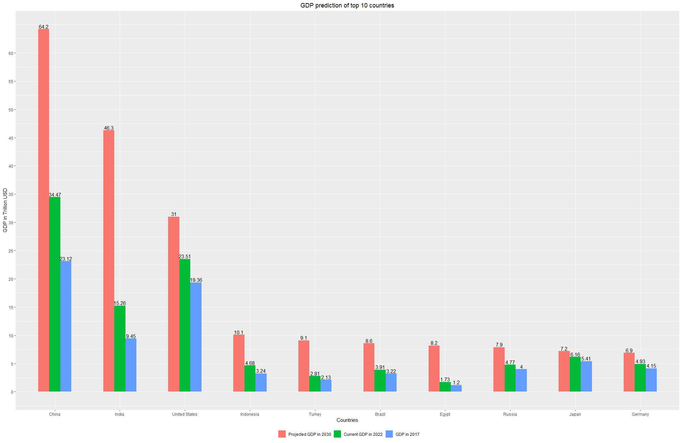
GOOD GRAPH
The change shown is linear.
The change in quantities is easy to see
Added the latest data to see tends and spans.

Slide 7
REDESIGN – 2: UPI
2

Slide 8
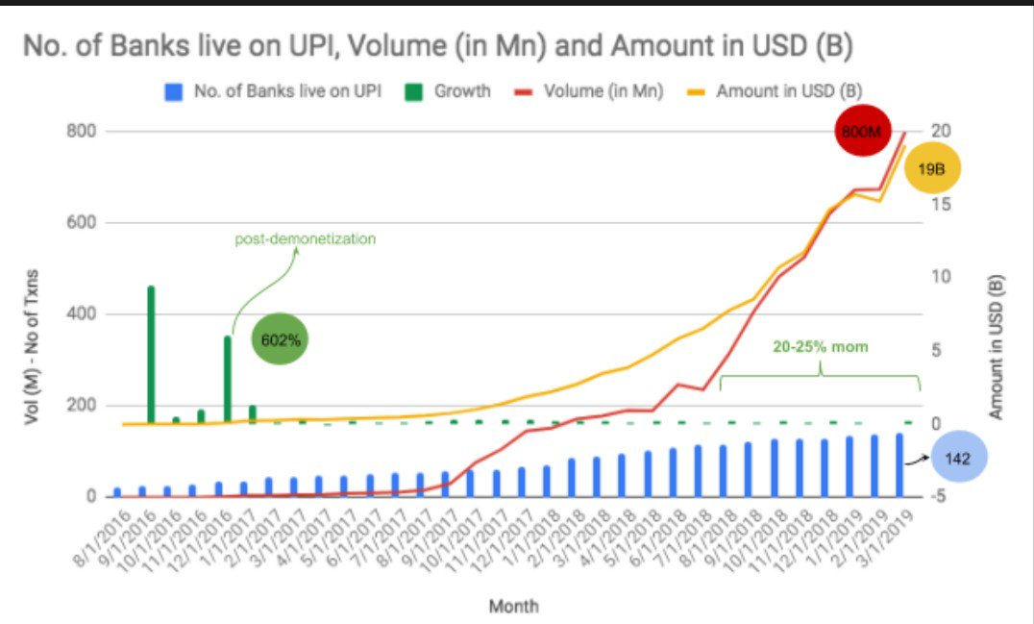
BAD GRAPH
Too much data in one graph
Scales starting at dfferent positions.
Scales have different intervals
Misleading scales and volumes

Slide 9
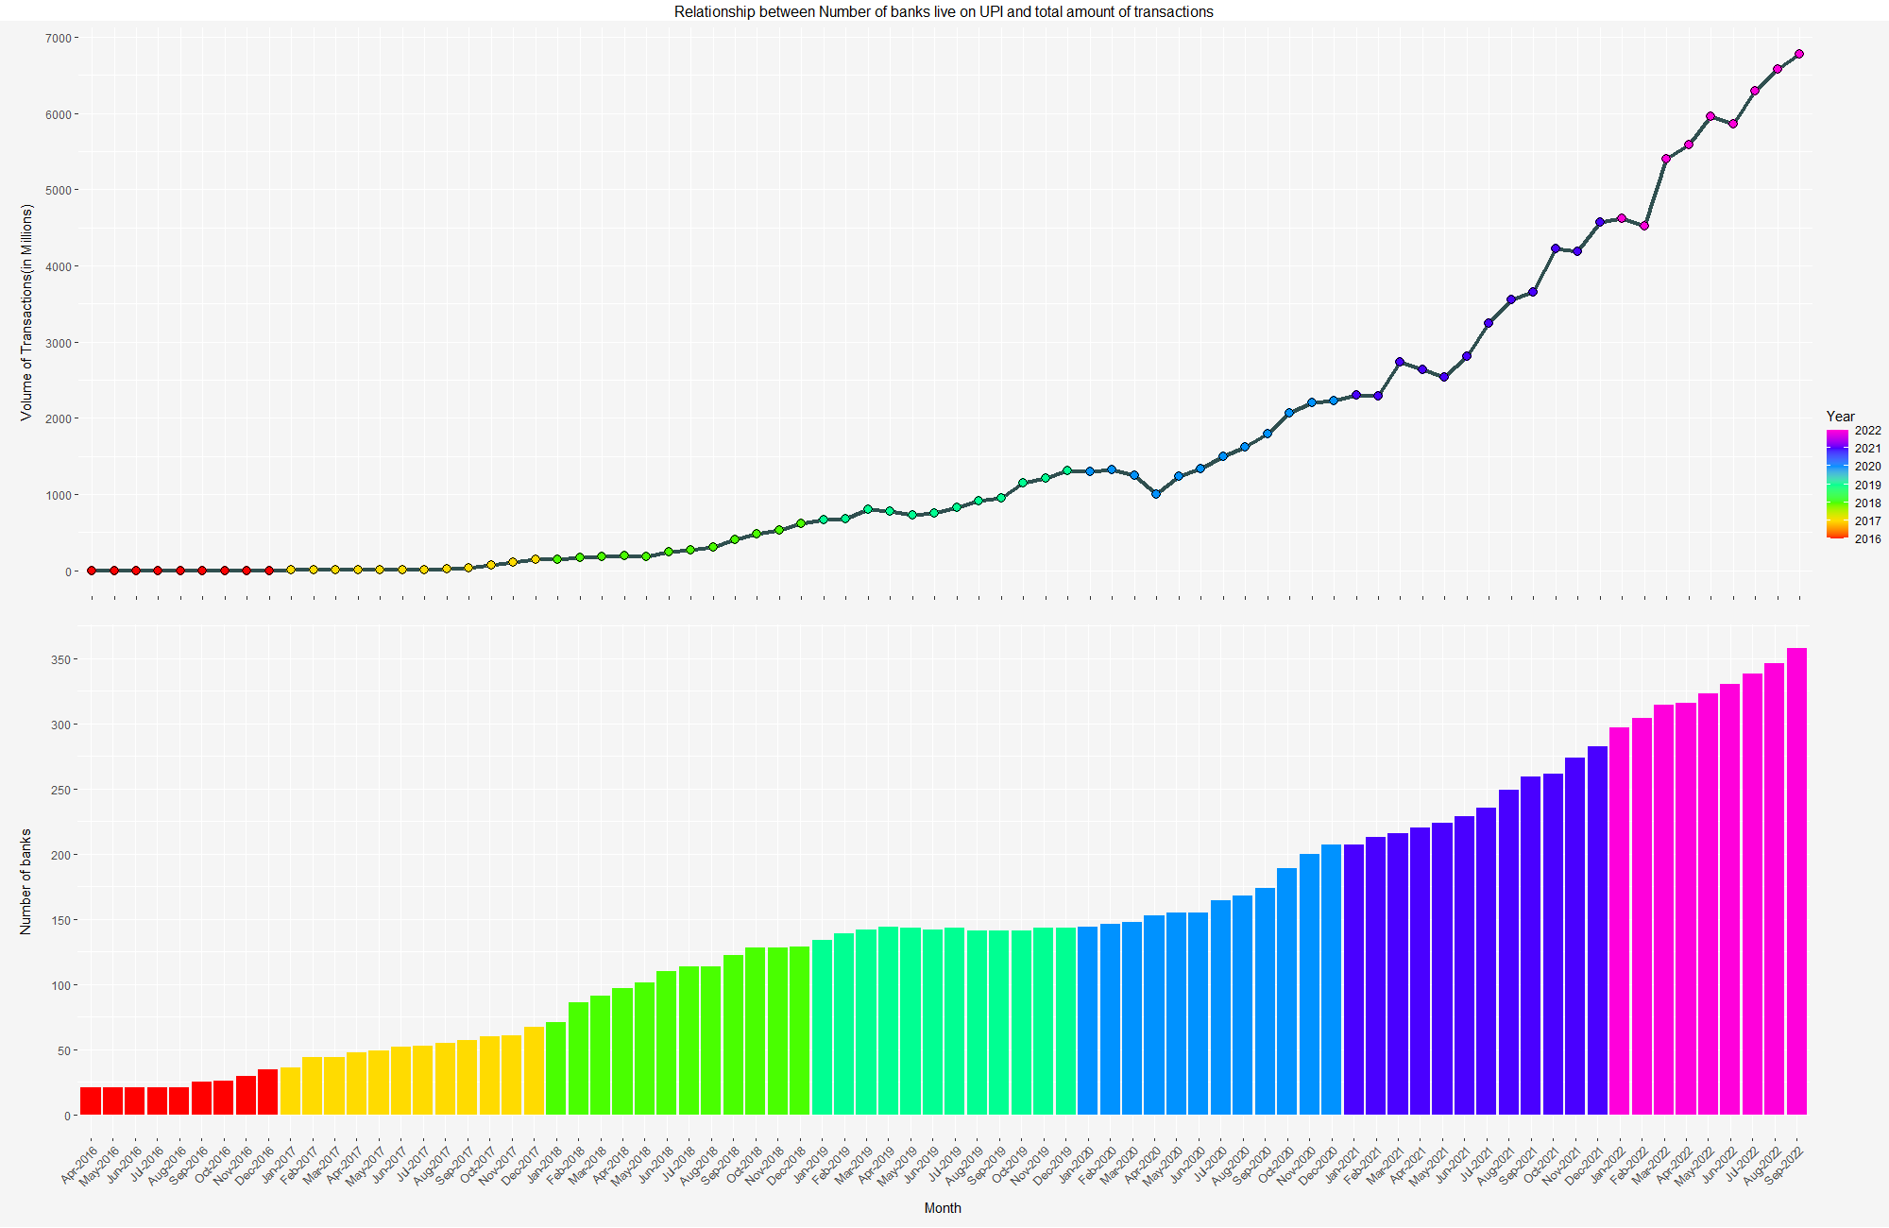
GOOD GRAPH
The banks live on UPI and the volume of transactions shown correlates.
The volume and number of banks are shown with their own scale without data manipulation

Slide 10
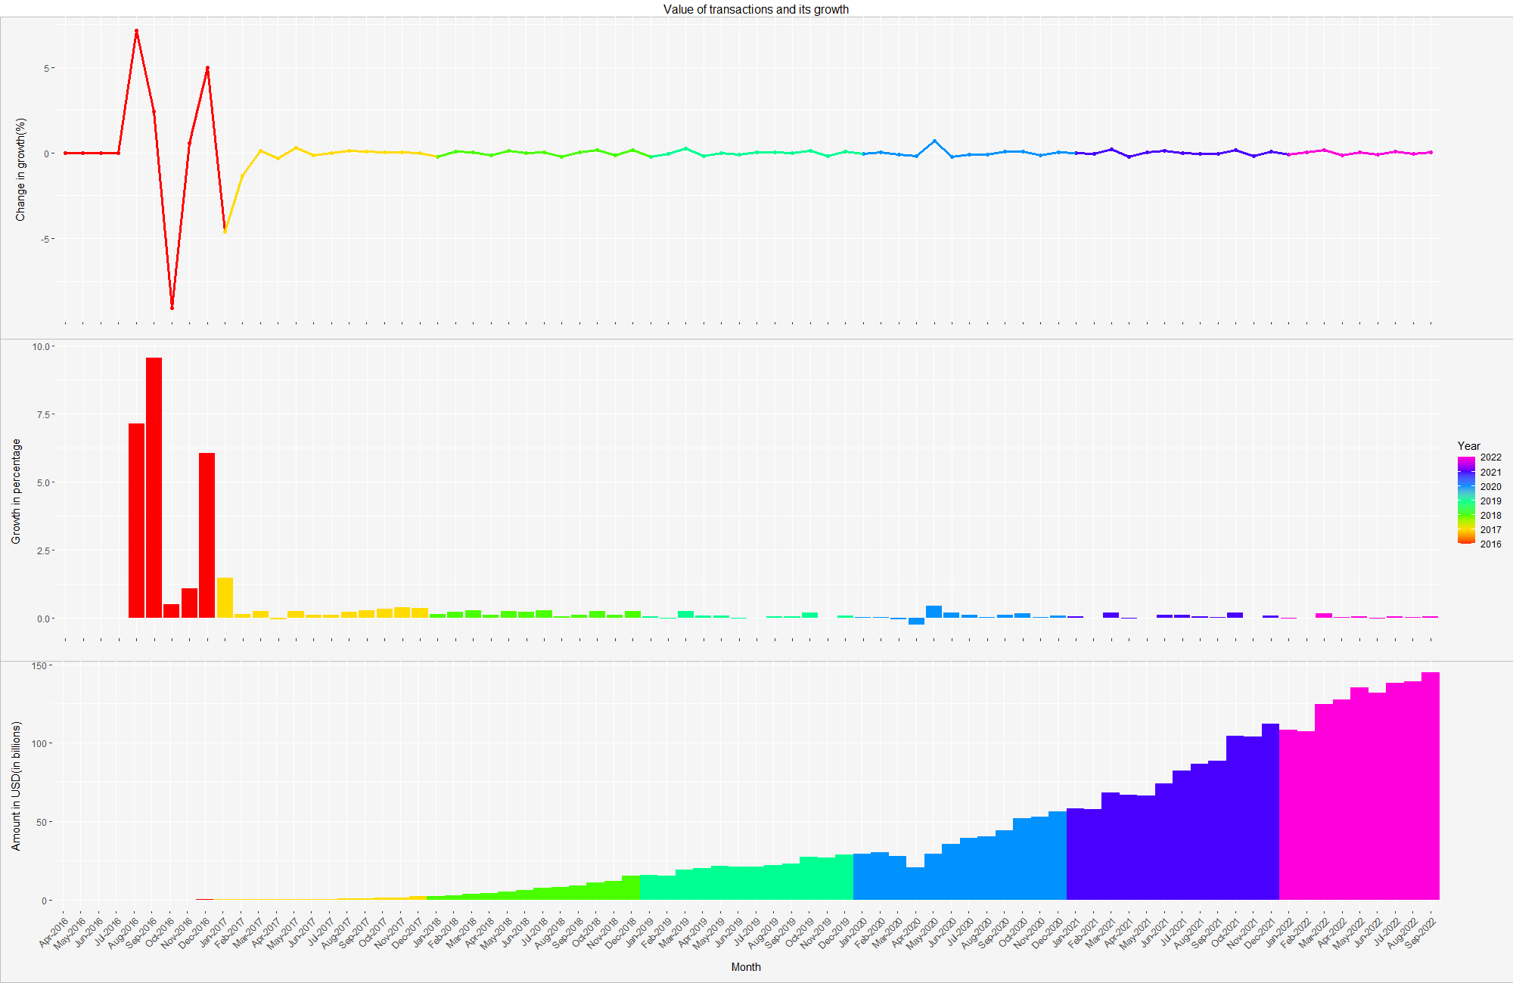
GOOD GRAPH
The data is sorted according to years, months, and volume.
The growth rate has its own scale to show the data trend
The change of growth is shown to see the growth and stability of the graph

Slide 11
REDESIGN – 3: COVID
3

Slide 12
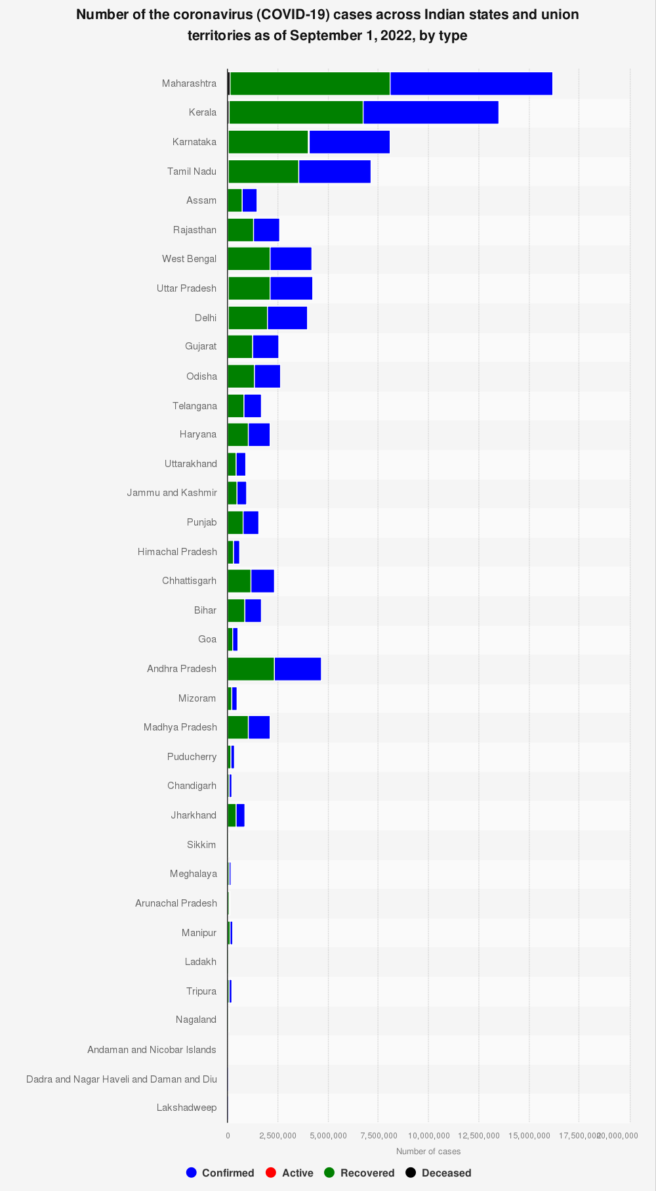
BAD GRAPH
Have numbers of different orders of magnitude in the same stack
The sorting isn’t of any meaning because the data of similar volume is far apart.

Slide 13
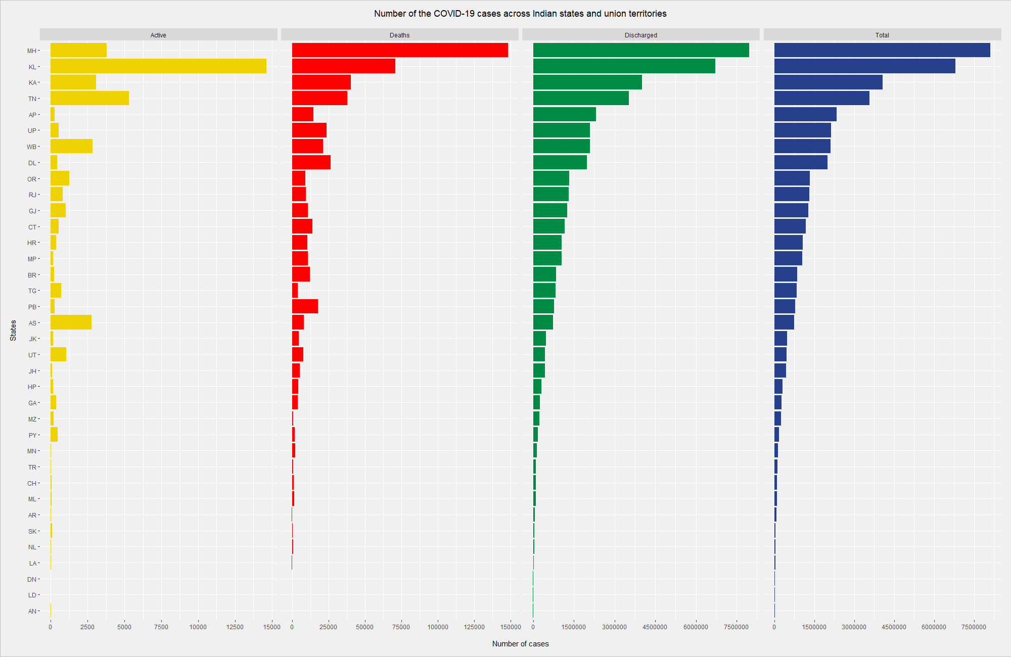
GOOD GRAPH
The data shown has its own magnitudes and scales.
Significant data is shown with proper ordering.

Slide 14
THANK YOU
Find us at
amureboi@gmu.edu
vchalla2@gmu.edu

