Slide 1

DATA ANALYSIS

Slide 2
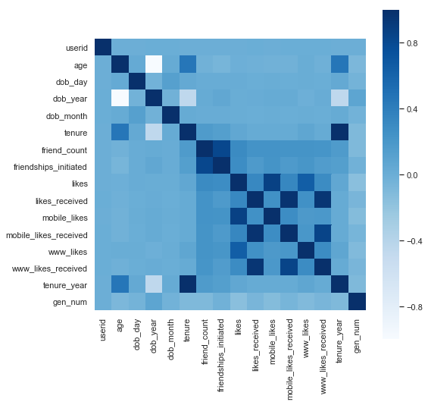
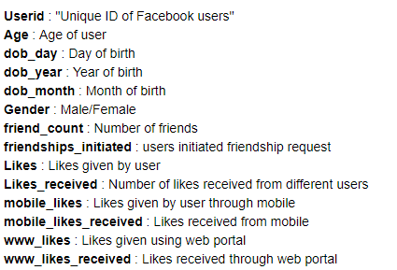
Dataset summery

Slide 3
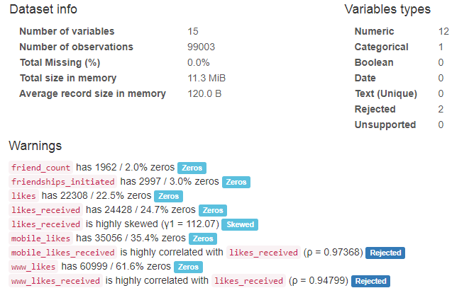
OVERVIEW

Slide 4
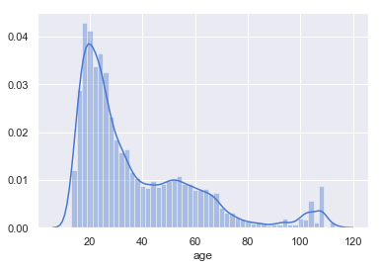


Age Trend
Right skewed distribution, most of the users are in the age group of 20-40 years
Total Number of users w.r.t Gender

Slide 5
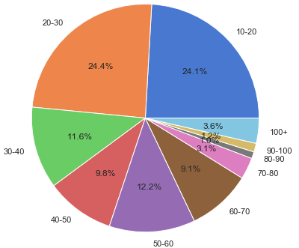
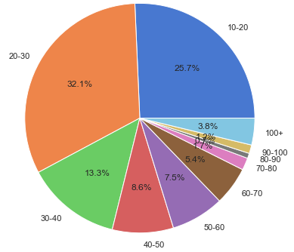
Age group
Female
As per analysis users age group b/w 10 to 40 years are more irrespective of gender
Male

Slide 6
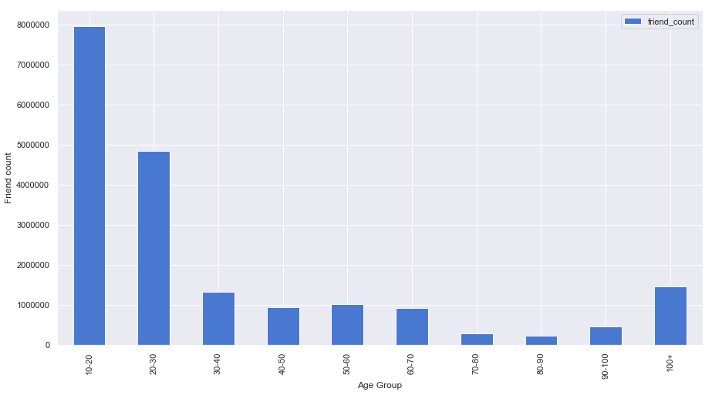
Age Vs Friend count
No. of friends is more b/w age group of 10-30 year bcz users are more b/w this age group. Note that users above 100years also have more number of friends

Slide 7
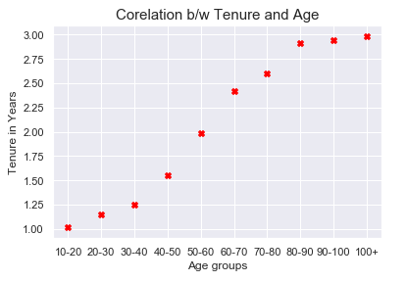
Age Vs tenure
Age and Tenue is positively corelated.
All users have subscribed to Facebook at the age of 10-20 years, so because of this trend is positively corelated.

Slide 8
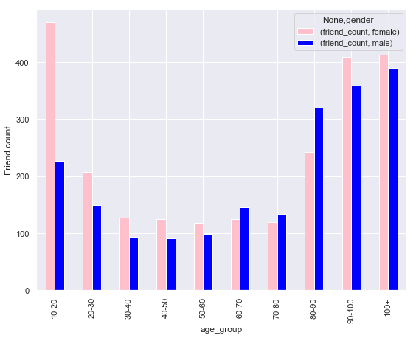

Which age group has more friends
Female Age group 10-20 years have more friends than any others.
Male age group 60-90years have more friends than Females.

Slide 9
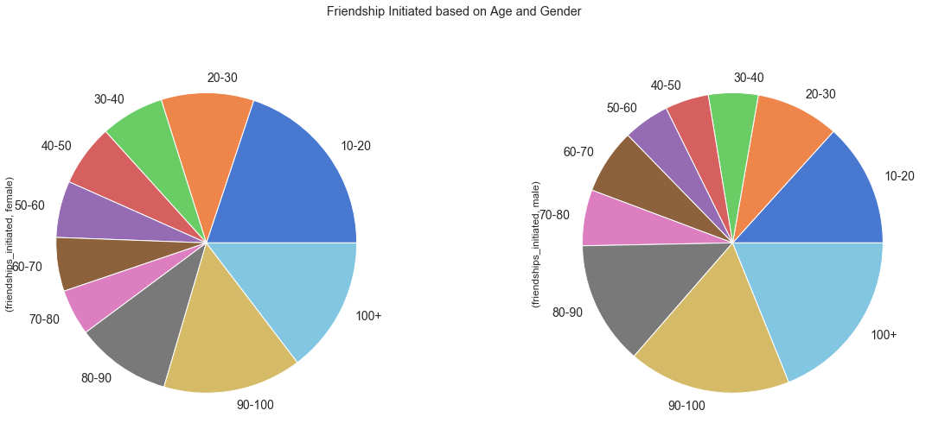

which age group has initiated more friend request?
Represents friends initiated on an average by each age group w.r.t gender.
Age group b/w 10 to 20 and 80+ years has initiated more friend request.

Slide 10
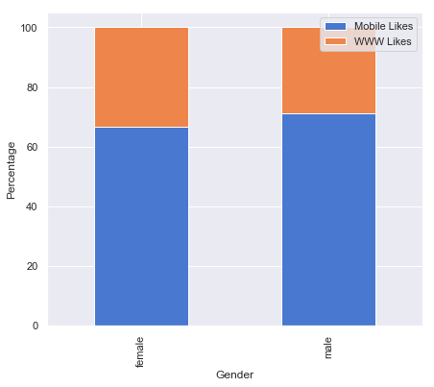
Likes given
Irrespective of gender most of the users are using mobile application than web application to give likes to the posts they have come across.
65-70% of like was given from mobile application

Slide 11
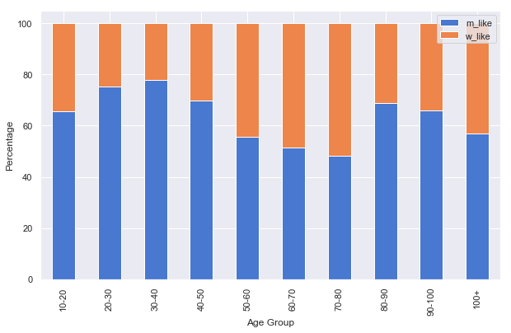
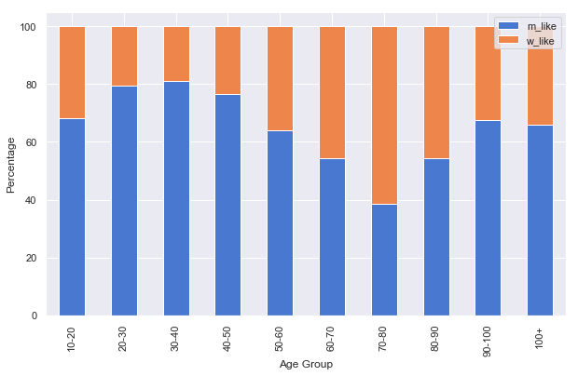
Application vS age group
Female
Male
As per analysis male age group 70-80 years is accessing web portal than mobile app.

Slide 12
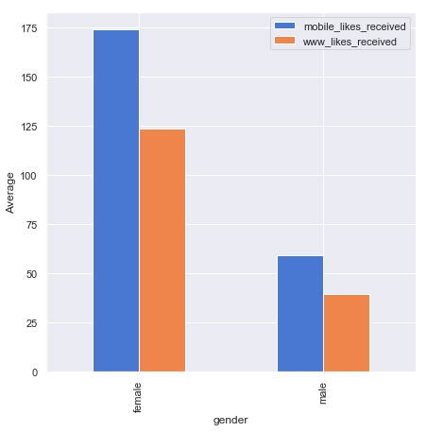
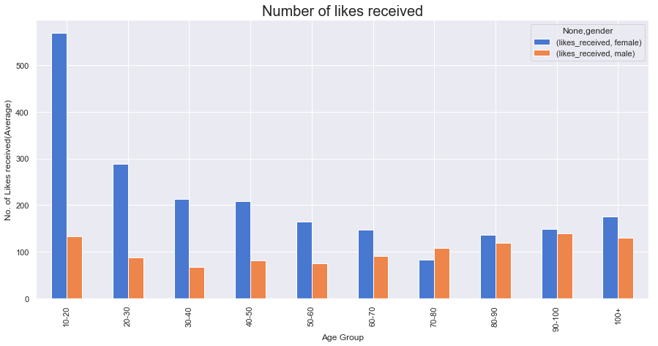
Received more likes
On an average female age group of 10-20yrs received more number of likes.
30-40 years of Males and 70-80 years of Females received less number of likes.
Received most of the likes from mobile App.
Females have received more like than Males.

Slide 13
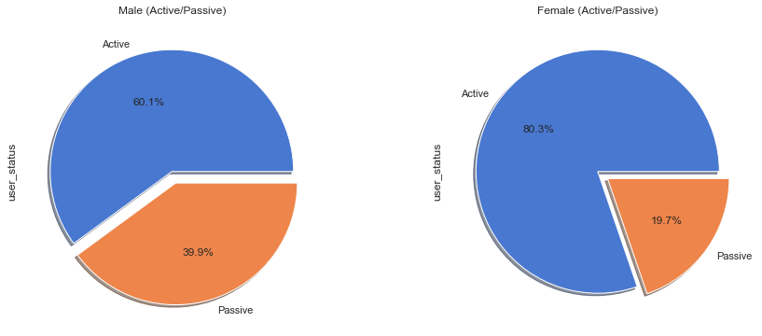
Passive users
Chart represents that there are 39.9% and 19.7% of Passive users of males and females respectively. Parameters considered for Passive status is No. of friends,likes and likes_received is zero(0)

Slide 14
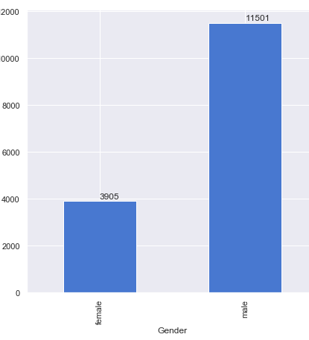
Different category of facebook users
User who did not give or received likes
But these users have more than one friends.
This implies that users is either inactive or users can be using Facebook platform for marketing/Advertising/Bulk posting/Promotions to group of users.
As per analysis there are more males than Females in this category.

Slide 15

- Age group b/w 20-40 users are more active than other age groups, FB need to attract other age group users as well in order to improve their business.
- In this given sample Male users are more than female users, FB need to strategies on attracting more female users.
- As per analysis more the age lower the friends count, in order to improve friends count FB to work on more powerful and accurate friend recommendation engine.
- 10 to 20 years age group is more social as they have initiated more friend requests than any other age group, FB should pull in other age groups for building network by giving suggestion on friends they may know.
- Likes Received : Female users have received more likes than male users,which inturn projects that either males are not posting much data or failed to get likes. Some kind guidelines or steps to be provided on how to post a relevant structured data to get more number of likes.
- Regardless of gender, users are extensively using mobile application when compared to web application. FB need to constantly improve mobile app as it is widely used and also more effort is required to improve Web application and make it as powerful as mobile app, so that all users can easily switchover b/w apps as and when required.

