Slide 1
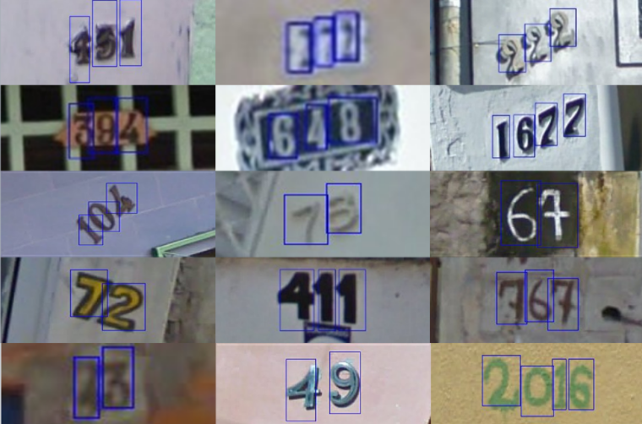
ECE 542 / CSC 591
Team 25: Street View House Number Detection
Anil Kumar Yalla
ayalla@ncsu.edu
Department of Computer Science
Ankur Sharma asharm48@ncsu.edu
Department of Computer Science
Priya Sharma
psharm23@ncsu.edu
Department of Computer Science
The classification of street view house numbers has many real world limitations which requires images to be properly aligned and deskewed and images with glares or blurriness can affect the accuracy of the data extracted.
The goal of the project is to implement deep learning neural networks to effectively identify the house numbers found on Google Street View images and translate them into number characters

Slide 2
Introduction and Problem Statement
Detecting Google Street View House Numbers using Image Recognition.
A technique that is commonly used for recognizing text from images is Optical Character Recognition.
However, OCR has real world limitations - requires images to be properly aligned and deskewed, images with glares or blurriness can affect the accuracy of the data extracted.

Slide 3

Data Set
Street View House Numbers Dataset
Training Data →73257
Testing Data 26032 digits for
10 class labels - 1 for each digit
32x32 images centered around a single character

Slide 4
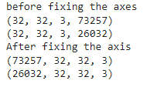
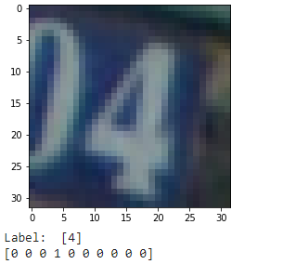
Preprocessing
Fix the axis of the images
Normalize the image data
Perform one hot encoding of the class labels to convert the multi-labels into binarization.

Slide 5
Neural Networks Implemented
Feed Forward Neural Network
Convolutional Neural Network
Residual Neural Network

Slide 6
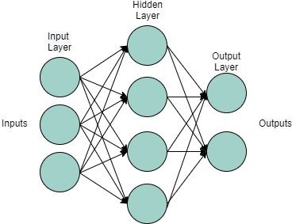
Feed Forward Neural Network
A feed forward network is a basic ANN where information moves between layers in only one direction - forward.

Slide 7
Architecture Description
We first flatten the image, 3 layers
We then learn 256 weights in the first layer and apply the ReLu activation function.
The next layer learns 128 weights.
There is another fully connected layer, this time only learning 10 weights, corresponding to the ten (0-9) output classes.
Instead of a ReLu activation, we’ll use a softmax activation to obtain normalized class probabilities for each prediction.
ADAM OPTIMISER
NUMBER OF EPOCHS=100
Training Dataset
F1 score macro -->0.8319392193198596
F1 score micro --->0.8319392193198596
F1 score weighted-->0.8409402837219927
Test Dataset
F1 score macro -->0.7736729814807687
F1 score micro --->0.7908727719729564
F1 score weighted-->0.7903363600837161

Slide 8
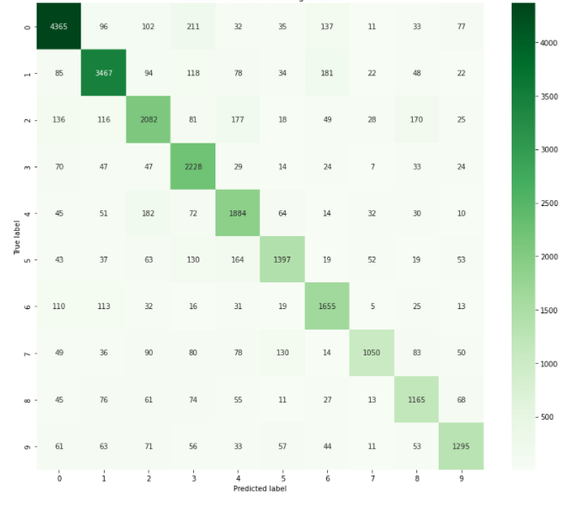
Confusion Matrix of Test DataSet

Slide 9
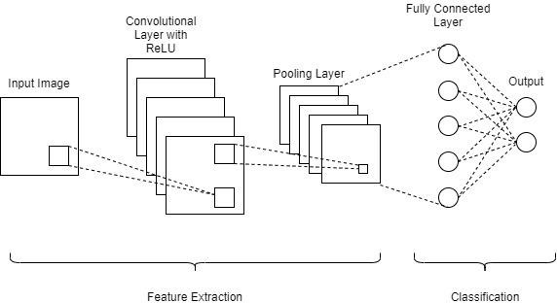
Convolutional Neural Network
A convolutional neural network (CNN or ConvNet), is a network architecture for deep learning, which learns directly from data, eliminating the need for manual feature extraction.

Slide 10
CNN
Building the CNN model:
We first add a convolutional layer with 32 nodes.
We have chosen ReLU (rectified linear) as our activation function in our hidden layer to avoid vanishing gradient problem.
We are implementing max pooling because it extracts the sharpest features from the feature map
Fully Connected (FC) Layer: This layer is basically a feed forward network where the input to this layer is the output of our last Convolutional Layer or pooling layer.
Before being fed into the FC layer, we flatten the 3D output into a vector which is then passed on to more FC layers.

Slide 11
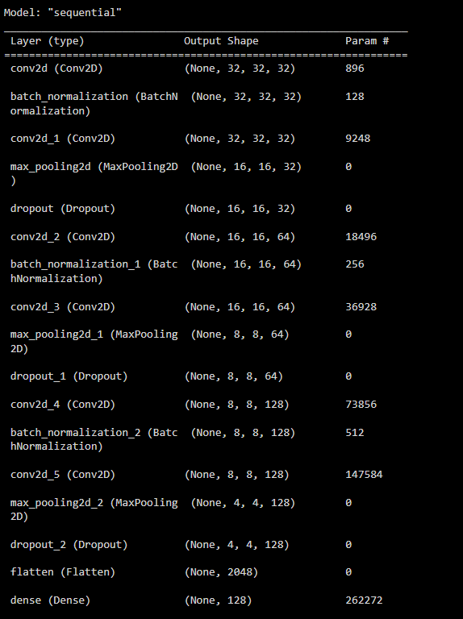
CNN-Architecture

Slide 12
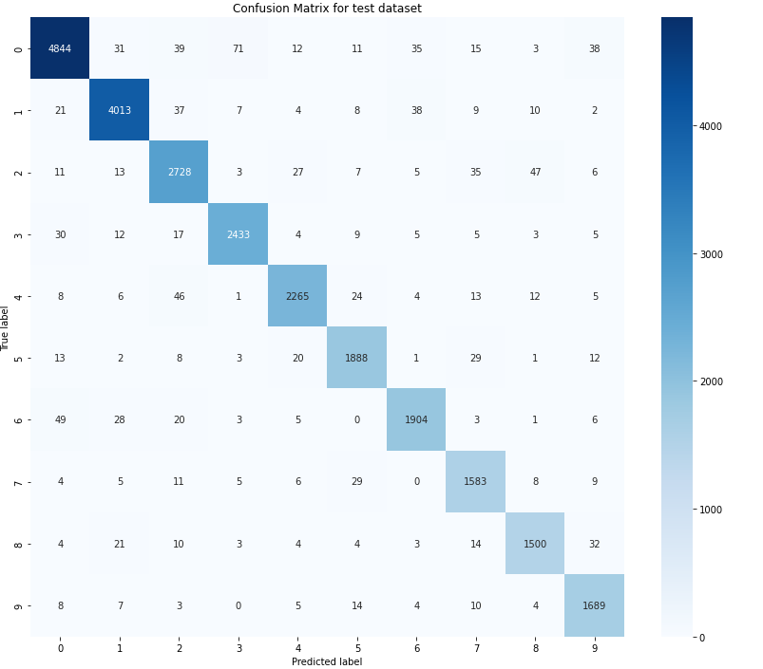
Confusion Matrix
Test accuracy is: 0.9545
Test loss is: 0.1895
F1 score
macro -->0.9519504200408896
micro --->0.954479102642901
weighted-->0.954521567249528

Slide 13
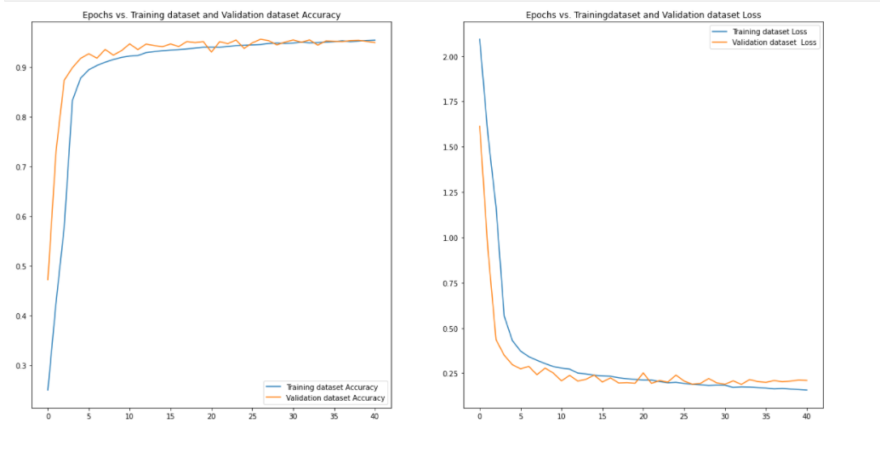
Epochs vs Training and Validation data for loss and accuracy

Slide 14
RESNET
One of the key changes to our CNN model this time is the addition of the residual block, which adds the original input back to the output feature map obtained by passing the input through one or more convolutional layers.
WHY?
To improve accuracy and performance solve vanishing gradient problem

Slide 15
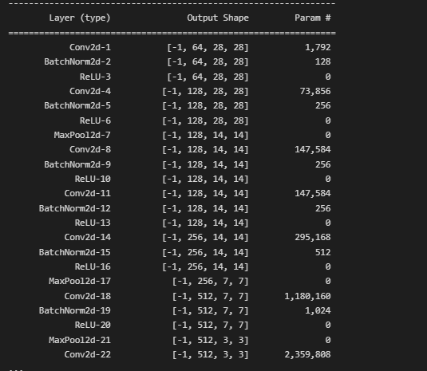
ResNet–Architecture

Slide 16
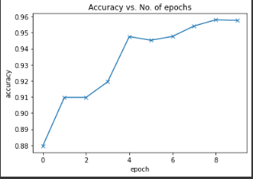
ResNet-Accuracy
Test loss: 0.1814599186182022
test Accuracy: 0.9578227400779724}

Slide 17
Conclusion
ResNet
Test Accuracy: 0.9578227400779724
Test loss: 0.1814599186182022
Epochs: 10
Time:
CPU times: user 5min 39s, sys: 40 s, total: 6min 19s
Wall time: 6min 29s
CNN
Test accuracy is: 0.9545
Test loss is: 0.1895
Epochs : 41
Time
Auxilary Model :15 mins
CNN Model: 48 mins
Future Scope
Our future work involves training the resnet model with more CNN layers.
we would to like to implement the model using YOLO and RCNN to improvise the accuracy

Slide 18
References
Yuval Netzer, Tao Wang, Adam Coates, Alessandro Bissacco, Bo Wu, Andrew Y. Ng Reading Digits in Natural Images with Unsupervised Feature Learning NIPS Workshop on Deep Learning and Unsupervised Feature Learning 2011.
Zhong-Qiu Zhao, Peng Zheng, Shou-tao Xu, Xindong Wu, Object Detection with Deep Learning: A Review, 2019.
Andrew G. Howard, Some Improvements on Deep Convolutional
Neural Network Based Image Classification, 2013.

