Slide 1
Search_Option Analysis

Slide 2
Introduction
BingHive is a streaming platform like Netflix, which allows its users to watch series and movies.
The OTT market is competitive and BingHive is competing against a lot of established players like Netflix, prime, Hotstar, etc. Their tech team keeps making new releases to the app and they rolled out a new update to the "Search" feature of the app.
The search functionality within an app plays a pivotal role in enhancing the overall user experience

Slide 3
Problem Identification
The users rely on the "Search" feature heavily to discover what they can watch on the platform.
In most of the reviews, the users complained that the "search" functionality isn't working as expected. Some users could not find what they were looking for whereas others had to scroll a lot. A good part of them reported the search button became unresponsive and sometimes showed errors.

Slide 4
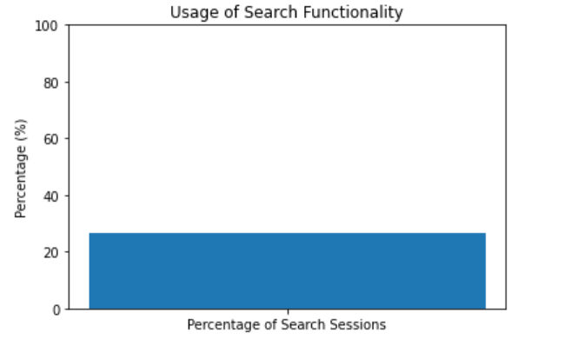
Usage of Search Functionality
The bar chart illustrates the percentage of sessions where users engaged with the search functionality. Approximately 26.59% of sessions involved interactions with the search feature.

Slide 5
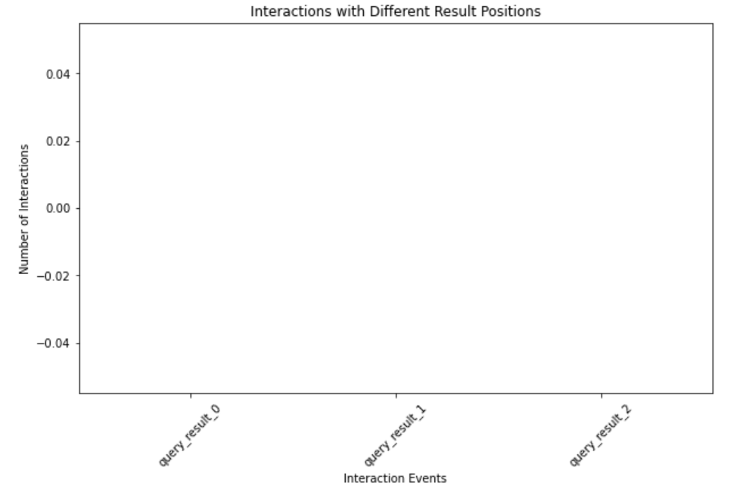
Search Success Rate
0.0
Are Users Able to Find What They Search For?
Search Success Rate: [0.0] %

Slide 6

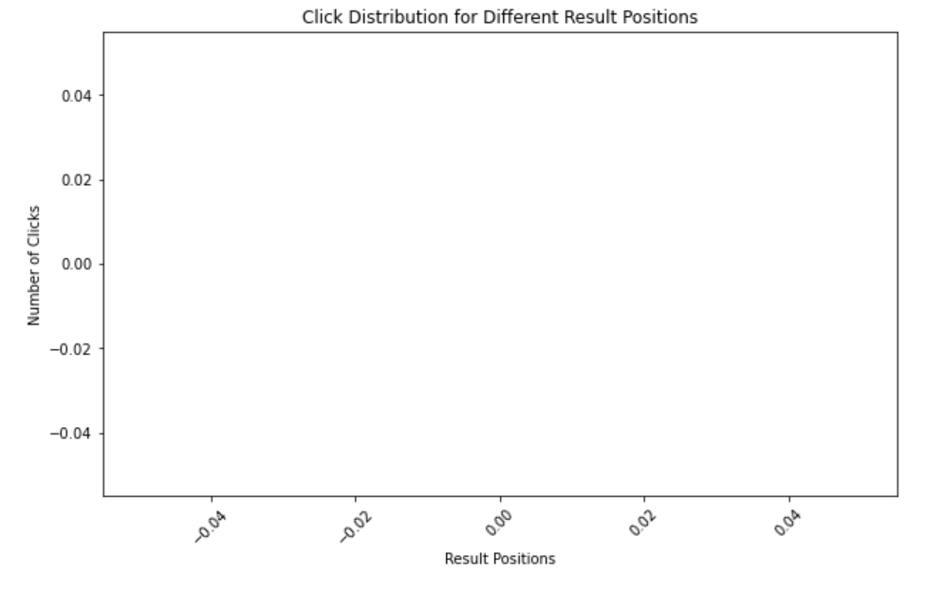
Search Result Ordering and User Experience
Does the Ordering Algorithm Need Tuning?
Analyzing user behavior to determine if search results need better ordering for improved user experience.

Slide 7
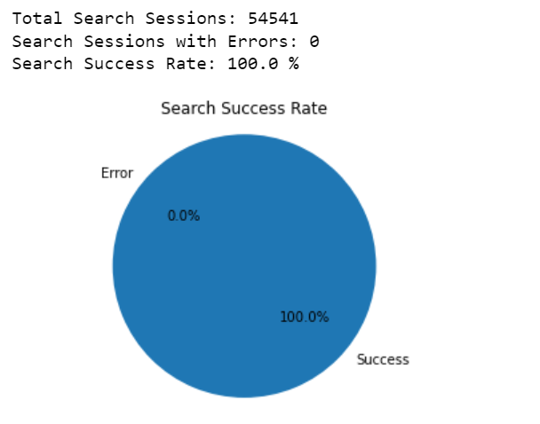
Search Functionality Assessment
Evaluating User Experience with the Search Feature
Analyzing the functionality and responsiveness of the search button to ensure a seamless user experience.

Slide 8
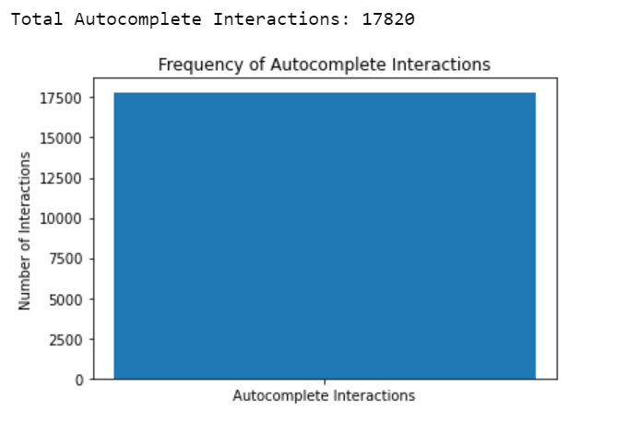
Autocomplete Suggestions and User Engagement
Assessing User Engagement with Autocomplete Feature
Analyzing the usefulness and user interaction with autocomplete suggestions to enhance content discovery.

Slide 9
Recommendations for Improvement
Enhancing Search Functionality for Optimal User Experience
Refine Search Algorithm: Fine-tune the search algorithm to ensure more accurate and relevant search results, reducing the need for users to scroll extensively.
Enhance Autocomplete: Improve the autocomplete feature by incorporating user behavior data to suggest more relevant and timely options.
Optimize Button Responsiveness: Ensure the search button is responsive across all devices and OS versions to prevent user frustration.
Error Resolution: Address any issues causing errors after search queries promptly, enhancing user confidence in the search feature.

Slide 10
Conclusion
By addressing these recommendations, BingHive can elevate its search functionality, creating a more seamless and enjoyable experience for users. A user-centered approach will contribute to increased engagement, satisfaction, and a competitive edge in the OTT market.

