Slide 1
Affected Users Analysis

Slide 2
Introduction
Analyzing problems found across all OS and their versions.
Checking if the problems found are occurring on specific devices.
User Behavior: Clicked on Lower Results
Problems by OS and OS Version
Top Devices Facing the Problem

Slide 3
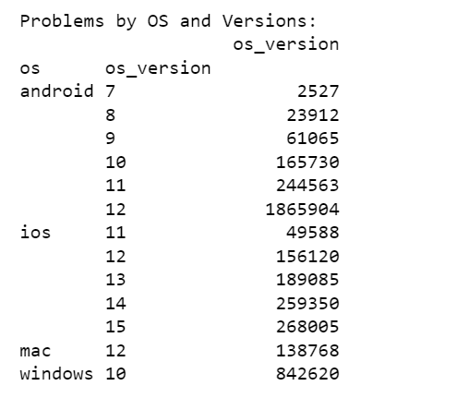
problems found across all OS and their versions.

Slide 4
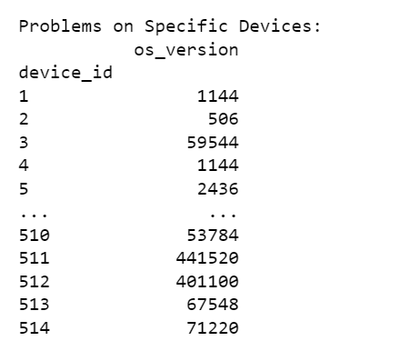
problems found are occurring on specific devices.

Slide 5
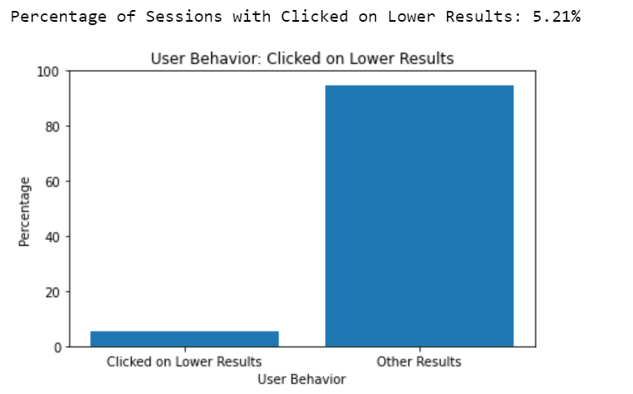
User Behavior: Clicked on Lower Results

Slide 6
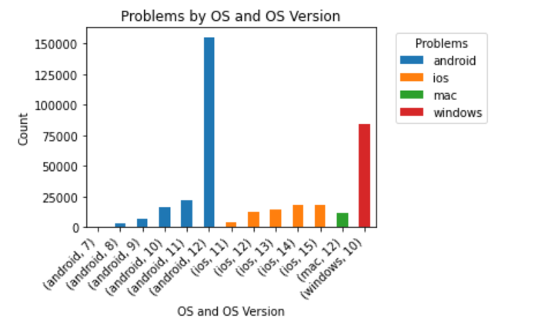
Problems by OS and OS Version

Slide 7
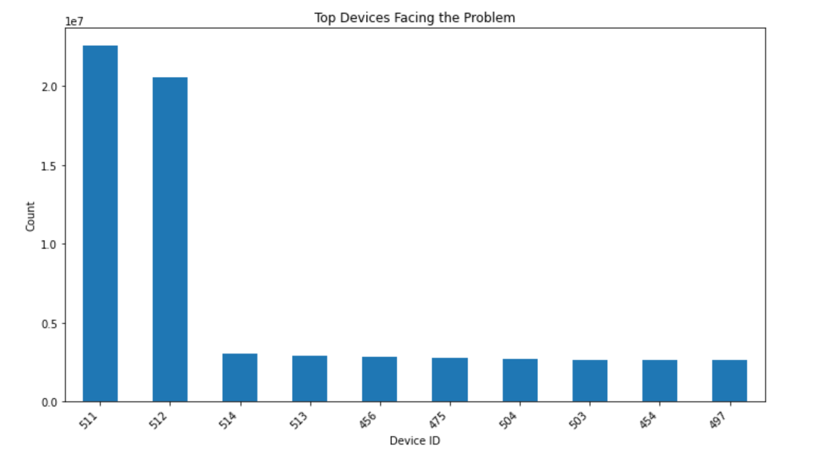
Top Devices Facing the Problem

Slide 8
Recommendations:
Optimize Search Algorithm: Collaborate with the tech team to review and optimize the search algorithm. Ensure that search results are relevant and users are able to find what they're looking for within the first few results.
Enhance Autocomplete Suggestions: Improve the autocomplete suggestions to better predict users' search intent. Utilize machine learning techniques to offer more accurate suggestions that aid users in finding content quickly.
Responsive Design Testing: Conduct thorough testing of the app's search functionality on different devices and operating systems. Ensure that the search button is responsive and provides consistent behavior across platforms.
User-Centric Design: Prioritize user feedback and conduct user testing sessions to identify pain points in the search feature. Incorporate user feedback to refine the search experience and address specific user needs.
Error Handling and Reporting: Implement a robust error-handling mechanism for search queries. Provide users with clear error messages and an option to report issues, helping the development team identify and address problems swiftly.
A/B Testing: Consider conducting A/B testing to assess the impact of changes made to the search functionality. This iterative approach allows you to measure the effectiveness of improvements and make data-driven decisions.

Slide 9
Conclusion:
In conclusion, the analysis of BingHive's search functionality has provided valuable insights into the challenges users are facing. By investigating user behavior, problems with the search feature have been identified, ranging from unresponsiveness to ineffective search results. The analysis has revealed that the issues are not evenly spread across all users; specific OS versions and devices are more prone to certain problems.
Addressing these issues is crucial for enhancing user experience and retaining user engagement on the platform. By implementing the recommended strategies, BingHive can ensure that users can easily find content, have a seamless search experience, and enjoy the platform to its fullest potential.
Through continuous monitoring, testing, and collaboration with the tech team, BingHive can strive towards providing a search feature that meets users' expectations and contributes to a more satisfying streaming experience.

