Slide 1

The Web
at Fuqua
and You

Slide 2
New opportunities
Selection of DreamWeaver as Fuqua’s standard web editing software.
The imminent selection of easy-to-use version control software for publishing web files.
Improvements in Fuqua’s web computer hardware.
The development of Fuqua web page templates.

Slide 3
Today’s focus
Conceptual
  an understanding of Fuqua’s web-related challenges and opportunities
Technical
  an introduction to HTML codes in preparation for DreamWeaver training
Colleague-to-colleague
  panel discussion/Q&A on web experience

Slide 4
Session Agenda
Fuqua’s web site: Your critical role in its development and maintenance
Where web publishing at Fuqua is headed
TSC support for your work on the web
HTML coding basics
Panel discussion

Slide 5
Your responses to the e-mail survey...

Slide 6
What do you use the web for?
Personal research: 17
Work-related research: 20
Purchases: 9
Music: 7
Software downloads: 8
Communication: 14
Other: 4
GEMBA work, completing on-line surveys, marketing.

Slide 7
Your current level of web publishing experience
Absolutely none: 10
Enough to be dangerous: 4
Moderate knowledge: 5
Solid knowledge: 1
Expert 0

Slide 8
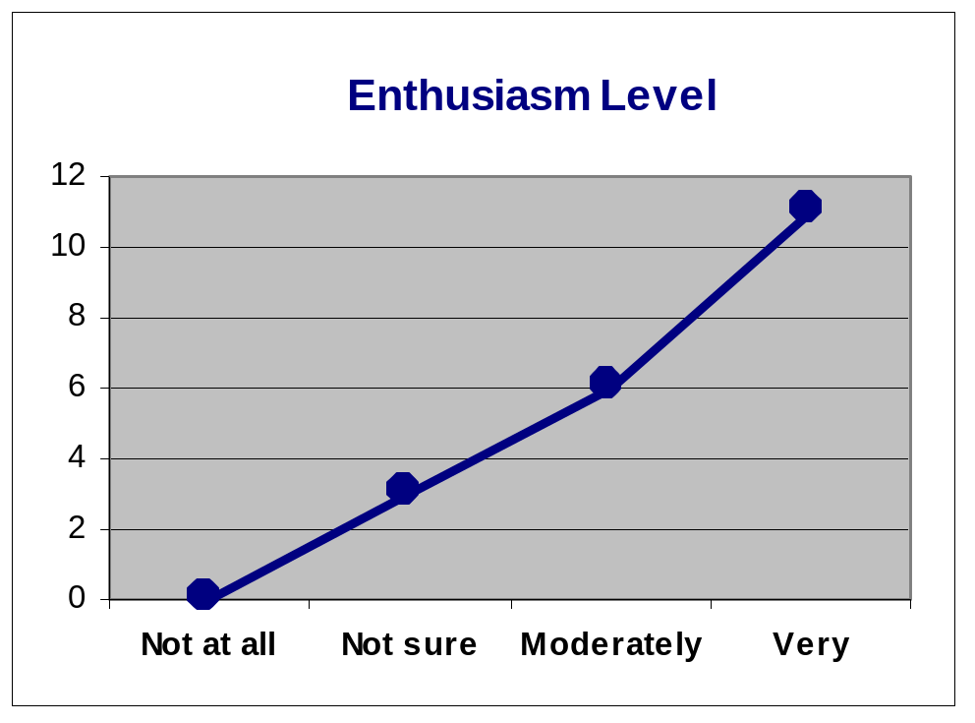
Your interest in publishing
Not at all enthusiastic: 0
Not sure yet: 3
Moderately enthusiastic: 6
Very enthusiastic: 11

Slide 9
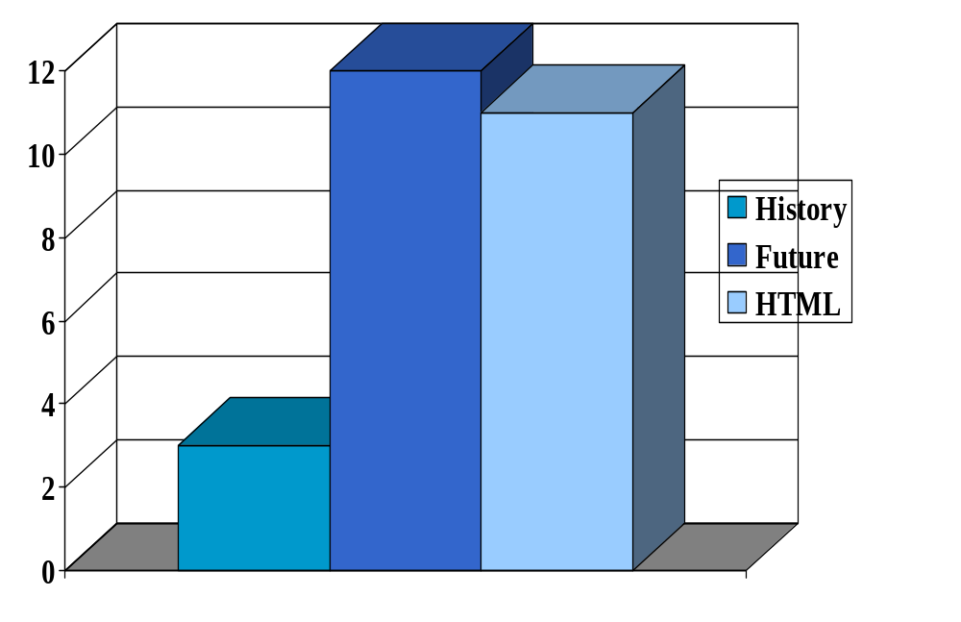
Your interest in topics

Slide 10
Next...
Fuqua’s web site
and your critical role
Nevin Fouts
Direction of web
work at Fuqua
Paul Hilburger
TSC support
Diane Reynolds

Slide 12
Intro to HTML Codes
What are they?
Why should I care about them?

Slide 13
What are HTML codes?
Every web page you see with your browser is formatted with HTML codes.
HTML is an acronym for
    Hyper
    Text
    Markup
    Language

Slide 14
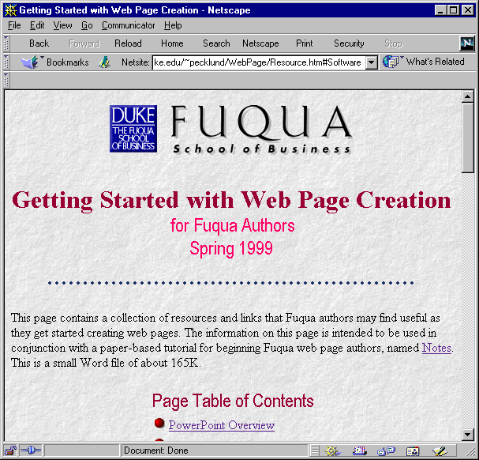
For example...

Slide 15
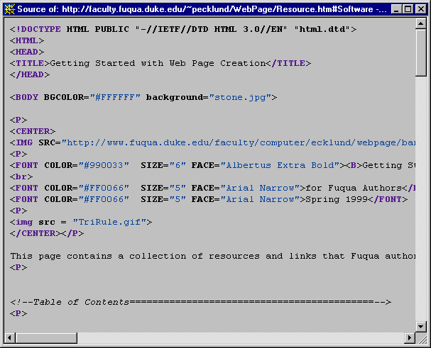
In Netscape: View, Page Source
a closer look

Slide 16
HTML codes control the look of the page
when a reader views the page in a browser like Netscape.

Slide 17
Why care about HTML codes?
Maybe you don’t care…
  With a web page editing tool (like DreamWeaver) you may never have to see an HTML code.
  The HTML codes may look strange and boring to you.
  That’s OK!

Slide 18
Some reasons you might care
  Remember WordPerfect codes?
  Even Word makes some codes available.
  Knowing something about HTML codes can help you:
    debug when things aren’t quite right
    tinker when you want something special
    understand how some cool web page was constructed (by viewing the page source)

Slide 19
The idea is:
Use a high-end software tool like DreamWeaver to do most of your web editing work.
But also…
Know a little about HTML codes so you can tell what’s going on behind the scenes (if you need to know).

Slide 20
You don’t have to be an expert
“Codes” don’t mean programming.
There is a relatively small set of basic HTML codes.
Many of the codes are logical and easy to remember.
Once you understand the general rules, most codes will make sense.

Slide 21
What do HTML codes do?
Codes establish the formatting for a web page. For example:
  What typeface to use
  What color background for the page
  What graphic and where to position it
  What kind of indentation for text
  When to use bullet points
  Etcetera

Slide 22
What are the HTML code rules?
There are really only a few “rules”.
(And -- of course -- there are some exceptions to the rules.)
HTML codes appear in brackets.
HTML codes are “paired”.

Slide 23
Example
To “turn on” bolding: <b>
To “turn off” bolding: </b>
This code:
The quick <b> red fox </b> jumped over the lazy dog.
Appears as:
The quick red fox jumped over the lazy dog.

Slide 24
Another concept
You can stack up codes to get multiple effects
This code:
The quick <b><i><u>red fox</u></i></b> jumped over the lazy dog.
Appears as:
The quick red fox jumped over the lazy dog.

Slide 25
3 HTML codes
Bolding: <b> </b>
Italicizing: <i> </i>
Underlining: <u> </u>
“Rules” for these codes: They
  appear in brackets
  are paired
  surround the text they affect

Slide 26
Examples of exceptions
Examples of codes that affect layout:
  <br> generates a line break
  <p> starts a new paragraph
  &nbsp; adds a space
These codes do not have to be paired.
And notice that the “space” code does not appear in brackets.

Slide 27
<br> code example
This code:
The quick, <br> red fox <br> jumped over the lazy dog.
Appears as:
The quick,
red fox
jumped over the lazy dog.

Slide 28
<p> code example
This code:
Where’s the fox? <p> Where’s the lazy dog?
Appears as:
Where’s the fox?
Where’s the lazy dog?

Slide 29
&nbsp; code example
This code:
The quick red dog &nbsp; &nbsp; &nbsp; &nbsp; jumped over the lazy fox.
Appears as:
The quick red dog jumped over the lazy fox.

Slide 30
Another layout code
<center> </center>
This code:
<center>The Story of the Fox</center>
Appears like:
The Story of the Fox

Slide 31
Some codes provide “canned” services
<h1>This is a main header</h1>
<h2>This is a secondary header</h2>
<h3>This is a tertiary header</h3>
These “header tags” are a convenient way to control both font size and bolding.

Slide 32
“Canned” headers might look like this
This is a main header
This is a secondary header
This is a tertiary header
The text on the web page would be sized proportionately smaller.

Slide 33
A set of “list codes” formats a list
Code for an “ordered” (numbered) list:
<OL>My favorite trees:
<li> oak
<li> beech
<li> maple
</OL>

Slide 34
Another set of list codes
Code for an “un-ordered” (bulleted) list:
<UL>My favorite trees:
<li> oak
<li> beech
<li> maple
</UL>

Slide 35
The list results
Ordered List
My favorite trees:
1. oak
2. beech
3. maple
Unordered List
My favorite trees:
• oak
• beech
• maple

Slide 36
Linking
A very important web page topic.
Kinds of links include links:
  to another part of the same page
  to an entirely different web page
  to a document (for download)
  to an e-mail screen (a “mail-to” link)
  to an electronic bulletin board

Slide 37
What about linking codes?
HTML link codes are special.
A simple link has 4 components:
  1. An “anchor reference” to start.
  2. The item to link to.
  3. What the reader sees underlined.
  4. A “close link” code to end.

Slide 38
Example: A link to another web page
How do we write the code for this sentence:
Birds native to North Carolina include the fantastic-looking pileated woodpecker.
…so when the reader clicks the underlined link they go to a page about this particular bird?

Slide 39
How to link to another web page
1. The starting “anchor reference”:
<A HREF=
2. The item to link to:
“woodpecker.htm”>
3. What the reader sees underlined:
pileated woodpecker
4. A “close link” code to end:
</A>

Slide 40
Put it all together
This code:
Birds native to North Carolina include the fantastic-looking <A HREF=“woodpecker.htm”>pileated woodpecker</A>.
Appears as:
Birds native to North Carolina include the fantastic-looking pileated woodpecker.

Slide 41
One more link code example
This code:
For problems with Microsoft products, send electronic mail to Bill <A HREF="mailto:Bill.Gates@Microsoft.
com">Gates</A>.
Appears as:
For problems with Microsoft products, send electronic mail to Bill Gates.

Slide 42
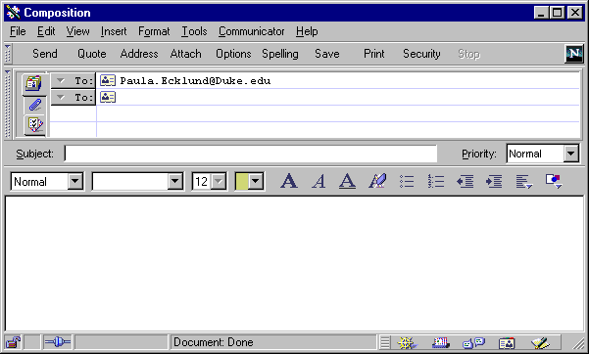
Bill.Gates@Microsoft.com
Clicking the mail-to link opens up a special
e-mail window in the web browser.

Slide 43
Key concepts to remember
It’s useful to know a little about HTML codes if you need to:
  fix a problem on one of your web pages
  see what’s “really” going on behind the scenes
There’s a small set of basic codes.
You can always look up the meaning of any code you don’t know.

Slide 44
How can you look up an html code?
Use the handout for quick reference to basic codes.
Fuqua’s library has HTML books in its collection.
Do a web search on the word “HTML”.

Slide 45
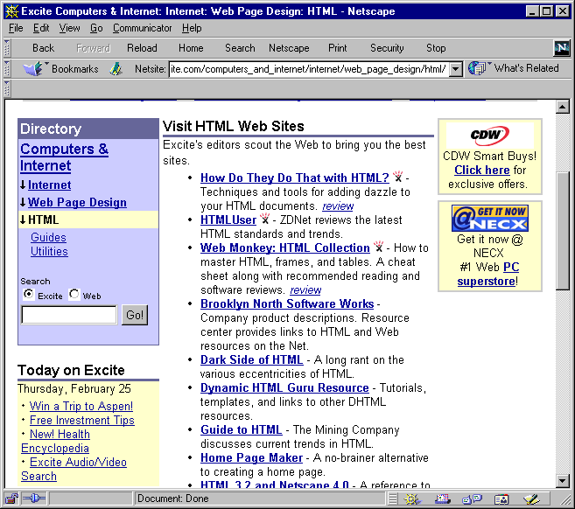

Slide 46
Practice recognizing
how HTML codes work.

Slide 48
Other link examples
Appendix
Link to a document for download
This code:
For more information get this <A HREF=“Excel.xls”>Excel</A>file.
Reads like this:
For more information get this Excel file.

Slide 49
Other link examples
Appendix
Link to a bulletin board
This code:
<A HREF= "news://news.fuqua.duke.edu/Announce.General”>Announce</A>Bulletin board.
Reads like this:
Announce Bulletin board.

Slide 50
Other link examples
Appendix
Link to another location on the same page
Enter this code:
<A HREF="#PPT">Excel Overview</A>.
Then further down the page enter this code:
<A NAME="PPT">
The link reads like this:
Excel Overview.
Click this link to jump to the part of the page that has the <A NAME> code.

