Slide 1

Blockchain-Based Verifiable Academic Credential System
Team Members:
  Manu M P — 2411021061545
  Tarun Kumar S — 2411021061552
  Anilkumar U K — 2411021061563
  Pruthviraj D N — L2411021061688
Name of the Mentor: Dr. Saravanan P
E1CSA313 Design Project -1
Review 2 — Implementation, Evaluation & Deployment

Slide 2

Agenda
Introduction
Review of literature (Refer minimum of 10 Recent Journal / Conference papers)
Observations from the literature review (Brief description as points)
Limitations from the literature review (Brief description as points)
Problem Definition & Proposed Methodology
  Problem Statement
  Proposed Research / Methodology
  Hardware Requirements
  Software Requirements
Design Diagram, Modules & Novelty
Implementation: Smart Contract, Database, Security, Dataset
Experimentation, Results & Deployment
Conclusion & Future Directions
References
Plagiarism Report

Slide 3

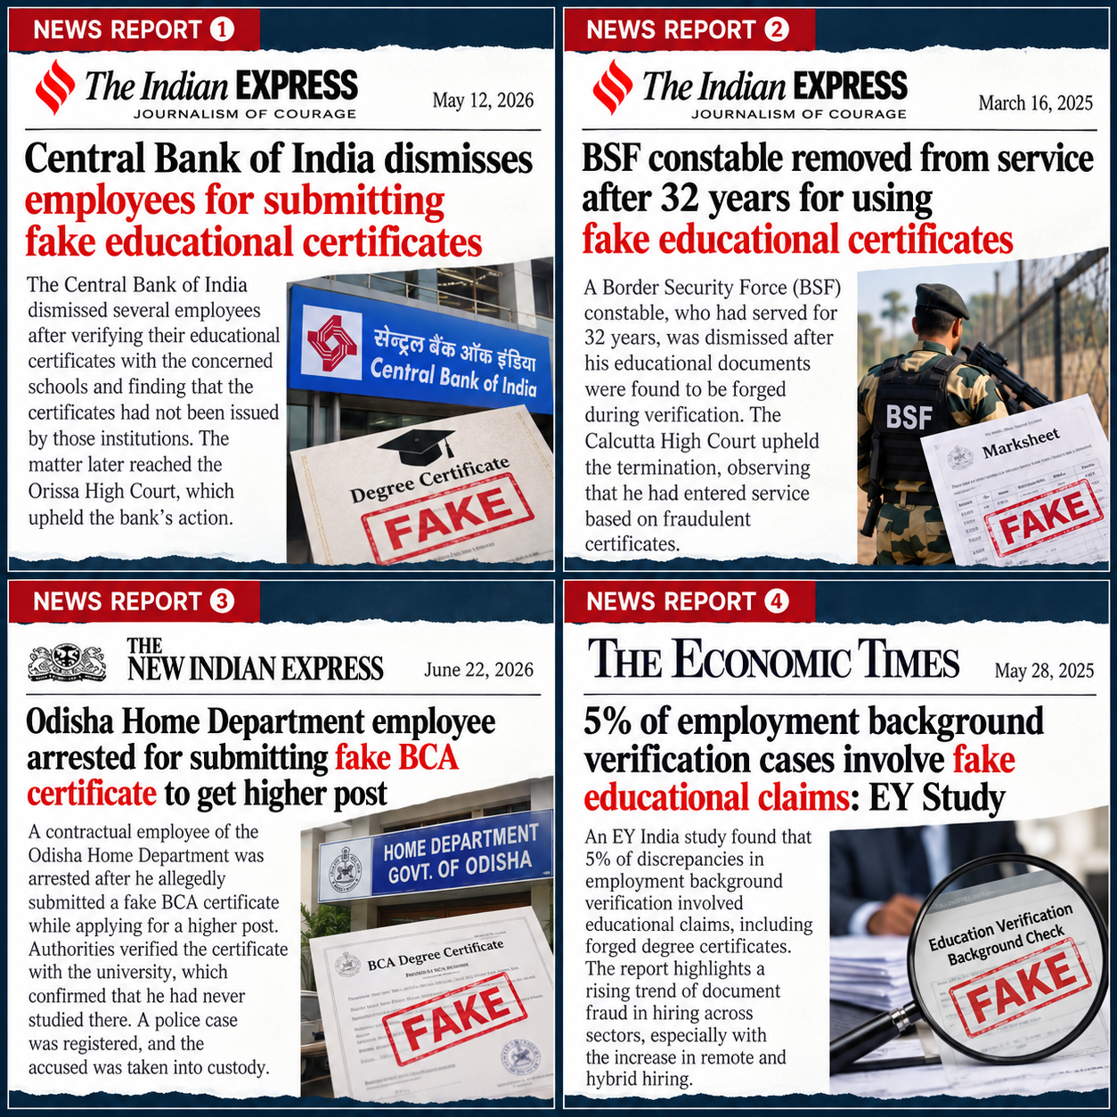
Introduction
Academic credentials — degree certificates, mark sheets, provisional certificates — are still issued and verified largely as paper documents or static PDF/image files.
Verification today depends on manual, institution-specific processes — phone calls, emails, or physical visits to the issuing college — which are slow and do not scale across employers, other universities, and government portals.
Digital certificates can be convincingly edited (fonts, grades, dates) with common editing tools, and a viewer has no independent way to check whether a certificate is genuine or altered.
Blockchain offers a tamper-evident, publicly verifiable record: once a cryptographic fingerprint (hash) of a credential is written on-chain, any change to the original document changes the hash and is immediately detectable.
Fired over ‘fake’ certificates, Central Bank workers
BSF constable — forged educational documents detected
Odisha Home Department — fake BCA certificate
EY India — employment background verification

Slide 4

Review of literature
Sl.No | Author Name, Journal, Publication Year | Research/ Methodology | Performance Metrics | Advantages | Disadvantages
1 | Nikolić, Matić & Čapko — TELFOR, 2022 | "Ethernal" NFT-based certificate on Polygon Supernets | Non-transferable certificate tokens in student wallets | No third-party verifier needed; certificates cannot be resold/transferred | Wallet-based UX unfamiliar to non-technical users; limited performance data
2 | Soe Moe Aye et al. — ICAIT, 2025 | Encrypted, content-addressed records anchored on Ethereum; file in IPFS | SIWE auth; minimal on-chain registry; Ethereum L1 vs ZK-rollup comparison | Strong privacy via proxy re-encryption + key rotation; low on-chain footprint | Added key-management complexity; overhead not fully quantified
3 | Bharati et al. — ICCUBEA, 2024 | Converts paper documents to e-files, hashes them, stores hash on-chain | QR + inquiry codes for mobile/website verification | Simple, practical retrofit for existing paper-based records | Basic hash-only check; no batching or advanced tamper detection
4 | ICIRCA, 2026 | Hybrid model: certificate + Verifiable Credential docs on IPFS | Merkle-tree hash batching; one-click QR verification | Large transaction-cost reduction via batching | Depends on IPFS pinning; Merkle-proof adds client complexity
5 | RCSM, 2025 | Permissioned blockchain + governance layer + layered storage (IPFS/Filecoin/Arweave) | zk-rollup auth; multimodal verification (image, signature, OCR) | 82% lower verification latency, ~100x throughput vs. baseline (reported) | Governance layer adds complexity; permissioned model is less decentralized
6 | ICUIS, 2025 | Ethereum smart contract metadata; file + JSON metadata on IPFS | Dual-hash binding; OCR + NLP semantic verification | 95% name-matching precision on a 400-certificate test set | NLP/OCR pipeline adds overhead; tested at modest scale
7 | ICCAMS, 2025 | Hybrid blockchain: private institutional nodes + public verifier nodes | SHA-256 hashing, QR-embedded signed PDF, BFT consensus | Lightweight — 0.02s block replication, ~200KB RAM/transaction (reported) | Requires institutional node infrastructure; BFT setup complexity

Slide 5
Review of literature (contd.)
Sl.No | Author Name, Journal, Publication Year | Research/ Methodology | Performance Metrics | Advantages | Disadvantages
8 | IEEE Access, 2023 (Systematic Literature Review) | Systematic review of blockchain-based academic certificate verification systems | 34 relevant studies selected from 1,744 papers (2018–2022) | Maps the design space and open problems across the field | Secondary study; no implementation or benchmark
9 | arXiv:2109.11590, 2021 | Tree-based (Merkle) construction for verifiable diplomas with issuer transparency; Solidity implementation | Design and security argument (no large-scale benchmark) | Batching + issuer transparency; informs our Merkle batch design | Research construction; usability and deployment not addressed
10 | Turkanović et al. — IEEE Access, 2018 (EduCTX) | Blockchain credit platform modelled on ECTS; institutions run the peer nodes (Ark platform) | Prototype platform; credits represented as ECTX tokens | Cross-institution credit transfer on a shared ledger | Credit-transfer focus, not degree-certificate verification; older

Slide 6

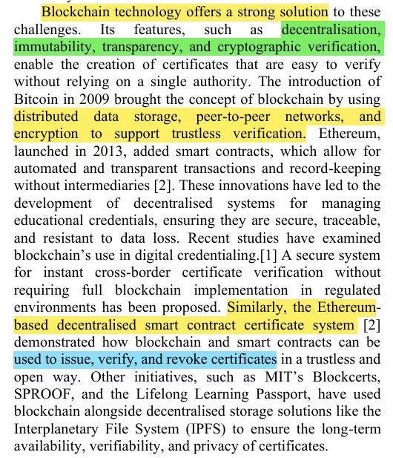
Observations from the Literature Review
Blockchain can make academic certificates more trustworthy by providing decentralization, transparency, immutability, and secure verification. [Img-1]
Smart contracts can make certificate management easier and more automated, especially for issuing, verifying, and revoking certificates. [Img-1, Img-4]
Most approaches combine blockchain with IPFS, keeping the actual certificate file off-chain while storing its hash or reference on the blockchain for verification. [Img-2, Img-4]
QR codes make certificate verification quick and convenient by connecting the certificate directly to its blockchain/IPFS record. [Img-3, Img-4]
OCR and NLP can make verification more reliable by extracting information from a certificate and comparing it with the trusted blockchain record. [Img-2, Img-4]
Newer approaches go beyond simple hash checking and try to detect changes in the actual certificate content, even when the visual format looks unchanged. [Img-2]
The research shows a move toward a complete digital verification process, from generating and storing certificates to QR-based access and automated verification. [Img-3, Img-4]
Overall, the reviewed systems use blockchain mainly for trust and verification, while IPFS is used to store the actual certificate documents. [Img-1, Img-2, Img-4]
Image-1

Slide 7
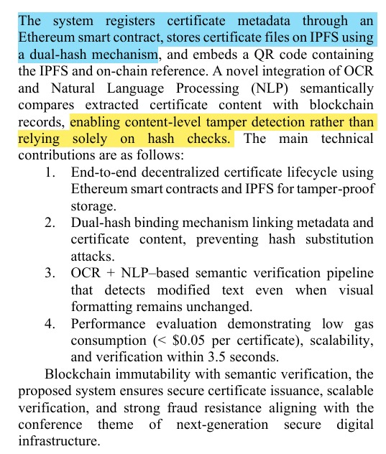
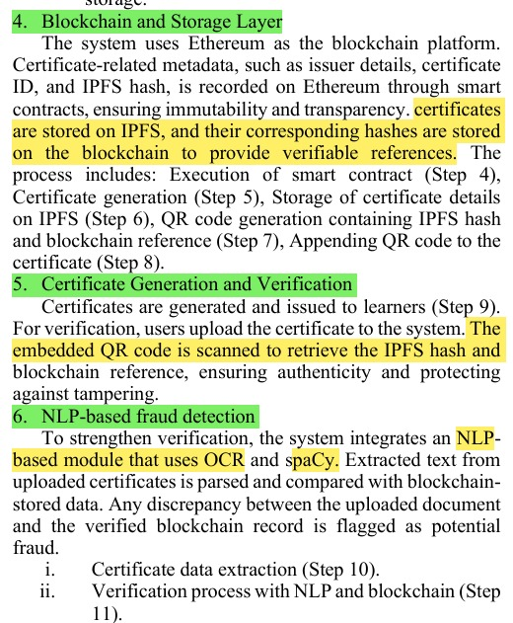
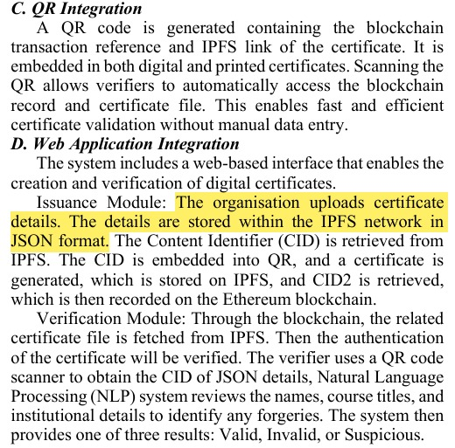
Observations from the Literature Review
Image-3
Image-4
Image-2

Slide 8

Limitations from the Literature Review
Existing Research / Finding | Gap / Limitation | Our Project Approach
Too much data stored on blockchain can increase cost and expose metadata. | High cost & privacy risk | Store certificate details off-chain; keep only essential hash/ID on blockchain.
Many systems are tested only in small or limited environments. | Scalability is not fully proven | Use lightweight blockchain records and off-chain certificate storage.
Different universities may use different blockchain and certificate systems. | Limited interoperability | Use APIs, credential ID and QR-based verification for easier integration.
Blockchain records are tamper-proof, but student information can still be exposed. | Privacy concerns | Keep detailed student information off-chain and use role-based access.
Existing studies do not always provide consistent performance comparisons. | Limited performance evaluation | Measure verification time, transaction time, storage size and success rate.
Advanced solutions such as DIDs, zero-knowledge proofs and cross-chain systems add complexity. | Complex implementation | Focus on a simpler hybrid architecture suitable for a practical prototype.

Slide 9

Problem Statement / Scope of the Project
Problem Statement
Degree certificate forgery remains a serious problem in India, affecting employers, educational institutions, and students. Manual verification processes are slow, expensive, and prone to error. There is no standardized, tamper-proof system for issuing and verifying academic credentials. Students face delays in employment and higher education admissions due to cumbersome verification procedures.
Scope:
The project covers the issuance, secure storage, verification, and revocation of academic certificates using blockchain and off-chain storage. It includes an Admin/Issuer dashboard, Student interface, and Verifier portal, with QR codes and credential IDs for quick verification. The system will also support secure management of certificate records and detection of altered or revoked certificates

Slide 10

Proposed Idea
A blockchain-backed verification layer added on top of the university's existing academic-record system.
Our proposed idea connects colleges and students by issuing blockchain-verified digital certificates that students can securely share and verify anywhere.
  The college database continues to manage full student and academic data as normal.
  At issuance, a SHA-256 hash of each credential — plus issuer ID, credential type and status — is written to a smart contract on an Ethereum-compatible network.
  Students receive their usual certificate plus a QR code; anyone — an employer, another university, a government portal — can scan the QR or enter the credential ID to instantly recompute and compare the hash on-chain, without contacting the university.
  Revocation updates the on-chain status rather than deleting historical data, so the full issue-to-revoke trail stays auditable.

Slide 11
Objectives — Status at Review 2
Objective (from Review 1) | Delivered in Review 2 | Status
Smart-contract registry storing only hash + status | CredentialRegistry.sol on Sepolia: hash, issuer, time, status | Done
Three-role frontend (Admin, Student, Verifier) | Live on Vercel; real logins for registrars and students | Done
REST backend with JWT roles + blockchain bridge | Express API, JWT + RBAC, ethers.js bridge, PDF + QR | Done
Instant self-service verification (QR / ID) | By credential ID, printed certificate no., QR or PDF upload | Done
Auditable revocation (valid / invalid / revoked) | On-chain state change + event history per credential | Done
Evaluate against realistic failure scenarios | 10 scenarios automated; 71 tests; gas + latency benchmark | Done
Future work named in Review 1: Merkle batching | One transaction per university batch (17 batches on Sepolia) | Done

Slide 12

Proposed Research / Methodology
Iterative, module-by-module build-and-test methodology:
Module / Stage | Methodology
Requirements & System Design | Study requirements and define Admin, Student, and Employer/Verifier roles, data flow, and on-chain/off-chain separation.
Academic Data Layer | Use PostgreSQL to manage student, academic, and administrative records off-chain, integrated with existing college data.
Frontend Development | Develop React.js interfaces for the Admin Console, Student Portal, and Verification UI.
Backend Development | Develop Node.js + Express REST APIs for authentication, credential management, verification, and blockchain integration.
Smart Contract Development | Develop Solidity smart contracts with issueCredential, verifyCredential, and revokeCredential functions on an Ethereum-compatible test network.
Credential Integration | Generate a SHA-256 hash, QR code, and PDF certificate for each credential and connect the backend to the smart contract using ethers.js.
Verification & Testing | Verify credentials through QR scanning or Credential ID lookup and perform 10 structured test scenarios covering valid, modified, revoked, unauthorized, and infrastructure-failure cases.
Deployment & Evaluation | Deploy the prototype with the frontend on Vercel, online backend APIs, and smart contract on an Ethereum-compatible test network, followed by real-world scenario evaluation.

Slide 13

Hardware Requirements
Requirement | Details
Development Machine | Intel i5 / AMD Ryzen 5 or higher, 8 GB RAM minimum (16 GB recommended), SSD storage.
Institutional Hardware | No specialized hardware is required; blockchain network and hosting are cloud/testnet-based.
Smartphone for Verification | A modern smartphone for QR-code scanning during certificate verification.
Internet Connectivity | Stable internet connection for accessing the blockchain test network and cloud-hosted services.

Slide 14

Software Requirements
No. | Category | Software / Technologies
1 | Programming Languages | Solidity 0.8.24, JavaScript (Node.js 20), SQL
2 | Frontend | React.js 19 + Vite, Tailwind CSS (Vercel)
3 | Backend | Node.js + Express REST API (Vercel serverless function)
4 | Blockchain | Ethereum Sepolia testnet, OpenZeppelin, Hardhat
5 | Storage & Database | PostgreSQL 17 on Supabase (IPFS planned)
6 | Integration & Security | ethers.js v6, MetaMask, JWT, scrypt, Helmet
7 | Development Tools | Git/GitHub, Vercel CLI, Docker, Mocha/Chai

Slide 15

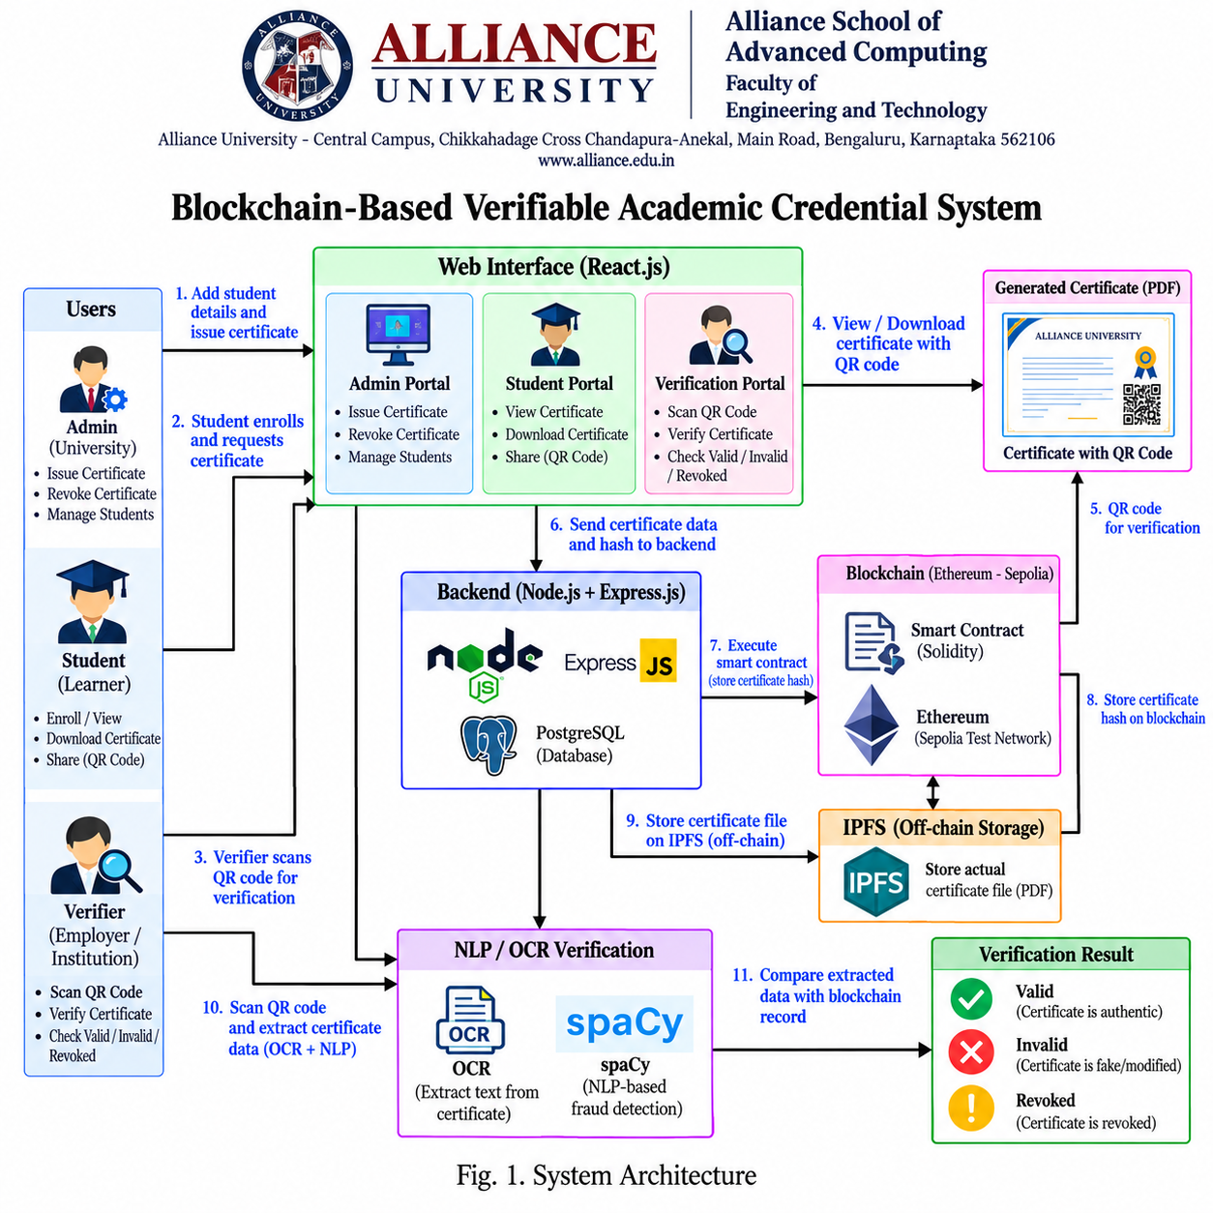
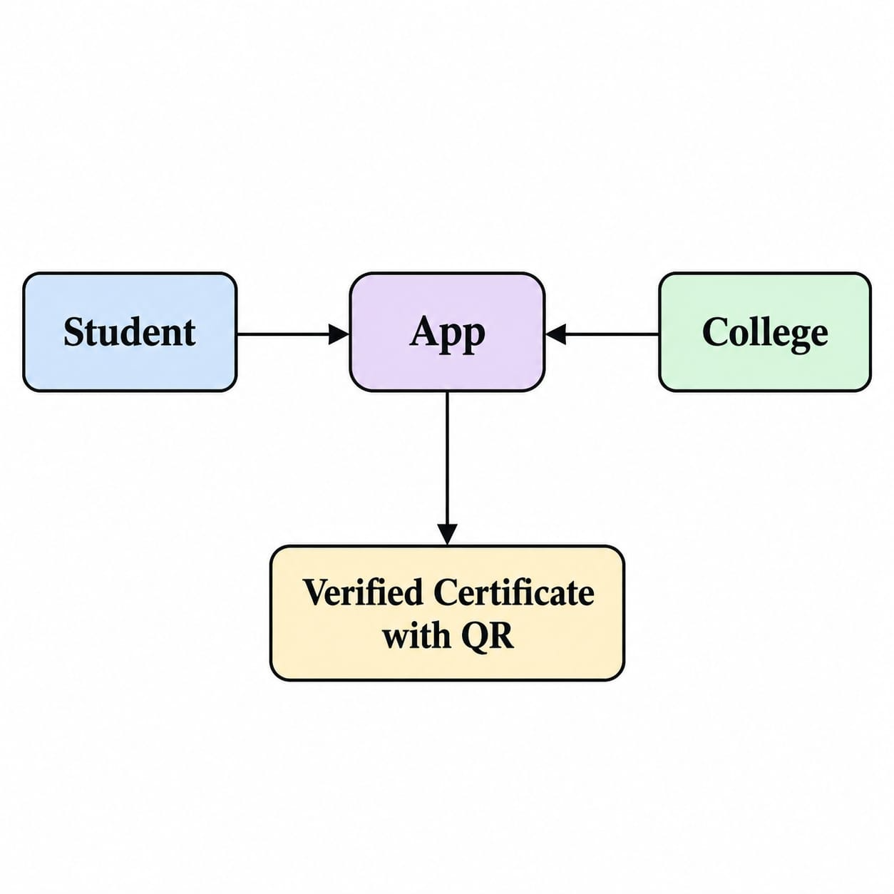
Flow Diagram

Slide 16
System Architecture (Implemented)
Users
Platform admin
University registrars
Students
Employers / verifiers
React frontend
Admin Console
Student Portal
Verification UI
(Vercel)
Express REST API
JWT + RBAC, rate limits
SHA-256, PDF, Merkle trees
Vercel serverless
HTTPS
ethers.js
SQL / TLS
Data placement
On-chain: SHA-256 fingerprint, issuer address, timestamps, status, batch roots
Off-chain: names, register numbers, grades, emails, reasons, Merkle proofs
Verification trusts the chain and cross-checks the database record
Supabase PostgreSQL
13 tables, RLS on all
verified TLS
students, records, audit
Ethereum Sepolia
CredentialRegistry
17 university wallets
Merkle batch roots

Slide 17

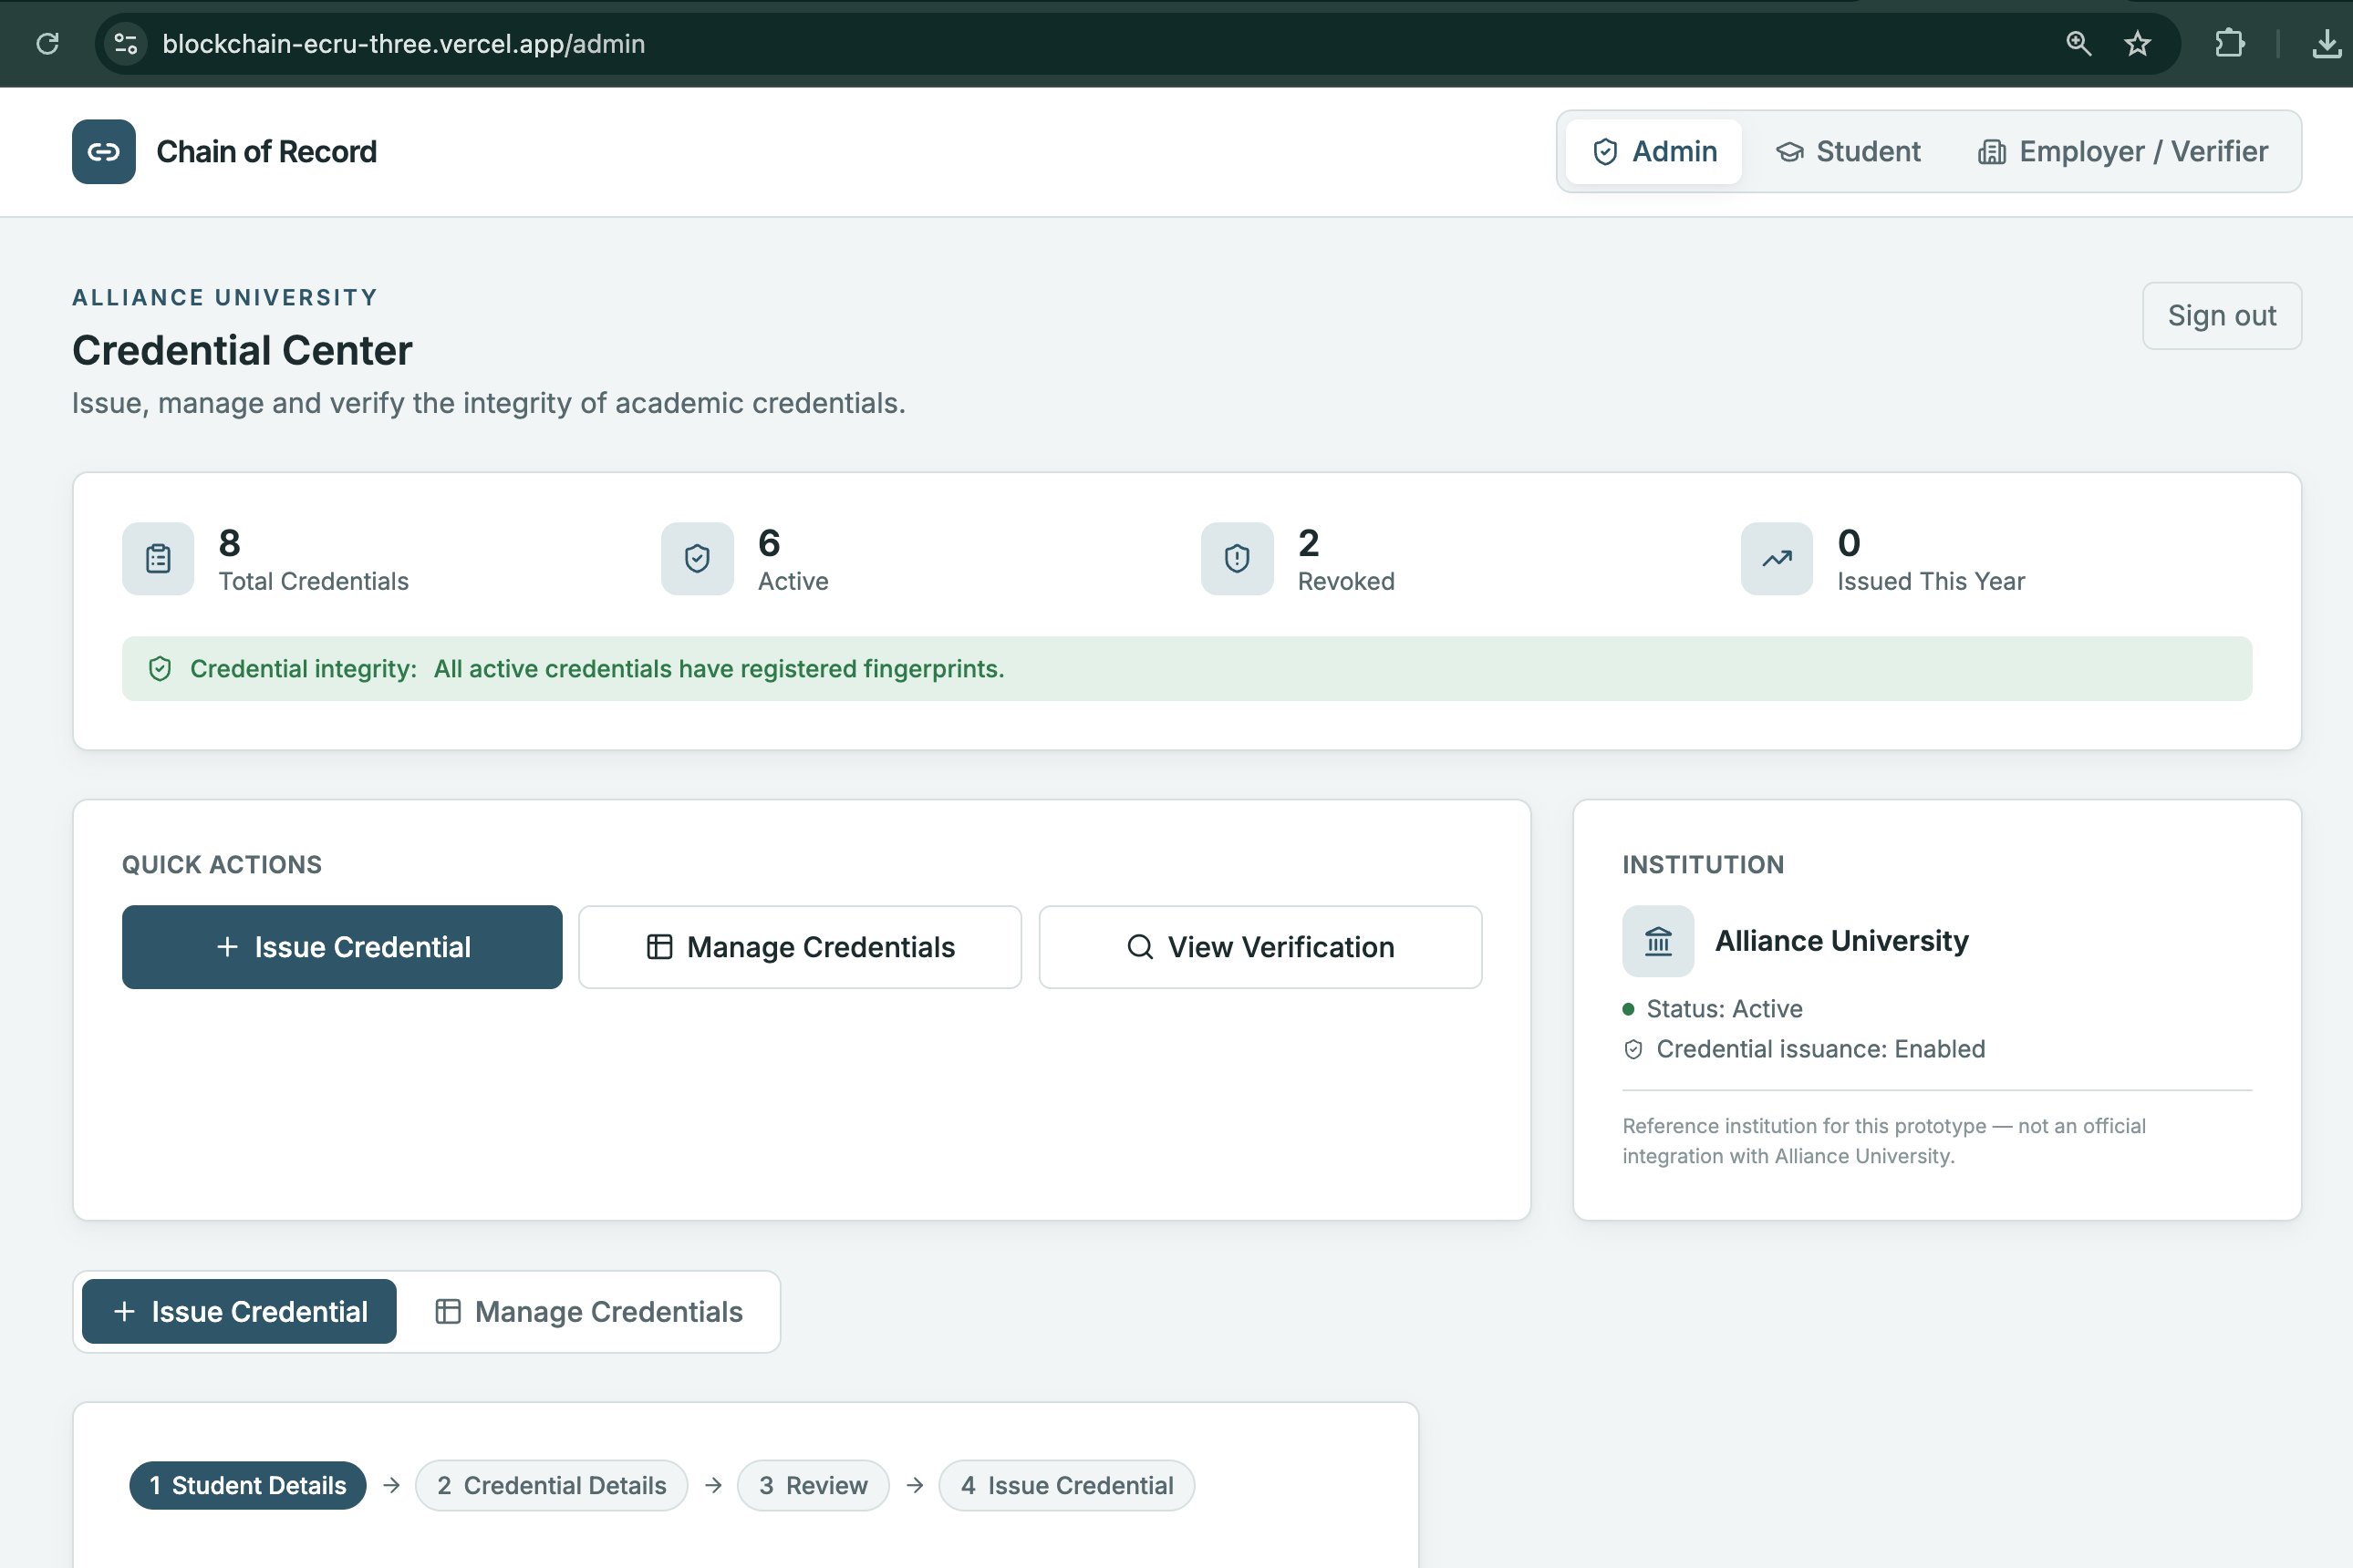
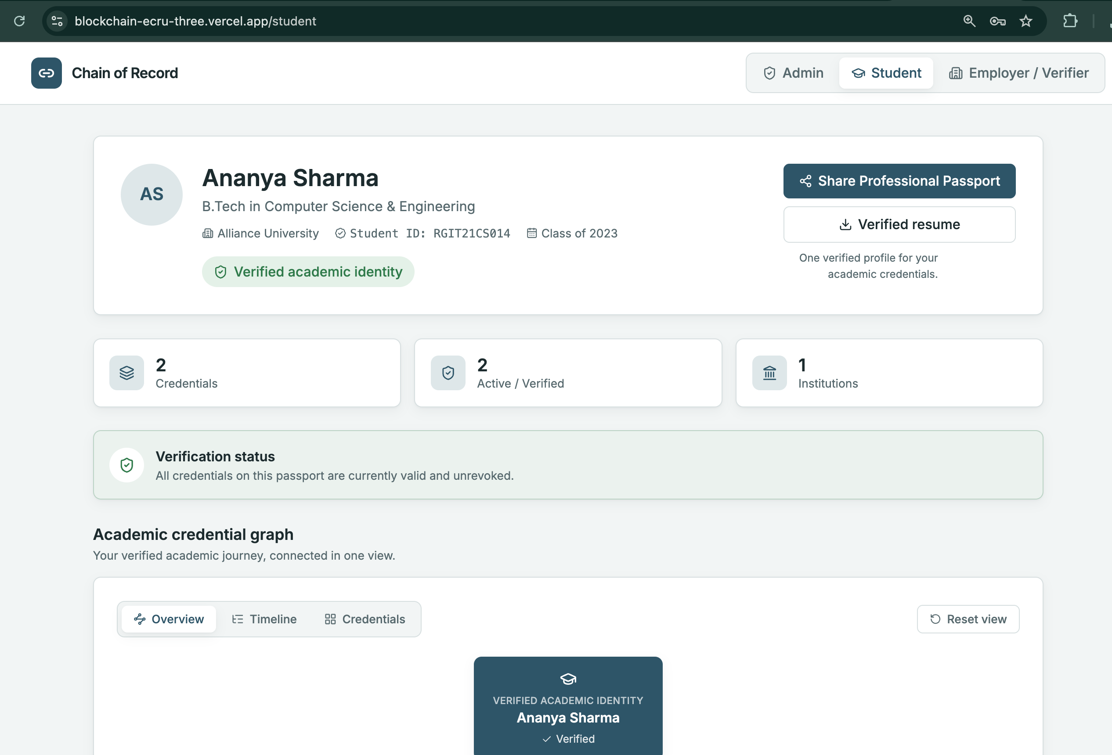
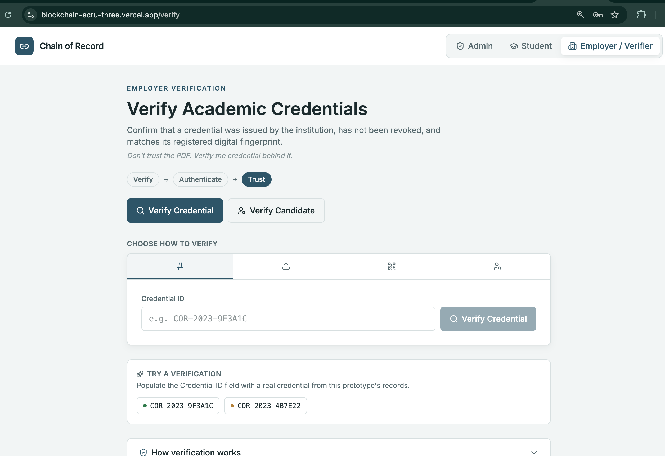
Proposed Modules
1. Admin Console Module — credential issuance, revocation, and record management (Admin role).
2. Student Portal Module — credential viewing, download, and QR-based sharing (Student role).
3. Verification Module — QR scan / credential-ID lookup and hash comparison (Employer / public role).
4. Blockchain & Backend Services Module — Auth Service, Credential Service, Verification Service, Blockchain Bridge, and the Solidity smart-contract registry.
Admin console module
Student portal module
Verification Module

Slide 18
Smart Contract: CredentialRegistry.sol
Function | Purpose
issueCredential(id, hash) | Anchor one certificate fingerprint
anchorBatch(root, count) | Anchor a whole batch as one Merkle root
revokeCredential / revokeBatchCredential | Status change; history kept
verifyCredential / verifyBatchCredential | Free read-only checks
setIssuer(address, name, active) | Authorise a university's wallet
pause() / unpause() | Emergency stop (verify still works)
transferOwnership / acceptOwnership | Two-step ownership transfer
Built on OpenZeppelin
Ownable2Step, Pausable, MerkleProof
Custom errors: duplicate ID, wrong issuer, already revoked
Events give a full issue → revoke audit trail
Merkle batching
One transaction per university: up to 156 certificates
Each certificate keeps a short proof (4–9 hashes)
Double-hashed leaves prevent second-preimage attacks

Slide 19
Academic Data Layer: Supabase PostgreSQL
13
4
TLS
0
tables, Row Level Security on all
versioned SQL migrations
verified with Supabase CA
rows readable via public API key
Academic registry
institutions, colleges, programs
students (masked Aadhaar / mobile)
enrollments, semester_results
degree_certificates (33 attributes)
Verification layer
credentials: anchored record + Merkle proof
lookup by credential ID, certificate no. or hash
nad_awards (DigiLocker NAD template)
verification_requests (666 test cases)
Accounts & audit
users: scrypt hashes, lockout state
university wallets: AES-256-GCM encrypted
audit_log: append-only (trigger blocks edits)
constraints enforce valid hashes and statuses

Slide 20
Security Controls
1
Tamper detection
SHA-256 on-chain; a 1-byte edit fails verification
2
Fake issuers
Only universities approved on-chain are trusted
3
Database tampering
Each check compares the record with the chain
4
Account security
scrypt passwords, lockout after 5 failures, 1-h JWT
5
API hardening
Rate limits, Helmet headers, CORS allow-list, input limits
6
Secrets
Keys only in env vars; wallet keys encrypted at rest
7
Data exposure
Row Level Security blocks Supabase's public API
8
Fail-safe
Chain unreachable → 'unavailable', never a false pass

Slide 21
Dataset: Karnataka Degree Registry
17
2,000
10,407
1,604
666
universities
students
semester results
degree certificates
labelled test cases
About the data
Synthetic records in the DigiLocker NAD layout; university names real, people not
Includes colleges, programs, enrollments and SGPA per semester
Not-valid certificates are revoked on-chain with the registry's reason
666 VALID / INVALID requests give ground truth for evaluation

Slide 22
Novelty of the Proposed Idea
Minimal on-chain footprint
Hash + issuer + status only; no personal data on-chain
Per-university trust
Each university signs with its own on-chain identity
Batch anchoring
A whole graduating class in one Merkle-root transaction
Two-sided integrity
Chain checks the document; the record is checked against the chain
Auditable revocation
State change with reason hash; never deletion
Complete, deployed system
All three roles live on Vercel, Supabase and Sepolia
The novelty is the integrated, deployable design, not a new blockchain primitive.

Slide 23

Experimentation
All 10 scenarios are automated end-to-end tests that run against the real Solidity contract and Express API (71 automated tests in total, all passing):
Test case​ | Condition​ | Result​
Valid credential​ | Original certificate​ | Verified​
Modified certificate​ | PDF content changed​ | Hash mismatch​
Invalid credential ID​ | Unknown ID​ | Not found​
Revoked credential​ | University revoked it​ | Revoked​
Wrong issuer​ | Unauthorized issuer​ | Verification failed​
Duplicate credential ID​ | Existing ID reused​ | Rejected​
Unauthorized issuance​ | Non-admin attempts issue​ | Access denied​
Blockchain unavailable​ | Network / contract down​ | Unavailable​
Invalid file format​ | Corrupted / unsupported​ | File rejected​
Corrected credential​ | Old revoked, new issued​ | New credential valid​

Slide 24
Results: Cost, Storage and Accuracy
0.17%
128 B
per credential, 500-batch vs single
on-chain per credential (fixed)
100%
100%
genuine certificates verified (50/50)
1-byte forgeries caught (50/50)
Measured with npm run benchmark (Hardhat EVM):
Issue ≈ 125k gas, revoke ≈ 45k gas, verify free
Verify by ID or PDF ≈ 1.5 ms on the local stack
Revoked credentials reported as revoked: 10/10

Slide 25
Results and Discussion
Results
All 10 Review-1 scenarios pass as automated end-to-end tests
71 automated tests: contract, Merkle batches, security, PostgreSQL
1,604 Karnataka certificates anchored on Sepolia in 17 transactions
Each university signs with its own authorised wallet
Suspending a university makes its credentials fail verification
System fails safe when the blockchain is unreachable
Discussion
Confirms the literature: hash-anchored, off-chain-data design gives tamper evidence cheaply
Merkle batching (future work in Review 1) now cuts per-credential cost by 99%+
Public testnet confirmations (~12 s) affect issuance only; verification stays instant
OCR/NLP content checks and IPFS storage remain future work

Slide 26
Deployment
Component | Where it runs | Address / detail
Frontend + API | Vercel (serverless function) | https://blockchain-ecru-three.vercel.app
Smart contract | Ethereum Sepolia testnet | 0xA34BE0F943de87b2414da6Ea44A49c2bb8d5B37a
Database | Supabase PostgreSQL 17 (Tokyo) | Session pooler, verified TLS, RLS on all tables
Source code | GitHub | github.com/anilkumaruk/blockchain (branch review-2)
Secrets | Vercel environment variables | Never in code or git; private keys entered by the team
Roles available on the live system
Platform admin (Alliance University) · 4 university registrars · 15 students across 15 universities · public verifier

Slide 27
Conclusion & Future Directions
Conclusion
A blockchain verification layer on top of a university database is practical and cheap
Delivered: contract on Sepolia, API, three portals and Supabase registry
Validated with 10 scenarios, 71 tests and a 1,604-certificate dataset
Employers verify instantly without contacting the university
Future directions
Run the 666 labelled requests as an accuracy benchmark
OCR + NLP checks for scanned certificates
IPFS storage for certificate files
Hardware-wallet or multisig keys for universities
Student email verification and SSO login
Integration with DigiLocker / NAD

Slide 28

References
Authors, Year, Title of the Paper, Journal / Conference, Volume and Page Details, DOI
1. S. Nikolić, S. Matić, and D. Čapko, "Development of a Blockchain-Based Application for Digital Certificates in Education," in 2022 30th Telecommunications Forum (TELFOR), Novi Sad, Serbia, 2022, doi: 10.1109/TELFOR56187.2022.9983672.
2. S. M. Aye et al., "Electronic Student Records on Ethereum: File Management Model and Comparative Analysis," in 2025 6th Int. Conf. on Advanced Information Technologies (ICAIT), 2025, doi: 10.1109/ICAIT68809.2025.11236794.
3. R. Bharati et al., "Document Generation and Validation using Blockchain," in 2024 8th Int. Conf. on Computing, Communication, Control and Automation (ICCUBEA), Pune, India, 2024, doi: 10.1109/ICCUBEA61740.2024.10774827.
4. "Blockchain-based Verifiable Credentials for Secure One-Click Academic Certificate Verification," in 2026 7th Int. Conf. on Inventive Research in Computing Applications (ICIRCA), 2026, doi: 10.1109/ICIRCA69024.2026.11570435.
5. "Management of Academic Credentials via Hybrid Blockchain and Off-Chain Storage," in 2025 IEEE 1st Int. Conf. on Recent Trends in Computing and Smart Mobility (RCSM), 2025, doi: 10.1109/RCSM67767.2025.11507688.
6. "A Blockchain and IPFS-based Framework for Secure and Verifiable E-Learning Certificates using Ethereum Smart Contracts," in 2025 5th Int. Conf. on Ubiquitous Computing and Intelligent Information Systems (ICUIS), 2025, doi: 10.1109/ICUIS67429.2025.11380207.
7. "A Lightweight Blockchain Framework for Secure Academic Credential Verification Using Python and Docker," in 2025 2nd Int. Conf. on New Frontiers in Communication, Automation, Management and Security (ICCAMS), 2025, doi: 10.1109/ICCAMS65118.2025.11234493.
8. "A Systematic Literature Review on Blockchain-Based Systems for Academic Certificate Verification," IEEE Access, 2023, doi: 10.1109/ACCESS.2023.3289598.
9. "A Tree-based Construction for Verifiable Diplomas with Issuer Transparency," arXiv preprint arXiv:2109.11590, 2021.
10. M. Turkanović, M. Hölbl, K. Košič, M. Heričko, and A. Kamišalić, "EduCTX: A Blockchain-Based Higher Education Credit Platform," IEEE Access, vol. 6, pp. 5112–5127, 2018, doi: 10.1109/ACCESS.2018.2789929.

Slide 29

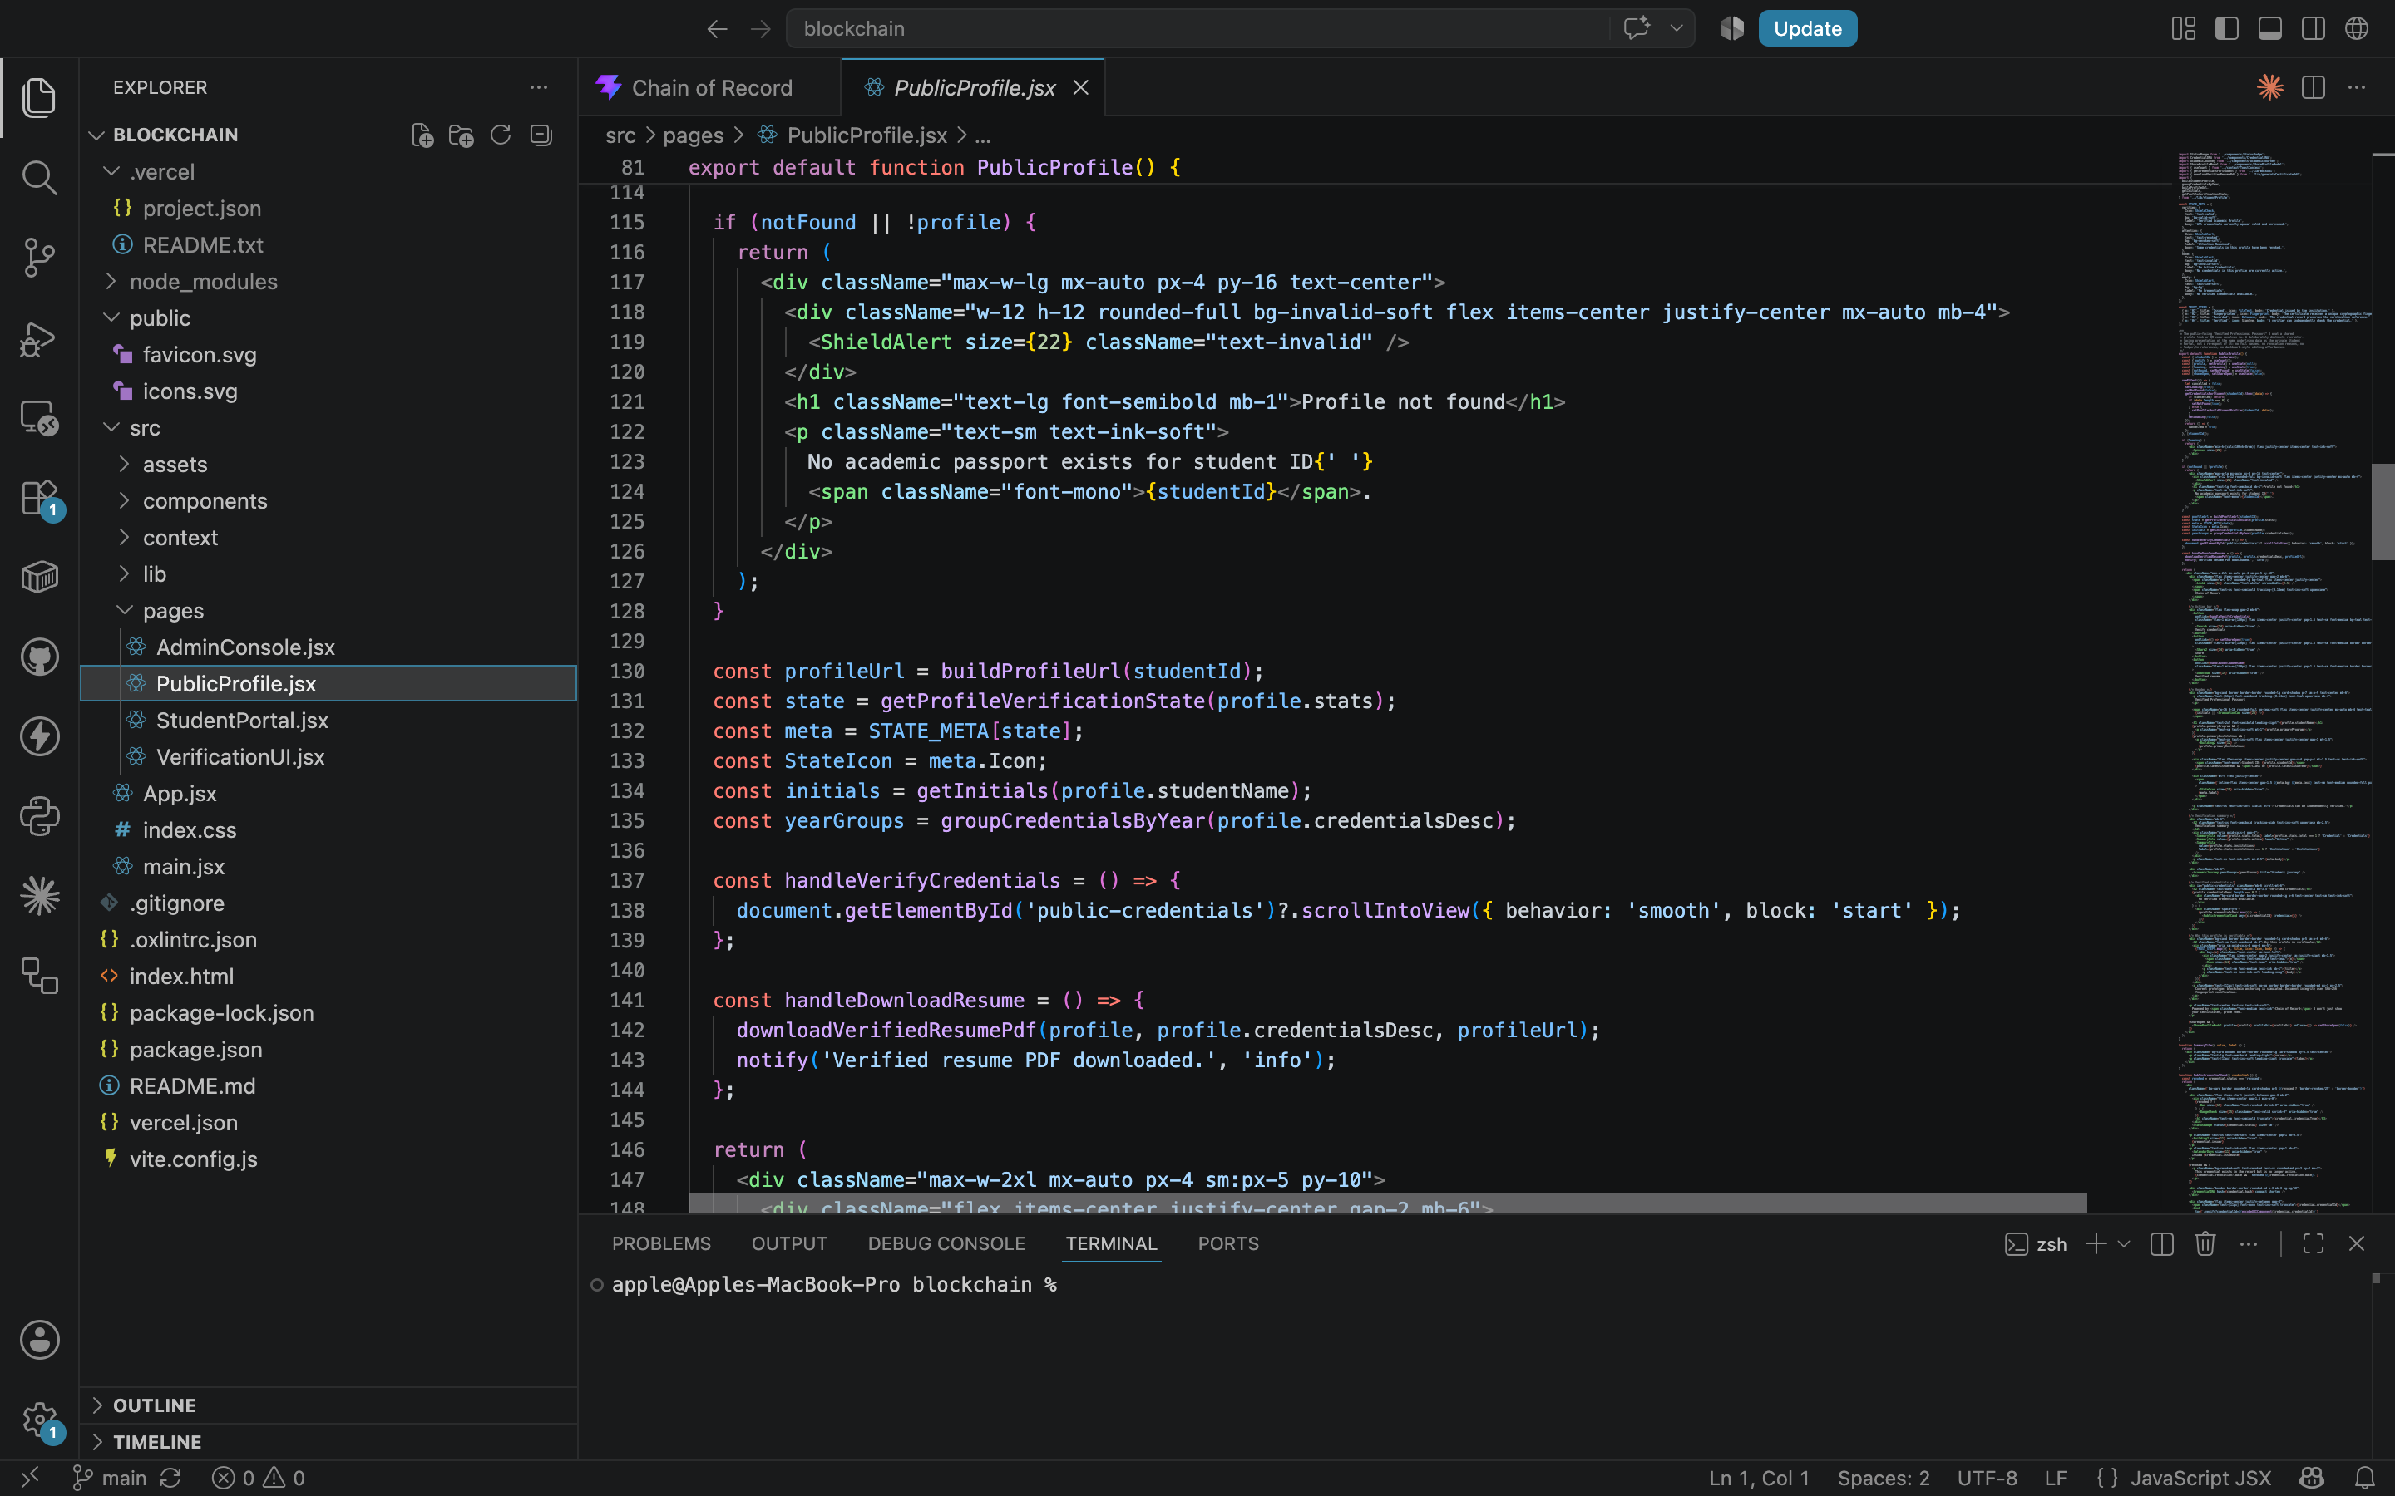
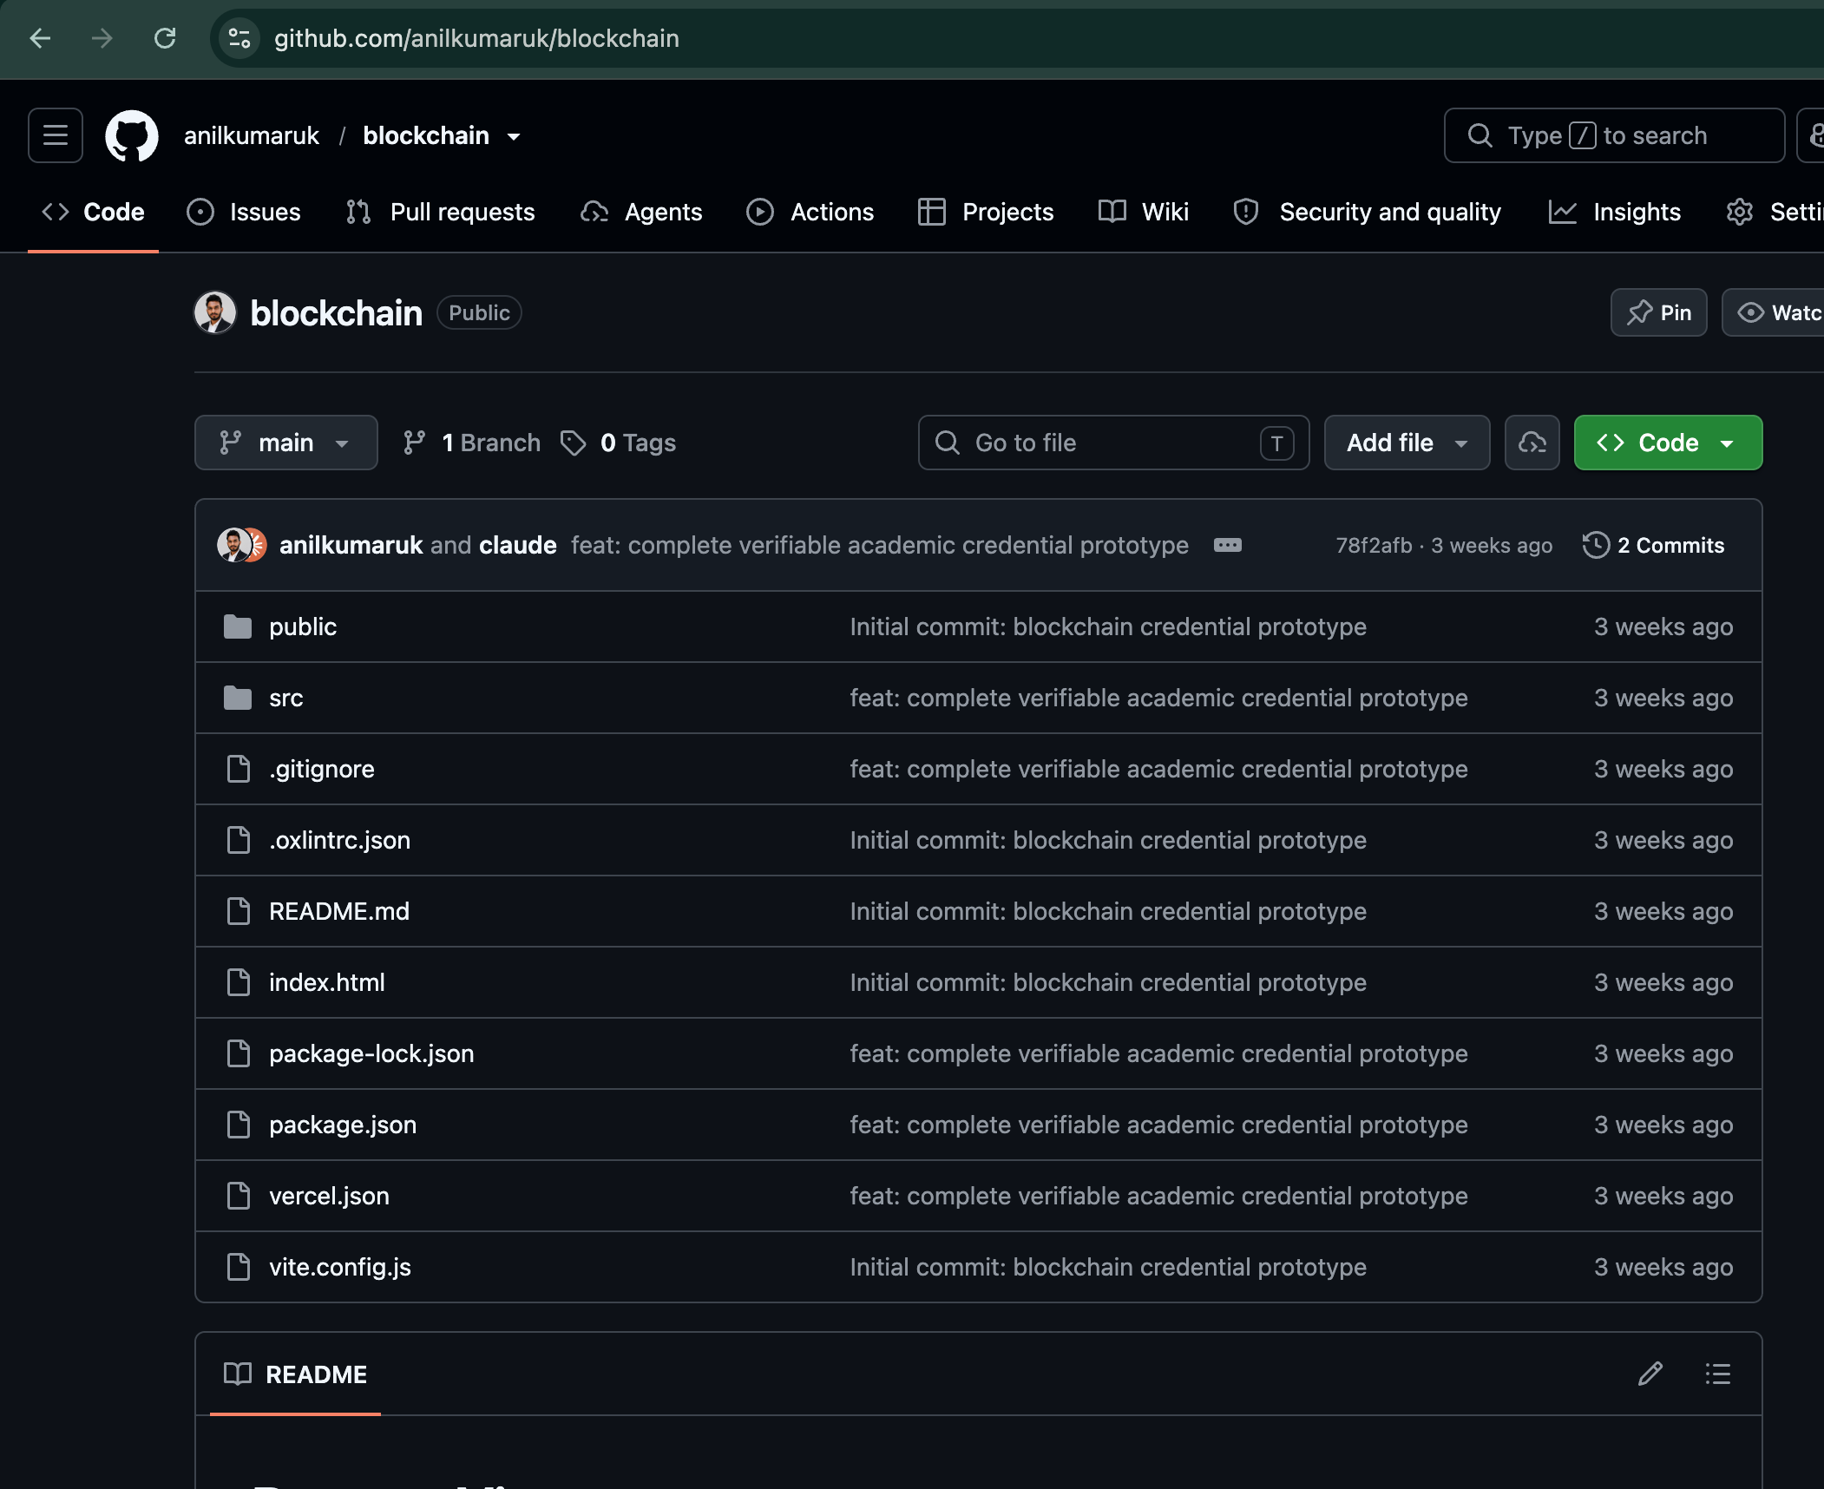
Implementation (Sample of the Source Code)
Prototype code : https://github.com/anilkumaruk/blockchain
Prototype : https://blockchain-ecru-three.vercel.app

Slide 30
Submission Page of the Paper
This slide is a placeholder for institutional evidence that only you can supply.
  Insert a screenshot of the paper-submission confirmation page (conference/journal portal, or your department's submission tracker) showing the project/paper title, submission ID, and date.
  If no paper has been submitted yet, note the planned submission venue and target date here instead.

Slide 31

Plagiarism Report
This slide is a placeholder for your actual plagiarism-check report.
  Insert a screenshot or summary of the similarity report (Turnitin / Urkund / your institution's tool) showing the similarity percentage and report ID.
  Run the full report text of this presentation and the accompanying project document through your institution's plagiarism-checking tool before submission.

