Slide 1
Generative Adversarial Networks

Slide 2
Introduction:-
GANs are introduced by IanGood fellow in 2014.
GANs are an unsupervised learning method.
GANs contains two adversarial networks which are always competing each other
A Generator(An artist) neural network.
A Discriminator(An art critic) neural network.

Slide 3
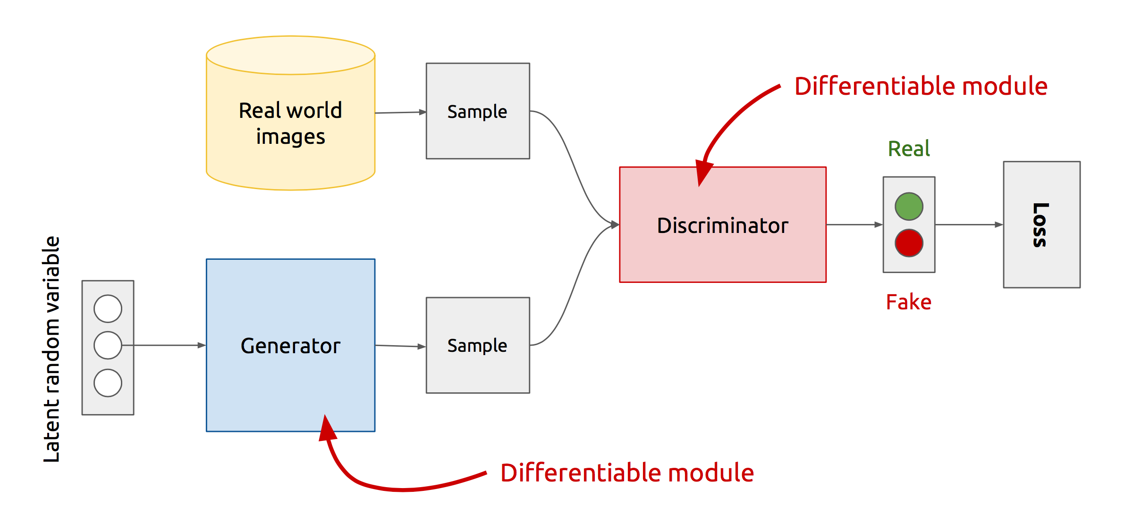
GAN’s Architecture:-

Slide 4
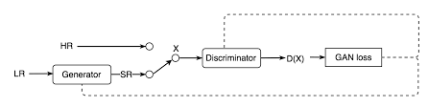
Super Resolution GAN (SRGAN)
Super-resolution GAN applies a deep network in combination with an adversary network(GAN) to produce higher resolution images from lower resolution Images.

Slide 5
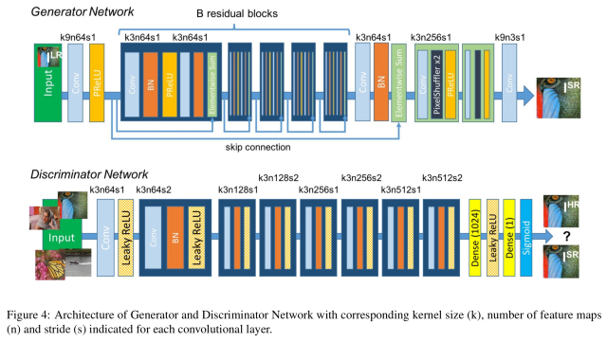
SRGAN Architecture

Slide 6
Conditional GAN (CGAN)
Conditional GANs are a very interesting extension to the GAN framework.
CGANs are allowed to generate images that have certain conditions or attributes.
If we want to generate particular data from generator then we have to give that particular condition to both generator and discriminator.
That condition should be in the form of One-hot code vector only.

Slide 7
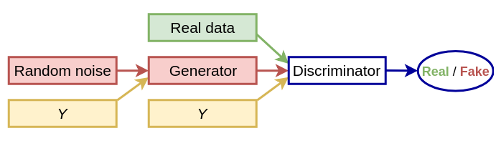
Architecture of CGAN

