Slide 1
Genrative
Adversarial
Networks

Slide 2
Introduction:-
GANs are introduced by IanGood fellow in 2014.
GANs are an unsupervised learning method.
GANs contains two adversarial networks which are always competing each other
A Generator(An artist) neural network.
A Discriminator(An art critic) neural network.

Slide 3
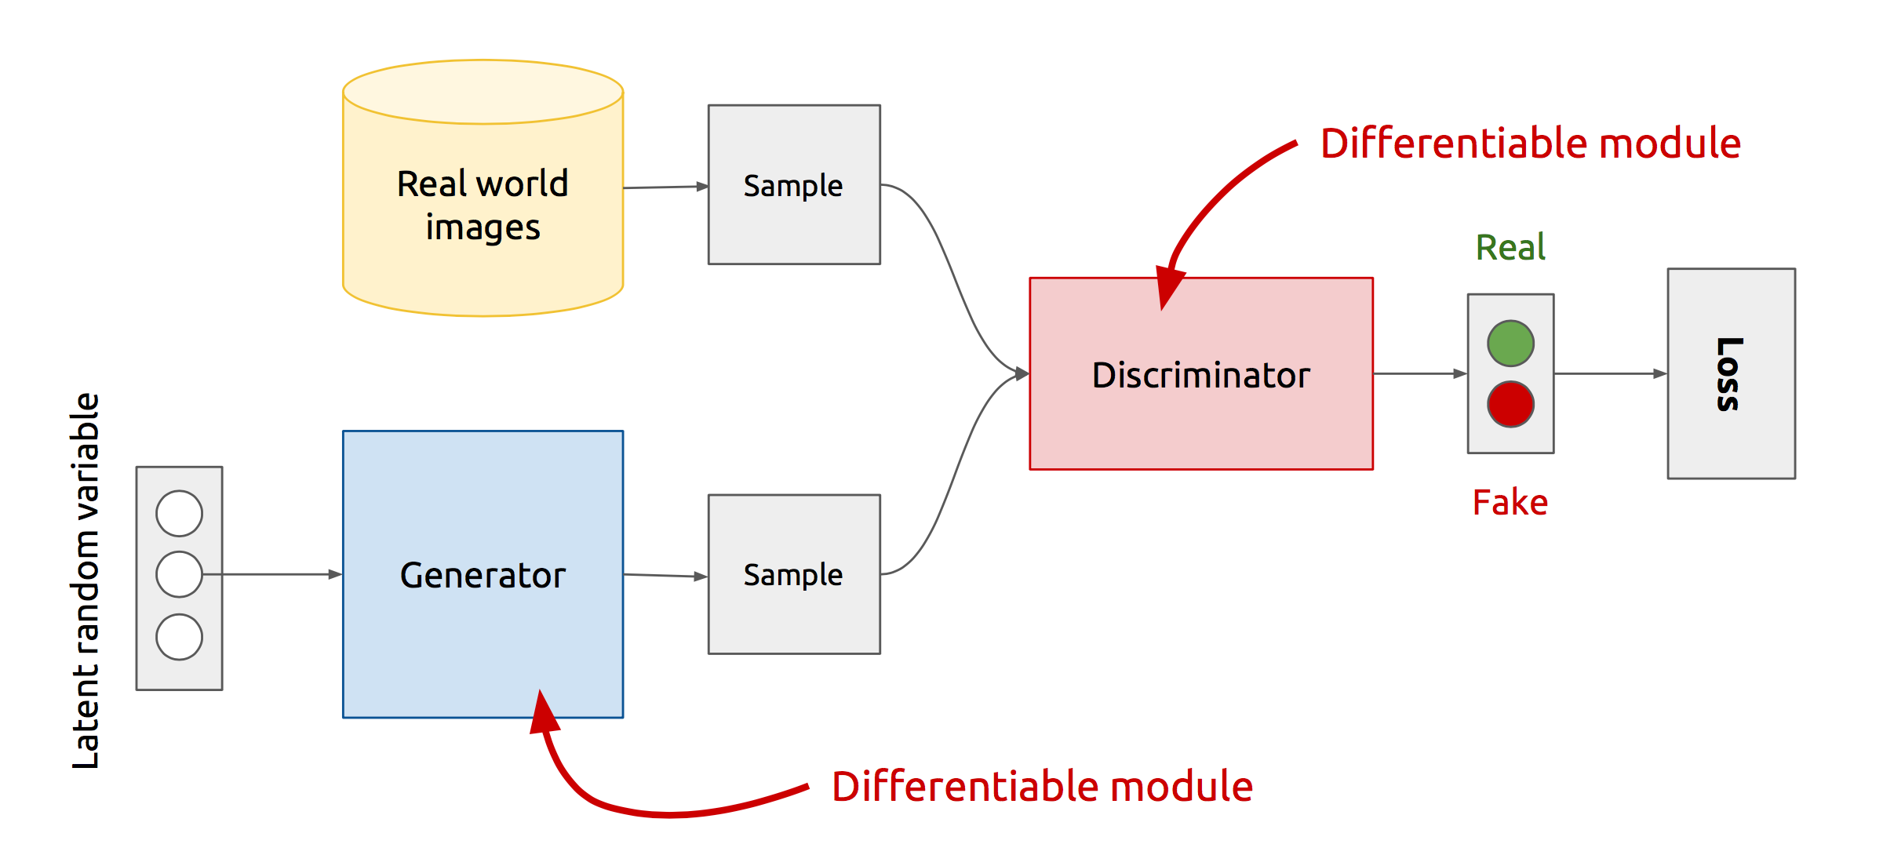
GAN’s Architecture:-

Slide 4
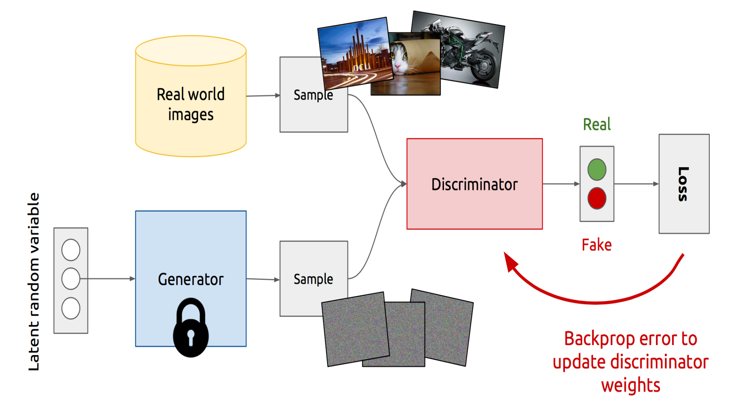
Training discriminator :-

Slide 5
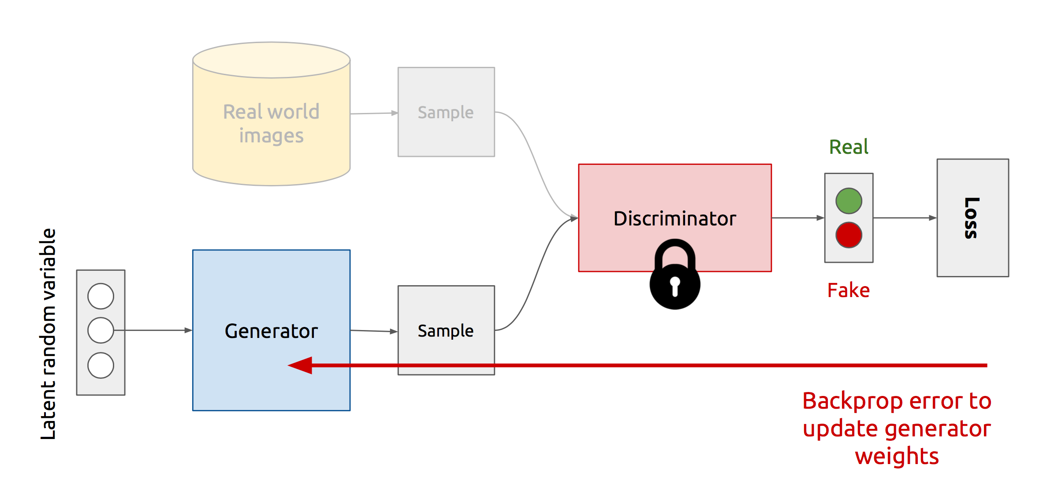
Training generator:-

Slide 6
Types of GAN’s:-
Conditional GAN (cGAN)
Deep Convolutional GAN (DCGANs)
Stack GAN
InfoGAN
Wasserstein GANs
Discover Cross-Domain Relations with Generative Adversarial Networks(Disco GANS)

Slide 7
Conditional GAN:-
Conditional GANs are a very interesting extension to the GAN framework.
CGANs are allowed to generate images that have certain conditions or attributes.
If we want to generate particular data from generator then we have to give that particular condition to both generator and discriminator.
That condition should be in the form of One-hot code vector only.

Slide 8
Architecture of CGAN:-
Real data
Noise
Generator
Discriminator
0/1
Condition
Condition

Slide 9
Generator:-
The generator network is heavily inspired by the architecture of U-Net.
The architecture of U-Net is almost the same as that of an auto-encoder network.
One major difference between them is that the U-Net network has skip connections between the layers in the encoder, and the decoder parts of the generator network and auto-encoder doesn't have skip connections.
The U-Net network consists of two networks: the encoder network and the decoder network. The following diagram illustrates the architecture of U-Net at a basic level:

Slide 10
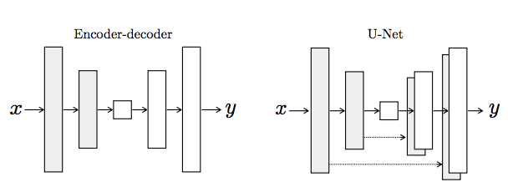
U-Net :-

Slide 11
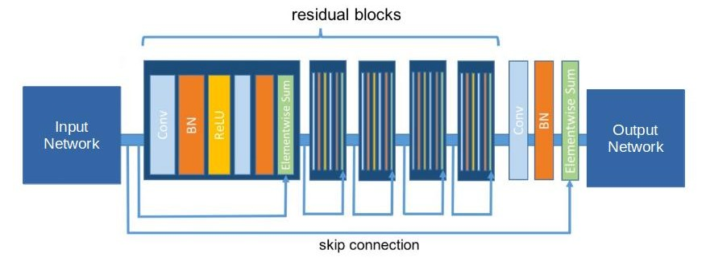
ResNet :-

Slide 12
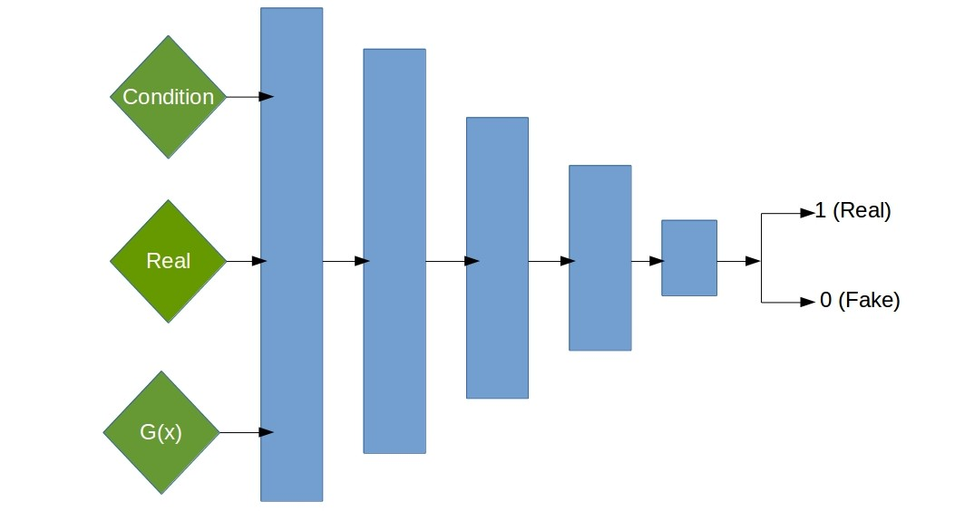
Discriminator:-
The architecture of the discriminator network in CGAN is inspired by the architecture of the PatchGAN network. The PatchGAN network contains eight convolutional blocks.

Slide 13
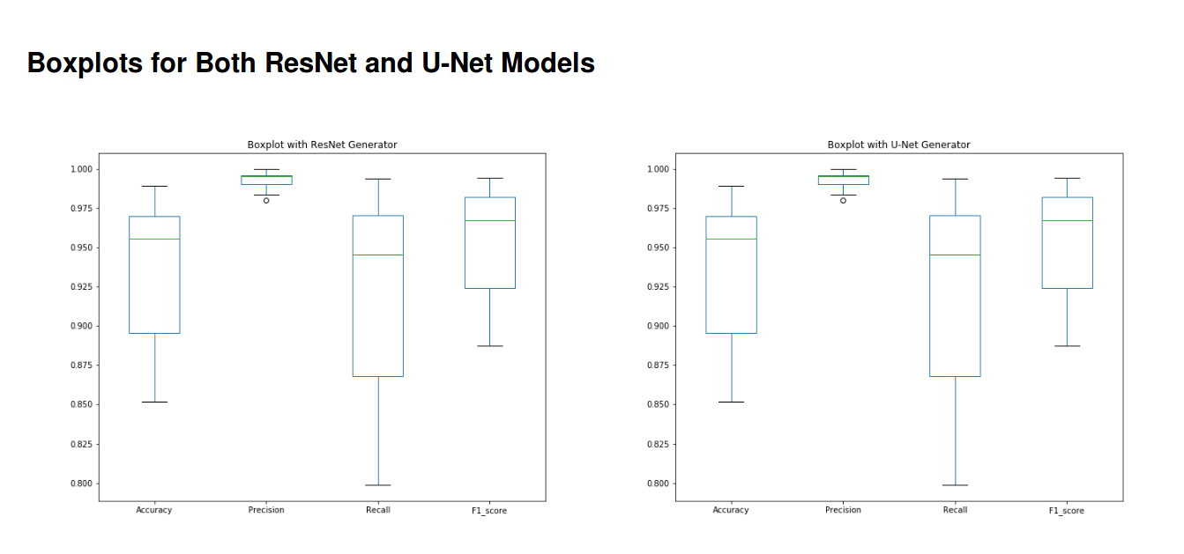

Slide 14
Difficulties with GAN :
Probability Distribution is Implicit
Not straightforward to compute P(X).
Thus Vanilla GANs are only good for Sampling/Generation.
Training is Hard
Non-Convergence
Mode-Collapse

Slide 15
Potential future applications of GANs:-
The future of GANs is bright! There are several areas in which I think it is likely that GANs will be used in the near future
Creating infographics from text
Generating website designs
Compressing data
Drug discovery and development
Generating text
Generating music

Slide 16
THANK YOU

