Slide 2
Arduino-Arduino communication through the serial ports
Serial is used for communication between the Arduino board and a computer or other devices
All Arduino boards have at least one serial port
Requires only 2 pins
Communication either half-duplex or full-duplex

Slide 3
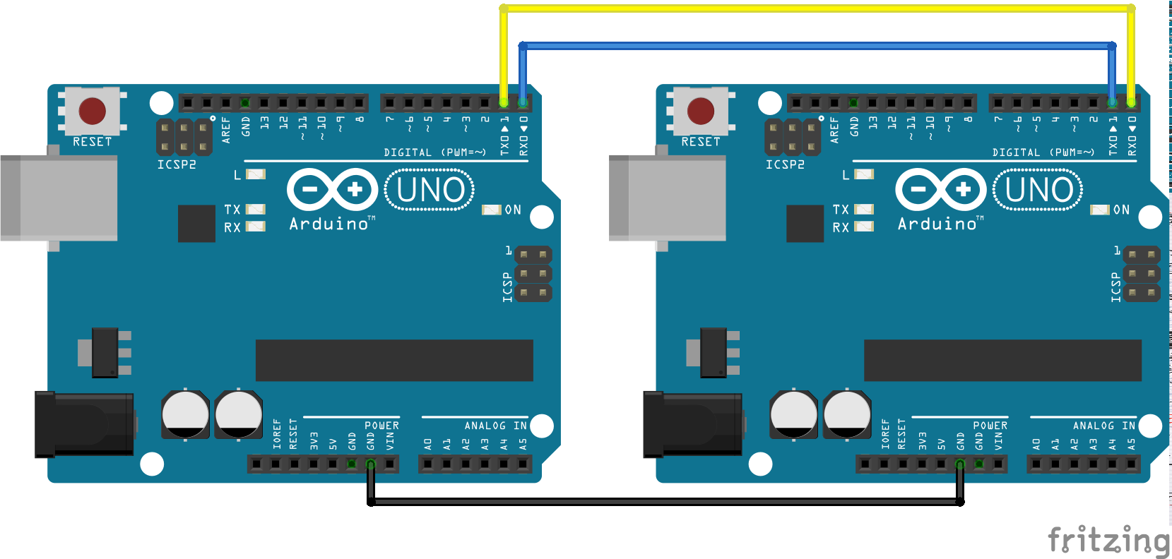

Slide 4
Remove Connections Before Upload Code

Slide 5
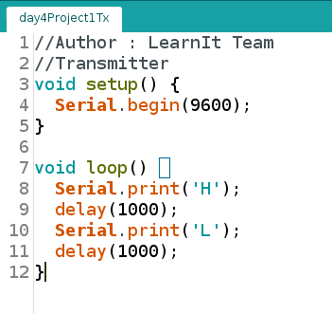
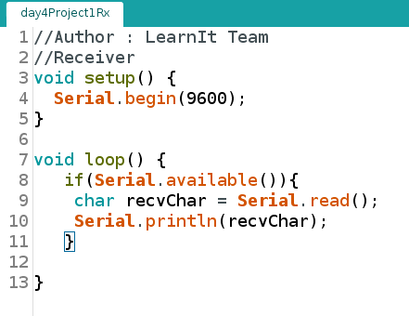
Transmitter Receiver

Slide 6
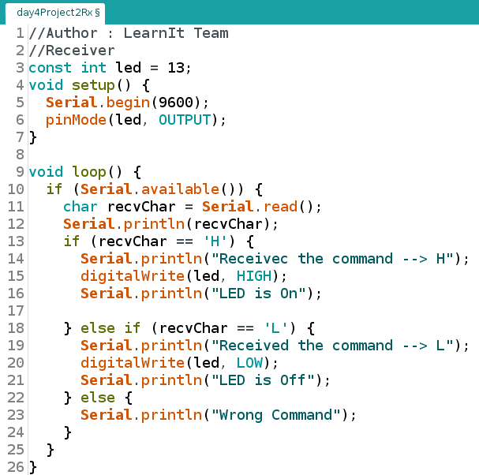
Control Rx from Tx

Slide 7
Software Serial
Why remove wires before uploading code ?
serial port is connected to the computer through the USB cable
Its not possible to upload the code when it is already connected to the another arduino
to send the commands from Tx to be transfered to the Rx , Software Serial Library is used

Slide 8
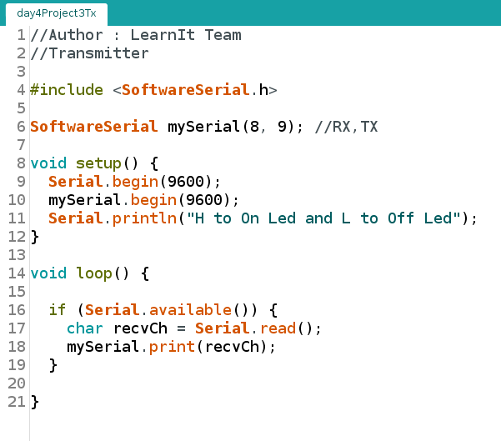
Command Rx from Tx

Slide 9
SPI Communication
Tx , Rx are Asynchronous – no control over when the data is sent or receive
SPI is a Synchronous data bus
It uses separate lines for data and clock to keep both sides in perfect sync

