Slide 2
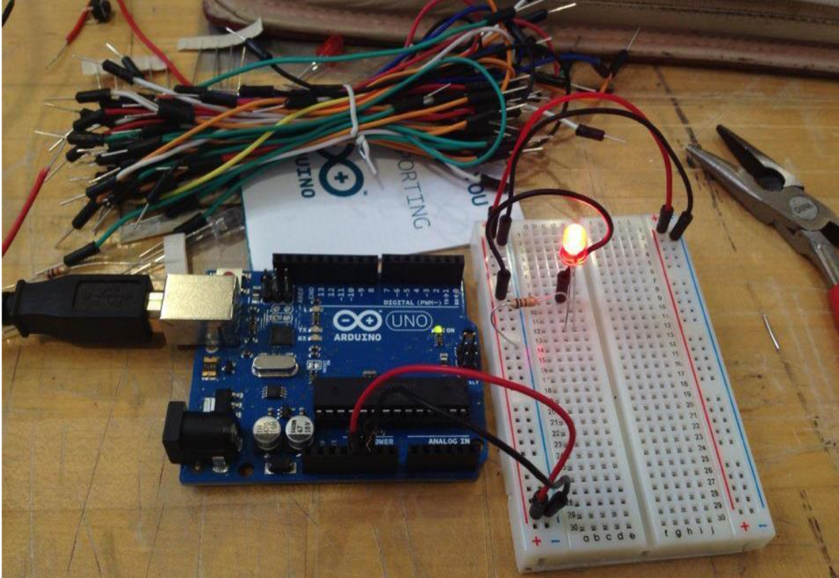
Getting Started

Slide 3

Concepts – INPUT vs. OUTPUT
Input is a Signal / Information going into the board
Output is any signal exiting the board

Slide 4
Project -1
Blinking LED
.... External One This time

Slide 5
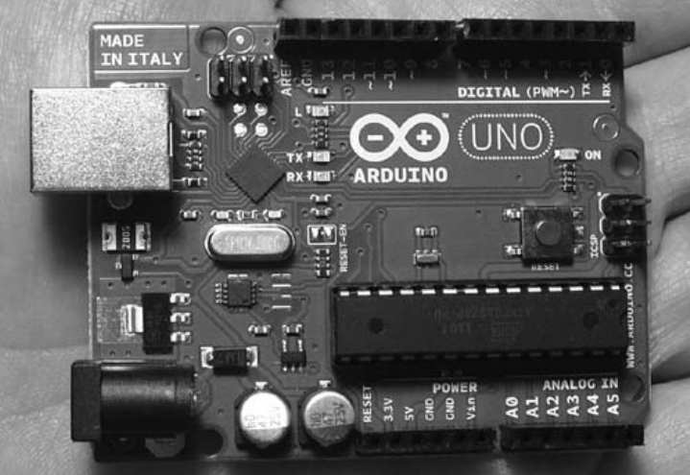
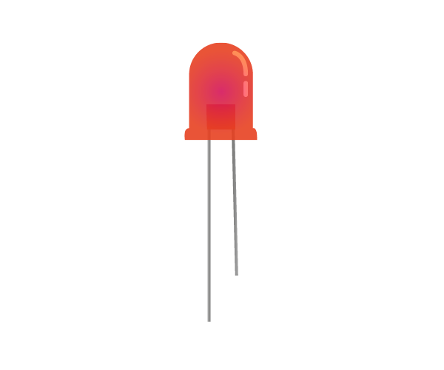
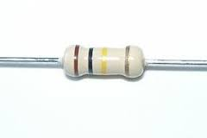
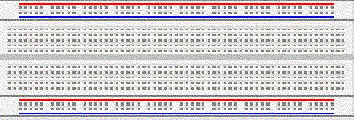
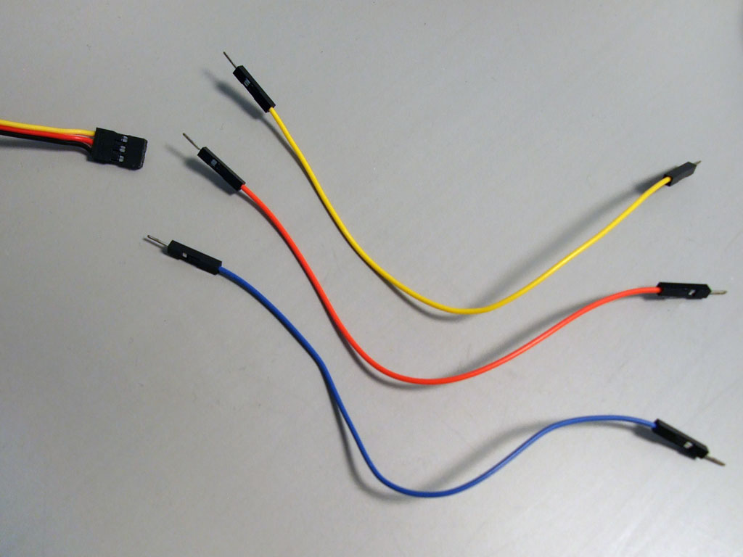
Things You need

Slide 6
Things You need - LED

Slide 7

LED
A light-emitting diode (LED) is a diode that glows when electrical current passes through it
Longer Lead is Positive
Max Current is 20mA

