Slide 1
Estimating crowd on a bus using Wi-Fi/Bluetooth
Anil Yelam
Notes:
Warning: graphic

Slide 2
Motivation
Inform bus stops further ahead on the route
Tracking crowd transit patterns
Better scheduling of buses during times of day
Improved efficiency
Optimal bus routes
Notes:
201 was mostly empty except at few bus stops around UCSD, a better route would improve service efficiency.

Slide 3
Related work
Surprisingly, no work directly on this problem (to the best of my knowledge)
Other simpler and more accurate solutions like sensors installed at door?
They could be expensive or complex to install? (Not sure, but I hope so!)
Interesting problem nevertheless!
One paper on Wi-Fi sniffer based statistics collection at bus stops
Does not account for mac address randomization
Notes:
http://www.arpnjournals.org/jeas/research_papers/rp_2016/jeas_0616_4532.pdf

Slide 4
Smartphones as proxies
Have you seen anyone without a smartphone, or a smartphone without Wi-Fi?
Not like localization through human detection
Cannot actively localize
Requires complex setup of access points
Need lots of training data
Definitely not going to beat “sensors at doors” solution!

Slide 5
How to count devices *passively*
Using Wi-Fi
Probe requests
Using Bluetooth
Responses to Bluetooth scans

Slide 6

Challenges with Wi-Fi
Could be turned off, although assumption is that it’s usually rare
Exceptions: Both my roommates
No access points – no active data traffic
Probe requests to the rescue!
Excluding outside traffic
Filtering out the short-lived traffic

Slide 7
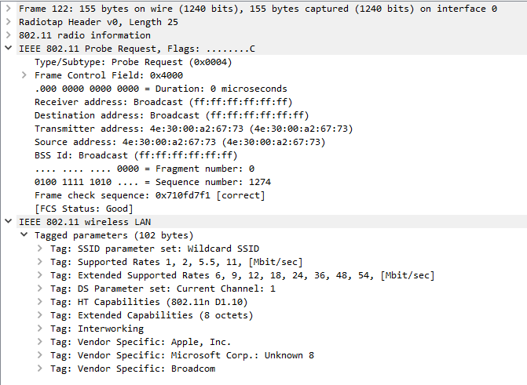
MAC address randomization
High adoption
Insight: Probe packets still carry certain signature
Tagged parameters
Sequence number

Slide 8


Challenges with Bluetooth
Main issue: Not always ON
Much less than Wi-Fi
Involves active responses?
Otherwise, much easier. No randomization!

Slide 9

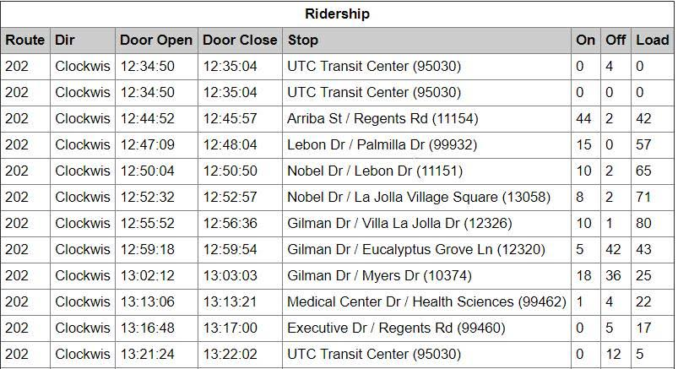

Test data & the ground truth
Few rides on 201 route
Bluetooth data: Bluetana
Wi-Fi data: Wireshark on Mac

Slide 10
Started with Bluetooth
Scans every 10-15 seconds
Should have used every second scanning
Almost 70% is external traffic – doesn’t last more than a minute

Slide 11
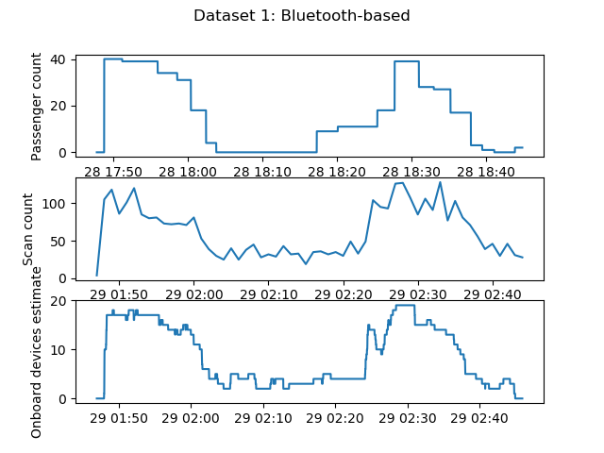
Dataset 1

Slide 12
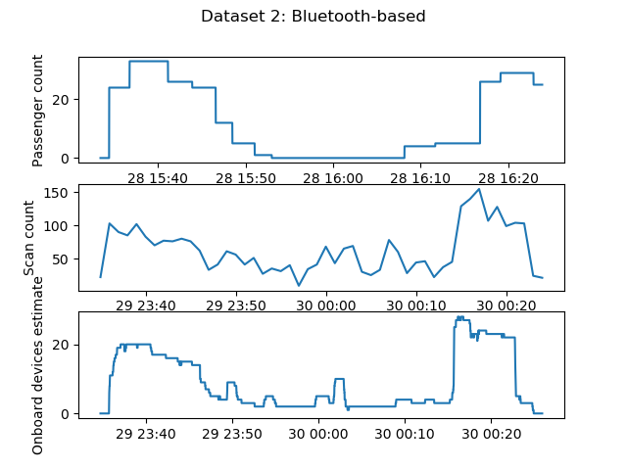
Dataset 2

Slide 13
Over to Wi-Fi
More excited about results from Wi-Fi
Looking into the data, didn’t get to clustering yet
Hoping it’ll give better estimate

Slide 14
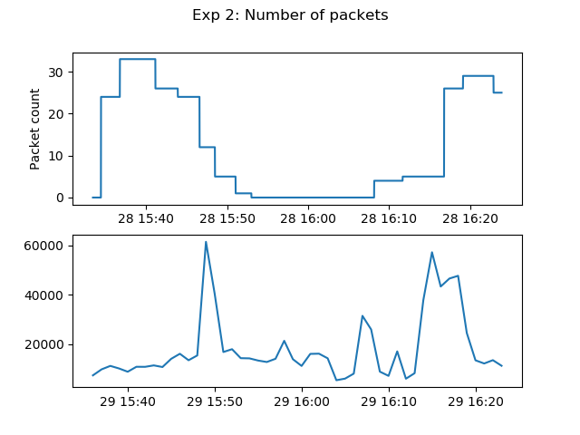
Dataset 1

Slide 15
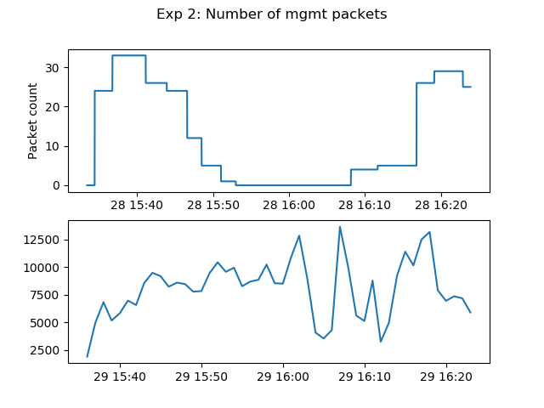
Dataset 2

Slide 16
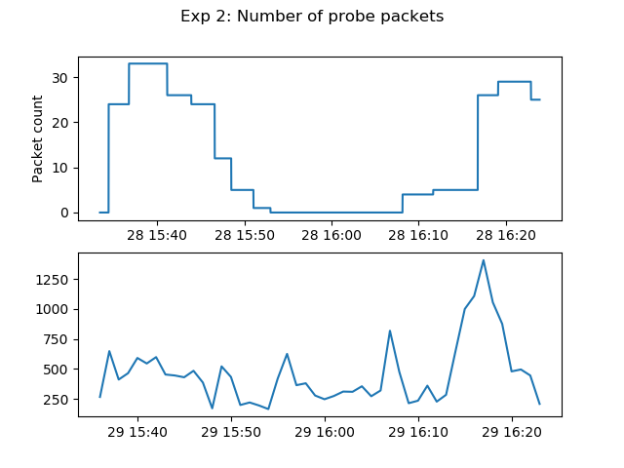
Dataset 2

Slide 17
Conclusion
Work on Wi-Fi data
Look a bit more into Bluetooth results
Will show you any interesting results

Slide 18
Thank you!

