Slide 1
Overview
Explaining performance of Scatter-gather ops

Slide 2
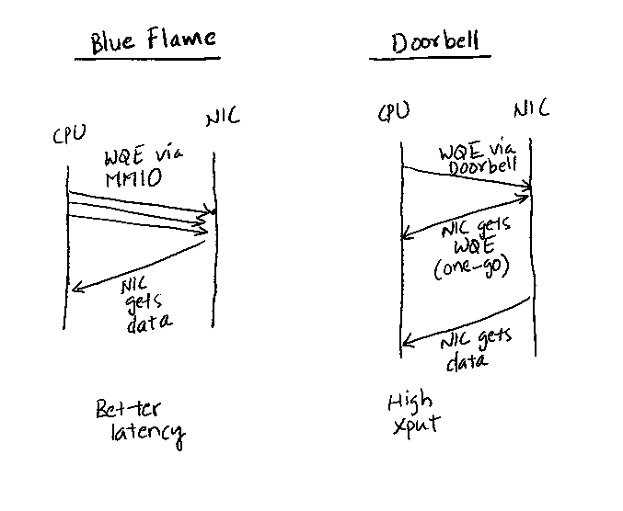
WQE by MMIO vs Doorbell
Courtesy: Anuj Kalia et al. Design Guidelines for RDMA apps. ATC 2016

Slide 3
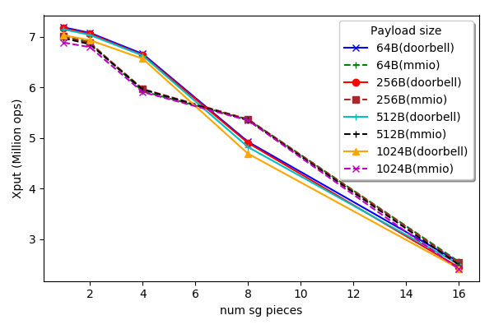
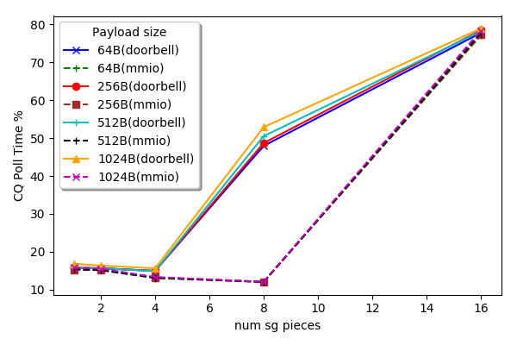
MMIO vs Doorbell

Slide 4
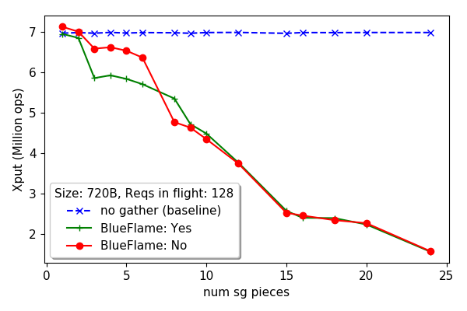
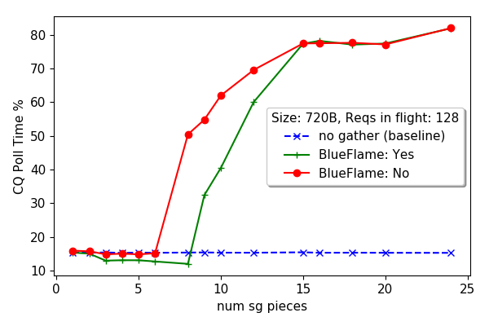
MMIO vs Doorbell (720B)

Slide 5
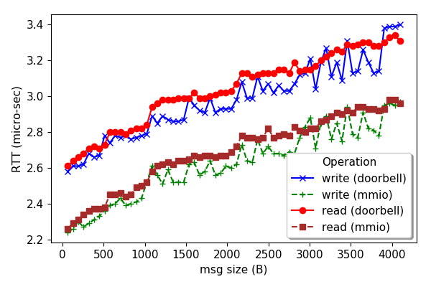
MMIO vs Doorbell (RTT)

Slide 6
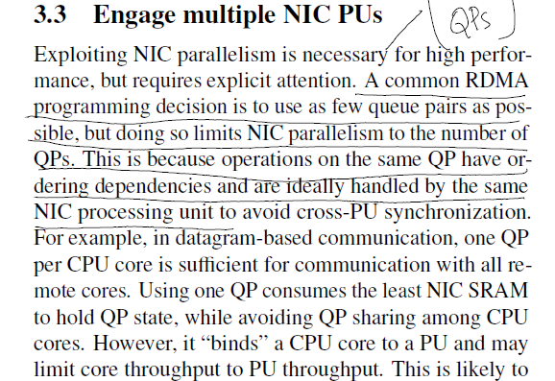
Another suspect: NIC PUs
Courtesy: Anuj Kalia et al. Design Guidelines for RDMA apps. ATC 2016

Slide 7
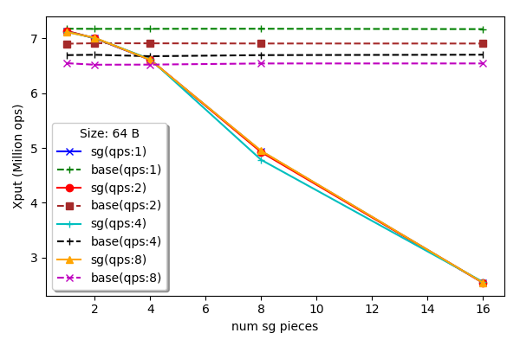
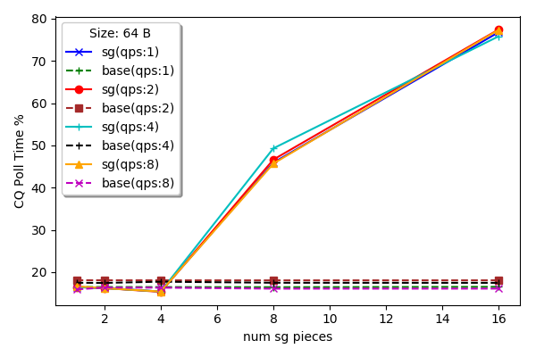
Increasing NIC PUs (Single core)

Slide 8
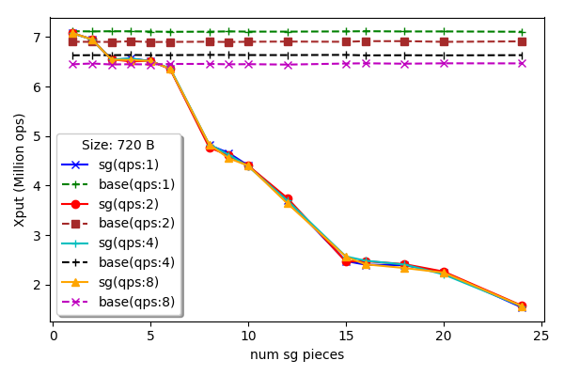
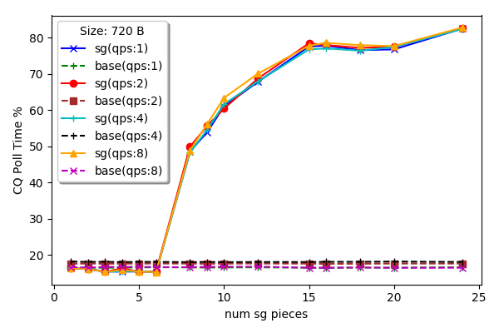
Increasing NIC PUs (Single core)

Slide 9
PCIe?
NIC is still not ruled out…
Fundamental limit on PCIe bandwidth: bits/sec
~30Gbps PCIe bitrate for 64B and 8 SG pieces
Do we need this? Yes, we need to get the best that SG can do…
or shall I move on?

Slide 10
Next
Look at PCIe more closely
Adding more cores may not help, but doesn’t hurt to check?
Helping Raj – not sure what’s going on…

Slide 11
Misc

Slide 12
Scatter-gather ops
Three data transfer options for a message:
No gather: data already available in single buffer
CPU-gather: CPU puts the message together
NIC-gather: NIC puts the message together using RDMA SG op
Piece-by-Piece: each piece sent in its own RDMA write op
Variables:
Message size
Num of pieces

Slide 13
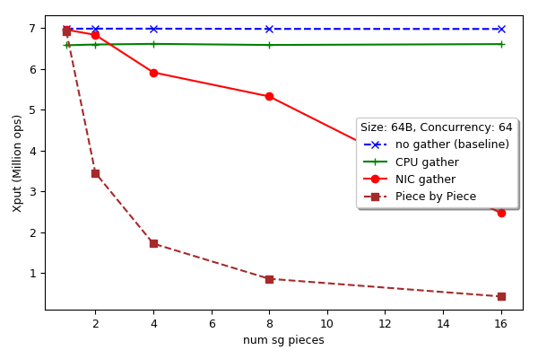
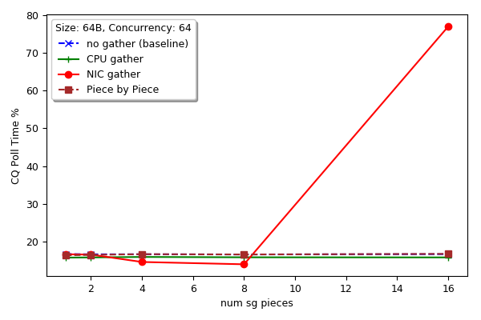
Scatter-gather ops (64B)
Xput (ops)
CQ poll time (%)

Slide 14
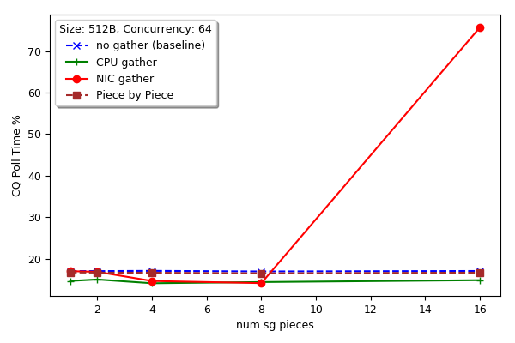
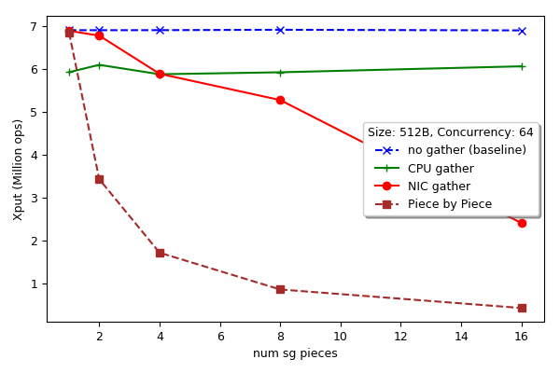
Scatter-gather ops (512B)
Xput (ops)
CQ poll time (%)

Slide 15
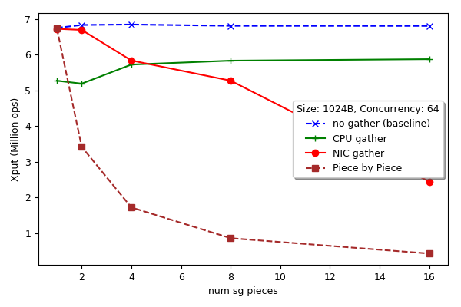
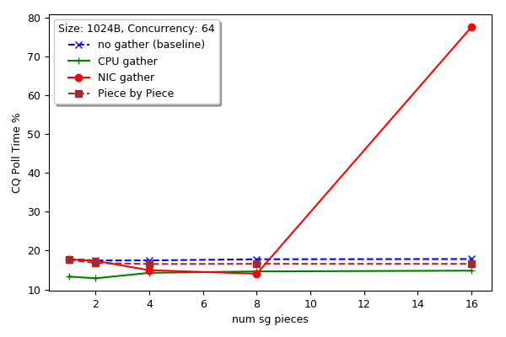
Scatter-gather ops (1024B)
Xput (ops)
CQ poll time (%)

Slide 16
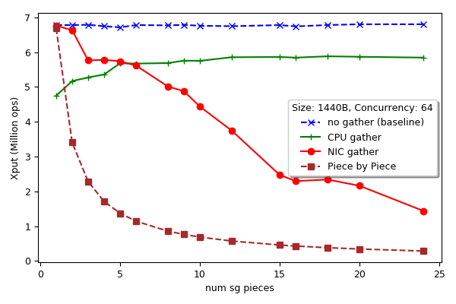
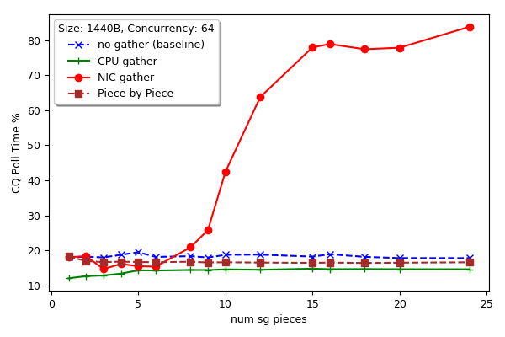
Scatter-gather ops (1440B)
Xput (ops)
CQ poll time (%)

Slide 17
BlueFlame vs Doorbell
How to switch to doorbell? – No idea
May get around it with more threads…

