Slide 1
Overview
Recapping RDMA experiments in the past month:
Original goal was to answer this question:
What is the best-case CPU/Xput gains we can get by involving NIC in serialization?
Spark experiments => high dispersion in data layout
Default/traditional way: CPU needs to copy data into “bounce buffers”
Best-case: We completely avoid copies. How much CPU can we save?

Slide 2
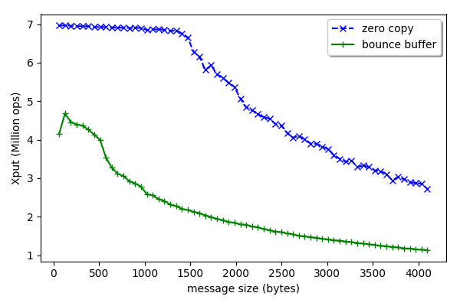
Copying overhead

Slide 3
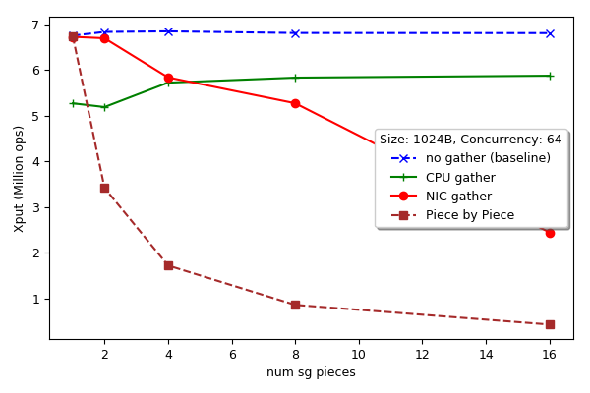
Revisiting SG plots

Slide 4
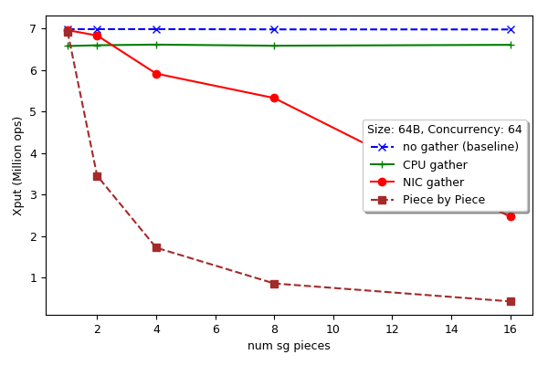
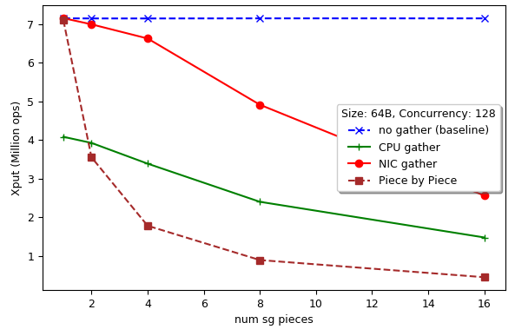
Revisiting SG plots (64B)

Slide 5
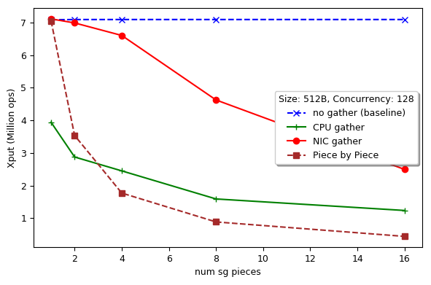
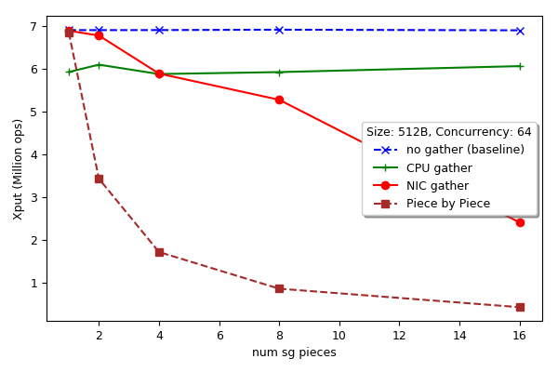
Revisiting SG plots (512B)

Slide 6
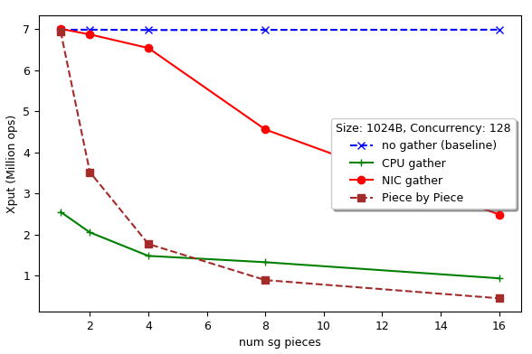
Revisiting SG plots (1024B)

Slide 7
Revisiting SG plots: Next
First thing: double-check the results
A clear case to be made for SG; comes down balancing CPU and NIC usage

Slide 8
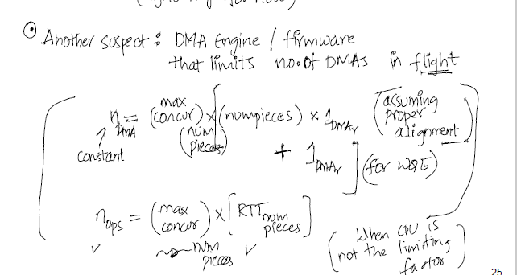
SG Xput: Another suspect
Limit on DMAs in flight

Slide 9
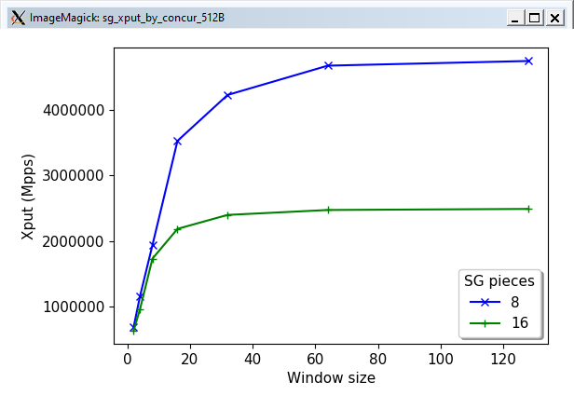
SG Xput: Another suspect
Max concurrency point

Slide 10
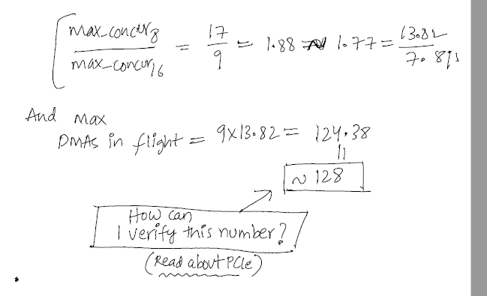
SG Xput: Another suspect
Limit on DMAs in flight ~128

