Slide 1
Overview
Some new takeaways from RDMA xput plots
Thoughts on starting the real implementation

Slide 2
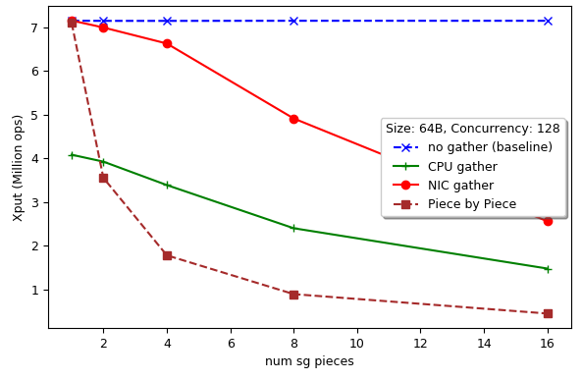
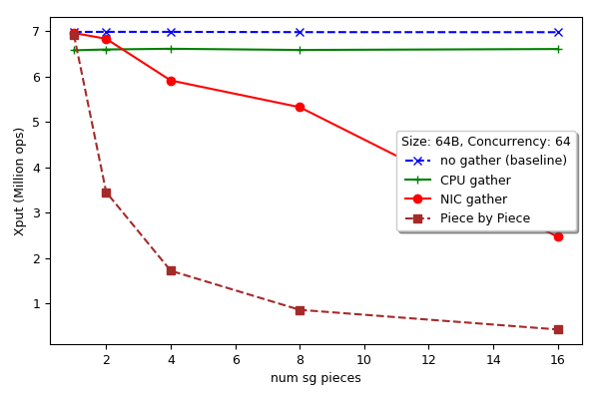
Revisiting SG plots
(Fixed a bug with CPU gather on the right)
Takeaway: Evidence that NIC-based serialization can help!

Slide 3
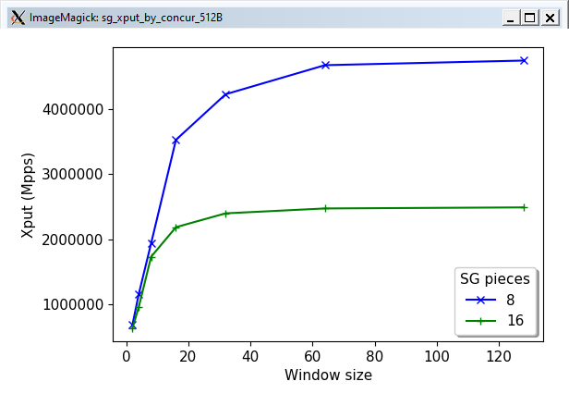
Scatter-gather xput limit
128 max reads in flight on PCIe
PCIe imposes 256 max reads
Takeaway: There is a transactional limit on PCIe.

Slide 4
NIC-based serialization
What makes the CPU inefficient?
Cache misses from CPU traversal of the object
Exacerbated by copying
Unable to exploit parallelism

Slide 5
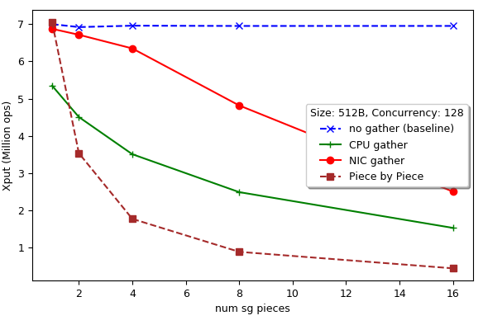
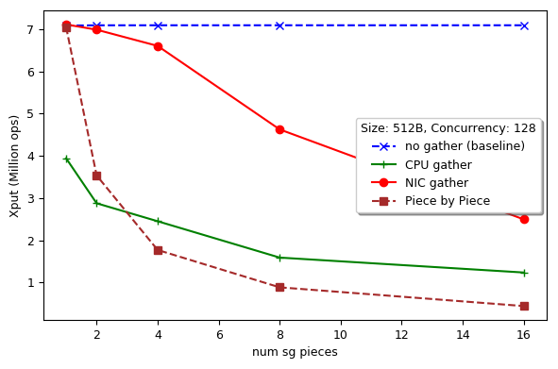
CPU traversal vs copy
Takeaway: Both traversal and copy contribute to CPU inefficiency

Slide 6
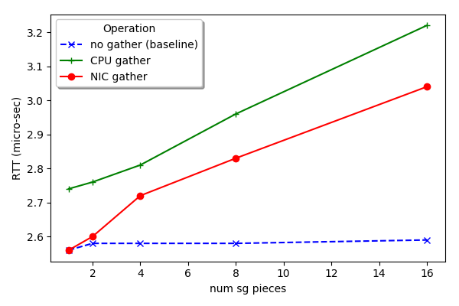
A preview of parallelism I could exploit…
Takeaway: NIC-based serialization may be worthwhile…

Slide 7
Key challenge now: address translation
RDMA-style
Fixed set of registered pages
Static TLB
Small memory with regular sized pages
Get all to-be-serialized data in this region of memory
ODP-style (OnDemand Paging)
Dynamic registration
Offers flexibility but hides performance pitfalls

Slide 8
Next step: Find a SmartNIC?
FPGA ones, with libraries like StRoM
ConnectX NICs with any configurability?
Comeup with a roadmap for SOSP

