Slide 1
Overview
Memory registration-related numbers (TLB size) 😒
Experiments with scatter-gather ops 🙂
Debugging pktgen 😐

Slide 2
MR numbers (last update)
Max registered buffers ~ 16k for any size
With 4kB buffers, it’s just 64 MB!
Find the TLB cache size
Increase the number of buffers accesed as I measure xput
Xput does not change with number of buffers

Slide 3
MR numbers (last update)
Max registered buffers ~ 16k for any size
With 4kB buffers, it’s just 64 MB!
Find the TLB cache size
Increase the number of buffers accesed as I measure xput
Xput does not change with number of buffers
Randomized access to buffers did not help
Could not find a hardware manual either

Slide 4
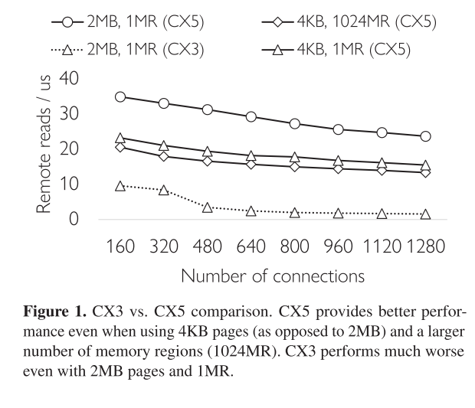
MR numbers
StoRM paper
Claim: diff between solid lines = TLB faults
Setup
20GB registered memory, random 64B access.
Uses CX-5s
Not too clear on other details

Slide 5
Scatter-gather ops
Three data transfer options for a message:
No gather: data already available in single buffer
CPU-gather: CPU puts the message together from multiple pieces before xmit
NIC-gather: RDMA SG op. NIC puts the message together.
Variables:
Message size
Concurrent requests in flight
Num of pieces

Slide 6
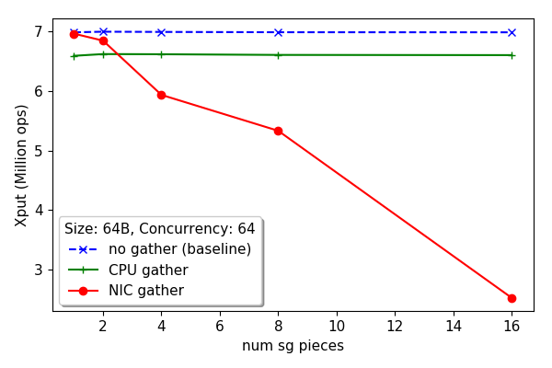
Scatter-gather ops
NIC gather drops dramatically: indicates that xput is originally limited by PCIe (or NIC side), not Host CPU

Slide 7
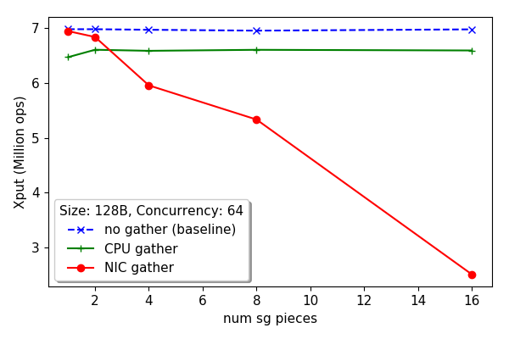
Scatter-gather ops
No diff from 64B: For CPU, it may be the cache-line. For NIC-gather?

Slide 8
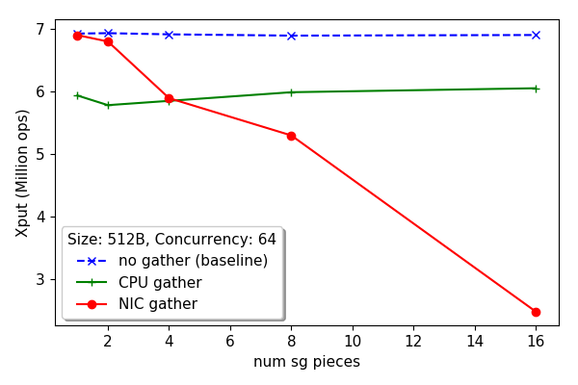
Scatter-gather ops

Slide 9
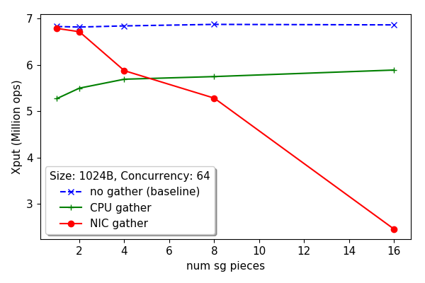
Scatter-gather ops

Slide 10
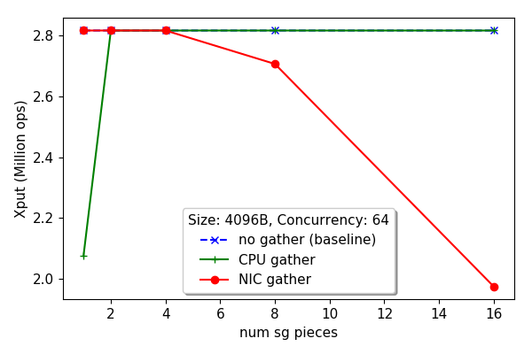
Scatter-gather ops
Hits line-rate

Slide 11
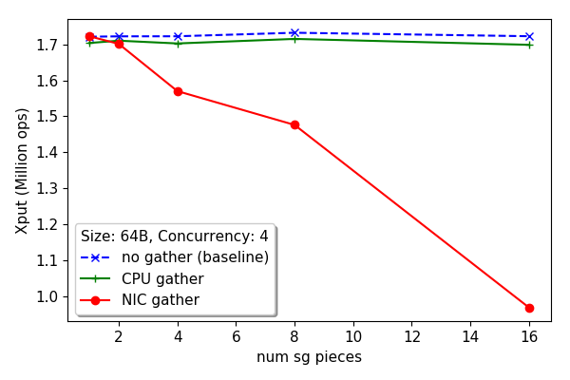
Scatter-gather ops (concurrency: 4)
Here the bottleneck is RTT. Then why is NIC gather still worse?

Slide 12
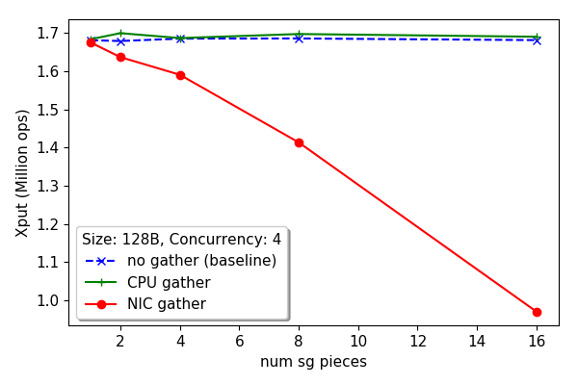
Scatter-gather ops

Slide 13
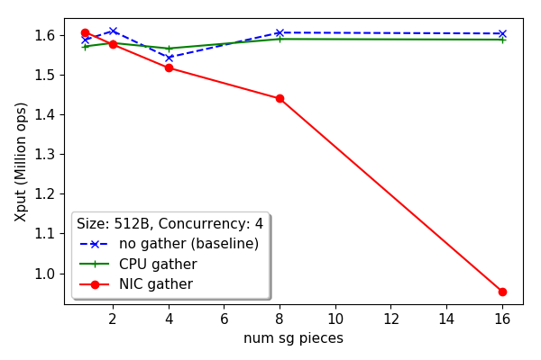
Scatter-gather ops

Slide 14
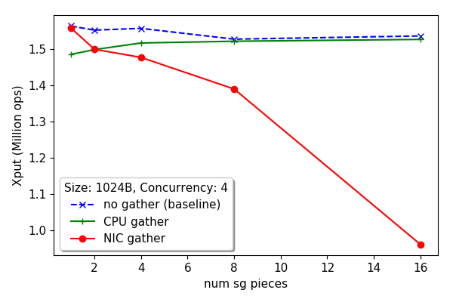
Scatter-gather ops

Slide 15
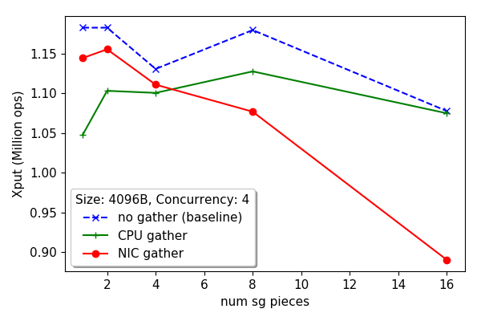
Scatter-gather ops

Slide 16
Immediate takeaways
CPU-gather generally wins
NIC-gather is optimal only for bigger payloads with less dispersion
Gains vary with concurrency as well?
Can (should) I nicely model this behavior?

Slide 17
Next
Another line on the plots: No gather, but send scattered pieces one-by-one
How do these results affect the original story?
Contact Yizhou for MR details in Storm paper…
Understanding ODP – on demand paging in CX-5s
Debugging pktgen

