Slide 1
Overview
No progress with mem registration
Explaining performance of Scatter-gather ops
Got CPU utilization along with Xput
Some time on pktgen

Slide 2
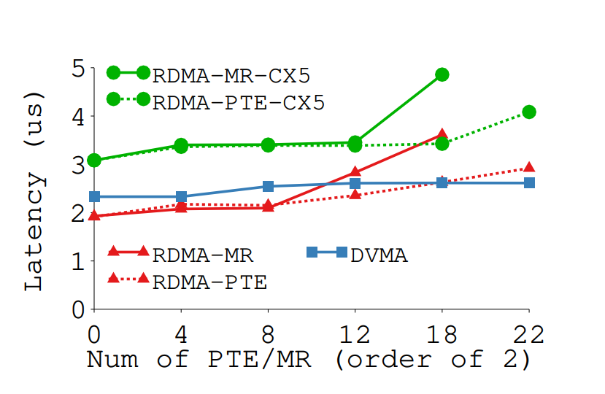
reg_mr() numbers

Slide 3
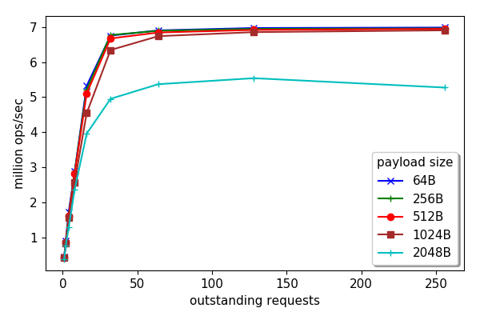
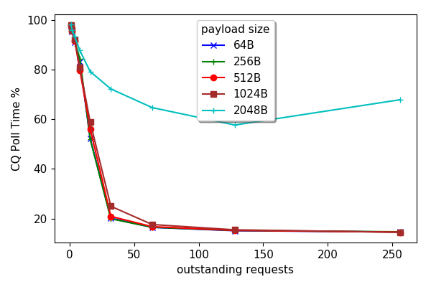
CPU Usage
CQ poll time as an (approx.) proxy for idle time.

Slide 4
Scatter-gather ops
Three data transfer options for a message:
No gather: data already available in single buffer
CPU-gather: CPU puts the message together
NIC-gather: NIC puts the message together using RDMA SG op
Variables:
Message size
Num of pieces

Slide 5
Scatter-gather ops
Three data transfer options for a message:
No gather: data already available in single buffer
CPU-gather: CPU puts the message together
NIC-gather: NIC puts the message together using RDMA SG op
Piece-by-Piece: each piece sent in its own RDMA write op
Variables:
Message size
Num of pieces

Slide 6
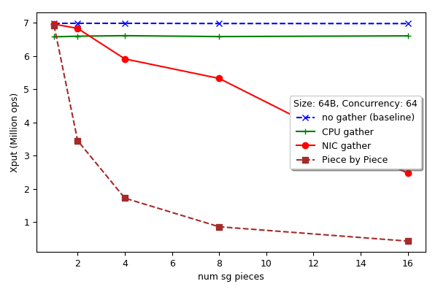
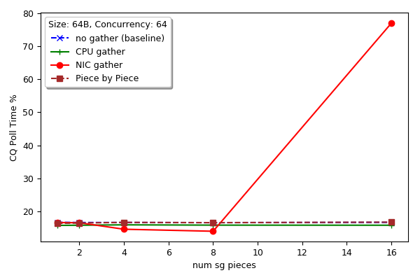
Scatter-gather ops (64B)
Xput (ops)
CQ poll time (%)

Slide 7
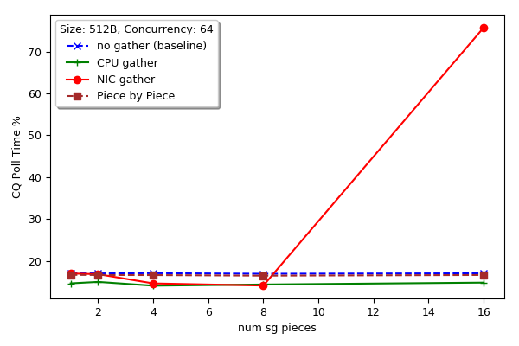
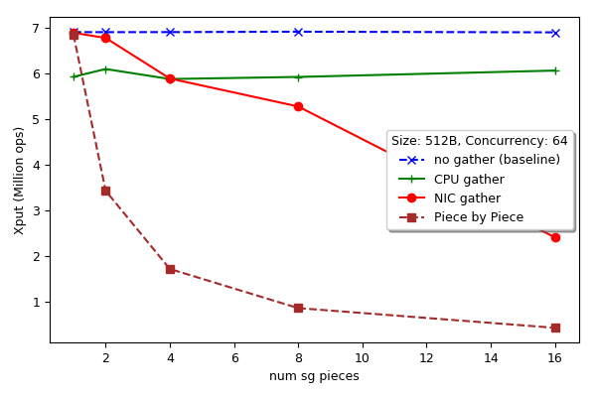
Scatter-gather ops (512B)
Xput (ops)
CQ poll time (%)

Slide 8
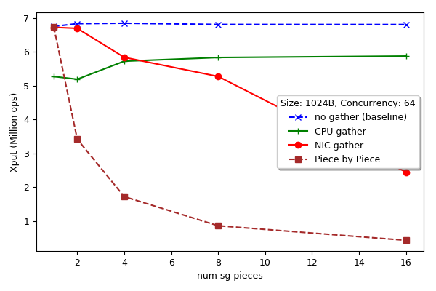
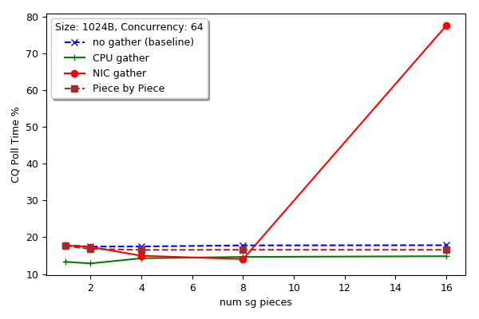
Scatter-gather ops (1024B)
Xput (ops)
CQ poll time (%)

Slide 9
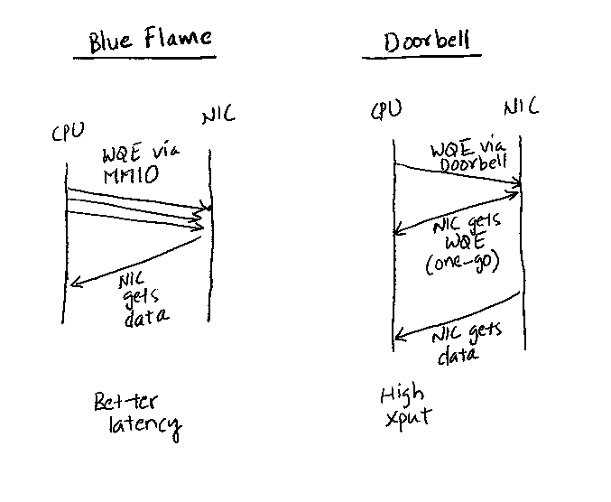
BlueFlame vs Doorbell
MMIO op cannot exceed 64 B.
So, SG may take more MMIOs
Also, it may take a few SG entries
to add an extra MMIO…
Credits: Anuj Kalia et al. Design Guidelines for RDMA apps. ATC 2016

Slide 10
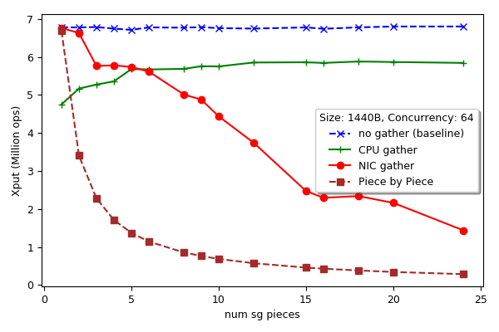
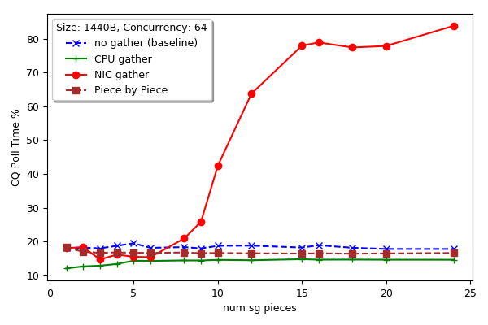
Scatter-gather ops (1440B)
Xput (ops)
CQ poll time (%)

Slide 11
BlueFlame vs Doorbell
How to switch to doorbell? – No idea
May get around it with more threads…

