Slide 1
Update
Setting up basic RDMA-connection with two servers ✓
  Looking thru RDMA example workflows
  RDMA manual to understand scatter-gather and other complex functionality
Goal:
Get basic data transfer “cost” in different settings
Emulate data layout of the spark example

Slide 2
Update
Setting up basic consistent RDMA-connection with two servers ✓
  Looking thru RDMA example workflows
  RDMA manual to understand scatter-gather and other complex functionality
Goal:
Get basic data transfer “cost” in different settings
Emulate data layout of the spark example

Slide 3
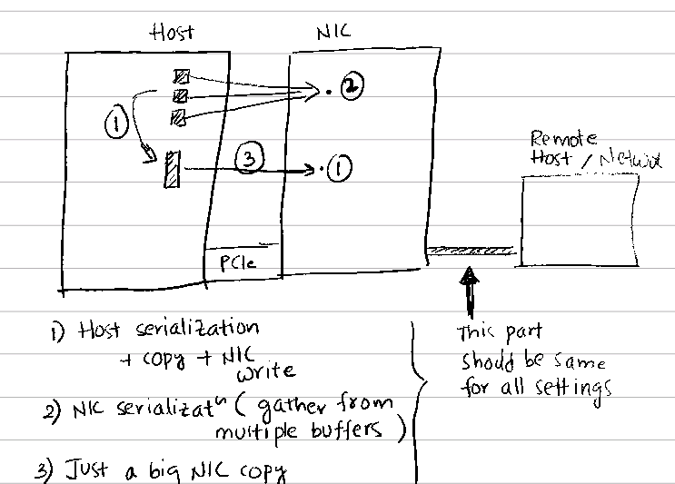
Update

