Slide 1
Update
Got some baseline numbers for RDMA one-sided ops
Throughput
RTT

Slide 2
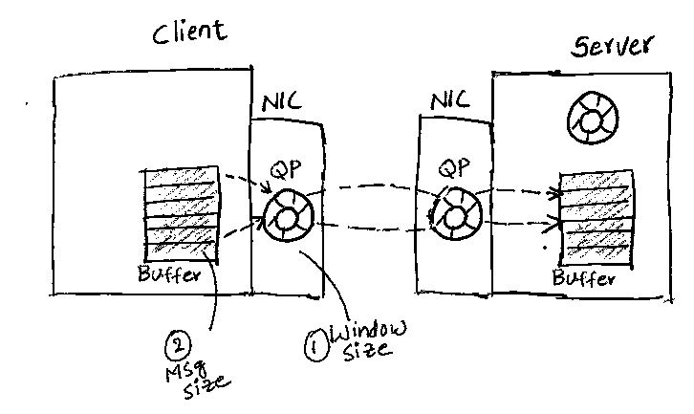
RDMA Xput: Setup

Slide 3
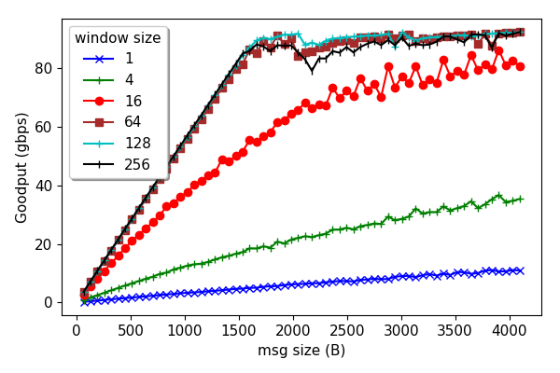
RDMA Write Xput

Slide 4
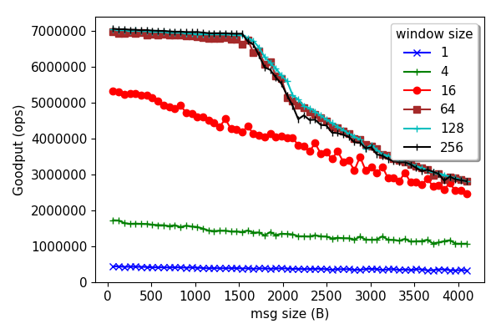
RDMA Write Xput

Slide 5
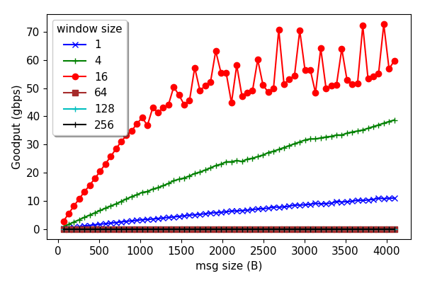
RDMA Read Xput

Slide 6
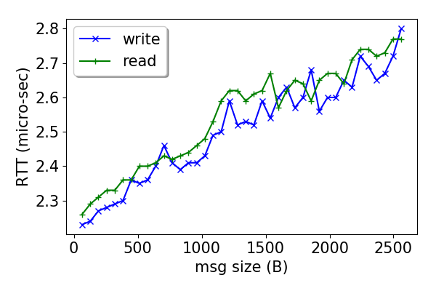
RDMA one-sided RTT

Slide 7
Coming week
Get similar numbers when using:
scatter-gather
multiple threads per queue pair
large number of registered buffers
memory registration in the data path

Slide 8
Misc

Slide 9
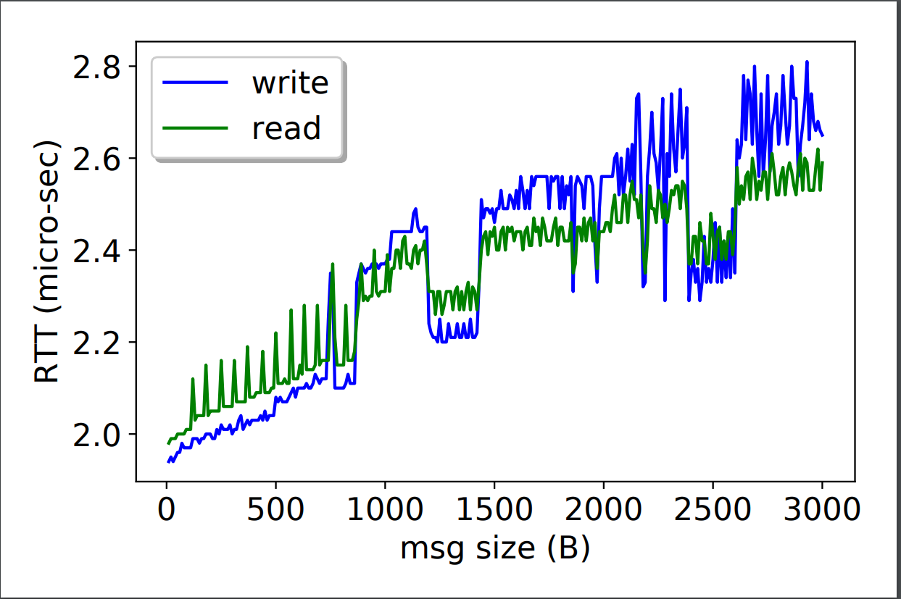
RDMA Read Xput

