Slide 1
Overview
RDMA Mem reg-related numbers (NIC TLB size) 😒
Experiments with RDMA scatter-gather ops 🙂

Slide 2
reg_mr() numbers
Reg + dereg latency ~ 16
Max registered memory ~ 16k pages
With 4kB pages, it’s just 64 MB!
MTT cache size
MTT: Memory Translation Table (one entry per registered page)
Maintained in OS, cached in NIC
Varied numbers of pages to observe drop in Xput – hit the memory limit

Slide 3
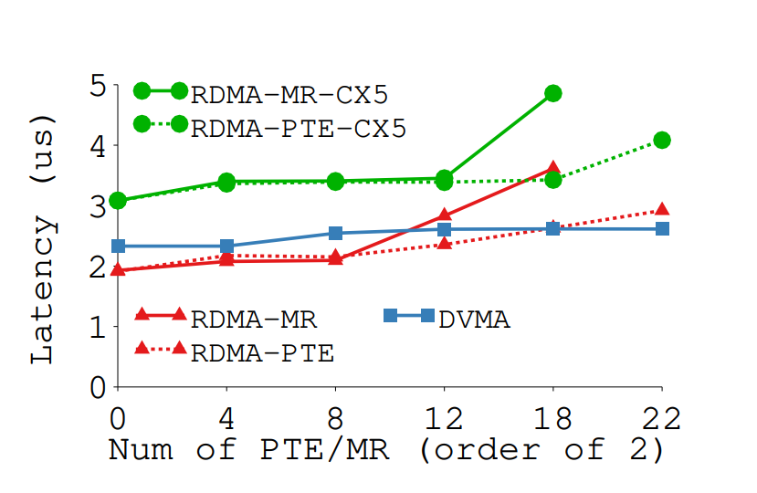
reg_mr() numbers

Slide 4
reg_mr() numbers
Mellanox driver hell – mlx4 vs mlx5

Slide 5
Scatter-gather ops
Three data transfer options for a message:
No gather: data already available in single buffer
CPU-gather: CPU puts the message together from multiple pieces before xmit
NIC-gather: RDMA SG op. NIC puts the message together.
Variables:
Message size
Num of pieces

Slide 6
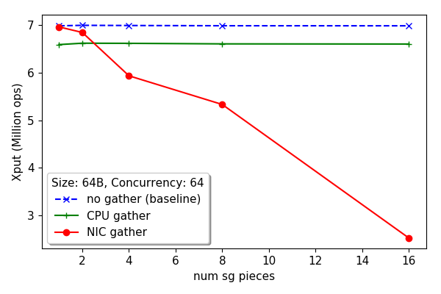
Scatter-gather ops
NIC gather drops dramatically: indicates that xput is originally limited by PCIe (or NIC side), not Host CPU

Slide 7
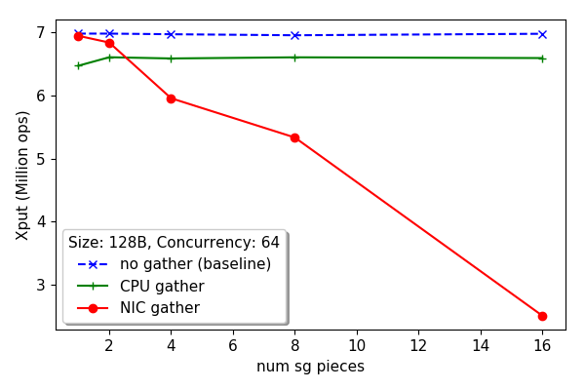
Scatter-gather ops
No diff from 64B: For CPU, it may be the cache-line. For NIC-gather?

Slide 8
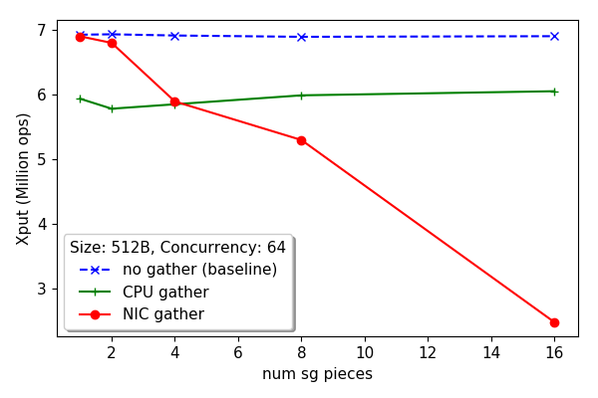
Scatter-gather ops

Slide 9
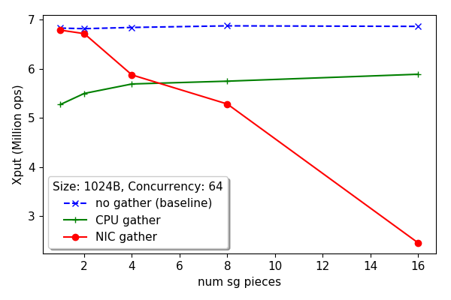
Scatter-gather ops

Slide 10
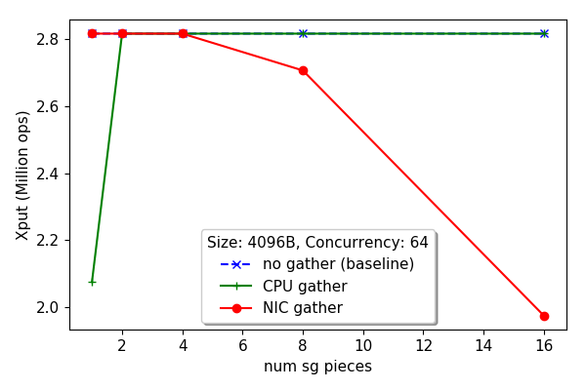
Scatter-gather ops
Hits line-rate

Slide 11
Next
Explaining these plots
Try and get mem-reg cache size plot
Debugging pktgen for Raj

