Slide 1
Overview
Explaining performance of Scatter-gather ops
Got CPU utilization along with Xput

Slide 2
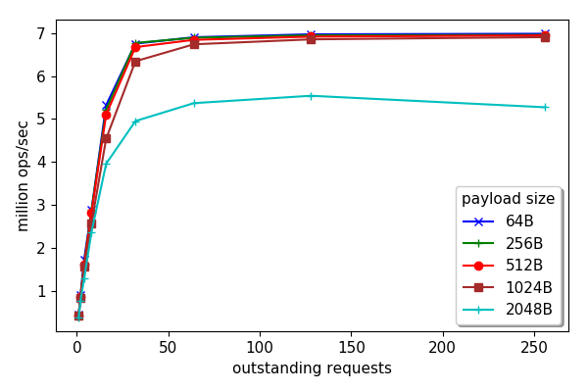
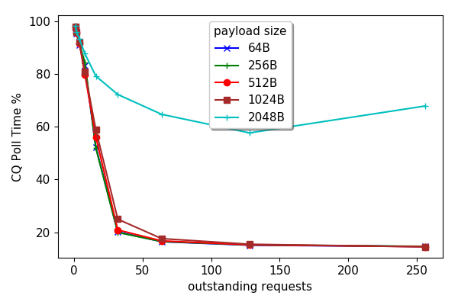
CPU Usage
CQ poll time as an (approx.) proxy for idle time.

Slide 3
Scatter-gather Xput with CPU

Slide 4
Scatter-gather Xput with CPU (1440B)

Slide 5
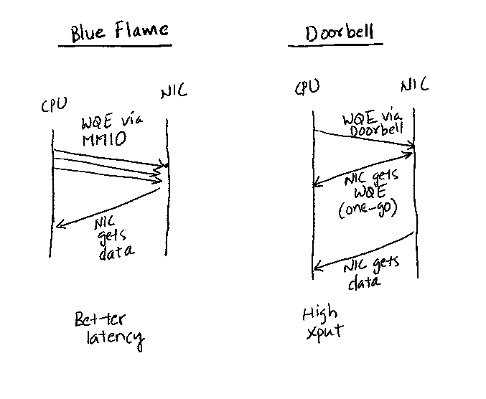
WQE by MMIO vs Doorbell
Disabled BlueFlame…
Credits: Anuj Kalia et al. Design Guidelines for RDMA apps. ATC 2016

Slide 6
With/Without BlueFlame

Slide 7
Misc

Slide 8
Scatter-gather ops
Three data transfer options for a message:
No gather: data already available in single buffer
CPU-gather: CPU puts the message together
NIC-gather: NIC puts the message together using RDMA SG op
Piece-by-Piece: each piece sent in its own RDMA write op
Variables:
Message size
Num of pieces

Slide 9
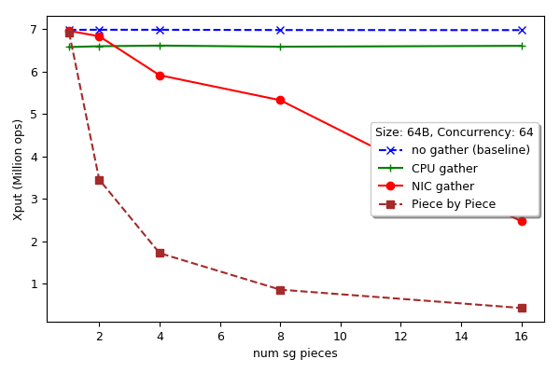
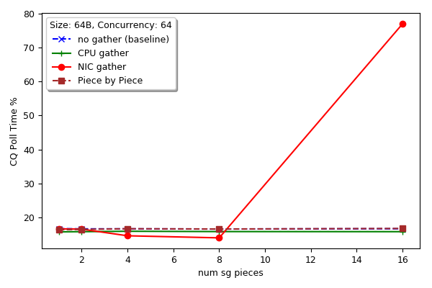
Scatter-gather ops (64B)
Xput (ops)
CQ poll time (%)

Slide 10
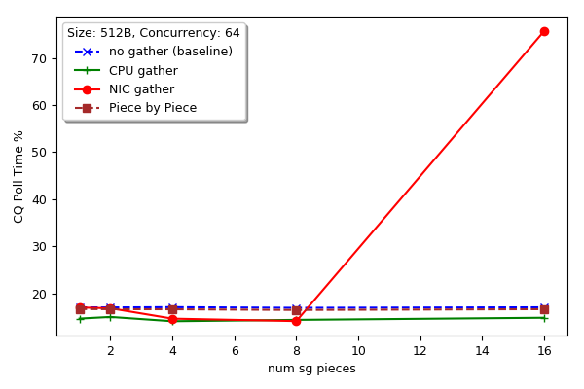
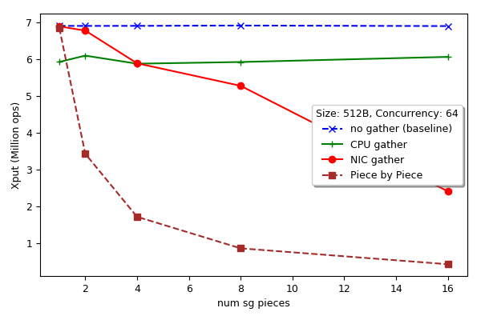
Scatter-gather ops (512B)
Xput (ops)
CQ poll time (%)

Slide 11
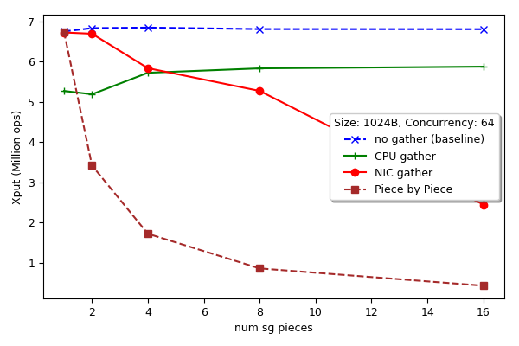
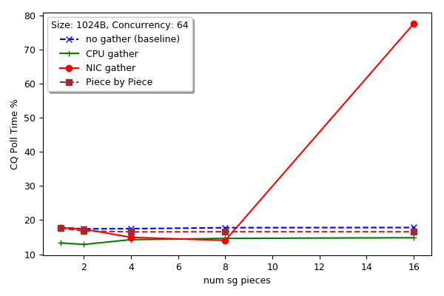
Scatter-gather ops (1024B)
Xput (ops)
CQ poll time (%)

Slide 12
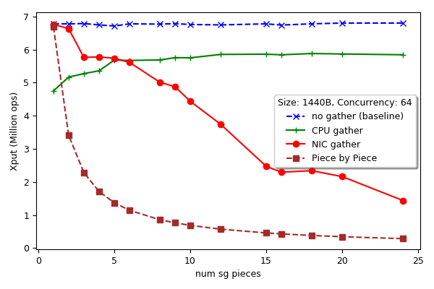
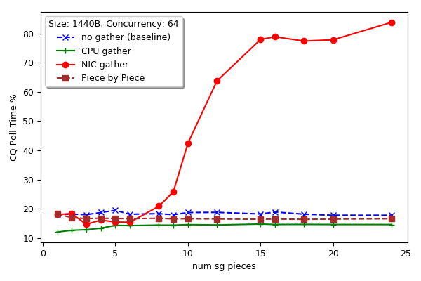
Scatter-gather ops (1440B)
Xput (ops)
CQ poll time (%)

Slide 13
BlueFlame vs Doorbell
How to switch to doorbell? – No idea
May get around it with more threads…

