Slide 1
Overview
PCIe learnings: Two possible sources of pps limit
Tag bit in MRd requests
Flow control credit limit – invisible to software
Cannot explain the 128 but the point that there is such a limit is good enough?

Slide 2
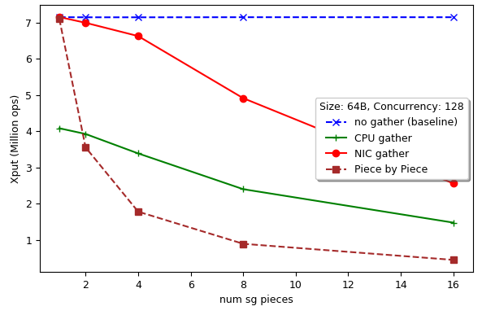
SG Xput is a hard limit!

Slide 3
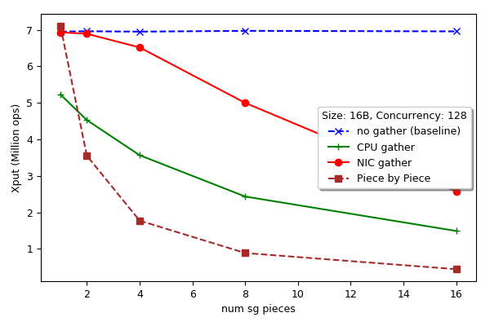
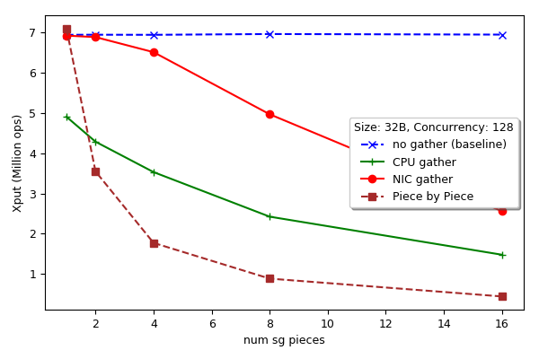
SG Xput for smaller sizes

Slide 4
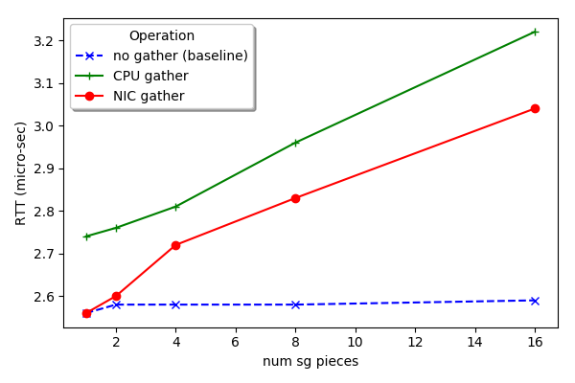
SG RTTs
SG parallelism…

Slide 5
NIC-based serialization
How to emulate it with the RDMA NIC?

