Slide 1

Update
Accelerating Spark
Or, using in-network compute to accelerate data analytics

Slide 2
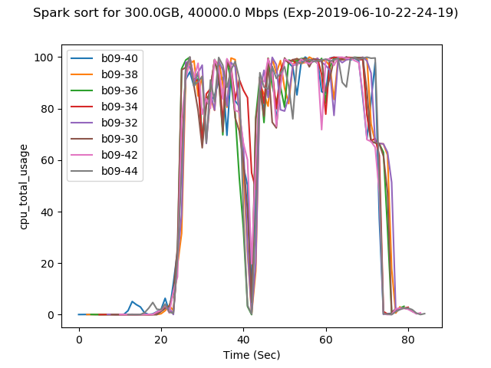
WHY
Spark is CPU-bound

Slide 3
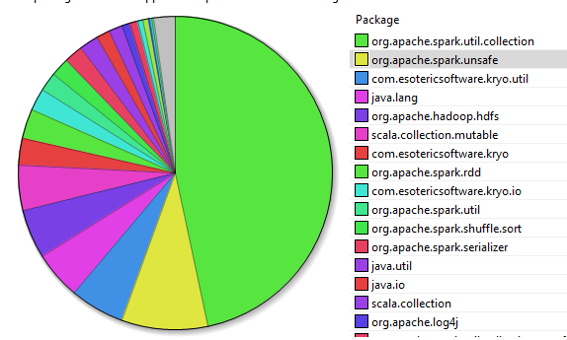
WHY
Sorting
Spark is CPU-bound
Opportunities for relieving CPU
Assisting sorting
CPU Breakdown for Sort (Map + Shuffle + Reduce)

Slide 4
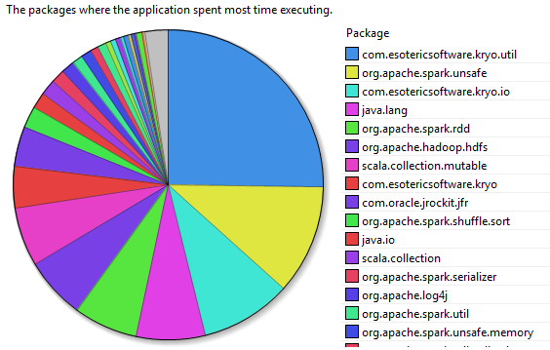
WHY
Serializing data
Spark is CPU-bound
Opportunities for relieving CPU
Assisting sorting
Serialiazation
CPU Breakdown for Shuffle

Slide 5
LITERATURE
On-the-side accelerators
GPU, FPGA
Seen some papers (from earlier in the decade)
On-path accelerators – data filtering
Switches
NICs

Slide 6
LITERATURE
On-the-side accelerators
GPU, FPGA
Seen some papers (from earlier in the decade)
On-path accelerators – data filtering
Switches – two approaches
NICs – haven’t seen any so far

Slide 7
SWITCH-BASED
Key idea: Filter data earlier in the data processing so that later (CPU) computation doesn’t get as much work
Limited support for operators like:
PROJECT
TOP N
DISTINCT
JOIN

Slide 8
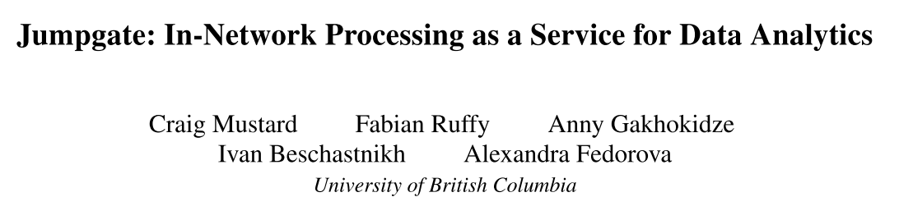
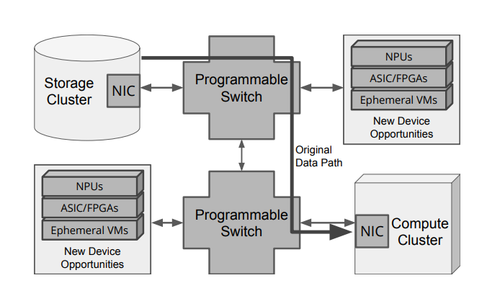
Jumpgate
Where to filter data?
Disaggregated design
Closer to storage (before data reaches workers)
Talked to the author from UBC
Thanks, Stew!

Slide 9

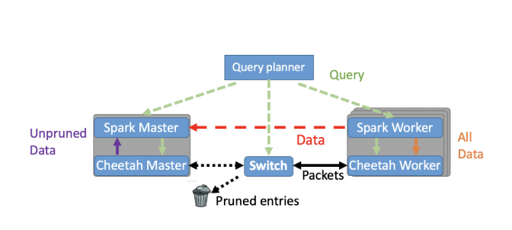
CHEETAH
Where to filter data?
Traditional design
Between master and workers
CPU savings mostly at master during query processing

Slide 10
CHEETAH
Where to filter data?
Traditional design
Between master and workers
CPU savings mostly at master during query processing
Limitations
Very limited flexibility – only simple queries
Zero integration – separate master/workers

Slide 11
Can NICs HELP?
On-path, like switches
but more flexible
Allows for better integration and complex queries
Attached to the host, like on-the-side accelerators
Can enable custom workload acceleration & data placement
Best of both worlds?

Slide 12
NEXt
Reading some earlier papers that use on-the-side accelerators
Hasn’t really picked up back then with database engines
possibly due to data movement overhead across PCIe
Also, is Spark the platform of choice for data analytics or is there something else?

Slide 13
MISC

Slide 14
SmartNIC benefits
Picking on FLOEM and NICA…
(Nothing personal!)

Slide 15
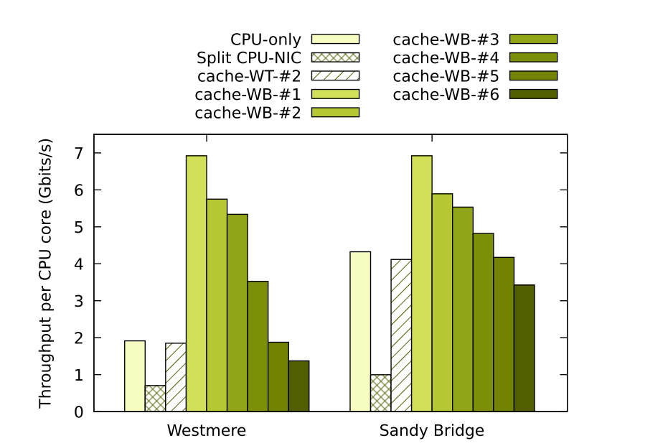
Floem KVS
Compares CPU-only and “CPU+Caching on NIC”
Shows caching benefits
Which does worse at <50% hitrate
Benefits from:
Caching speedup – Yes
Kernel overheads/netstack – No
Additional resources – Yes
NIC acceleration for caching – Unlikely
Confident that on-CPU caching will have similar benefits.

Slide 16
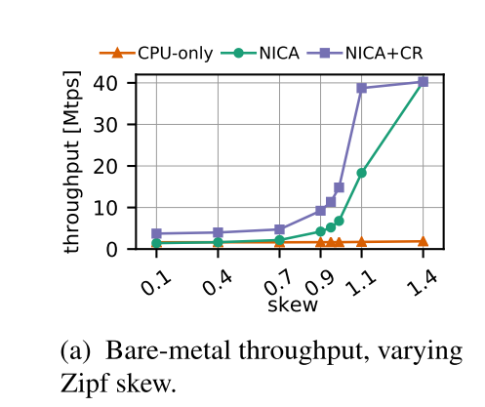
NICA KVS
Compares CPU-only and “CPU+Caching on NIC”
Shows caching benefits
Which does worse at <50% hitrate
Benefits from:
Caching speedup – Yes
Kernel overheads/netstack – No
Additional resources – Yes
NIC acceleration for caching – likely
Confident that on-CPU caching will have similar benefits.

Slide 17
SmartNIC benefits
Both works point out KV-Direct as inspiration for KVS offload (and we point to Floem in FairNIC)
But they take wrong things to offload
KV-Direct uses caching only to overcome it’s PCIe bottleneck, which is unlikely to happen in hybrid Host-NIC KVS apps.
Would be good exercise to prove this… but what then?
At least hands-on FPGA experience is tempting..

