Slide 1
Update
Accelerating Spark
Or specifically, using in-network compute to accelerate data analytics

Slide 2
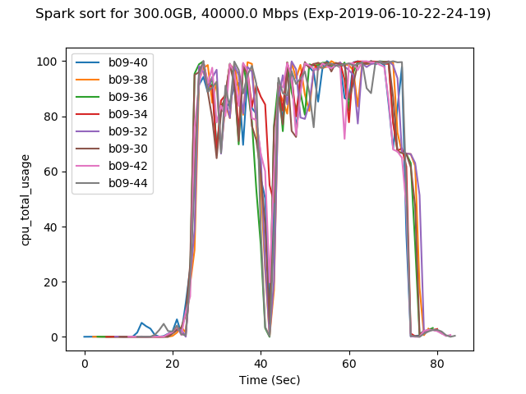
WHY
Spark is CPU-bound

Slide 3
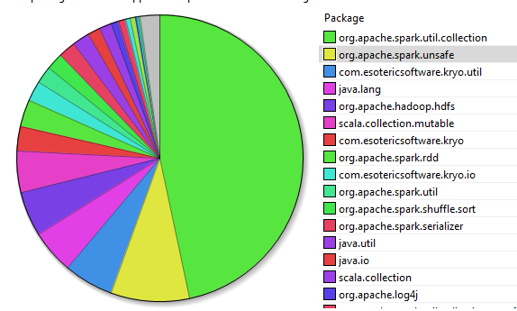
WHY
Sorting
Spark is CPU-bound
Opportunities for relieving CPU
Assisting sorting
CPU Breakdown for Sort (Map + Shuffle + Reduce)

Slide 4
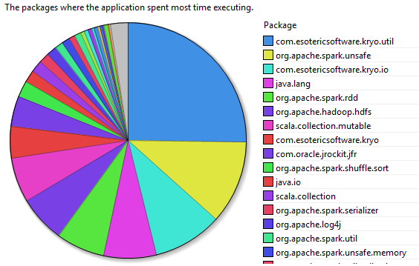
WHY
Serializing data
Spark is CPU-bound
Opportunities for relieving CPU
Assisting sorting
Serialiazation
CPU Breakdown for Shuffle

Slide 5
LITERATURE
On-the-side accelerators
GPU, FPGA
Seen some papers, haven’t read any
On-path accelerators – data filtering
NICs
Switches

Slide 6
LITERATURE
On-the-side accelerators
GPU, FPGA
Seen some papers, haven’t read any
On-path accelerators – data filtering
NICs
Switches

Slide 7
Off-path ACCELERATORS
Core library acceleration
Serialization e.g., Cereal
Sorting – haven’t found any yet
Third-party lib acceleration
Integrating FPGAs/GPUs with Spark to enable accelerating workloads using Spark
Machine learning

Slide 8
ON-path ACCELERATORS
Off-path: Leave it to the Architecture folks. (Not our expertise)
Right?
Differentiating NICs from off-path accelerators
What diff does it make when FPGAs are used on-path vs off-path?
We could take off-path use-cases and find computation just before and after network communication?
E.g., Shuffle
Sweetspot between acceleration benefit and price of two-way PCIe communication

Slide 9
ON-path ACCELERATORS
Focus on framework acceleration first…
May backfire
NEXT On This Front:
Read serialization, sorting accel papers
Investigate all computation during shuffle
Improving cache locality using NICs placement ability?

Slide 10
FlexNIC paper
Two use-cases I’m convinced of for SmartNICs:
Workload accelerators
Flexible Packet Steering
Packet Steering
Improve load balancing
Avoid unnecessary memory copies
Improve cache locality/avoid cache pollution
Require Flexible DMA Interface
FLOEM and others actually restrict this!
Uses RMT model
App aware packet steering

Slide 11
RMT Model for NICs
…

Slide 12
MISC

Slide 13
SWITCH-BASED
Key idea: Filter data earlier in the data processing so that later (CPU) computation doesn’t get as much work
Limited support for operators like:
PROJECT
TOP N
DISTINCT
JOIN

Slide 14
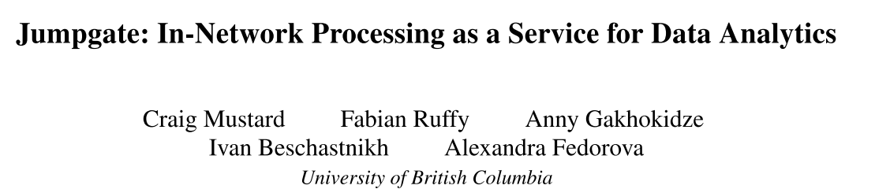
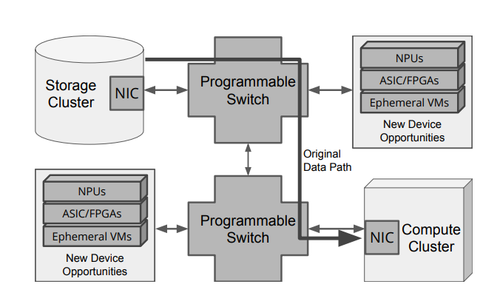
Jumpgate
Where to filter data?
Disaggregated design
Closer to storage (before data reaches workers)
Talked to the author from UBC
Thanks, Stew!

Slide 15

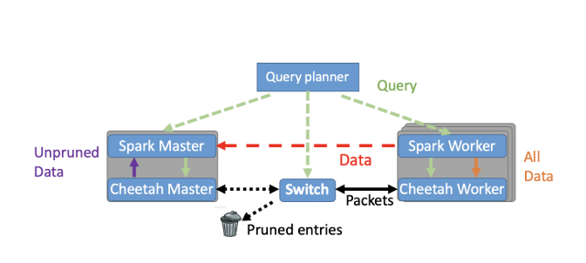
CHEETAH
Where to filter data?
Traditional design
Between master and workers
CPU savings mostly at master during query processing

Slide 16
CHEETAH
Where to filter data?
Traditional design
Between master and workers
CPU savings mostly at master during query processing
Limitations
Very limited flexibility – only simple queries
Zero integration – separate master/workers

Slide 17
Can NICs HELP?
On-path, like switches
but more flexible
Allows for better integration and complex queries
Attached to the host, like on-the-side accelerators
Can help with custom workload acceleration
Best of both worlds?

Slide 18
NEXt
Reading some earlier papers that use on-the-side accelerators
Hasn’t really picked up back then.
“Modern database engines, that make use of the multi-core CPUs and their wide SIMD units, are rarely compute bound … Unless reading data from storage, offloading core SQL operators is unlikely to bring orders of magnitudes improvements in performance. There is, however, cause for optimism if we look beyond such operators and in the direction of machine learning, both training and inference.”

