Slide 1
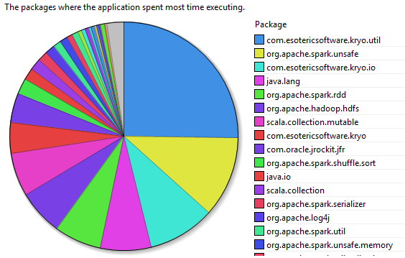
ACCELERATING SPARK
Serializing data
Spark is CPU-bound
Opportunities for relieving CPU
Serialiazation
Other computation around Shuffle
CPU Breakdown for Shuffle

Slide 2
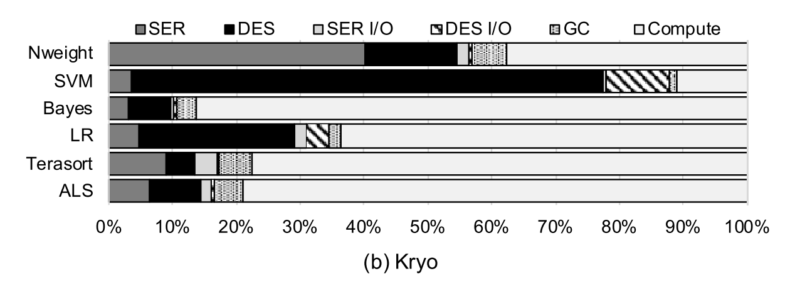
SERIALIZATION in SPARK

Slide 3

ACCELERATING SPARK
Deserialization – 6%
Serialization – 8%

Slide 4
CEREAL vs SMARTNIC
On-chip Co-processor:
Min Latency communication
Exploit all available DRAM bandwidth
Similar DRAM latency – No data transfer across PCIe
Easier time integrating with existing framework
With PCIe-based accelerator, you cannot afford to make multiple DRAM accesses.

Slide 5
WITH NIC: APPROACH?
Gather all the pieces of an object (and its sub-objects) using DMA
And put them together on the NIC
Similarly on the receive side…
Scatter-gather DMA?
Might avoid some aspects of serialization altogether
How does NIC know where the pieces are?

Slide 6
WITH NIC: CHALLENGES
Virtual to physical/IO address mapping
Again, Use CPU’s help?
Socket-based interface no longer works
Need an app-specific Host-NIC communication interface – RDMA++
An opportunity for enabling NIC-offloaded operators as well
Doing this with Java might be non-trivial
Looking at SparkRDMA effort
Spark-architectural challenges
Spark serializes objects during the map phase and stores them to disk…

Slide 7
NEXT
Thinking further about the challenges
Going thru the implementation of both Spark and a Java Serializer
Apache Giraph as well
May be setup SparkRDMA…

Slide 8
CEREAL vs SMARTNIC
Virtual address space access
TLB & Faults
1GB Hugepages
DMA thru PCIe
How flexible is it?
Is there enough bandwidth i.e., TPS.
Cannot do writebacks
Cannot work with traditional interfaces
Use CPU to list all references and use scatter-gather DMA?
Avoid serdes altogether…
A new interface could help with in-network programming too…

Slide 9
The APPROACH FOR NICs
Explore off-path (PCIe) acceleration solutions (e.g., FPGA-based).
Morphing these to NICs.
Closer-to-network computation – like shuffle
Avoid two-way communication across PCIe
Other factors ?

Slide 10
Other H/W BASED SERDES
Other works (based in SSD): Morpheus, HODS
Narrow definition of serialization
Text (Ascii) => Int, Float
Basically Int.Parse() and Float.Parse() engines
Marginal speedups
One on embedded core, other on FPGAs
Does not apply in our case… but could be an interesting use-case for SmartNICs

Slide 11
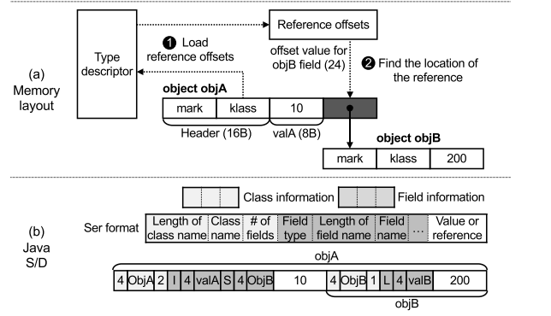
JAVA OBJECT LAYOUT
Header
Type
Hash code
Length
Data
Values
References

