Slide 1
Update
How much left to improve after Skyway?
No good answer yet.
Spark’s/JVM’s memory layout and other challenges with DMA
No response yet from Skyway author…
Browsing thru SparkRDMA codebase (not too big)

Slide 2
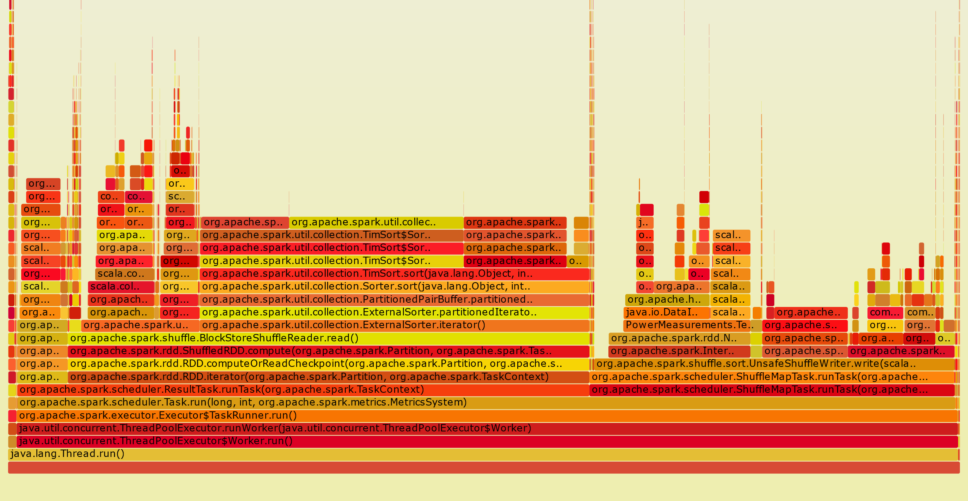
REDUCE
MAP
X1
4%
Deserialize
6%
Not
Sure
5%
Custom
Map
4%
X2
9%
ReadInput
9%
Sort
40%
Serialize & copy
9+2%
X1: Size estimator
X2: Write partitions (mostly intermediate memcopy)
Spark Terasort CPU Flame Graph

Slide 3
Spark Control Flow
Read RDD from Disk
Map (user)
Serialize
Partition & Write to Disk
Read from Network
Deserialize
Sort
Reduce (user, within partition)
Repeat from 2
Write RDD to Disk
}
MAP Task
}
REDUCE Task

Slide 4
Spark Control Flow
Read RDD from Disk
Map (user)
Serialize
Partition & Write to Disk
Read from Network
Deserialize
Sort
Reduce (user, within partition)
Repeat from 2
Write RDD to Disk
}
MAP Task
}
REDUCE Task

Slide 5
Challenge
Computation b/w Serialize and Deserialize:
e.g., Partitioning, Shuffle Disk writes
- Can we ignore them and keep in memory?
- How to do partitioning? Offload it?
- how does Spark RDMA deal with it?

Slide 6
Questions
How much left to improve after Skyway?
How much is the copy overhead of SerDes?
What’s left after Skyway…

Slide 7
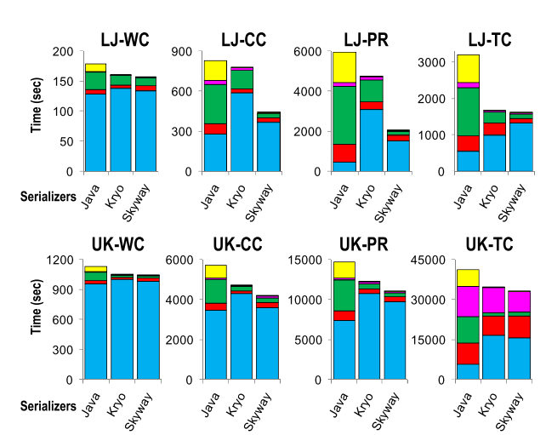
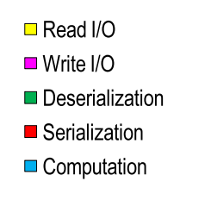
Skyway

