Slide 1
Update

Slide 2
On JVM side
Nothing from Skyway authors
Some reading into JVM (Java) architecture
and source code
how objects are stored on heap
Platform-dependent JVM implementation
How heap memory layout looks in physical memory?
Allocation method can be tweaked for compactness…
For now: More-or-less closely in VA space

Slide 3
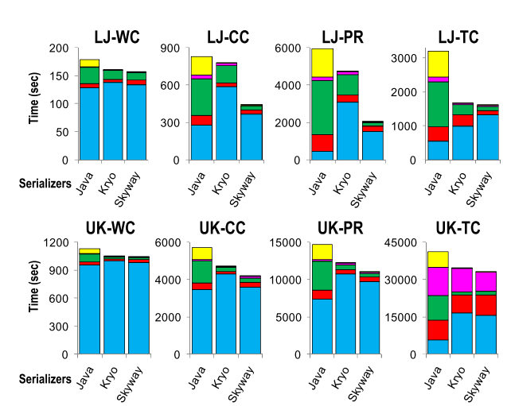
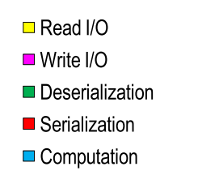
Skyway Question: Still open

Slide 4
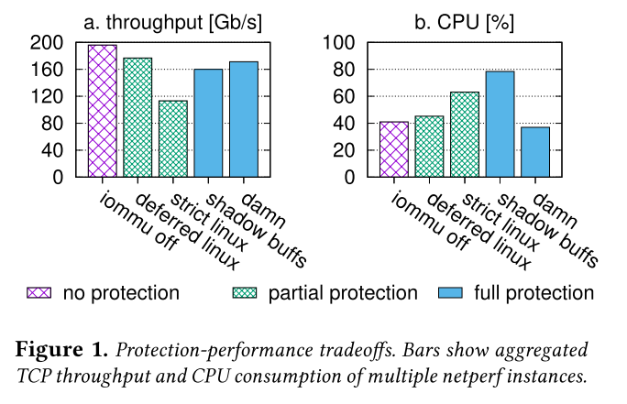
On DMA side
Characterizing DMA map/unmap performance more thoroughly

Slide 5
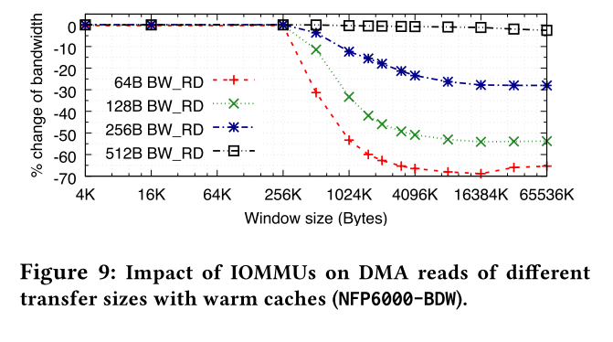
On DMA side
Characterizing DMA map/unmap performance more thoroughly
Estimating page walk latency – because IOTLB has limited entries

Slide 6
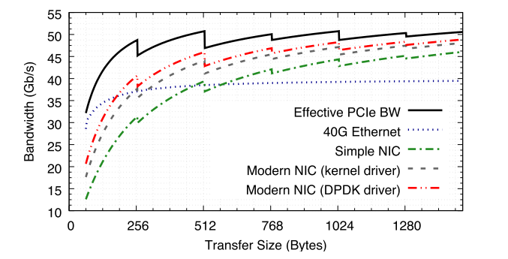
On DMA side
Characterizing DMA map/unmap performance more thoroughly
Estimating page walk latency – because IOTLB has limited entries
PCIe throughput – max TPS, max DMAs in flight, etc.

Slide 7
On DMA side
Characterizing DMA map/unmap performance more thoroughly
Estimating page walk latency – because IOTLB has limited entries
PCIe throughput – max TPS, max DMAs in flight, etc.
A comprehensive picture, or a model, of DMA thru PCIe
Gather from literature
Start some experiments – with our SmartNIC?

Slide 8
Other relevant reading
On shared address space for CPU and accelerators
As a potential RE topic
More focused on TLB/MMU designs
Mix of HW/SW designs

Slide 9
Other
CNS

Slide 10
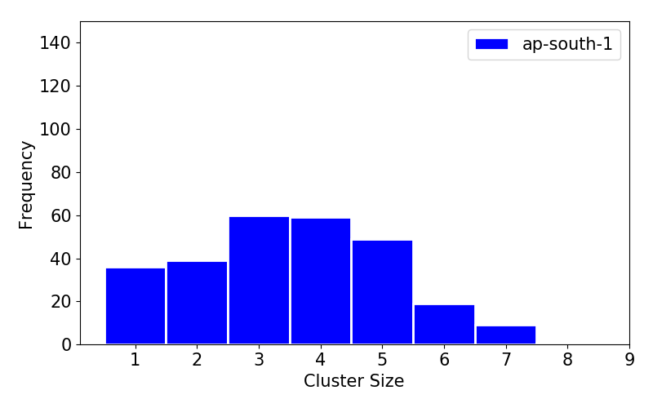
Other
CNS
My security project: Aiming to submit to the web conference.

