Slide 1
Update
RDMA Memory Registration
Does it all happen in the control path?
Does RDMA provide the flexibility of registering any memory?
What’s the cost?
Where’s the protection domain crossing?

Slide 2
RDMA reg_mr
APP
libibverbs
KERNEL
ioctl
uverbs
read,
write, etc.
mlnx4
RDMA NIC

Slide 3
RDMA reg_mr
Control path
Reg_mr(virt_addr, size)
User-kernel switch
Pin physical pages
DMA map the pages (get IOVAs)
IOMMU on/off?
Communicate with the NIC, which caches it in TLB
Return mr handle
APP
libibverbs
KERNEL
ioctl
uverbs
read,
write, etc.
mlnx4
RDMA NIC

Slide 4
RDMA reg_mr in datapath
Copy into pre-registered buffer
vs
register memory in datapath
Can register every piece of data – but cancels benefits of RDMA
Amortize reg_mr call with batching?
Is that enough?

Slide 5
Misc

Slide 6
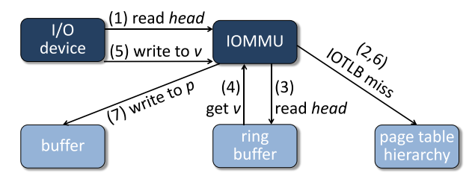
rIOMMU
Breaking down the cost of map and unmap operations.
DMA access

Slide 7
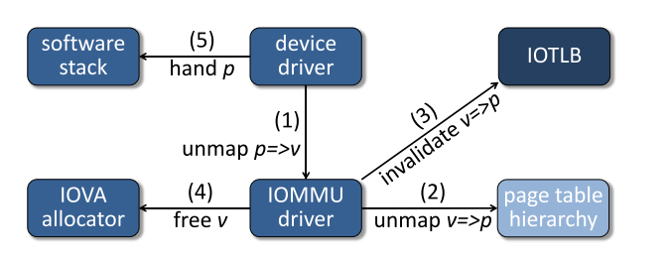
rIOMMU
Breaking down the cost of map and unmap operations.
DMA unmap

Slide 8
rIOMMU
Breaking down the cost of map and unmap operations.
DMA unmap

Slide 9
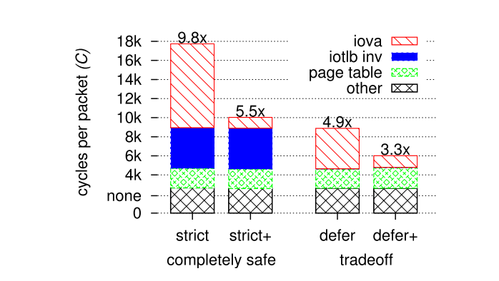
rIOMMU
Breaking down the cost of map and unmap operations.
Cost of mapping dwarfs the cost of translation
These prices are paid on every packet and that’s how it is in Linux => Another reason why DPDK performs so well!

Slide 10
rIOMMU
Breaking down the cost of map and unmap operations.
Cost of mapping dwarfs the cost of translation
These prices are paid on every packet and that’s how it is in Linux => Another reason why DPDK performs so well!

Slide 11
RDMA: Memory registration
Does it all happen as control path?
Does RDMA provide the flexibility of registering any memory?
Tracing jVerbs for an answer
What’s the cost?
Where’s the protection domain crossing?

Slide 12
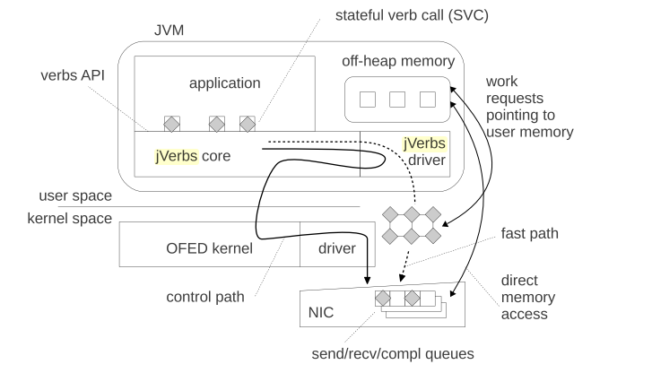
jVerbs
Wrapper around native RDMA calls
Uses off-heap because of direct buffers and access to virtual addresses
RDMA-Core libs

Slide 13
Next
Learn more about RDMA Memory Registration
5G talk

