Slide 1
Update
Goal: Understanding memory layout of spark shuffle data
✓ Setting up spark
✓ TeraSort workload with 10 Gb
Instrumenting memory layout right before shuffle…

Slide 2
Testbed
Spark-29
Spark-30
SPARK Executor
SPARK Executor
TeraSort
TeraSort
Network
HDFS + YARN
HDFS + YARN

Slide 3
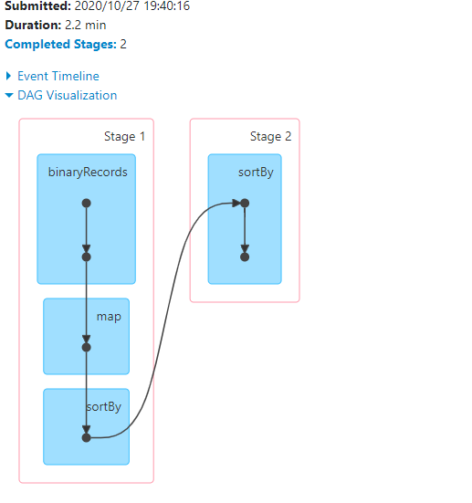
Spark shuffle

Slide 4
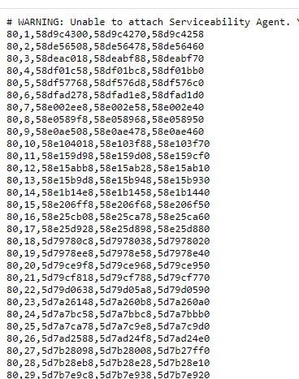
Just got some data..

