Slide 1
Update
Understanding Spark’s memory allocation.
Bugfix; updated results.

Slide 2
Testbed
Spark-29
Spark-30
SPARK Executor
SPARK Executor
TeraSort
TeraSort
Network
HDFS + YARN
HDFS + YARN

Slide 3
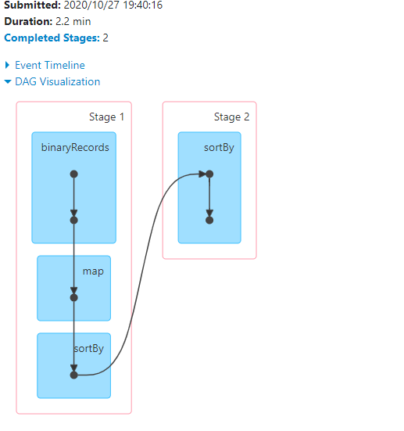
Spark shuffle
Snapshot

Slide 4
Data layout
1 GB

Slide 5
Data layout
1 GB
32 MB

Slide 6
Data layout
1 GB
32 MB

Slide 7
Data layout
1 GB
32 MB
100 B

Slide 8

Data layout
Input
Partition
100 B
Record
10 B Key
90 B Value
Java Object
Base Tuple
Key
Value

Slide 9
Questions
I’m interested in:
Record spread
Partition spread

Slide 10
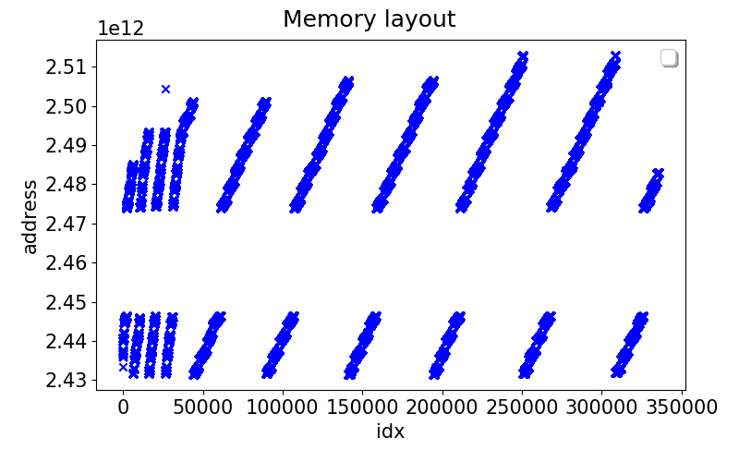
Bug
24341960736

Slide 11
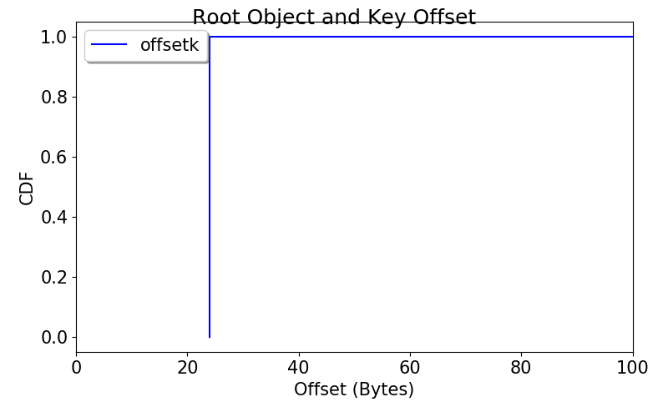
Record spread: Tuple Key Offset

Slide 12
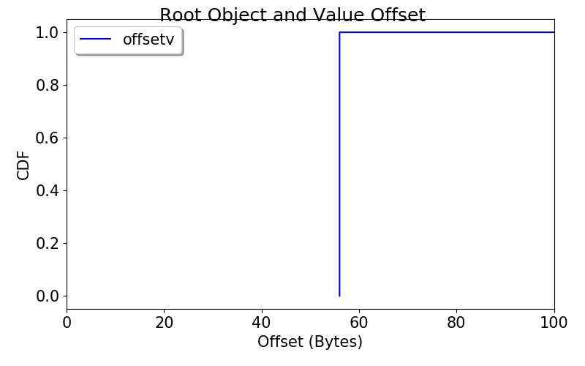
Record spread: Tuple Value Offset

Slide 13
Record spread
Data sticks together
Might want to try other workloads
With more complex records

Slide 14
Partition spread

Slide 15
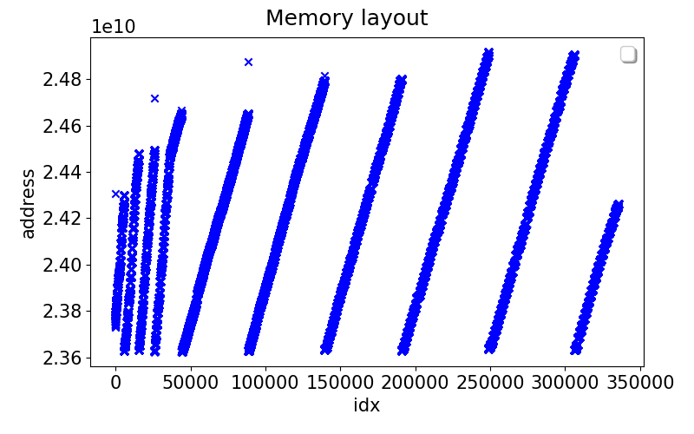
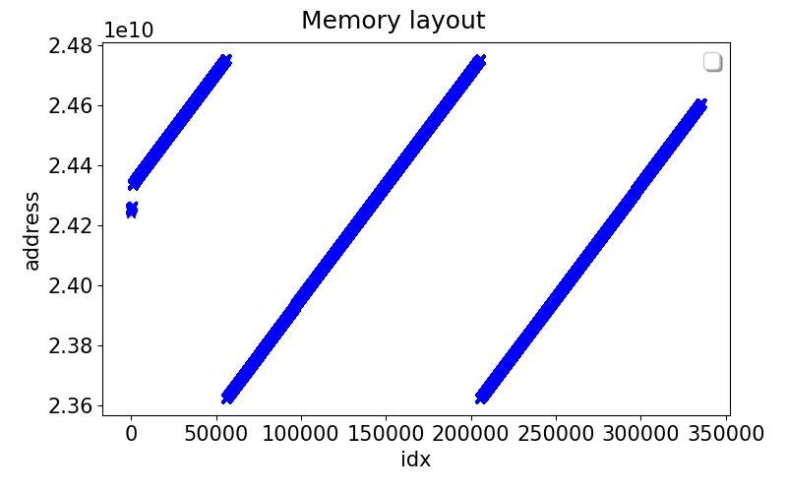
Partition spread: Layout
Multi-threaded
Single threaded

Slide 16
Partition spread: Layout
Multi-threaded
Single threaded
Slope ~ 26 KB
Slope ~ 8 KB

Slide 17
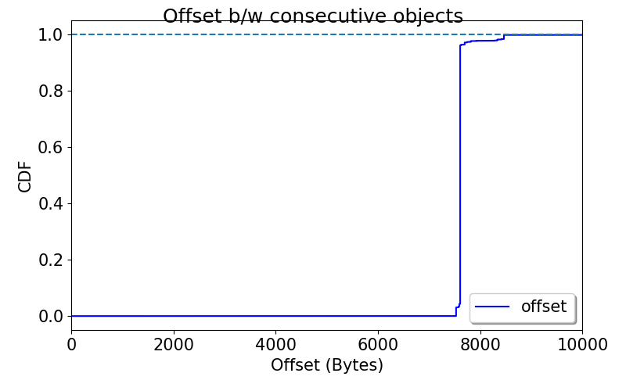
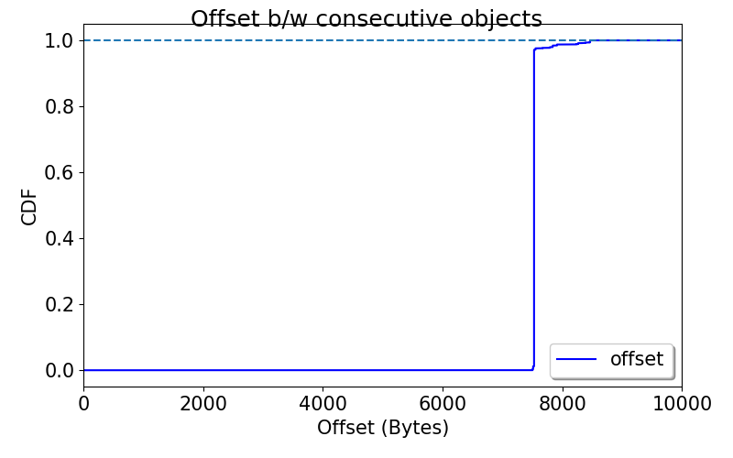
Partition spread: Stride
Multi-threaded
Single threaded

Slide 18
Partition spread: Layout

Slide 19
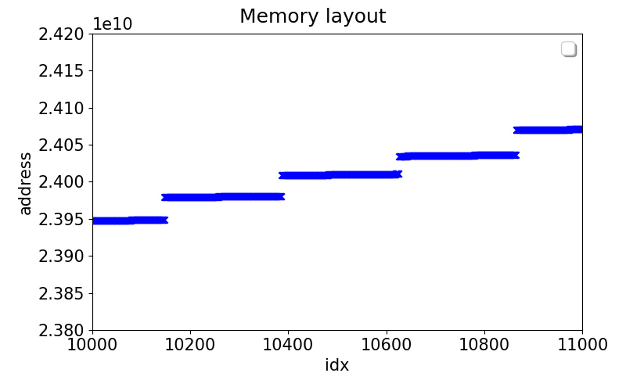
Partition spread: Layout

Slide 20
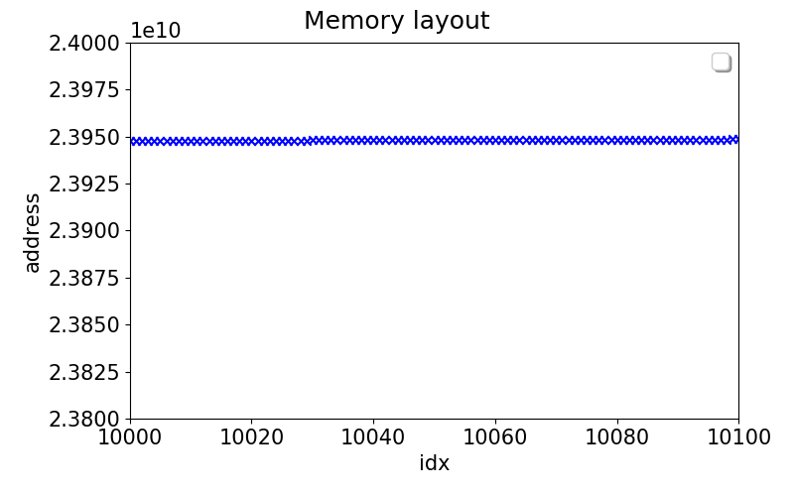
Partition spread: Layout

Slide 21
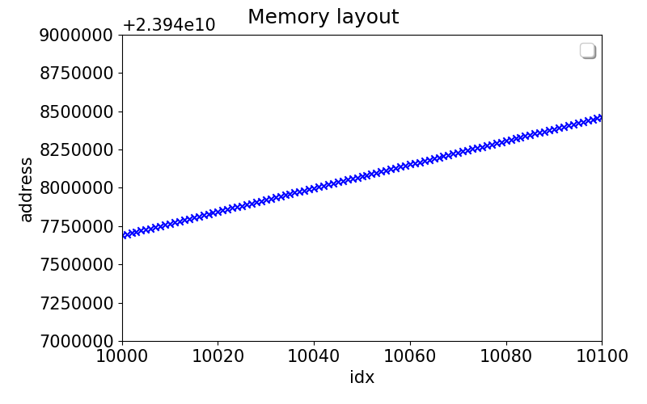
Partition spread: Layout
Slope ~ 7.5 KB

Slide 22
Partition spread: Stride
Multi-threaded
Single threaded

Slide 23
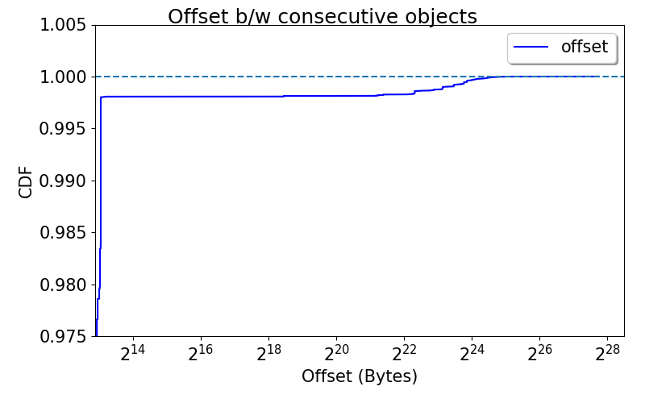
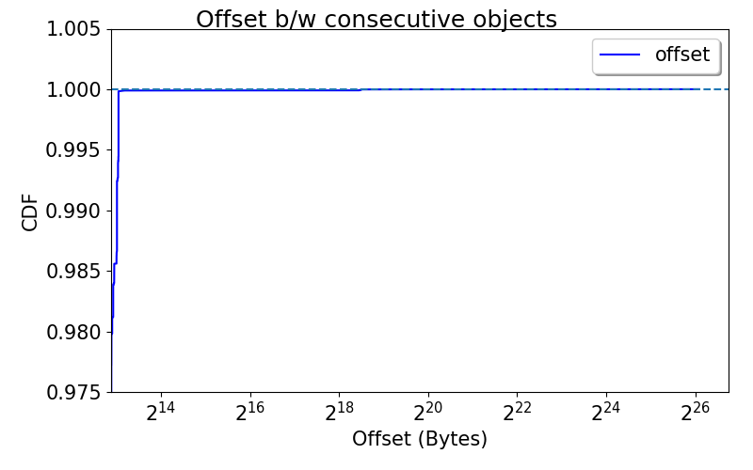
Partition spread: Stride (2.5% tail)
Multi-threaded
Single threaded

Slide 24
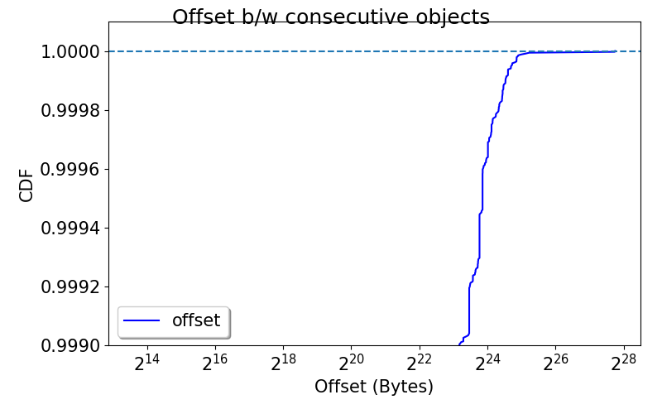
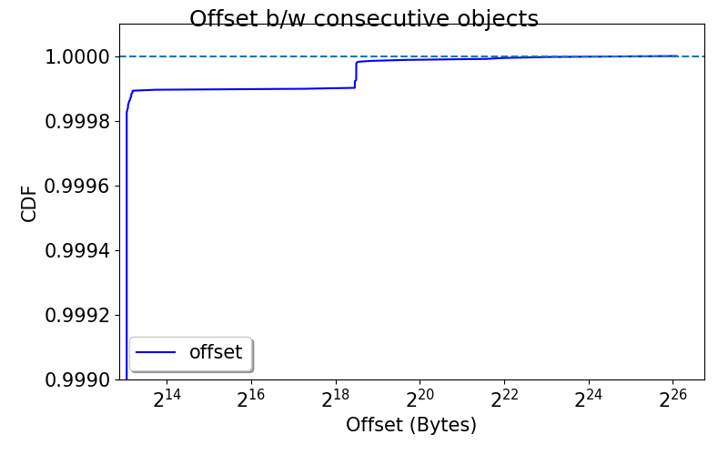
Partition spread: Stride (0.1% tail)
Multi-threaded
Single threaded

Slide 25
Partition spread: Layout
Multi-threaded
Single threaded

Slide 26
Question
Are the objects in next stripe replacing earlier stripes?

Slide 27
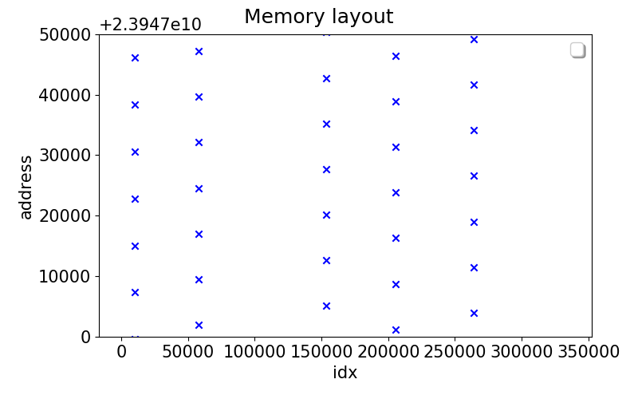
Question
No.

Slide 28
Partition spread: Questions
What determines the ~7k Bytes distance?
Not a thread interleaving thing
The algorithm itself?
What determines the ~1MB inter-batch distance?
Multiple threads receiving memory in chunks
Why is address space range constant (23.6 GB to 24.8 GB)?
Regardless of number of threads, input size, etc.

Slide 29
Next
Looking into spark/java memory allocator

