Slide 1
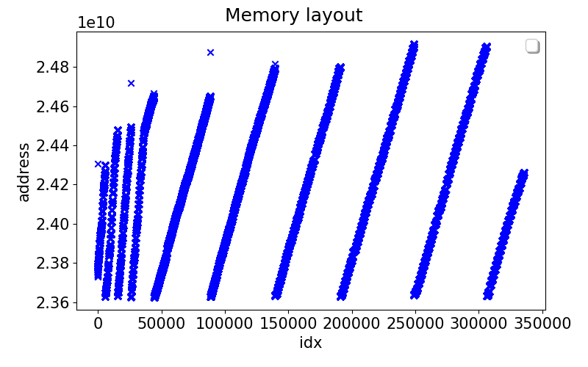
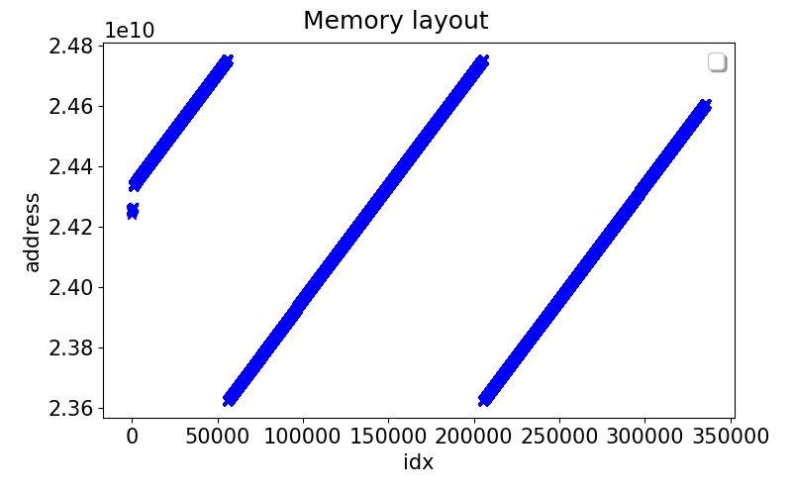
Partition spread: Layout
Multi-threaded
Single threaded
Slope ~ 26 KB
Slope ~ 8 KB

Slide 2
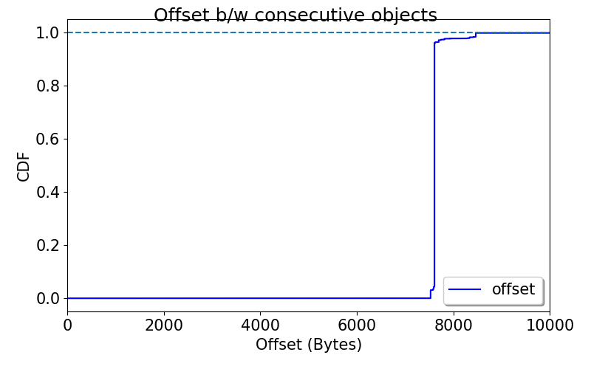
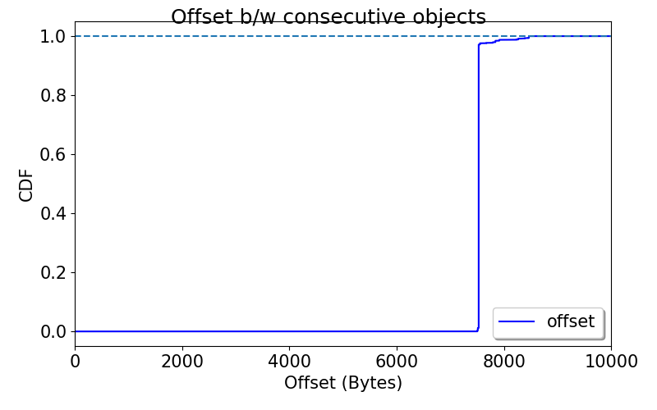
Partition spread: Stride
Multi-threaded
Single threaded

Slide 3
Partition spread: Layout

Slide 4
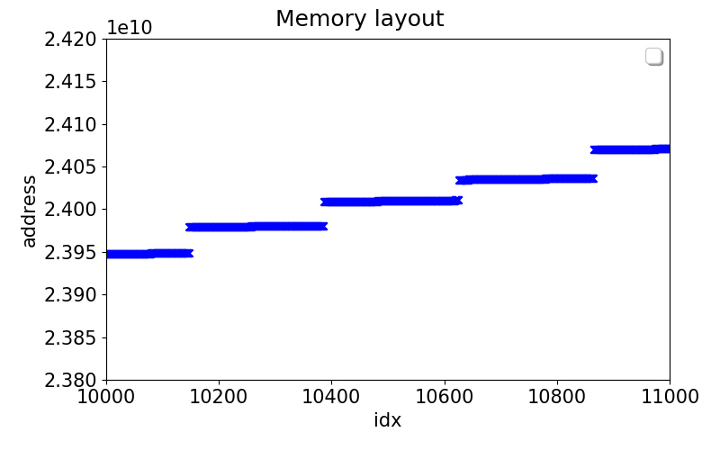
Partition spread: Layout

